Slide 1



process examples
Abhinav Sabharwal RPA & AGILE Trainer @ School of RPA
P.h: 9004809189 EMAIL :schoolofrpa@gmail.com

Slide 2
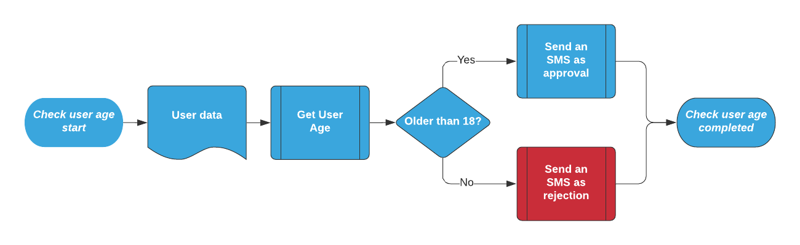
What is complexity of this process (p1)
FTE: 1
Business Benefit : Low

Slide 3
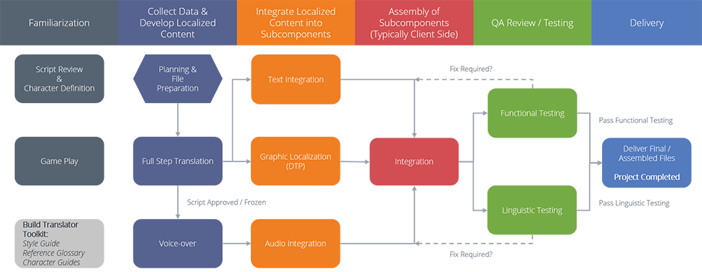
What is complexity of this process (p2)
FTE: 2
Business Benefit : Medium

Slide 4
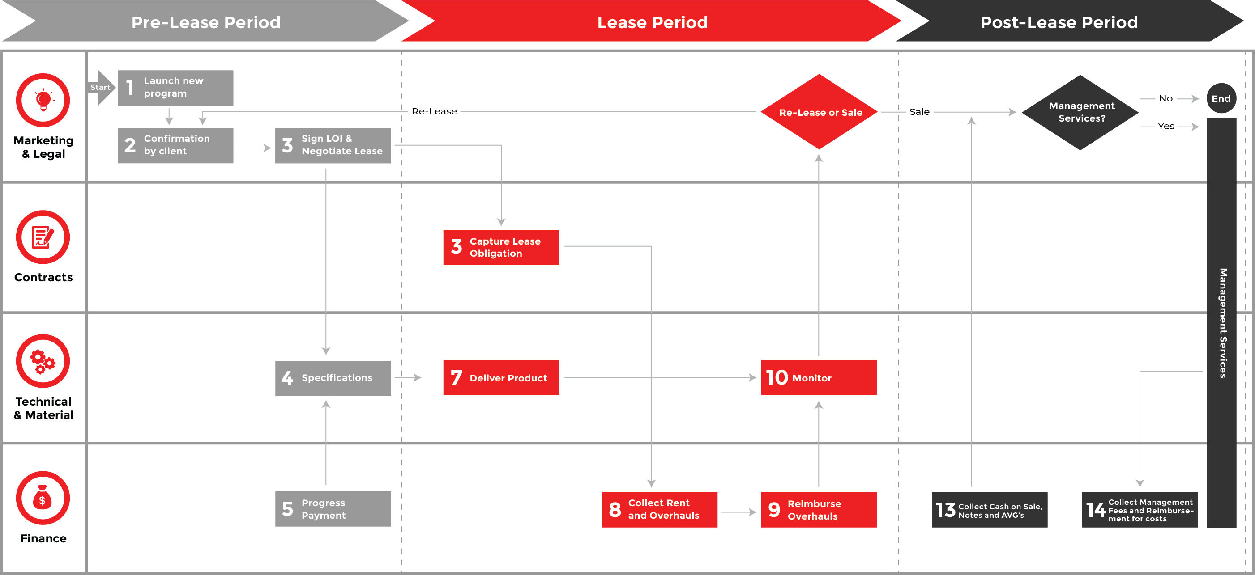
What is complexity of this process (p3)
FTE: 3
Business Benefit : high

Slide 5
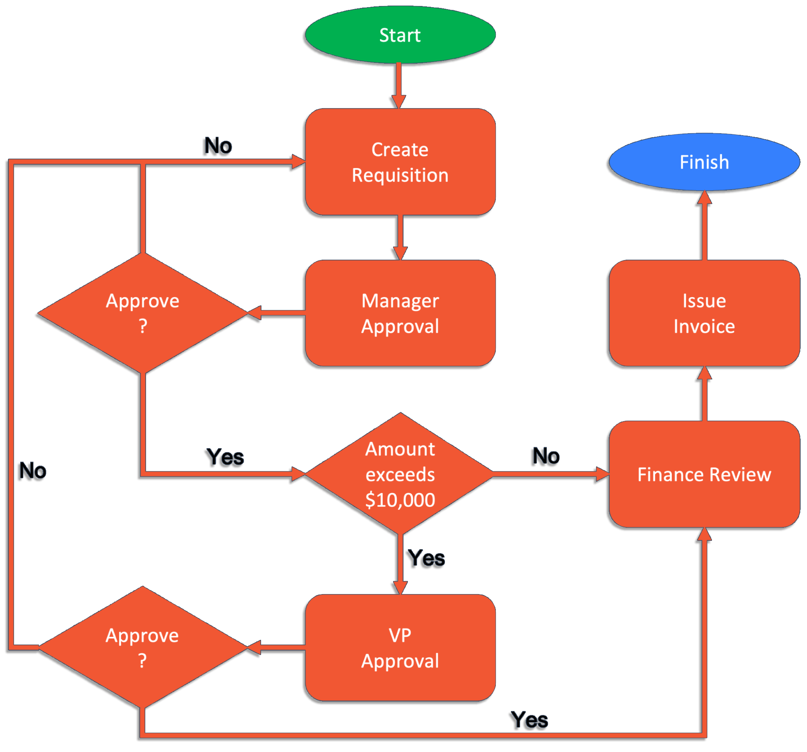
What is complexity of this process (p4)
FTE: 3
Business Benefit : low

Slide 6
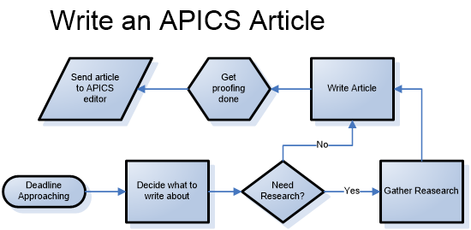
What is complexity of this process (p5)
FTE: 3
Business Benefit : medium

Slide 7


