Slide 1
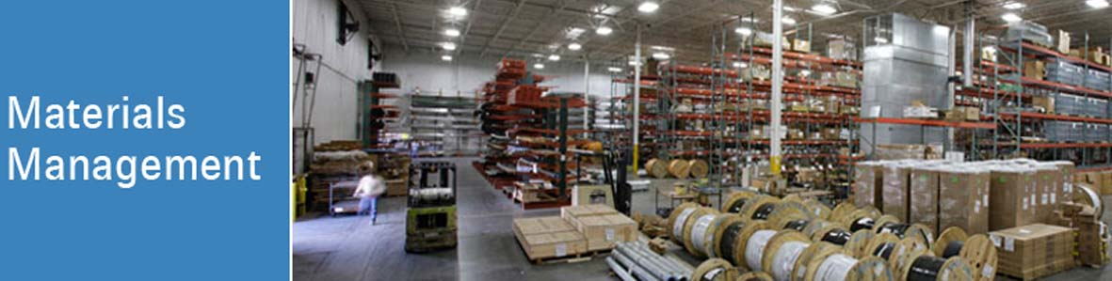

Prof. Vikram Hande
Session 1

Slide 2
Materials Management – Credit 2 Course Hrs.20
Learning Objectives –
Understand..
  Concept of material function
  Importance of material cost
  Material department as a profit centre
Analyse..
  Various approaches for Material Procurement in different types of Organizations.
Evaluate…
  Various steps involved in Vendor selection, rating, Vendor management
  E-procurement and Reverse Auctions

Slide 3
Modules
Introduction to Materials Management
Organizing for Materials Management
Materials Budget, Planning & Control
Vendor Development
Purchasing Management
Stores Management
Inventory Management
Computers in MM
E-Procurement & Reverse Auction

Slide 4

Why Managers are important for business?
“The productivity of work is not the responsibility of the worker but of the manager.”
Improve Efficiency..
Output/Input

Slide 5
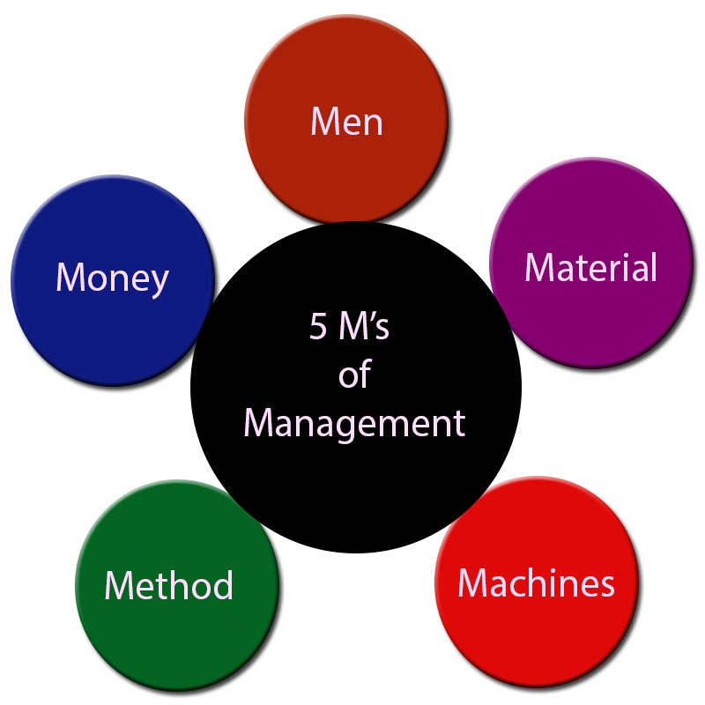
MM- Introduction

Slide 6
Introduction to Materials Management (MM)
Materials Management
  Definition
  Importance
  Objectives
  Scope
  Concepts
Modern Trends in Material Management

Slide 7
Definition
Material management is a function responsible for
  Planning
  Purchasing
  Storing
  Controlling
  In an optimum manner ….. To provide service to the customer
  P. Gopalakrishnan

Slide 8
Definition
Material management is the flow of materials in an organization
Where…
Materials are converted into the firm’s end product
Bailey and Farmer

Slide 9
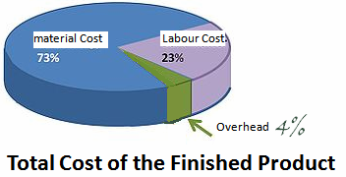
Why Materials Management?
Increasing Material Costs
Profit Improvement
Quality of Product Depends on Material Quality
Important Form of Current Assets
Challenge for Material Manager to Explore New Source

Slide 10

Importance of Materials Management-
MM is associated with the Operational Efficiency of an Organization
Reduce costs & improve profits
Materials -add value to the product
Required supply of materials
Quality of finished product depends on quality of materials used
MM covers many functions like-
  Purchasing
  Storing
  Inventory controlling

Slide 11
Objectives of Materials Management
Primary-
  Low prices for purchasing materials, parts and assemblies
  Efficient handling & storing material
  Continuity of supply
  Consistency of quality
  Keep idle time in production at minimum level
  Maintain good relations with supplier
  Maintain good records of transaction
  Develop executives and employees in their department
  High inventory turnover
    Inventory turnover = Cost of goods sold / Cost of average inventory held

Slide 12
Objectives of Materials Management
Secondary-
  Standardisation of Materials
  Economic Make or Buy Decisions
  Forecasting Demand (Quantity of Materials Requirement)
  Assistance to Production Department
  Product Improvement
  Inter Departmental Coordination
  Material Handling

Slide 13
Scope of MM
Material –
  Planning
  Procuring
  Handling
  Storing
  Distribution
  Controlling

Slide 14
MM Concepts
Profit-Centre Concept
Integrated Concept
System Concept

Slide 15
Profit-Centre Concept
Buy Materials- Right Quantity Quality Price Time Delivery
Saving - Avoiding Wastage Reduce Inventory
Profit

Slide 16
MM-Department
Chief Executive Officer
Or
Managing Director
Purchase Manager
Stores
Manager
Material Planning & Control Manager
Material Handling Manager

Slide 17
Why Integrated Concept -MM ?
If the functions of Materials Management are separately handled-
  A conflict occurs
  There is a need to balance the conflicting objective
To achieve optimum results for the organization.
Professional Managers Fulfill the Requirements of an Integrated Materials Management

Slide 18
Integrated Concept
Organization-
  Sales Turnover – 1 Crore (100 Lakhs)
  Material Cost – 60 Lakhs
  Profit – 10 Lakhs
  Manager has given task to improve profits – 3 Lakhs
How to achieve results?

Slide 19
Integrated Concept
Increase sales turnover by 30% in a specific time
Reduce material cost by 5% in a specific time
Managerial Efforts- Reduce material cost by 5% = Increase sales by 30
Indian Managers should devote attention on material functions

Slide 20
Need for Integrated Concept
Responsible for coordination of –
  Planning
  Purchasing
  Storing
Materials in an optimum manner
Transfer of Data with effective communication channels

Slide 21
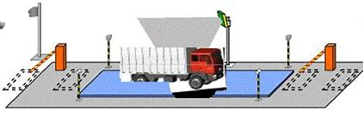
Advantages of Integrated MM
Better Accountability with Centralization
Better Coordination
Improved Performance- All functions are integrated greater speed & accuracy
Helps to Design Data Processing System ( Electronic data processing)
Adaptability to Computerization
Opportunities to Growth & Development

Slide 22
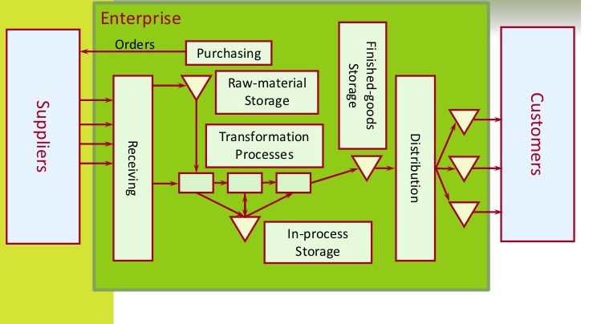
System Concept- Framework for Managing Materials
Input
Conversion Process
Output

Slide 23
System Concept- Benefits
Achieve desired results
Strict adherence to plans and schedule
Timely procurement of material
Optimum inventory turnover ratio
Good supplier relationship
Control of costs
Coordination with various departments
Elimination of duplication of MM functions
Resolution of conflicts through central authority

Slide 24
Challenges- MM
Capital investment in MM
Difficult to forecast demand
Increasing Storage space
Vendor selection
Optimizing purchasing quantity
Product diversification
Managing information

Slide 25
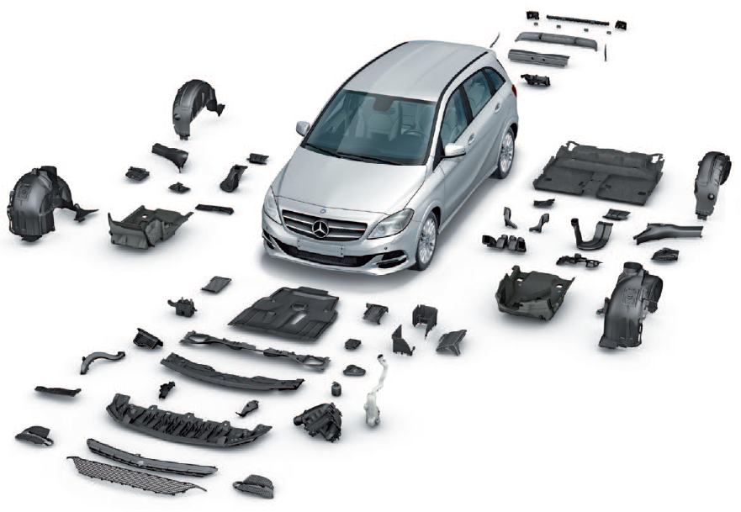

MM Job Profiles
Purchase Manager
Material Manager
Strategic Planner
Warehouse Manager
Import / Export Manager

Slide 26

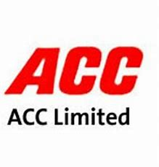






Top Recruiters

Slide 27
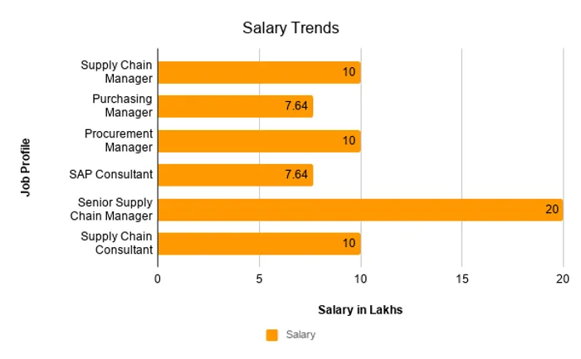
Salary …

Slide 28

Case Study- Customer Centric MM
Purpose –
Supporting India’s Nuclear Power Program

Slide 29
Problem
Impact of the globalisation-sickness in 1998-99
  ECIL suffered a loss of Rs.10 crore in 1997-98
  Substantial loss of Rs.60 crore in 1998-99

Slide 30
Materials Management Initiatives
Material costs constituting around 55-60 % of the total cost
Introduce innovative practices in the area of materials management.
Global electronics business characterized by-
  High rate of obsolescence
  Falling prices
  High quality inputs and global sourcing
  No Assured Market

Slide 31

Innovative Measures
Supplier Communication-
  Ensure- Requirements of the customers of ECIL are clearly communicated to the suppliers
  Through written and verbal means
  Hosting vendor meets
  Vendor Development
  Quality Assurance

Slide 32

Innovative Measures
Implementation of ISO 9000 Quality Management System
Other industry standards and practices
Emphasis was on prevention rather than detection and correction
Suppliers are encouraged to imbibe the culture of ‘Ownership of Quality’

Slide 33
Innovative Measures
Inventory Control-
Timely availability of material
Minimization of waste and surplus due to obsolescence etc.

Slide 34

Innovative Measures
Negotiations and Payments
Suppliers are involved in-
Tender to offer-
Competitive term-Quality, Cost, Delivery

Slide 35

Innovative Measures
Implementation of IT
Integrated Materials management fully computerised
Speedy material requisition
Reduction in lead time

Slide 36
Results
National award-SCOPE winner with achievements –
Turnover shot up from Rs.250 crore to Rs. 1000 Crore
Profit from loss to 130 Crore
Loans Nil
Efficient working capital Management
Improved Quality
Procurement time reduced from 60 to 30 days
Customer satisfaction index improved from 66 % to 95%
Image of the company enhanced remarkably

Slide 37
Review Questions
Define Materials Management
Why materials management is important?
State primary & secondary objectives of MM
Discuss the scope of MM
Explain the challenges of MM today
Explain 3 concepts of MM
Explain profit centre concept, integrated concept and system approach in MM
List the benefits of system approach
List the advantages of integrated concept
What are the job opportunities for MM?

Slide 38
Text Books
1. Materials Management –An integrated approach P. Gopalkrishnan and M. Sundaresan (Prentice Hall India, New Delhi)
2. Materials Management- K. Sridhara Bhat
Note-Books Available in our library

Slide 39
Reference Books
1 Materials and Logistics Management Prof. L.C. Jhamb (Everest Publishing House, Pune)
2 Introduction to Materials Management JR Tony Arnold and Stephan Chapman (Pearson Education, New Delhi) 2004 Fifth Edition
3 Purchasing and Materials Management N.K.Nair (Vikas Publishing House, New Delhi)
Thank You

