Slide 1
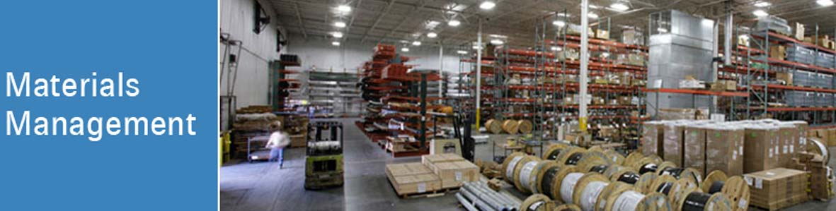

Prof. Vikram Hande
Session 1

Slide 2
Introduction to Materials Management (MM)
Modern Trends in Material Management
Flow of Material –
Supply Chain Management

Slide 3




Supply Chain Management
Material Flow

Slide 4
Supply Chain Management
Way of material flow in the organization
Starting with raw materials to finished product
It consists of –
  Suppliers
  Operations
  Warehouses
  Retail outlets
  Management function – Efficient Flow of Material

Slide 5
SCM & MM
Receiving
& Inspection
Raw
Materials
Production
Finished Goods
Packaging
Supplier
Customer
Materials Management
Purchasing
Material Planning
& Control
Warehousing
Shipping

Slide 6
Logistics Management
Organizing operations with Right-
  Material
  Quantity
  Time
  Place
  Price
  Condition
  Customer

Slide 7
Managerial Implications
SCM & Logistics
  Create model
  Analyze
  Visualize
  Optimize

Slide 8

Understanding MM – Case Study QSR
Domino’s Pizza Turn Around
Second largest pizza company
More than 9000 stores globally
95% franchised
Franchisees Purchase
Ingredients
Toppings directly from company owned supply chain system

Slide 9

Domino’s Pizza ..Turn around
Problem-
Commodity prices became more volatile in 2007 and 2008
Wheat prices shoot up 24%
Managerial Challenge-
How to manage cost?
How to handle risk?
Discuss your views
https://www.youtube.com/watch?v=AH5R56jILag&feature=emb_logo

Slide 10
Managerial Implications
Managers at Domino’s changed …
The way they worked with
Suppliers
Franchisees
Leverage on supply chain systems
Company prepared to accelerate international supply chains

Slide 11
Managerial Implications
Managers contemplated ( continue attention)
How to best apply their purchasing & supply chain knowledge into new international market

Slide 12
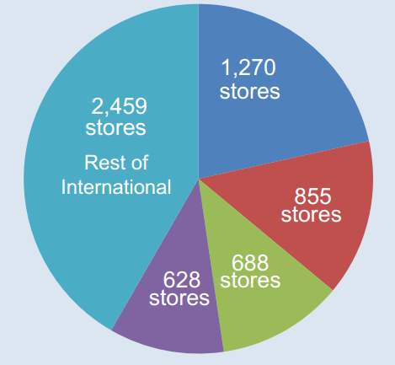
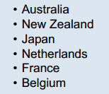



Managerial Implications

Slide 13
Review Questions
Discuss modern trends in materials management
Explain supply chain management as a modern trend of MM
Explain logistics management- new trend of materials management
Activity-
Study any global QSR company on modern trends in materials management

Slide 14

Thank You !!

