Slide 1
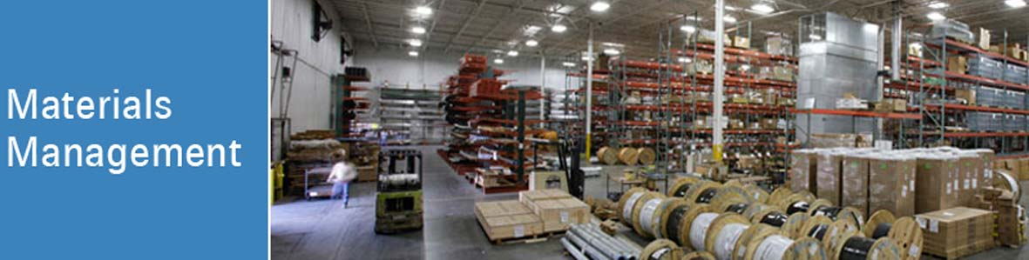

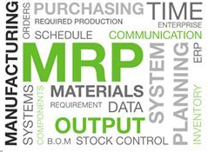
Prof. Vikram Hande
Session 4

Slide 2
Materials –Planning, Budgeting & Control
Major Learnings
Materials Planning-
What is materials planning?
MRP
Significance
Benefits
Influencing Factors
Approaches / Techniques
Problems in material planning
Guide lines for effective planning
Materials Budgeting-
Purpose
Process of preparing materials budgets
Benefits
Materials Control-
Importance
Establishing the bases of materials management
Materials control cycle
Records
Skills- Planning, Budgeting & Controlling

Slide 3
What is Material Planning?
Scientific way of planning and determining the requirements of raw materials, spare parts and other miscellaneous materials essential for the production plan
Planning material requirement as per production plan
Production Requirement
Material Planning

Slide 4
What is Material Planning?
Concerned with answering –
  What materials are required?
  How many required?
  When they are required?

Slide 5
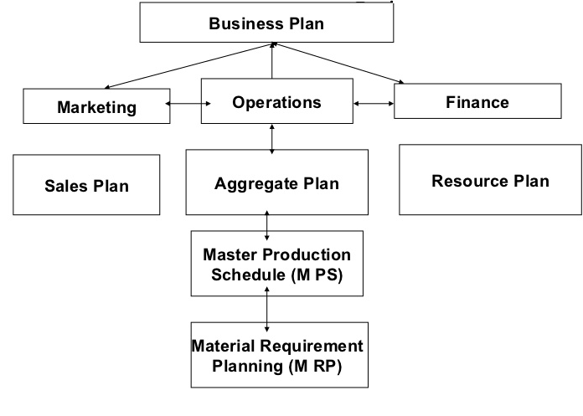
Material Requirement Planning
Companies use material requirements-planning systems to estimate quantities of raw materials and schedule their deliveries

Slide 6
Significance of Material Planning
Lack of materials planning leads to-
  Overordering – Extra storage
  Underordering – shortages
  Delays in production
  Rush / emergency orders
Spend capital in optimum manner
Improves efficiency in materials management function

Slide 7
Benefits of Material Planning
Improves business efficiency
Better forecasting for future materials
Effective materials budgeting
Avoids material shortages
Reduces production cost
Provides timely & accurate information

Slide 8
Factors Influencing Material Planning
Global Price Trends
Business Cycles
Government Import / Export Policies
Macro Factors

Slide 9
Factors Influencing Material Planning
Plant Capacity
Plant Utilization
Production Plan
Inventory Holding
Working Capital
Seasonality
Micro Factors

Slide 10
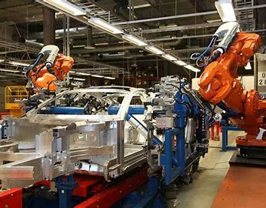
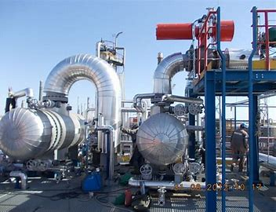
Techniques of Materials Planning
Bill of Materials Explosion
  &
Past Consumption Analysis

Slide 11
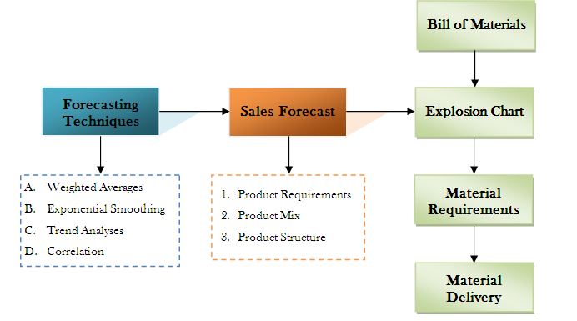
Bill of Materials Explosion
A bill of materials explosion –
Displays an assembly at the highest level broken down into its individual components and parts at the lowest level

Slide 12
What is Bill of Materials?
BOM is
  List of raw materials
  Sub assemblies
  Sub components
  Parts
  Quantity needed to manufacture end product
A bill of materials is a centralized source of information used to manufacture a product.

Slide 13

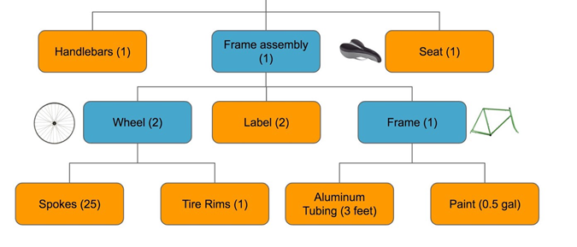
Bill of Materials- Example

Slide 14


Techniques of Materials Planning
Forecasting-
Systematic approach to probe future demand of material
Techniques-
Weighted Average
Exponential Smoothing
Trend Analysis
Correlation

Slide 15

Techniques of Materials Planning
Past Consumption Analysis
  Applicable for No bill of material is possible
  Past consumption data is analyzed
    &
  Projection for the future
  On the basis of past experience and future need
  Mean & Standard Deviation are taken as a bases
  Suitable for Process Industry

Slide 16
Problems in Material Planning
Depends on sales forecast
Government policy
Credit availability
Lead time for procurement
Seasonal variations in demand
Time period for material planning
Computerized panning & information system

Slide 17
Guide lines for effective planning
Proper time horizon
Must take care for demand fluctuations
Quarterly plans are more popular than monthly or weekly
Computerization is advisable
Computerization saves time & gives accurate forecasting

Slide 18

Create BOM for-

