Slide 1

Materials Management
Session 5
Materials Budgeting
Purpose
Process
Benefits
Materials Control
Purpose
Bases for materials control
Procedure
Benefits

Slide 2
Materials Budgeting
What is Materials Budgeting?
Materials budgeting details the raw materials that must be purchased to fulfill the production requirements and to provide for adequate inventories.

Slide 3
Purpose of Materials Budget
Materials budget provides information on
Cash requirement for procuring materials
Financial resource availability
Long term purchase contracts
Trends – Price & Sales
Understand prices of controllable & uncontrollable elements
Materials budget is prepared based on sales forecast- Need flexibility

Slide 4
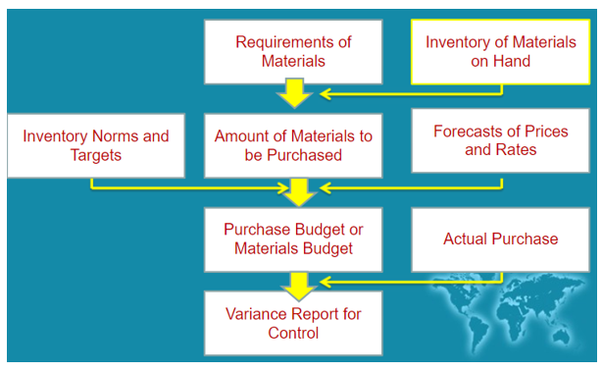
Process of Preparing Materials Budget

Slide 5
Benefits of Materials Budgets
Finance department can schedule cash requirements
Contract purchasing
Reduce inventory risks
Maximum purchasing lead time ( time between initiation and completion)
Careful selection of suppliers
Negotiations
Smoothing purchasing work load
Supplier relation can be improved
Costs can be reduced

Slide 6
Materials Control
Maintaining available supply of raw materials & parts required for manufacturing
Function includes-
  Purchase materials –
  In economic quantities
  At proper time
  Storage & receipt
  Issuing the materials
  Maintain & verify inventory records
American Production & Inventory Control Society

Slide 7
Purpose / Importance of Materials Control
If material control is not done properly-
Workers & machines will be idle
Delivery promises will not be met

Slide 8
Bases of Material Control
Raw materials – Purchased & processed into finished product
Component parts – spare parts
Supplies / indirect items – used in production process but not part of finished goods. Includes – coolant, oil, cotton waste
Work in progress – Under production
Finished products- ready to deliver

Slide 9
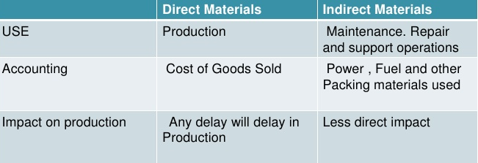
Direct & Indirect Materials

Slide 10
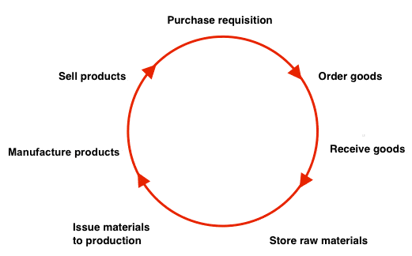
Materials Control Cycle
Material control is a management activity that administers how the inventory employed in the production process is procured, acquired, handled and utilized.

Slide 11
Materials Control Cycle
Procedures necessary for materials provision for manufacturing
With-
Minimum investment
Lowest cost

Slide 12
Materials Control Cycle
Determining materials needs
Prepare purchase requisition
Create order
Receive goods
Inspect received goods
Enter into store records
Issue materials to production
Enter into cost accounting records
Manufacture the product
Standardize materials for lowest cost

