Slide 1


Materials Management
Session 6
Vendor Development
Need for Vendor Development
Levels of Vendor assessment
Vendor evaluation and selection process
Vendor Rating Plan

Slide 2
Review Session 1-4
Introduction to Materials Management.. 1
Modern trends in MM …2
Organizing MM…3
Material Planning…4

Slide 3
Review Session -5
Materials Budgeting
Materials budgeting details the raw materials that must be purchased to fulfill the production requirements and to provide for adequate inventories.
Materials Controlling
Maintaining available supply of raw materials & parts required for manufacturing

Slide 4
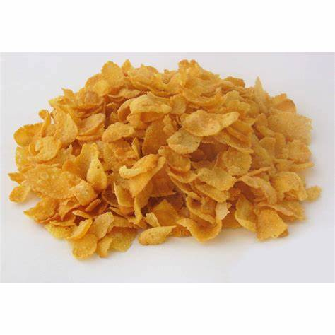
Case
Flakes Incorporated Co.
Produces cereals
For daily domestic consumption
The company is currently evaluating its material control process
Company deals with large amounts of cereals like rice, corn and oat
Problem
There are regular reductions caused by shipping and handling
It is hard to identify missing items
By just observing the containers

Slide 5
Solution
Supply Chain Manager appointed a Controller
Controller is in charge of reviewing and approving each container being delivered
Check the weight and proper storage procedures to be followed
He will supervise proper usage of weighting machines, container sealing and consumption orders
By providing a more systematic supervision to these processes the company expects to reduce the occurrence of these losses as much as possible

Slide 6

What is a Vendor?
Identify vendors required for Starbucks
A vendor is a party in the supply chain that makes goods and services available to companies or consumers.
A vendor sells products or services to another company
A vendor, also known as a supplier
Coffee
Tea
Cup

Slide 7
What is Vendor Development?
Buying Firm
Strategic Sourcing Technique
Selection & Development
Activities
Performance
Capability
To Meet Needs
Vendor
Vendor Development defined as –
Any activity that a Buying Firm undertakes to improve a Vendor's performance and capabilities to meet the Buying Firms' supply needs

Slide 8
Need for Vendor Development
Make or Buy Decision
Outsourcing are major decisions
Purchase certain parts
Subcontract operations to vendor
Manufacturing Organization

Slide 9

Tata Indica - The Making Of The Small Car
Once Telco made its make-or-buy choices
The next step was to identify the vendors
Most of the parts that went into making Telco were sourced locally
Telco employed a simple yardstick for selecting suppliers: the ability to supply components at the negotiated quality, cost, and quantities

Slide 10
Vendor Level Assessment
Vendor Level
Product Level
Product Quality
Process Level
Process Control
Company Level
Financial aspects
Quality Assurance System
Quality-Developed, maintained & improved

Slide 11
Vendor Selection Process
Recognize Need
Identify Key Sourcing Requirements
Determine Sourcing Strategy
Identify Potential Supply Source
Determine Vendor Selection Method
Select Vendor

Slide 12
Vendor Rating / Evaluation Methods
Carter’s 10 C
Categorial Method
Weighted point Method
Composite Rating
Cost Ratio Method

Slide 13
Carter’s 10 C- Method
Ray Carter developed this Supplier Evaluation method
10 C’s are
Competency
Capacity
Commitment
Control
Cash
Cost
Consistency
Culture
Clean
Communication

Slide 14
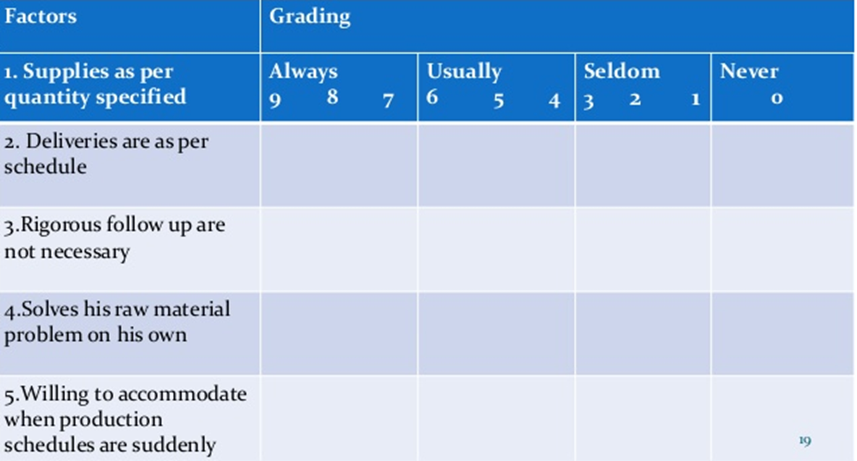
Categorial Method
List factors for vendor
Give grading to factors- never, seldom(rarely), usual, always

Slide 15
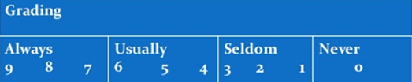
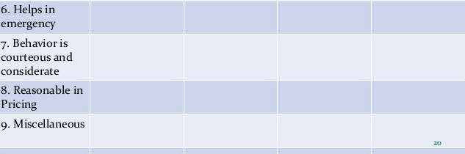
Categorial Method

Slide 16
Categorial Method
Evaluation

Slide 17
Weighted Point Method
Factors are categorized and weight is assigned to each factor based on vendor performance
Factors- Quality, Price, Delivery
Quality | 60
Price | 20
Delivery | 20

Slide 18
Weighted Point Method
Example
Company A inputs:
Total quantity supplied: 10 units
Total quantity accepted: 8 units
Price per unit: 10
Delay in delivery 20% time delay.
Example
Company B inputs:
Total quantity supplied: 10 units,
total quantity accepted: 9 units
Price per unit: 16
Delay in delivery 10% delay.
Find which vendor will get order?

Slide 19
Weighted Point Method
Vendor A- Analysis
Quality Rating = (8/10)X100=80%
Price Rating =(10/10)X100=100%
price rating =(Price Ratio Lowest/Vendor A Price) x 100
Delivery Rating = 100 – 20= 80%
Weighted vendor rating of company
A= (80X60+100X20+80X20)=84
Vendor B Analysis
Quality Rating = (9/10)X100=90%
Price Rating =(10/16)X100=62.5%
Price Rating =(Price Ratio Lowest / Vendor B Price) x 100
Delivery Rating = 100 – 10= 90%
weighted vendor rating of company
B= (90X60+62.5X20+90X20)=84.5
Though the price per unit of company B is more than company A, still company B wins because of overall rating is high.

