Slide 1

Materials Management
Session 9
Purchasing Management
Classification of purchasing Goods
Purchasing Cycle
Purchasing Methods
Make or Buy Decisions

Slide 2
Purchasing
What is Purchasing?
Process -
  The business / organization uses to acquire goods/ services to accomplish its goals

Slide 3
Classification of Purchasing Goods
Raw Materials – Not undergone any conversion in industry
  Example- iron ore, fruits
Semi Finished Products- Processed partially
  Example – Role wires
Supplementary Materials- Not part of end product
  Example- Lubricants, coolants
Components- Which will not undergo further physical changes
  Example- Batteries, fans
Finished Products- Purchased & Sold after value addition
  Example- Car radios

Slide 4
Classification of Purchasing Goods
Capital equipment- It is an investment made by a company to carry on its manufacturing activities.
  Example -Machine tools, Computers
Maintenance, Repair & Operating Materials (MRO)
  Example- cleaning materials, maintenance spare parts
Services-
  Example – Cleaning services, maintenance services

Slide 5

Changing-Consumer Preferences & Trends
Actions
Without
Certainty
Dynamic Environment
Unfamiliar
Environment
https://www.youtube.com/watch?v=MqQh9t-VLIY

Slide 6
Purchasing Cycle
Recognition of Need
Specification
Select supplier, Price
Enquire, tender, follow up
Negotiation
Issue Purchase Order
Store receipt note
Receive material, Authorize Payment
Closing the order

Slide 7
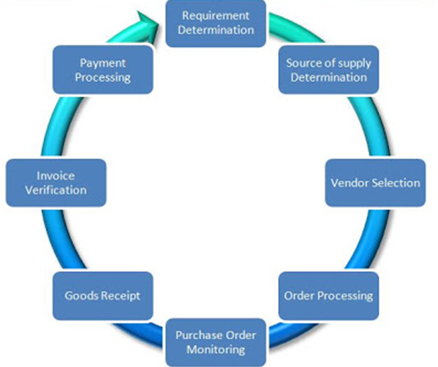

Purchasing Cycle
Systems, Applications, and Products in Data Processing

Slide 8
Purchasing Cycle
Requirement Come from –
  Multiple Departments
  Example-
  There is a need for a new Printer in the Finance Department
Material Requirement Planning
Requirement Determination
Identify Need

Slide 9
Purchasing Cycle
Classify Vendors to procure from
Send Request for Quotations (RFQs)
Source of Supply Determination

Slide 10
Purchasing Cycle
SAP automatically performs comparison based on quotations
Vendor Selection

Slide 11
Purchasing Cycle
Create Purchase Order
Manually or Automatically
Order Processing

Slide 12
Purchasing Cycle
Check Status of PO
How Much has been Delivered?
Remind Vendors for Outstanding
Purchase Order Monitoring

Slide 13
Purchasing Cycle
Incoming Deliveries
Set Over Delivery / Under Delivery
Good Receipt

Slide 14
Purchasing Cycle
Check-
Overpay
Underpay
Invoice Verification

Slide 15
Purchasing Cycle
Payment Processing
Payment to the Supplier
Clear overview of where your processes start and end

Slide 16
Purchasing Methods
Purchasing by requirements –
No purchase until need arises
Purchasing for a specified future period-
Purchasing period fixed
Purchasing according to market-
Price fluctuation

Slide 17
Purchasing Methods
Speculative Purchasing-
Buying when market is low
Forward buying-
Future – one year
Contract purchasing-
Continuous supply, price

Slide 18
Purchasing Methods
Scheduled purchasing-
Purchasing on regular basis
Blanket order-
Multiple delivery dates over- a period of time
Tender Buying-
Purchase material at competitive rate

Slide 19
Purchasing Methods
Cash Purchasing-
Paying cash on spot
Seasonal Purchasing –
During season
Reciprocal purchasing-
Agreement to buy each others' goods.

Slide 20
Purchasing Methods
Subcontracting-
Purchase parts from sub contractors, Outsourcing
Just in time purchasing-
Zero stock purchasing

Slide 21
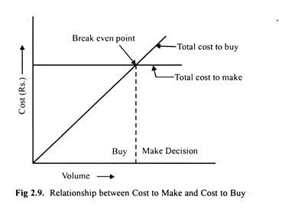
Make or Buy Decisions

Slide 22
Make or Buy Decisions - Need
New products introduced – make internally OR outsource
Fluctuating demand
Organizational cost reduction programs
Declining quality from suppliers
Scarcity of funds for additional plant
Standard item – Economical to buy
Management willing to commit resources – vertical integration

Slide 23
Make or Buy Decisions
Strategic Decisions-
Strengths of firm
Core competencies
Capabilities
Decision- Components make or buy
Critical to product
Special designs
New item fits in core competencies

Slide 24
Tactical Decisions
Unsatisfactory supplier performance
Changing sales demand
Restricted manufacturing capacity
Product modification
Efficiency
Quality
Cost

Slide 25
Factors Influencing Make / Buy Decisions
Cost Analysis-
  Determination of costs to make an item as well as the cost to buy it.
Plant capacity- Production volume
Quality
Design Secrecy
Unreliable suppliers
Manpower availability

Slide 26
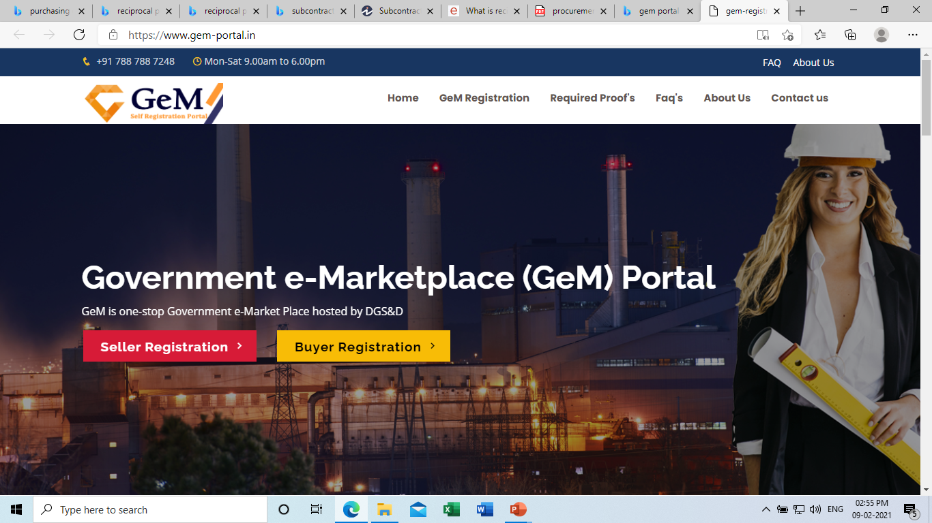
Purchasing Case- https://gem-portal.org/
https://www.india.gov.in/spotlight/government-e-marketplace-procurement-made-smart#tab=tab-1

Slide 27


