Slide 1

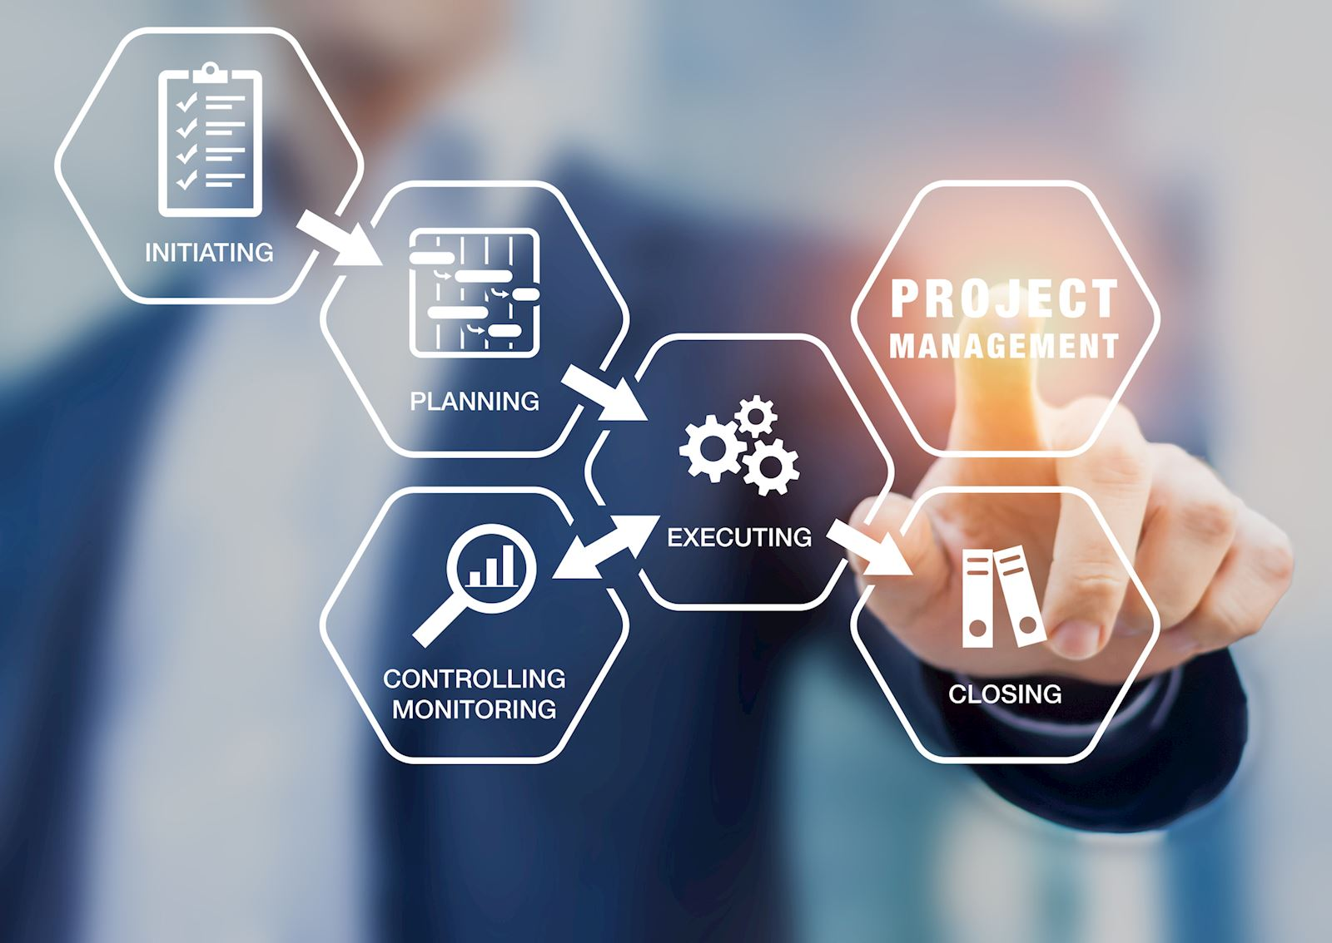
Project Management
Credit: 4
Session:1
Prof. Vikram Hande

Slide 2
What is a Project?
A project is “a temporary endeavor undertaken to create a unique product, service, or result”
(Endeavor = Work)
Examples-
  Personal Project-
  Obtaining PGDM degree
  Planting a garden
  Opening Startup
Industrial projects-
  Designing a new product
  Building Bridge

Slide 3

Course Outcomes
Understand
Project Management
Role & Importance
Launch of new product &
Services
Apply &Analyze
PM Practice & Tools
Resource allocation, costs & risks
Identify
Factors for successful completion of projects
Evaluate
Role of control & audits in Projects
Create

Slide 4
Topics
Project in Contemporary Organization
Strategic Management and Project Selection
The Project Manager
Managing Conflict and Art of negotiation
Project in Organizational Structure
Project activity & risk planning
Budgeting- Estimating Costs & Risks

Slide 5
Learning -Skills & Competencies
Planning and controlling projects
Project management- Tools
Behavioral skills necessary to successfully launch, lead projects
Realize benefits from projects

Slide 6
Topics
1.Project in Contemporary Organization
Definition of Project
Why Project Management
Project Life Cycle
Agile Project Management

Slide 7
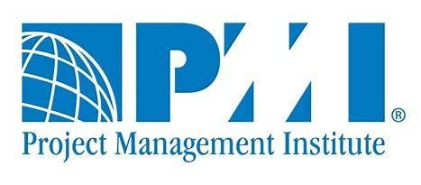
Project Management -Definition
PMI Defines-
“ A temporary endeavour undertaken to create a unique product or service”
Worlds largest professional
Project Management Institute

Slide 8
Project Management -Definition
Application of knowledge, skills, tools, and techniques to project activities to meet the project requirements
Unique venture with beginning & end, conducted by people to meet established goods within parameters of cost, schedule & quality

Slide 9
Project Management
A specific objective / goal
Defined start & end
Funding limits
Consume resources
Organized work
Project Management to have

Slide 10
Project Characteristics
A project has-
A set of objectives
A life cycle
Unique and no two projects are similar
Responsible for new product / service
Offers a change
Customers specific / requirements
Optimum utilization of resources
Risk and uncertainty

Slide 11
Why Project Management?
Saves time & money
Improves internal communications
Empowers to take data driven decisions
Enables project success
Facilitates better risk management
Smooth workflows
Project management is a profession

Slide 12
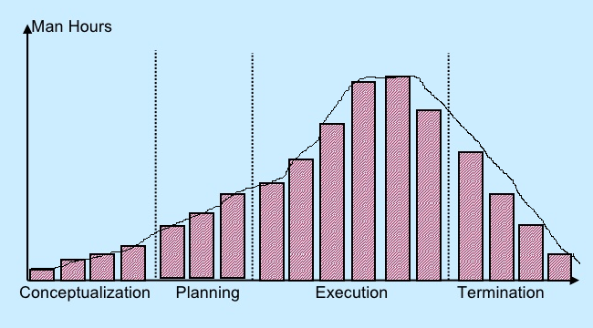
Project Life Cycle
A project life cycle is the sequence of phases that a project goes through from its initiation to its closure

Slide 13
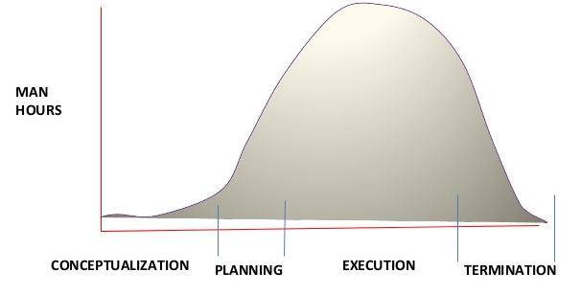
Project Life Cycle

Slide 14
Project Life Cycle
Conceptualization-
Development of initial goal & technical specifications for a project
Scope of work is determined
Resources – people, money etc. identified

Slide 15
Project Life Cycle
Planning
Develop –
Detailed specifications
Schedules & other plans
Individual pieces of project called as work packages are broken down
Individual assignments made
Process of completion defined

Slide 16
Project Life Cycle
Execution
Actual work of project is performed
Product created
Bulk project teamwork performed
Project cost rise during this face

Slide 17
Project Life Cycle
Termination
Completed project transferred to the customer
Project formally closed
Sub activities are completed
Project shrinks in scope
Cost declined rapidly

Slide 18
Determinants of Project Success
Time- Allotted
Cost- Budget
Performance- Quality check
Client acceptance- Satisfaction

Slide 19
Project Management - Types
Waterfall PM
Agile PM
Lean PM

Slide 20
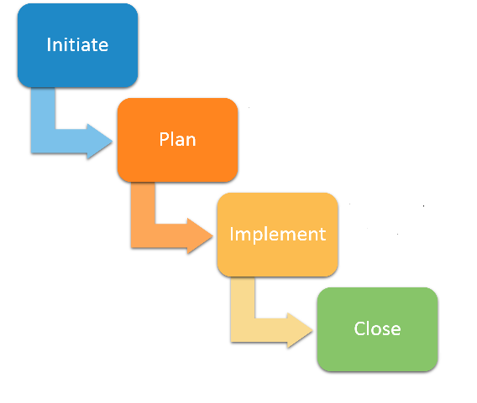
Waterfall Project Management
Similar to traditional project management
Each task needs to be completed before the next one starts
Steps are linear and progress flows in one direction—like a waterfall
Timelines are very important
Size of the team work on the project will grow as smaller tasks are completed and larger tasks begin

Slide 21
Agile Project Management
Computer software industry used this methodology
It is an iterative process ( mathematical)
Focused on the continuous monitoring and improvement of deliverables
Deliverables are-
Customer value
Team interactions
Adapting current business situations
Does not follow a sequential stage-by-stage approach
Phases of the project are completed in parallel to each other by team members

Slide 22
Agile Versus Traditional Project Management
Criteria | Agile | Traditional
Fundamental Concepts | Continuous improvement based on rapid feedback & change | Fully specific, extensive planning
Control | People Centric | Process Centric
Knowledge Management | Tacit | Explicit
Management Style | Collaborative | Control
Role Assignment | Self organizing team | Favors specialization
Communication | Informal | Formal
Planning Duration | Short (3-6 Months) | Long >6 Months

Slide 23
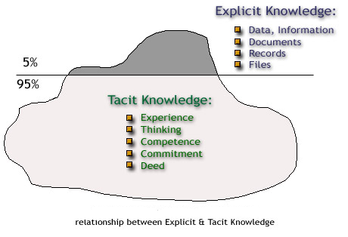
Tacit & Explicit Knowledge

Slide 24
Lean Project Management
This methodology is-
About avoiding waste of time and of resources.
Japanese manufacturing practices
The main idea behind them is to create more value for customers with fewer resources
The type used depends on the preference of the project manager or the company whose project is being managed.

Slide 25
Case Study
Company
Mega Tech Inc.
Manufactures automotive components
Company has stable market – Product consistency
North American Free Trade Agreement (NAFTA)
Focus on customer based & innovations
Management decided company as a project-based organization

Slide 26
Case Study
Managers determined
Product updates
Redesign new technologies
Innovative changes
Special project teams were formed
Project given – strict costs & schedule for new product
Challenges
Employees rethink – time & resource allocation
Success rate was less

Slide 27
Case Study
Project Management Approach
Started company how to operate & do smarter things in faster way
Questions-
What is about project management that offers Mega-tech a competitive advantage?
What elements of marketplace led the firm to believe project management would improve its operations?

Slide 28
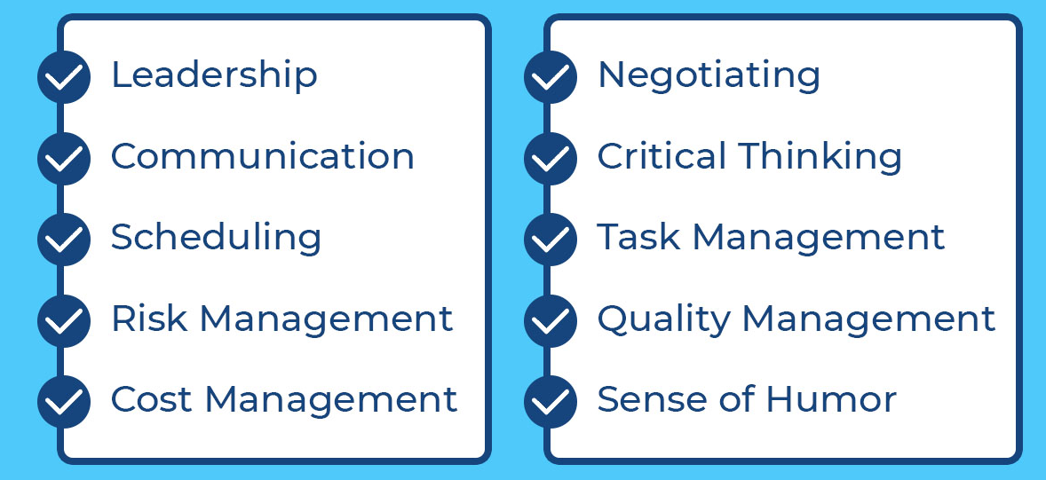
Project Manager Skills

Slide 29
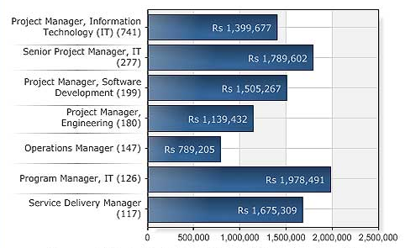
Project Manager Salary

Slide 30
MCQs
1.Which stage of project management life cycle requires the maximum time of completion
Conceptualization
Planning
Execution
Termination
2.The basic nature of a project is a…
Permanent
Temporary
Both a &b
None of the above

Slide 31
MCQs
3. Planning →Conceptualization →Execution→ Termination presents the correct project life cycle
True
False
4. Agile project management is people centric ?
True
False
5. Waterfall project management is similar to traditional project management
True
False

Slide 32
Review Questions
What is a project? List examples
Define Project management
List characteristics of project
Why project management is important?
What are the important phases of a project life cycle? Discuss each phase briefly
Draw a project life cycle with phases & man hours
what are the determinants of project success?
list types of project management & explain with details
Differentiate between agile and traditional project management
What are the skills required for project manager?

