Slide 1

Project
Management
Session -3
Review Session 2
Project Selection Models-
  Numeric
  Non Numeric

Slide 2
Review-Session 2
Strategic Management- Management of an organization’s resources to achieve its goals and objectives
Project Management Maturity (PMM)- Progressive development of an organization for project management
Project Management Maturity Models (PMMM)- Ad hoc, Planned, Integrated, Managed, Continuous improvement
Project Selection- Process of evaluating proposed projects & choosing to implement
Souder Project Selection Model- Realism, Capability, Flexibility, Ease of use, Cost & Easy Computerization

Slide 3
Project Selection Models
Project Selection Models
Numeric Models
Numbers as inputs for decision process in selecting projects
Nonnumeric Models
No Numbers
Depends on other data
If you choose the wrong project, this may go to lose instead of giving business benefits.

Slide 4
Numeric Models
Models use profitability as the sole measure of acceptability
Payback Period
Average Rate of Return
Net Present Value (NPV) / Discounted Cash flow
Internal Rate of Return (IRR)
Profitability Index / Benefit Cost Ratio

Slide 5
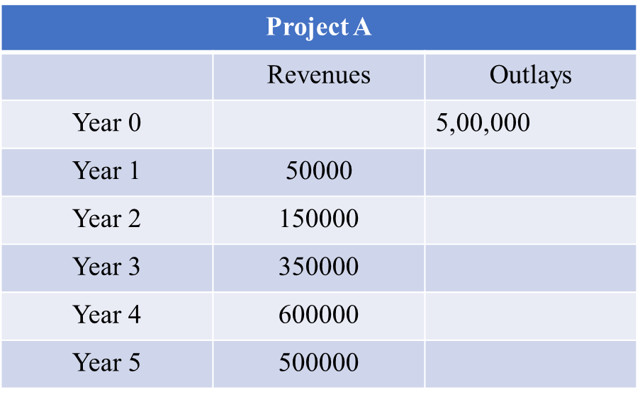
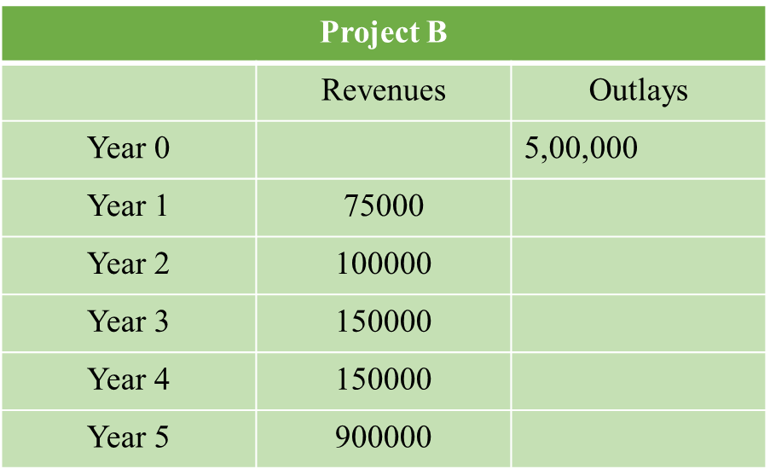
Numeric Model -Payback Period
Initial fixed investment in the project divided by the estimated annual net cash inflows from the project
Is the number of years required for the project to repay its initial fixed investment.
Example-

Slide 6
Numeric Model -Payback Period
Project A
Year | Cash Flows | Cumulative Cash Flows
0 |  | -500000
1 | 50000 | -450000
2 | 150000 | -300000
3 | 350000 | 50000
4 | 600000 | 650000
5 | 500000 | 1150000
Payback period < 3 Years

Slide 7
Numeric Model -Payback Period
Project B
Year | Cash Flows | Cumulative Cash Flows
0 |  | -500000
1 | 75000 | -425000
2 | 100000 | -325000
3 | 150000 | -175000
4 | 150000 | -25000
5 | 900000 | 875000
Payback period > 4 Years

Slide 8
Numeric Model -Payback Period
Managerial Decision-
Project A is superior choice over Project B

Slide 9
Numeric Model – Average Rate of Return
Average Rate of Return = Average Annual Profit / Initial Investment
Example
A retail company X’s which has invested 1 million in a project which has a life of 4 years. During the project, year wise profit earned is given below:
Retail Company X
Initial Investment | 1000000
Year 1 | 76000
Year 2 | 45000
Year 3 | 89000
Year 4 | 67000

Slide 10
Numeric Model – Average Rate of Return
Average Annual Profit = (76000+45000+89000+67000) /4
Average Annual Profit =69250
Average Rate of Return = Average Annual Profit / Initial Investment
ARR = (69250 / 1000000) *100
ARR = 6.9 %

Slide 11
Numeric Model – Average Rate of Return
Advantage-
Simple models
Disadvantage-
Neither takes into account the time-value of money

Slide 12

Numeric Model – Net Present Value (NPV)
Most popular decision making approach in project selection
Takes into account time value of money
Positive NPV indicates firm will make money
  NPV = Net Present Value
  FVt = Future Value
  k = Interest rate
  N = Number of time periods
  t = Number of time periods

Slide 13
Numeric Model – Net Present Value (NPV)
Example
A project requires an investment of INR 20,000.
Interest rate is 8%.
Cash flows INR of the project are-
Year | Cash Flows
1 | 5000
2 | 6000
3 | 8000
4 | 7000
5 | 4000

Slide 14

Numeric Model – Net Present Value (NPV)
Calculating future value of cash flow-
Mathematical Formula
PV = Present Value
FV = Future Value
k = Rate of interest
N = Number of time periods

Slide 15

Numeric Model – Net Present Value (NPV)
 | Year1 | Year 2 | Year 3 | Year 4 | Year 5
Future Cash Flow | 5000 | 6000 | 8000 | 7000 | 4000
Present Value | 5000 / (1+0.08) | 6000 / (1+0.08)^2 | 8000 / (1+0.08)^3 | 7000 / (1+0.08)^4 | 4000 / (1+0.08)^5
Present Value | 5000 / 1.08 | 6000 / 1.17 | 8000 / 1.26 | 7000 / 1.36 | 4000 / 1.47
Present Value | 4630 | 5144 | 6351 | 5145 | 2722

Slide 16
Numeric Model – Net Present Value (NPV)
Sum of present value = 4630+5144+6351+5145+2722
Sum of present value = 23992
Investment value = 20000
Net Present Value = 23992- 20000 = 3992
NPV > 0
Accept project
Note- comparing two projects always select the project with a higher NPV.

Slide 17
Practice
A project requires an initial investment of $225,000 and is expected to generate the following net cash inflows:
Year 1: 95,000
Year 2: 80,000
Year 3: 60,000
Year 4: 55,000
Required: Compute net present value of the project if the minimum desired rate of return is 12%

