Slide 1

Project
Management
Session - 5
  The Project Manager
  Project Management and Project Manager
  Special Demands of Project Manager
  Attributes of effective Project Managers
  Problems of Cultural Differences
  PMO

Slide 2
Project Management & Project Manager
Project Manager
Finance
Engineering
Manufacturing
Contracts
Quality
Procurment
Project management organization showing responsibility of project manager

Slide 3
Project Management & Project Manager
Project Manager uses-
System Approach:
A set of interrelated components that accepts inputs and produces outputs in a purposeful manner.
Adoption of the systems approach is crucial for the project manager

Slide 4
Functional Management Vs Project Management
Functional Management | Project Management
Specialize Knowledge- Industry Specific | Generalist Knowledge A person competent in several different fields or activities.
Work with core group | Work with specialist
Knows capability of team | May not know team capabilities
Work is repetitive | Authority relates to project

Slide 5
Project Manager
Leader- Keeps everything and everyone organized and with a goal in mind
Responsible for Project-
Initiation
Planning
Execution
Control
Completion

Slide 6
Selecting Project Manager
Popular skills, and qualities for selecting project managers:
A strong technical background
A mature individual
Someone who is currently available
Someone on good terms with senior executives
A person who can keep the project team happy
One who has worked in several different departments

Slide 7
Project Manager- Research
Characteristics
Lead by example
Visionary
Technically competent
Decisive (Producing a definite result)
Good communicator
Stands up to top management when necessary
Supports team member
Encourages New ideas

Slide 8
Project Manager- Research
Emotional intelligence
Self awareness
Self regulation
Motivation
Empathy (understanding others feelings)
Social Skill

Slide 9
Project Manager-Research
Project manager abilities
Organizing under conflict
Experience
Decision making
Productive creativity
Organising with cooperation
Integrative thinking

Slide 10
Project Manager - Research
Conclusion
Effective Project Manager-
Good Communicator
Flexible to respond uncertainty
Work well with team
Skilled at various tactics

Slide 11
Project Champions
Senior managers serve as a champions
Identifies new developments
Creative organizer
Entrepreneur
Do everything to promote the project

Slide 12
What champions do..
Provide motivation
Visionary – firm idea for creating project
Good networking to ensure cooperation
Risk taker
Ambassador- maintaining good relations with all project stake holders

Slide 13
Project Manager & Culture
Example
Compadre system leads a manager to give preference to relatives and friends when hiring
Such practices are a major source of inefficiency
To manage effectively with unexpected events requires organizational culture
Flexibility

Slide 14
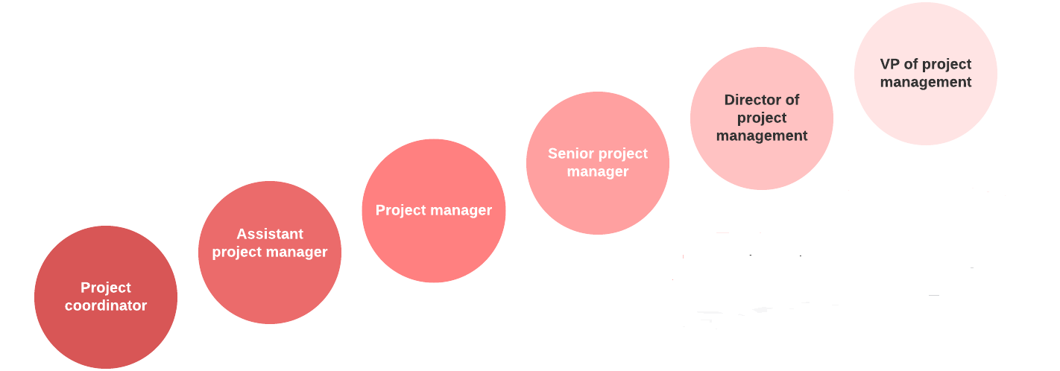
Project Manager Career

Slide 15

What Successful Project Managers Do?
Traditional Project Management-
Emphasize long term planning
Focus on stability to manage risk
Today’s Managers-
Leading complex projects
Combine traditional + agile methods with flexibility
Better results

Slide 16
How to become a Project Manager?
Project management education
Project management certification
Project Management Professional certification (PMP)
https://www.pmi.org/
PRINCE 2 ( Projects in Controlled Environment)
https://www.prince2.com/uk

