Slide 1

Project
Management
Session - 6
  Managing Conflict & Art of Negotiation
  What is Conflict?
  Sources of conflicts in project
  Types of Conflicts
  Conflict & Project Life Cycle
  Dealing with Conflict

Slide 2
What is Conflict?
Disagreement between people
Difference of opinion
Clash between ideas
One party frustrate other party

Slide 3
Sources of Conflicts in Project?
Project priorities
Cultural differences
Technical issues
Team Environment
Organization structure
Communication barriers
Poor planning
Project Costs & Budget

Slide 4
Types of Conflicts
Goal Oriented
Administrative
Interpersonal

Slide 5
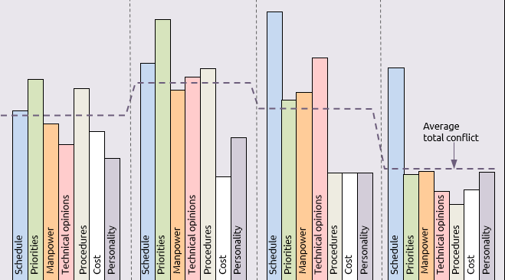
Conflict Intensity in Project
Conflict
Intensity
Project Formation
Early Stages
Main Project
Towards the end

Slide 6
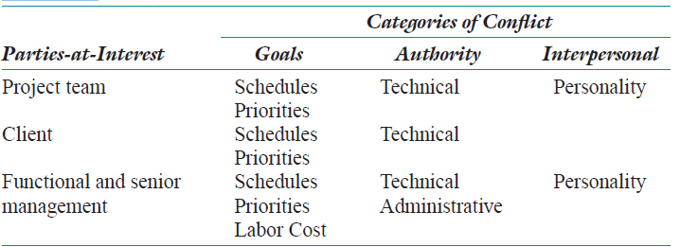
Project Conflicts by Category & Parties-at-Interest

Slide 7

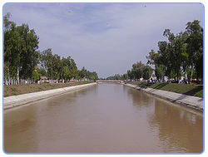
KHUS- Canal Project: Cultural Conflict
Canals are waterways channels, Water ways

Slide 8
Project Background
Guangxi Corporation for International Techno-Economic Cooperation (GCITEC)
Partnership between Assif & Sons with GCITEC
First international project
A joint venture initiative with a local Pakistani firm
2015
The Chinese firm brought funding and technical experience
Pakistani partner brought local experience and local construction staff

Slide 9
Learnings
Country’s context can affect joint venture
Differences in home operations & other country operation
How leaders think systematically
Take decisions & confront ( deal with situation)

Slide 10
Project Leaders
Yang & Chen leaders from Chinese side
Graduated from top universities
Management style – permissive (allow employees to take decisions)
Not prepared for their roles in Pakistan

Slide 11
Assif & Sons - Company
Assif & Sons family enterprise
Aggressive management style
Assif & his team successfully completed oil pipeline project in UAE (United Arab Emirates)
Project resulted in profit
Client provided bonus to Assif

Slide 12
Project Fund
Approved by International Development Bank
Project make quality assurance standards
Assif has to guarantee 7% investment to Chinese counterpart
Regardless project profit or loss

Slide 13
Project
Chinese team worked more than half year, without any breaks
Security was concern
Chinese engineers stay close to the camp
Chinese worker travelled miles to hunt birds, snakes, crocodiles & so on
Pakistan sensitive on preservation of wild animals
Chinese engineers beaten by local landlord for hunting frogs

Slide 14
Pakistani Labour Culture
Assif & Sons employed 13-14 years old children as full time labours
Workers bring babies on construction sites
Pakistan officers asked 20000 for site inspection
Chinese engineer refused to make payment
Chinese engineer complaint Assif & Sons for the same
Assif & Sons replied you have not clue about conditions in Pakistan
Mind your own business

Slide 15
Project Conflict -1
Chinese team not prepared for environmental features of Pakistani region
Local culture
Corruption
Labour relations

Slide 16
Project Conflict -2, 3
2. International development bank not trusting Pakistani side
3. Management styles of two sides

Slide 17
Chinese Labour Culture
Hour nap after lunch
Pakistani observed as laziness
Assif team member kicked sleeping Chinese engineers

Slide 18
Project- Conflict
Bank found quality problems in project
Suggested to improve quality
Settled with time, energy, money
Pakistani & Chinese team blamed other for the problem
Chinese engineers began to question & judgement of Assif’s competency

Slide 19
Project Conflict
Variation in project design
Chen identified faults in original design of project
Observed leakages-
Due to sub standard sand, cement, concrete mix
Canal slope
Required changing mixture ratio
Recalculation of bill of quantity
Profit loss to project

Slide 20
Incident
Assif- scold Chinese team & Chen with go back to your country
We can do ourself
Yang called meeting-
Decided Chinese team would terminate all site work
Leaving site for 3 days
Yang would negotiate with Assif an apology to Chen
Else suspension would be indefinite
2 days passed Chinese team not received apology from Assif

Slide 21
Project Work
Project resumed without Chinese engineers
Pakistani survey engineers observed – height of cannel incorrect
Issued written warning to the joint venture
Delay in construction
On 4th day yang reported case to president of Karachi

Slide 22
What Next
Redesign the project
Dissolve the partnership
Root of conflict- management styles
Personality conflict- Assif & Chen
Conflict would likely recure ( save from danger)
Difficult to save the project
Better simply scrap the joint venture

Slide 23
Questions
Suggest solutions to solve the problem
Should dissolve partnership?
Discuss cultural differences created problem
What happened?

Slide 24
Solutions
1. Chinese dominance
Chinese firm would return to the work & complete project
Isolate Assif & Sons
2. Silo Strategy
Assif should focus on Pakistani labours
Chinese firm interact Chinese engineers

Slide 25
Solutions
3. Status Quo Strategy
Minor changes required to solve interpersonal problems
Little change to maintain project
4. Co-operation Strategy
Both parties address misunderstanding
Find drivers of conflict
Outside consultant could brought

Slide 26
What Happened?

