Slide 1

Project
Management
Session - 7
  What is Conflict?
  Dealing with Conflict
  Building Project Team
  Nature of Negotiation
  Principles of Negotiation
  Partnering
  Chartering and Scope Change

Slide 2
What is Conflict?
Goal Oriented
Administrative
Interpersonal
Disagreement between people
Difference of opinion
Clash between ideas
One party frustrate other party

Slide 3
Dealing with Conflicts
Address Conflicts Early
Uncover Motivations Behind the Stakeholders’ expectations
Look For Relationships Between Issues
Involve Senior Management
Refines project Objectives and Approach
Cooperation
Use Multiple Routes and Forms of Communication
  Most productive methods of communication is in face-to-face discussion
  Formal documentation
  Facilitate discussion

Slide 4

Building Project Team
Team is defined as a group of people with skills –
Who work actively together to achieve a common goal

Slide 5
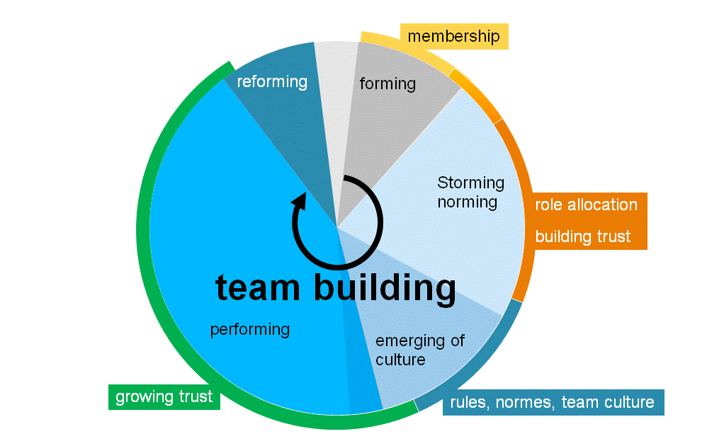
Team Building Process

Slide 6
6 Cs of Team Building
Conceive- Project objectives
Concurring - Agreeing
Commitment
Communication
Coordinating
Counseling
Controlling

Slide 7
Managerial Implications – Team Development
Balanced Roles
Open Communication
Handling Stress
Team Choice
Team Goals
Review Mechanism
Shared Leadership
Facilitation Skills
Consensus – Agree to implement important decision

Slide 8
Features of Team
Committed to Goal
Complimentary skills - Dissimilar skills that, when combined, become more useful than individual skills in accomplishing a goal
Support one another
Holds themselves collectively accountable for results
Trust & Support other members
Offer suggestions & give feedback
Generate greater outputs with no increase in inputs

Slide 9
Points .. To Create High Team Performance
High Team Performance
Size
Small
Increase in size harder to interact & influence
Skills
Technical
Problem Solving
Interpersonal
Behaviour
Speak respectfully
Listen without interrupting
Support each other
Roles
Task Specialist
Socio Emotional

Slide 10
Commitment – Project Need
Project needs individuals committed to the job-
  Challenging Work – feel pride, get recognition
  Opportunities for creativity
  Recognition- by felicitation
  Consulted on decision concerning
  Attention on personal needs
  Organizational culture
  Good quality of living conditions

Slide 11
Negotiation
Manager's ability to use his influence for productivity
Effective negotiation is an imperative for successful project management
Questions to ask before negotiations-
How much power do I have?
What pressures are there?
Do I trust my opponent?

Slide 12
Effective Negotiating Strategy
Separate people from problem
Don’t blame people for your problem
Recognize & understand emotions
Listen actively
Build a working relationship
Focus on interest not positions
Invent options for mutual gain
Insist on using objective criteria
Develop standards & procedures

Slide 13
Negotiation Process
Communication back and forth for the purpose of making a joint decision
A way of finding a mutually acceptable solution to a shared problem
Achieving an ideal outcome: a wise decision, efficiently and amicably agreed upon.

Slide 14
Negotiation Styles-P2O2
People
  ▪ Separate the people from the problem
Positions
  ▪ Focus on interests not positions
Options
  ▪ Generate options for mutual gain before choosing
Objective Criteria
  ▪ Decide based on objective criteria
BATNA (Best Alternative to Negotiated Agreement)

Slide 15
Sources of Power in Negotiation
Developing good working relationships among people negotiating
Understanding interests
Inventing an elegant option
Using external standards and benchmarks
Developing a good BATNA
Understanding their BATNA
Making a carefully crafted commitment: an offer, something you will do, something you will not do.

Slide 16

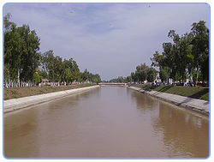
KHUS- Canal Project: Cultural Conflict
Canals are waterways channels, Water ways

Slide 17
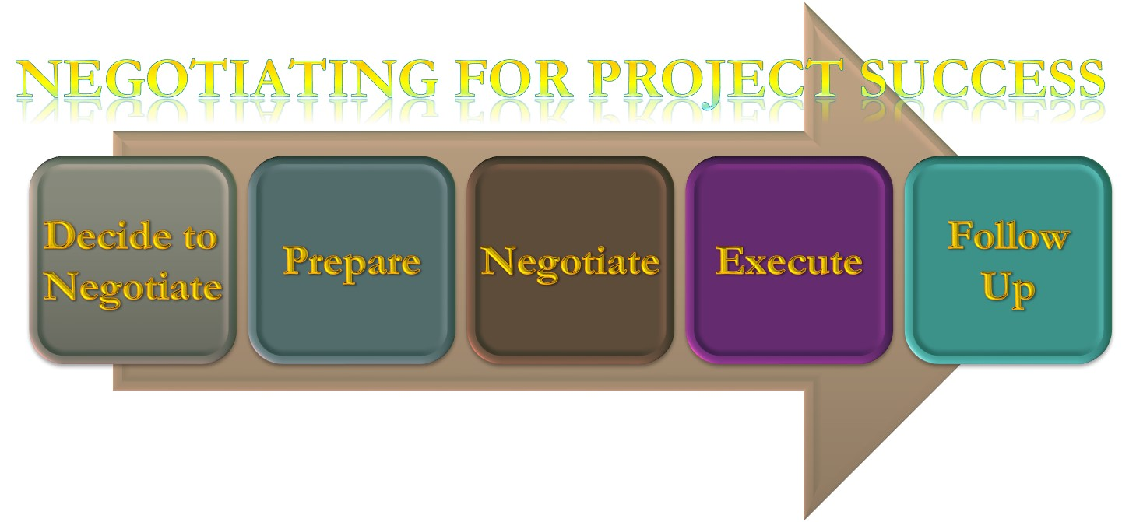

Slide 18
Solutions
  Chinese Dominance
  Silo Strategy
  Status Quo Strategy
  Co-operation Strategy

Slide 19
What Happened?
Reconcile (Join) 2 parties
Address complaints of each side
Arrive at a suitable outcome for both
Preserve partnership
Lead to success
Partner in future project

Slide 20
What Happened?
Yang-
Establish an authority to decide solution for both sides
Discussed legal partnership with Assif & Sons
Both sides need each other
Assif & sons requires- Technical & Financial support
Chinese team need local partner

Slide 21
What Happened?
Yang-
  Addressed concerns of the Chinese team
  Stressed importance of mutual respect
  Encouraged cultural sensitivity
  Rearrange work division
  Created new communications
  Address structural drivers of tension

Slide 22
Project Success
Settlement proven-
Project completed before schedule
With quality standards
Arrangement reached – enabled future joint ventures
Problem was solved with mixture of
Cooperation & Silo strategy
Result proving Chinese proverb- Out of blows friendship grows

Slide 23

Harvard Principles of Negotiation
https://www.youtube.com/watch?v=RfTalFEeKKE&feature=emb_logo

