Slide 1
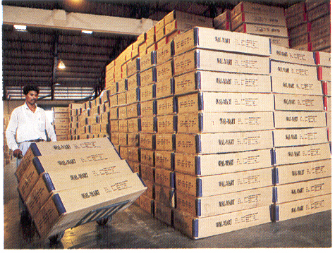
Warehousing : A Role Beyond Storage

Slide 2
Learning Objectives
To understand role of warehousing in logistics.
To understand warehouse functions and options.
To understand strategic decisions in warehousing (site, layout, type, storage).
To understand warehousing strategies.
To understand warehousing performance measures.

Slide 3
Warehousing is…
A place where finished goods are stored till they are further distributed.
A variable in make-and-sale equation of the organization.
A distribution centre playing key role in organization’s logistics strategy. It is a point where organization fails or succeeds in fulfilling the sales and marketing promises.
A switching facility in logistical network.

Slide 4
Typical Warehouse Layout
Material Inward and Inspection
Bulk Storage
Place
Rack/Bin Storage
Place
Order Picking Section
Packaging Section
Material Dispatch Section

Slide 5
Types of Warehouses
Captive warehouse
    Located inside the factory premises
    For monitoring excisable goods
Field warehouse
    Located near the place of consumption
    For servicing the customers and channel partners
Customs warehouse
    Located near to air and sea ports
    For goods meant for imports and exports

Slide 6
Warehouse Options
Private Warehouse
Public Warehouse
Contract Warehouse

Slide 7
Storage Alternatives
Factors | Private WH | Public WH | Contract WH
Investment | Very high | None | Very less
Controls | High | Low | Medium
Operation Flexibility | High | Low | Medium
Cost per unit stored | Inversely related to volumes | Low | Inversely related to volumes
Risk | High | Low | Medium

Slide 8
Warehouse Functions
Material Storage Functions
    Stock holding
    Consolidation
    Break bulk
    Cross docking
    Processing
    Postponement
    Assortment
    Mixing/assembling
    Packaging and labelling
Material handling Function
Order filling
Information handling

Slide 9
Warehouse Layout Design Guidelines
Make maximum use of available area.
Use ‘unitized‘ load system.
Minimize the goods movement by proper storage locations.
Provide flexibility for changes in future.
Design for safe, clean and secure space.

Slide 10
Factors Influencing Warehouse Layout Design
  Inventory turnover
  Storage method
  Product configuration
  Product characteristics
  Housekeeping
  Material handling methods
  Safety and security

Slide 11
Warehouse Site Selection
Consideration of warehouse site selection revolve around two major factors---service and cost
Factors…..
      Market proximity
      Infrastructure (Road, utilities, communication)
      Product
      Access to site
      Transportation cost
      Availability of space
      Regulation

Slide 12
Warehouse Network—Cost Implications
Primary transportation cost
Total
cost
Inventory carrying cost
Cost
Secondary
transportation cost
Number of warehouses

Slide 13
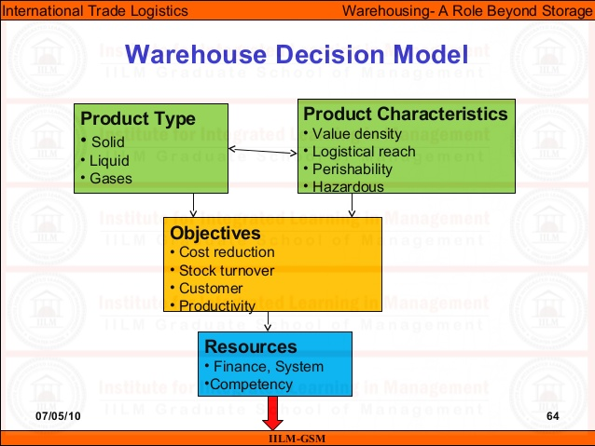

Slide 14
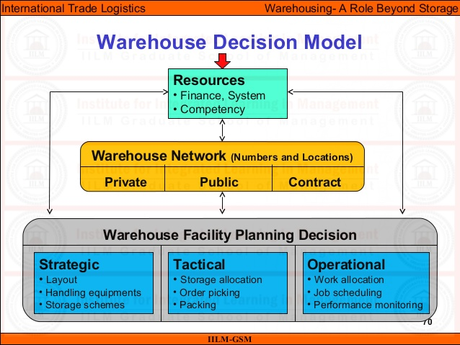

Slide 15
Warehousing Strategy
Capacity Switching
Hub Networking
Cobbling (Players coming together)
Outsourcing

Slide 16
Warehouse Performance Parameters
Stock turn over ratio
Warehouse cost to sales
Warehouse cost per unit handled
Warehouse occupancy rate

Slide 17
Warehouse Capacity Planning
Public or contract warehouse
(for 25 % of capacity)
Storage
capacity
requirement
Private warehouse
(for 75 % of capacity)
J F M A M J J A S O N D
Months

Slide 18
Video: Warehouse space Planning..Toyota

