Slide 1
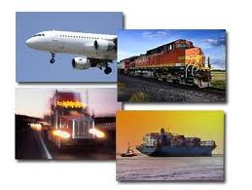
Transportation Management in SC

Slide 2
Introduction of Transportation
Transportation refers to the movement of product from one location to another as it makes its way from the beginning of supply chain to the customer.
Transportation is an important supply chain driver because products are rarely produced and consumed in the same location.

Slide 3
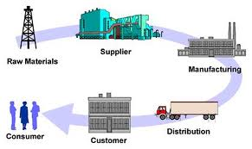
Role of transportation in supply chain management

Slide 4
Transportation Mode Selection Criteria
• Speed
• Frequency
• Availability of service
• Reliability (Condition & time frame)
• Consistency in delivery
• Capability
• Cost

Slide 5
Key Drivers
Shipper:
The party who wants to transport the product from one place to another place.
Carrier:
Carrier is company that moves the goods from one place to another place.
For example: DHL, Fed Ex. Etc.

Slide 6
Transportation Infrastructure
Transportation serves two purposes:
    Product movement
    In-transit product storage
Movement can be achieved thr’ various modes subject to availability and access provided by the infrastructure.
In-transit storage is not cost-effective for longer period of time.
In India the percentage of cargo movement
      60% by road
      30% by rail
      10% by water

Slide 7
Modes of Transportation
Air
Water
Surface
Intermodal
Package
Carrier
Inland
Overseas
Road
Rail
Pipeline

Slide 8
Air
Short lead times, or advanced service levels.
Best suited for small, high- value items or time sensitive emergency shipments that have to travel a long distance.
Suited for shipments that have high value but light weight .

Slide 9
Air Transport
Advantages
• Speed
• Low packaging cost
• Good security
• Less risk
Disadvantages
• High Freight cost
• Limitation on size
• Needs airport facility

Slide 10
Water
Water transport uses ships and large commercial vessels that carry billions of tons of cargo.
Water transport is used primarily for the movement of large bulk commodity shipments and it is the cheapest mode for carrying such load.
Water transport is particularly effective for significantly large quantities of goods that are non-perishable in nature and for cities or states that have water access.

Slide 11
Water Transportation
(Sea and Inland)
Advantages
• Cheapest freight cost
• No capacity constraints
• Size and shape no bar
• less environmental
problems
Disadvantages
• Strong packing required
• Weather conditions affect
delivery
• Slow movement

Slide 12
TRUCK
Trucking industry is divided into two parts i.e.
TL: Truck Load and LTL: Less than Truck load.
TL: TL pricing display the economic of scale with respect the distance travel. TL shipping suited for transportation between manufacturing facilities and warehouses.
LTL: LTL operations are priced to encourage shipments in small lots, usually less than half a TL. LTL shipping is suites for shipments that are large to be mailed as small packages.

Slide 13
Road Transportation
Advantages
• Flexibility
• Door to door service
• Reliability
• Cost-comparative
and negotiable
• Access to remote
places
Disadvantages
• Environmental
pollution
• Strong packaging
required
• Slow speed

Slide 14
Rail
Rail transport uses freight trains for the delivery of merchandise. Freight trains are usually powered by diesel, electricity and steam.
Rail is suited for bulk shipment of products like fertilizer, cement, food grains and coal etc. from the production plant to the warehouses.

Slide 15
Rail Transportation
The Railways record for about 2.30% of the GDP and employs approx 1.5 million people directly.
Advantages
• Any type of commodity
can be moved
• Low freight cost compared
to road and air
• Large carrying capacity
Disadvantages
• Strong packing required
• Needs loading/unloading
platforms
• Low delivery reliability

Slide 16
Pipeline
Pipeline is used primarily for the transport of crude petroleum, refined petroleum products and natural gas.
It include a significant initial fixed cost in setting up the pipeline and related infrastructure.
Pipelines are not flexible and this scope is limited with respect to commodities.
Unable to transport a variety of materials

Slide 17
Package Carrier
Package carriers are transportation companies which carry small packages. Examples: FedEx, UPS, DHL. Etc.
Package carriers use air, truck and rail to transport the goods.
Packages carriers also provide other value added services that allow shippers to inventory flow and track order status, shipper can proactively inform the customer about their packages.
Package carrier is suited for e- business.

Slide 18
Intermodal Transportation
Intermodal Transportation is use of more than one mode of transport for the movement of shipment from origin to its destination.
Intermodal operation is used two or more mode of transport
to take the advantage of inherent
economies of each and thus
provide the integrated service at
lower cost.
For example: truck/water/rail.

Slide 19
Transportation related problems in SC
Two perspectives of transportation which gives rise to problems:
    Design (Shipper’s Perspective)
    Operation (Carrier’s Perspective)
Shipper wants to balance inventory, facility and transportation costs while maintaining excellent service level
Carrier wants to maximise profit by making use of available transportation capacity

Slide 20
Transportation Network
• Point to point network
• Multiple delivery points
• Trans-shipment points
• Nodal network
• Hub and spoke network
• Milk run network

Slide 21
Transportation Network
Point-to-point Network
Origin
Destination
Multiple Delivery Points
Delivery Point
Origin
Delivery Point
Delivery Point

Slide 22
Transportation Network
Trans-shipment Network
Trans-Shipment
Point
Origin
Destination
Long Distance Haulage
Local Area Distribution

Slide 23
Transportation Network
Nodal Network
MPD
MPD
MPD
Road
Terminal
Port
Terminal
Road
Terminal
Rail
Terminal
Air
Terminal
Road
Terminal
(MPD – Multiple pick-up and delivery)

Slide 24
Transportation Network
Hub and Spoke
Plant-A
DC
DC
Mother
Hub
DC
DC
Plant-B
DC – Distribution Centres
Hub acts as central feeder to the DCs

Slide 25
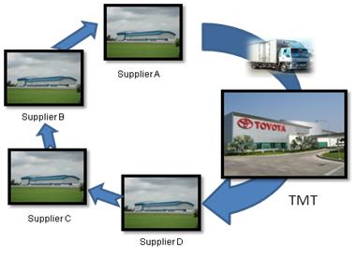
Milk Runs Network
Critical Variables for Milk-run design are :
  Distance
  Cost of delivery / pick-up
  Cycle time
  Perishability of the product

Slide 26
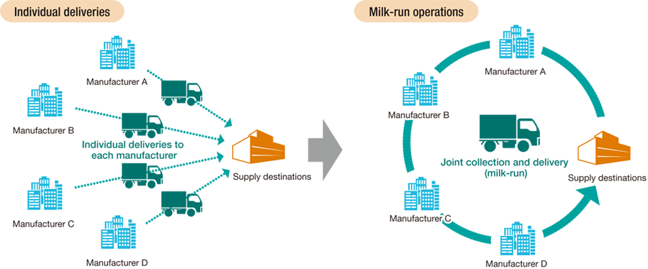

Slide 27
Freight Management
Freight management includes various strategies for
increasing the efficiency of freight and commercial transport.

Slide 28
Freight Management: Responsibilities
• Optimizing the transport cost
• Improve scheduling and routing to reduce freight vehicle mileage and increase load factor
• Reduce total freight transport by relying on nearby supplier
• Use efficient transport equipment
• Improve vehicle operator training

Slide 29
Freight Management: Tasks
• Rate negotiations
• Carrier evaluation
• Vehicle scheduling
• Carrier integration
• Tracing and tracking

Slide 30
Factors Affecting Freight Cost
• Volumes
• Distance
• Product density
• Product shape
• Product handling
• Product type
• Market dynamics

Slide 31
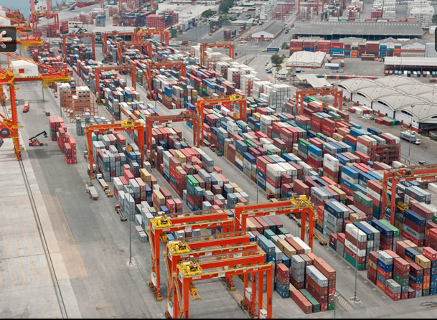
Containerization

Slide 32
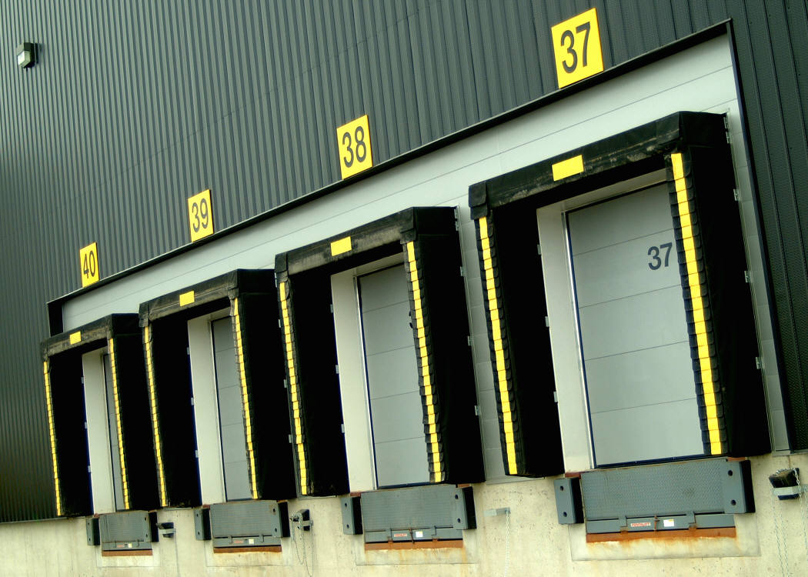

Prior to Containerization MULTIPLE HANDLING
All cargoes other than bulk commodities were moved package by package and piece by piece with multiple handling, resulting in damage, pilferage and time loss.

Slide 33
WHAT IS CONTAINERIZATION?
‘Containerization is a system of freight transport based on a range of steel intermodal containers (also 'shipping containers', 'ISO containers' etc).
Containers are built to standardized dimensions, and can be loaded and unloaded, stacked, transported efficiently over long distances, and transferred from one mode of transport to another—container ships, rail and semi-trailer trucks—without being opened.
Notes:
http://en.wikipedia.org/wiki/Containerization

Slide 34
ISO Standard for containers:
Five common standard lengths: 20-ft, 40-ft, 45-ft, 48-ft and 53-ft
Container capacity are measured in TEU = Twenty foot Equivalent Units or FEU = Forty foot Equivalent Units .
Height (8 feet 6 inches high or 9 feet 6 inches high for high cube containers)
Maximum gross mass for 20ft is 24000 kgs and for 40-ft is 30,480 kgs.
Some big names in Container Transport:
NYK Line, Evergreen Marine, CMA-CGM, Maersk Line, MSC, Hapag-Lloyd, APL, Hanjin, CSCL
In India – Shipping Corporation of India

Slide 35
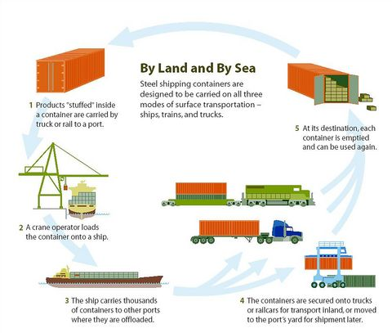
With the advent of Containerisation

Slide 36
Containerization: Benefits
• Inter-modal transportation possible
• Elimination of cargo trans-shipment leading to speedier delivery services
• Door-to door service to customer possible
• Risk of transit damages and pilferages reduced
• Substantial reduction in logistical packaging cost
• Reduction in overall distribution cost

Slide 37
CONTAINERIZATION IN INDIA
Some numbers about Sea Transport in India:
Sea Transport carries 95% of India’s exports by volumes and 70% by value
India has 12 major ports and 187 non-major ports along 7517 km coastline
Drivers of Container Traffic
INTERNATIONAL TRADE GROWTH
PENETRATION OF CONTAINERIZATION
HUB AND FEEDER SERVICE STRUCTURE
Notes:
http://www.frost.com/prod/servlet/press-release.pag?Src=RSS&docid=176131850
http://www.iimahd.ernet.in/~graghu/container.pdf
http://articles.economictimes.indiatimes.com/2011-11-06/news/30366543_1_export-target-export-destinations-foreign-trade-policy
http://www.indiastat.com/table/transport/30/trafficatmajorportsofindia/449979/55830/data.aspx

Slide 38
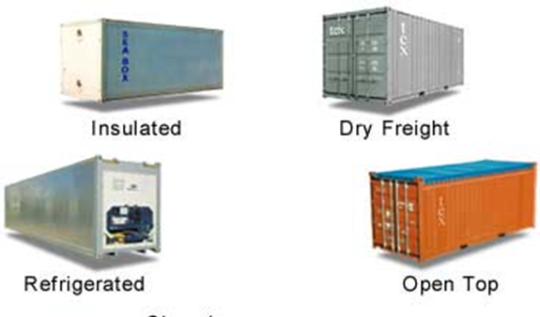
TYPES OF CONTAINER

Slide 39
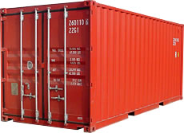
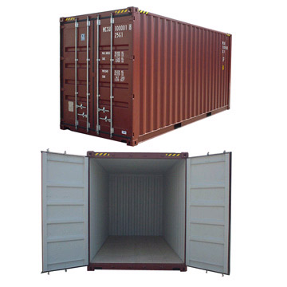
DRY STORAGE CONTAINER
Used for shipping dry goods that do not require temperature control.
They come in different dimensions standardized by ISO.
Ideal for manufactured products and some natural resources

Slide 40
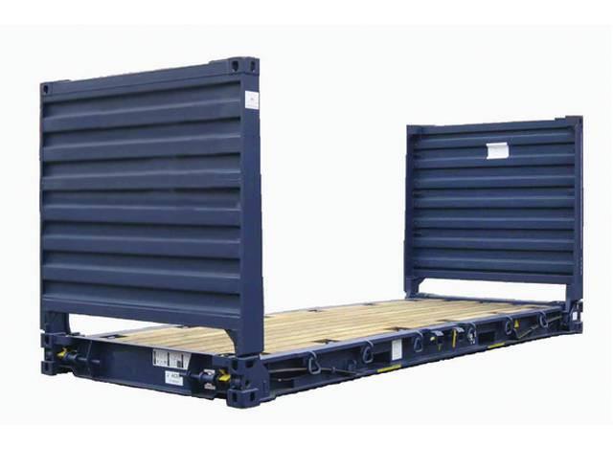
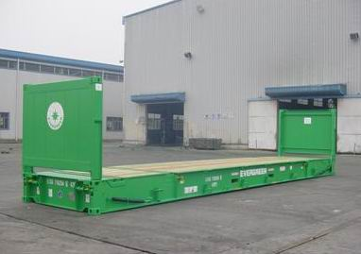
FLAT RACK CONTAINER
Especially suitable for heavy loads and cargo that needs loading from the top or sides.
Manufactured from steel and come in 20′ and 40′ sizes.
Ideal for cargo difficult to handle: heavy machinery, large industrial parts and construction materials.

Slide 41
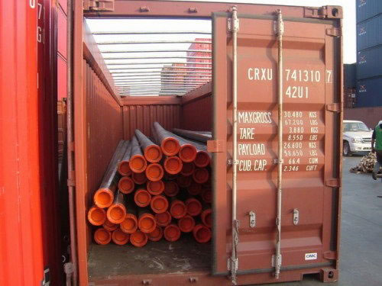
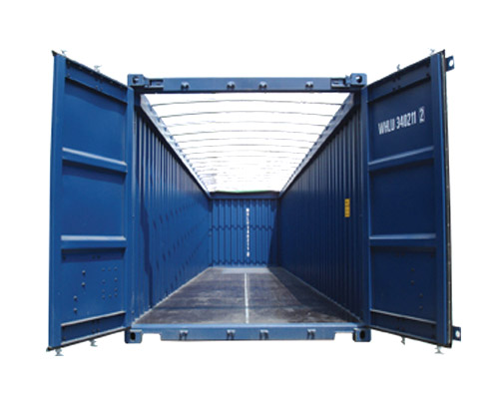
OPEN TOP CONTAINER
Do not have solid roofs. They have removable bows and a weatherproof tarpaulin roof which can be secured with ropes
Open top containers are ideal for bulky cargo such as machinery, wood, etc.

Slide 42
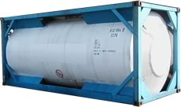
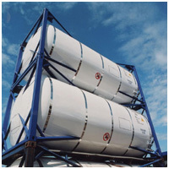
TANKS
Mostly used for transportation of liquid materials: toxic, corrosive, highly combustible, and oils, milk, beer, wine, mineral water, chemicals etc.
Mostly made of strong steel or other anti-corrosive materials providing them with long life and protection to the materials.

Slide 43

Insulated Containers
Rely on their insulation properties to maintain a steady temperature
No power supply
Advantage if goods are being shipped a short distance and power is not available
Pre-cooled cargo from cold storage can be used with an insulated shipping container to maintain a cold chain very successfully on short trips

Slide 44
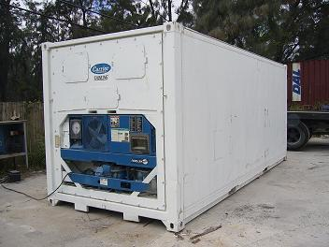
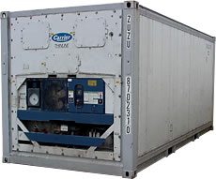
REFRIGERATED ISO CONTAINERS
Always have a carefully controlled low temperature.
Exclusively used for shipment of perishable substances like fruits and vegetables over long distances.

Slide 45
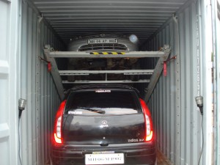
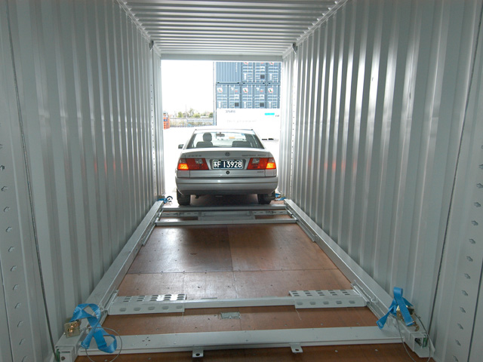
CAR CARRIERS
Units made especially for shipment of cars over long distances.

Slide 46
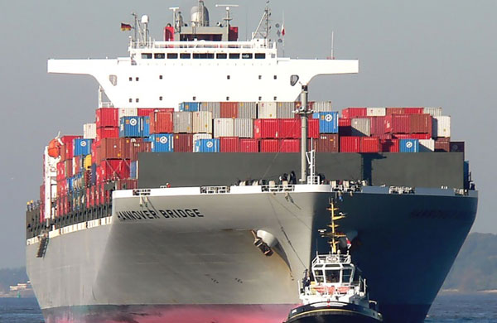
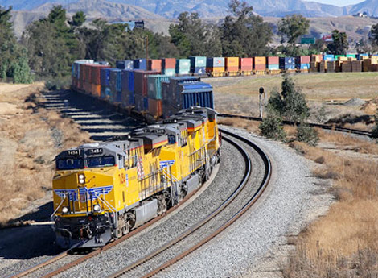
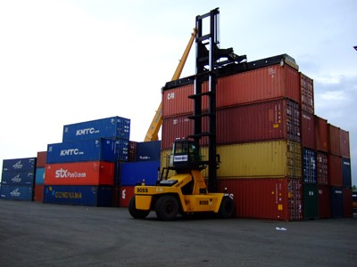
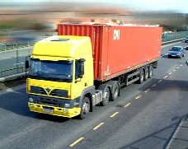
PLAYERS IN THE CONTAINER SUPPLY CHAIN
CARGO SHIPS
FREIGHT TRAINS
INLAND CONTAINER DEPOT
TRUCKS

Slide 47


