Slide 1


INTRODUCTION
TO SUPPLY CHAIN MANAGEMENT
2020

Slide 2
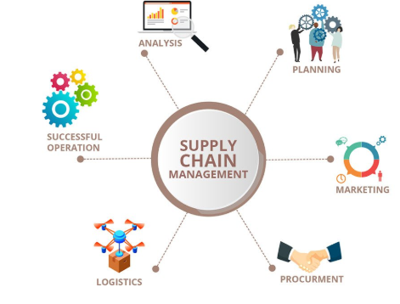
OVERVIEW
SUPPLY CHAIN CONCEPT
SUPPLY, SUPPLY CHAIN AND SUPPLY CHAIN MANAGEMENT
SUPPLY CHAIN ELEMENTS AND EXTENDED SUPPLY CHAIN
SUPPLY CHAIN LINKAGES AND INTEGRATION
SUPPLY CHAIN DECISIONS
SUPPLY CHAIN CHALLENGES

Slide 3
SUPPLY, SUPPLY CHAIN AND SUPPLY CHAIN MANAGEMENT
A SUPPLY IS THE QUANTITY OF INVENTORY/GOODS AVAILABLE (IN REQUIRED QUANTITY) FOR USE OR THE ACTUAL REPLENISHMENT OF A PRODUCT OR COMPONENT.
A SUPPLY CHAIN IS THE LINK CONNECTING SET OF FACILITIES, COMPANIES, DEMAND AND SUPPLY POINTS AND SERVICE PROVIDERS. CHAIN LINKS SUPPLIERS AND DOWNSTREAM CUSTOMERS WITH THE FLOWS OF PRODUCTS, SERVICES, FINANCES.
SUPPLY CHAIN MANAGEMENT (SCM) IS THE SYSTEMATIC AND STRATEGIC COORDINATION OF ALL BUSINESS FUNCTIONS WITHIN A COMPANY FOR THE PURPOSES OF IMPROVING THE LONG TERM PERFORMANCE OF THE SUPPLY CHAIN AS A WHOLE.

Slide 4
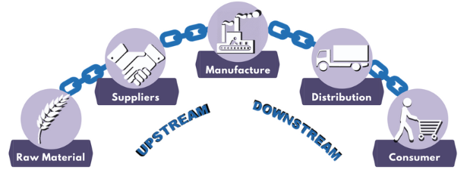
SUPPLY CHAIN
SUPPLY CHAIN CONSISTS OF ALL LINKS/STAGES INVOLVED DIRECTLY OR INDIRECTLY IN FULFILLING CUSTOMER’S REQUEST /ORDER.
THE SUPPLY CHAIN INCLUDES NOT ONLY THE MANUFACTURERS AND SUPPLIERS, BUT ALSO TRANSPORTERS, WAREHOUSES, RETAILERS AND EVEN CUSTOMERS THEMSELVES.

Slide 5
SUPPLY CHAIN MANAGEMENT…
SUPPLY CHAIN MANAGEMENT ENCOMPASSES THE PLANNING AND MANAGEMENT OF ALL ACTIVITIES INVOLVED IN
SOURCING AND PROCUREMENT
CONVERSION
AND ALL LOGISTICS MANAGEMENT ACTIVITIES
IMPORTANTLY, IT ALSO INCLUDES COORDINATION AND COLLABORATION WITH CHANNEL PARTNERS, WHICH CAN BE
SUPPLIERS
INTERMEDIARIES
THIRD PARTY SERVICE PROVIDERS
AND CUSTOMERS
IN ESSENCE, SUPPLY CHAIN MANAGEMENT INTEGRATES SUPPLY AND DEMAND MANAGEMENT WITHIN AND ACROSS COMPANIES.

Slide 6
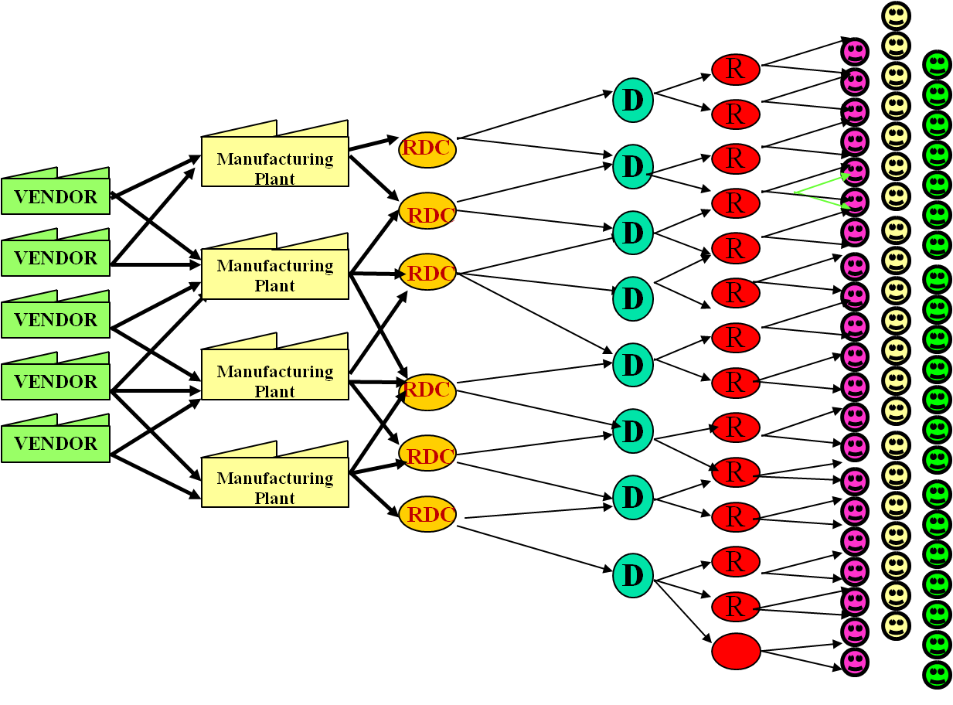
GENERIC SUPPLY CHAIN
Notes:
RDC- Regional DC

Slide 7
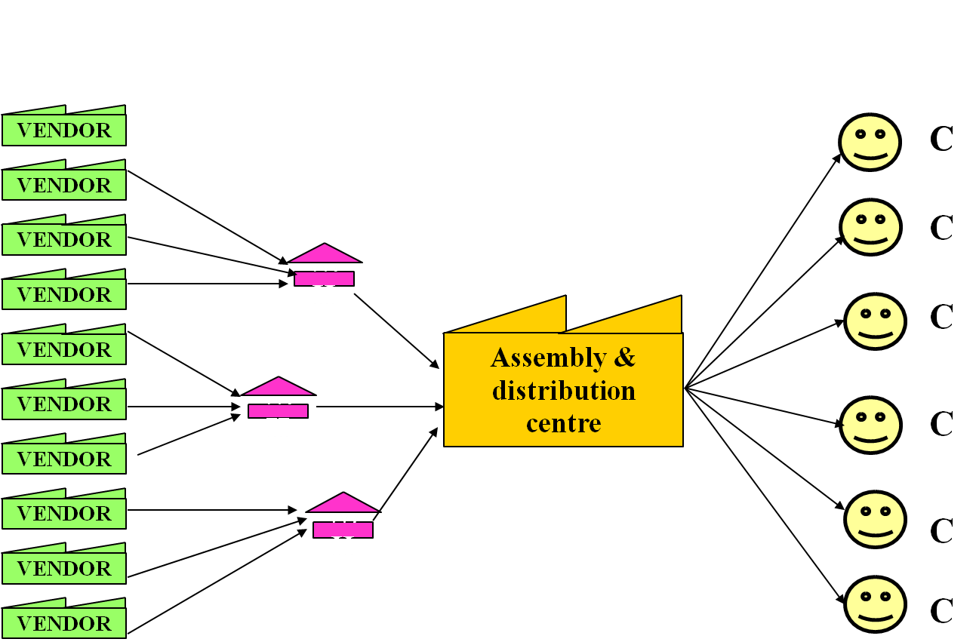
DELL SUPPLY CHAIN

Slide 8
WHAT IS SUPPLY CHAIN MANAGEMENT ?
Video- Supply chain Management 1.

Slide 9
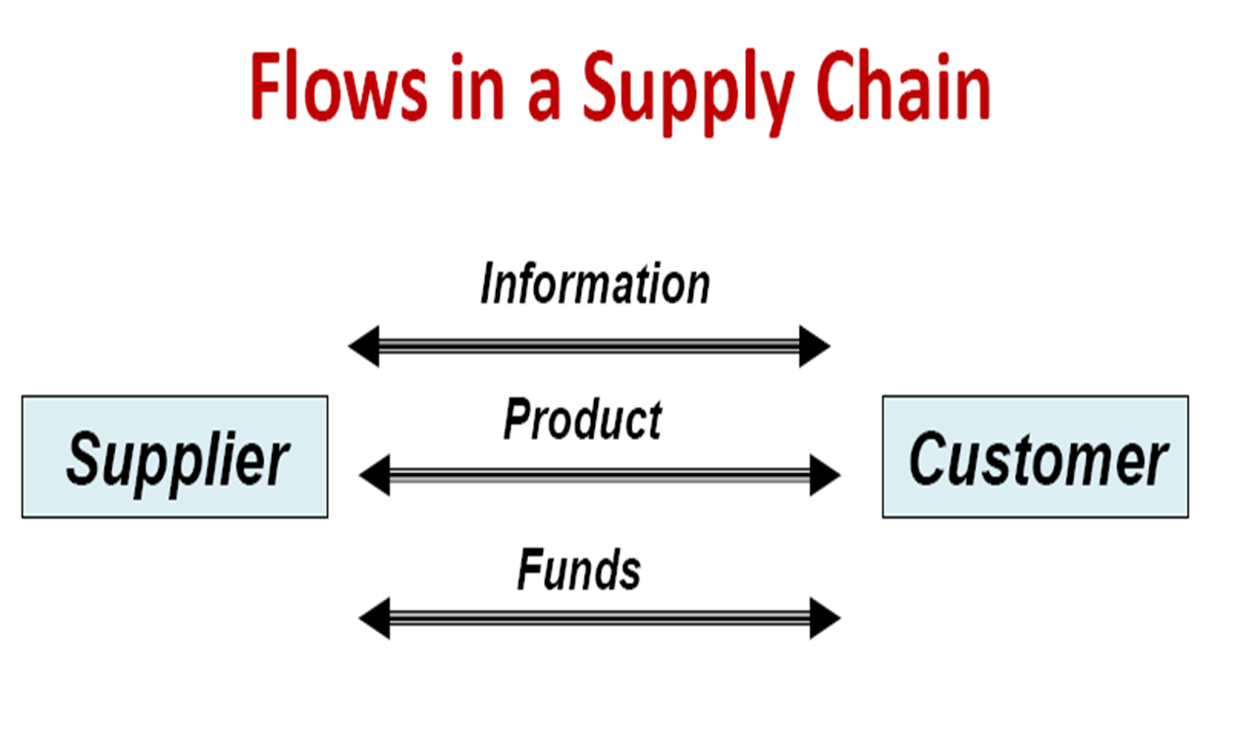
WHAT IS SUPPLY CHAIN MANAGEMENT ?
SUPPLY CHAIN MANAGEMENT IS NOTHING BUT MANAGING THE FLOW THROUGHOUT THE CHAIN.

Slide 10
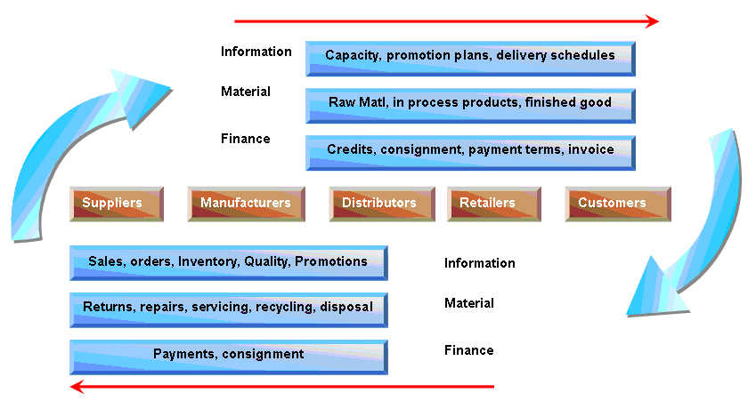
WHAT IS SUPPLY CHAIN MANAGEMENT ?

Slide 11
WHAT SCM DOES?
MANAGES THREE FLOWS
INVENTORY, INFORMATION AND CASH
MANAGES FOUR CYCLES
PROCUREMENT, MANUFACTURING, REPLENISHMENT AND ORDER FULFILLMENT
ALIGNS CAPABILITIES OF
SUPPLIERS AND SERVICE PROVIDERS

Slide 12
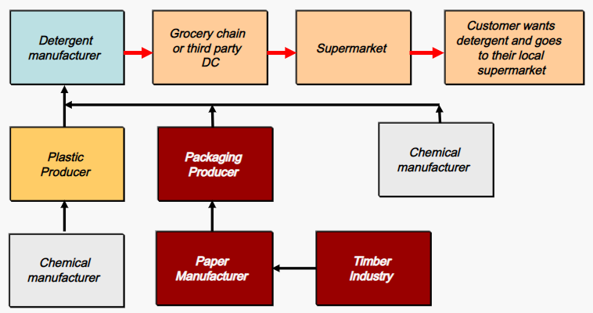
EXAMPLE
CUSTOMER WALKS…..WAL-MART TO PURCHASE…..SAY DETERGENT.
SC BEGINS WITH THE NEED FOR DETERGENT.
CUSTOMER VISITS WAL-MART.
WAL-MART….INVENTORY….SUPPLIED FROM……WAREHOUSE…..USING TRUCKS OF A THIRD PARTY.
THE DISTRIBUTOR…..STOCKED BY ….. MANUFACTURER (SAY P & G).
P & G MANUFACTURING PLANT RECEIVES RAW MATERIAL…..FROM A VARIETY OF SUPPLIERS…..WHO THEMSELVES ARE SUPPLIED BY LOWER TIER SUPPLIERS.

Slide 13
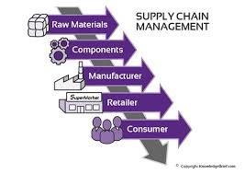
SUPPLY CHAIN

Slide 14
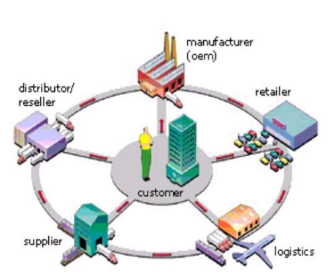
SUPPLY CHAIN
THE CUSTOMER IS AN INTEGRAL PART OF THE SUPPLY CHAIN. IN FACT THE PRIMARY PURPOSE OF ANY SUPPLY CHAIN IS TO SATISFY CUSTOMER NEEDS AND IN THE PROCESS GENERATE PROFIT FOR ITSELF.

Slide 15
SUPPLY CHAIN STAGES
A TYPICAL SUPPLY CHAIN MAY INVOLVE A VARIETY OF STAGES. THESE STAGES INCLUDE :
CUSTOMERS
RETAILERS
WHOLESALERS/DISTRIBUTORS
MANUFACTURERS
SUPPLIERS
EACH STAGE IN A SUPPLY CHAIN IS CONNECTED THROUGH THE FLOW OF PRODUCTS, INFORMATION AND FUNDS WHICH OFTEN OCCUR IN BOTH DIRECTIONS.

Slide 16
SUPPLY CHAIN PROCESS CYCLES
FOUR CLEARLY DEFINED PROCESS CYCLES IN SC FROM DOWNSTREAM TO UPSTREAM.
EACH PERFORMED AT THE INTERFACE BETWEEN TWO SUCCESSIVE STAGES OF THE SUPPLY CHAIN.

Slide 17
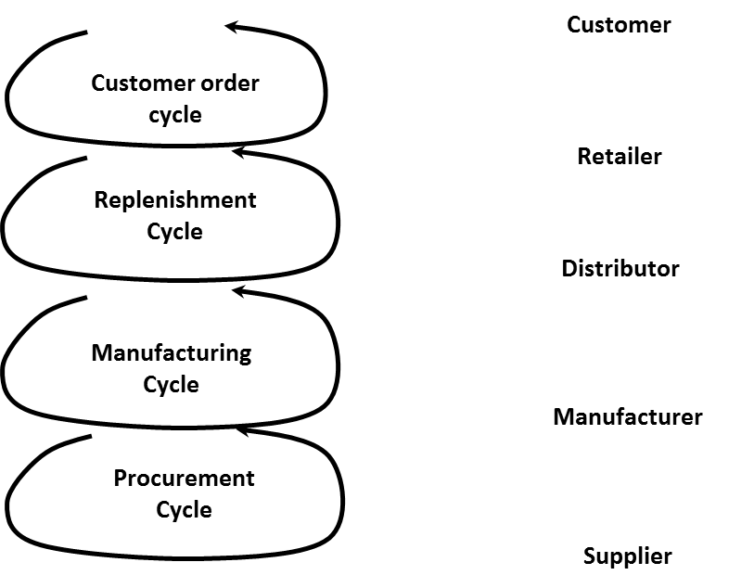
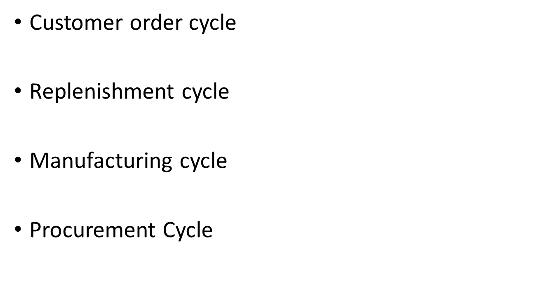
CYCLE VIEW OF A SUPPLY CHAIN
THE FIVE STAGES OF A SUPPLY CHAIN CAN BE BROKEN DOWN INTO FOUR PROCESS CYCLES.

Slide 18
CYCLE VIEW OF A SUPPLY CHAIN
EACH CYCLE OCCURS AT THE INTERFACE BETWEEN TWO SUCCESSIVE STAGES OF THE SUPPLY CHAIN
FOUR SUPPLY CHAIN PROCESS BETWEEN FIVE STAGES.
IT DEFINES PROCESSES INVOLVED AND OWNERS.
NOT EVERY SUPPLY CHAIN WILL HAVE ALL THE FOUR CYCLES CLEARLY SEPARATED.
DELL SELLS DIRECTLY TO CUSTOMERS, THUS BYPASSING THE RETAILER AND DISTRIBUTORS.

Slide 19
SUB-PROCESS IN EACH SUPPLY CHAIN PROCESS CYCLE
EACH CYCLE CONSISTS OF SIX SUB-PROCESSES
SUPPLIER STAGE MARKETS PRODUCTS
BUYER RETURNS REVERSE FLOWS TO SUPPLIER OR THIRD PARTY
BUYER STAGE PLACE ORDER
BUYER STAGE RECEIVES SUPPLY
SUPPLIER STAGE RECEIVES ORDER
SUPPLIER STAGE SUPPLIES ORDER

Slide 20
EXTENDED SUPPLY CHAIN
SUPPLY CHAIN OF A MANUFACTURING FIRM HAS 3 MAIN FUNCTIONS TO INTEGRATE AND MANAGE:
BUY
MAKE
DISTRIBUTE
IF SC IS FURTHER EXTENDED TO LOOK INTO
SUPPLIER’S SUPPLIERS AND
DOWNSTREAM TO CUSTOMER’S CUSTOMERS,
IT IS CALLED AN EXTENDED SC.
TOO COMPLEX TO CONTROL
BUT IF MANAGED PROPERLY, RESULTS IN BETTER CONTROL OF COST , DELIVERY AND END- PRODUCT QUALITY.

Slide 21
EXTENDED SUPPLY CHAIN...

Slide 22
SUPPLY CHAIN LINKAGES
BETWEEN PROCUREMENT AND MANUFACTURING
BETWEEN MANUFACTURING AND DISTRIBUTION

Slide 23
SUPPLY CHAIN LINKAGES
C0-Makership
JIT Manufacturing
Trade off of Inventory and Transportation cost
Asian Paints
Demand Mgmt
Not always dependent on forecast
Customer actual usage
Production schedule and inventory status
Promotion plan

Slide 24
SUPPLY CHAIN INTEGRATION
TODAY IS A COMPETITIVE WORLD
COMPANY CANNOT SURVIVE ON ITS OWN
CAN GROW WITH THE HELP OF SUPPLIERS AND THEIR CO-OPERATION
PROPER INFORMATION FLOW TO MANUFACTURER
UNCERTAINTY CAN BE HANDLED WITH ACCURATE MARKET FEEDBACK
DECISION MAKING NODES IN CHAIN TO JOIN HANDS TO
IMPROVE QUALITY
REDUCE COSTS
REDUCE LEAD TIMES
ENHANCE INFORMATION SHARING

Slide 25
Video: Color Ideas, by Asian Paints

Slide 26
OBJECTIVES OF SCM
IMPROVEMENT – COST AND QUALITY
SHORTENING PERFORMANCE CYCLE
SPEED TO MARKET
FLEXIBILITY – VOLUMES AND VARIETY
DEMAND MANAGEMENT

Slide 27
OBJECTIVES OF SCM
MAXIMISE OVERALL VALUE CREATED.
SUPPLY CHAIN VALUE : DIFFERENCE BETWEEN WHAT THE FINAL PRODUCT IS WORTH TO THE CUSTOMER AND THE EFFORTS THE SUPPLY CHAIN EXPANDS IN FILLING THE CUSTOMER'S REQUEST.
VALUE IS CORRELATED TO SUPPLY CHAIN PROFITABILITY. TO MAXIMISE THE SUPPLY CHAIN PROFITABILITY ( DIFFERENCE BETWEEN REVENUE GENERATED FROM THE CUSTOMER AND THE OVERALL COST ACROSS THE SUPPLY CHAIN.
TO REDUCE THE SUPPLY CHAIN COST TO MINIMUM.
SOURCES OF SUPPLY CHAIN REVENUE : CUSTOMER
SOURCES OF SUPPLY CHAIN COST: FLOWS OF INFORMATION,PRODUCTS OR FUNDS BETWEEN STAGES OF THE SUPPLY CHAIN.
SUPPLY CHAIN MANAGEMENT IS THE MANAGEMENT OF FLOWS BETWEEN AND AMONG SUPPLY CHAIN STAGES TO MAXIMIZE TOTAL SUPPLY CHAIN PROFITABILITY.

Slide 28
DECISIONS IN SCM
NETWORK
VENDORS
PRODUCTION
INVENTORY
DISTRIBUTION
INFORMATION

Slide 29
NETWORK
CHOICE OF SUPPLY POINTS NEAR DEMAND POINTS
PRODUCTION FACILITIES
STOCKING POINTS
SOURCING POINTS
LONG TERM PLANNING HORIZON
IMPACTS REVENUE, COST AND LEVEL OF SERVICE
HAVE IMPLICATIONS ON OPERATIONAL LEVEL ACTIVITIES

Slide 30
VENDOR
FIRMS NEED RELIABLE SUPPLIERS, CONFORMING TO DELIVERY SCHEDULES AND LEAD TIMES.
REDUCING SUPPLIER’S BASE ENHANCES CONTROL, RELIABILITY AND LOYALTY OF SUPPLIERS.
HELPS IN DEVELOPING LONG TERM RELATIONSHIP BASED UPON TRUST, MUTUAL DEPENDENCE AND SINCERITY
FIRMS CAN EMPLOY DISTRIBUTORS, WHO COLLECT RAW MATERIALS FROM VARIOUS SUPPLIERS AND DISPATCH IT TO MANUFACTURER
Suppliers
Consolidation Agent
Manufacturer

Slide 31
EXAMPLE
FOR MCDONALDS,
MUTTON COMES FROM HYDERABAD BASED AL-KABEER
LETTUCE IS FLOWN IN FROM PUNE AND OOTY
BUNS FROM CREMICA INDUSTRIES, LUDHIANA
CHEESE FROM DYNAMICA INDUSTRIES, BARAMATI (MAHARASTRA)
HUBS OF COLD CHAIN IS LOCATED IN NORTH AND WEST , MANAGED BY RADHAKRISHNA FOODLAND, WHO DISPATCHES SUPPLIES TO RESTAURANTS, PROCESSES INFORMATION AND COORDINATES THE WORK.

Slide 32
PRODUCTION
ABOUT PRODUCT MIX, LOCATION OF PLANT, SUPPLIER BASE TO THAT PLANT
DECISIONS ABOUT ALLOCATION OF PLANTS TO DCS AND DCS TO MARKET
CAPACITIES OF THE MANUFACTURING FACILITIES
DECISION IMPACTS REVENUES, COSTS, CUSTOMER SERVICE
FLEXIBLE MANUFACTURING SYSTEM
PRODUCTION PLANNING, EQUIPMENT MAINTENANCE
WORKLOAD BALANCING, QUALITY CONTROL

Slide 33
INVENTORY
R/M, SEMI-FINISHED, FINISHED GOODS
PURPOSE OF INVENTORY IS TO REDUCE THE LEVEL OF UNCERTAINTY IN SC.
PROPER INVENTORY CONTROL POLICY
ORDER QUANTITY, REORDER POINTS, SAFETY STOCK LEVEL

Slide 34
DISTRIBUTION
MODE OF TRANSPORT AND ROUTE
CONTROLLING THE COST AND SPEED TO THE MARKET
SELECTION OF TRANSPORTATION MIX
TRADE OFF OF COST OF TRANSPORTATION AND COST OF INVENTORY……AIR VS. SHIP

Slide 35
INFORMATION FLOW
MOST CRUCIAL ELEMENT
PROPER INTEGRATION THROUGHOUT THE CHAIN
USE OF INTERNET
ERP CAN BE ADOPTED TO CONNECT CUSTOMERS, SUPPLIERS AND ENTERPRISE

Slide 36
PERFORMANCE METRICS OF SCM
FOUR MEASURES OF SUPPLY CHAIN PERFORMANCE ARE:
DELIVERY
QUALITY
TIME
COST

Slide 37
CHALLENGES IN SCM
INCREASED SUPPLY CHAIN VOLATILITY AND UNCERTAINTY
CREATING GLOBAL CUSTOMER AND SUPPLIER NETWORK
CREATING OPTIMIZED SUPPLY CHAIN CONFIGURATION
RISK MANAGEMENT IN THE END-TO-END SUPPLY CHAIN
INTEGRATING AND EMPOWERING EXISTING SUPPLY CHAIN

Slide 38
MODERN APPROACHES TO SCM
JUST-IN TIME (JIT) INVENTORY MANAGEMENT
TOTAL QUALITY MANAGEMENT (TQM) MODEL
EFFICIENT CONSUMER RESPONSE (ECR)
Notes:
ECR- EDI Electronic Data Interchanged , MIS- Management Information System

Slide 39
THE IMPORTANCE OF SUPPLY CHAIN DECISIONS
CLOSE CONNECTION BETWEEN THE DESIGN AND MANAGEMENT OF SUPPLY CHAIN FLOWS (PRODUCT, INFORMATION AND FUNDS) AND THE SUCCESS OF A SUPPLY CHAIN.
WAL-MART, DELL COMPUTER ARE FEW EXAMPLES OF COMPANIES THAT HAVE BUILT THEIR SUCCESS ON SUPERIOR DESIGN, PLANNING AND OPERATION OF THE SUPPLY CHAIN.

Slide 40
WAL-MART
WAL-MART HAS INVESTED HEAVILY IN TRANSPORTATION AND INFORMATION INFRASTRUCTURE
CLUSTER OF STORES AROUND DISTRIBUTION CENTRES
FREQUENT REPLENISHMENT
LEADER IN SHARING INFORMATION AND COLLABORATING WITH SUPPLIERS

Slide 41
DELL
DELL BYPASSED DISTRIBUTORS AND RETAILERS
SELLS DIRECTLY TO CUSTOMERS.
CLOSE CONTACT WITH CUSTOMERS
IT STEER CUSTOMERS IN REAL TIME
CENTRALIZED MANUFACTURING AND INVENTORIES AT FEW LOCATIONS AND POSTPONEMENT TILL ORDER ARRIVES
IF INTEL INTRODUCED A NEW CHIP, LOW LEVEL OF INVENTORY ALLOW IT TO REACH MARKET FAST WITH A NEW PC
WITH SUDDEN DROP IN PRICE OF OLD STOCK, IT HAS LESS LOSS.

Slide 42
EFFICIENT AND RESPONSIVE SC
MANY COMPANIES HAVE MADE THEIR GLOBAL SC RUN EFFICIENTLY.
BUT THE TRUE TEST IN RUNNING A GLOBAL OPERATION ISN’T JUST EFFICIENCY—IT’S RESPONSIVENESS.
UNEXPECTED EVENTS, SUCH AS CHANGES IN CONSUMER DEMAND OR NATURAL DISASTERS, THREATEN TO UNDERMINE EVEN THE MOST EFFICIENT GLOBAL SUPPLY CHAIN OPERATIONS.
OPERATIONAL RESPONSIVENESS PROVIDES COMPANIES WITH THE FLEXIBILITY TO QUICKLY REACT TO THESE TYPES OF EVENTS AND REMAIN A STRONG PLAYER IN THE SUPPLY CHAIN GAME.)
THE DIFFERENCE BETWEEN AN EFFICIENT SUPPLY CHAIN AND A RESPONSIVE ONE COMES DOWN TO THE ABILITY TO MEET UNCERTAIN DEMAND.

Slide 43
EFFICIENT AND RESPONSIVE SC
THE DIFFERENCE BETWEEN AN EFFICIENT SUPPLY CHAIN AND A RESPONSIVE ONE COMES DOWN TO THE ABILITY TO MEET UNCERTAIN DEMAND.
AN EFFICIENT SUPPLY CHAIN CAN CORRAL ITS SUPPLIERS, MANUFACTURERS AND RETAILERS TO MANAGE ORDERS AND PROCESSING, AND MEET A STABLE, PREDICTABLE DEMAND AT A LOWER COST.
A RESPONSIVE SUPPLY CHAIN WORKS COLLABORATIVELY AMONG STAKEHOLDERS TO EXCHANGE INFORMATION IN A FEEDBACK LOOP IN ORDER TO PRODUCE ENOUGH OF A PRODUCT TO SATISFY UNCERTAIN DEMAND.

Slide 44
PUSH/PULL VIEW
THE PROCESSES IN A SUPPLY CHAIN ARE DIVIDED INTO TWO CATEGORIES DEPENDING ON WHETHER THEY ARE EXECUTED IN RESPONSE TO A CUSTOMER ORDER OR IN ANTICIPATION OF CUSTOMER ORDERS.
PULL PROCESSES ARE INITIATED ON CUSTOMER ORDER, WHEREAS PUSH PROCESSES ARE INITIATED AND PERFORMED IN ANTICIPATION OF CUSTOMER ORDERS.

Slide 45
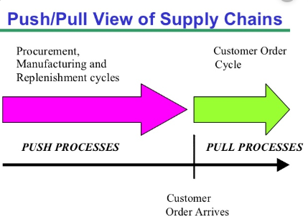
PUSH/PULL VIEW OF SUPPLY CHAINS

Slide 46
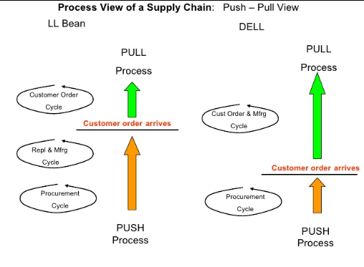
PUSH/PULL VIEW OF LL BEAN & DELL

Slide 47
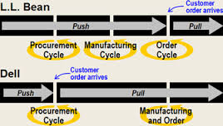
PUSH/PULL VIEW OF LL BEAN & DELL

Slide 48
SC INTEGRATION THROUGH MACRO LEVEL PROCESS
CUSTOMER RELATIONSHIP MANAGEMENT (CRM) PROCESSES THAT FOCUS ON DOWNSTREAM INTERACTIONS BETWEEN THE ENTERPRISE AND ITS CUSTOMERS.
INTERNAL SUPPLY CHAIN MANAGEMENT (ISCM) PROCESSES THAT FOCUS ON INTERNAL OPERATIONS WITHIN THE ENTERPRISE.
SUPPLIER RELATIONSHIP MANAGEMENT (SRM PROCESSES THAT FOCUS ON UPSTREAM INTERACTIONS BETWEEN THE ENTERPRISE AND ITS SUPPLIERS.

Slide 49
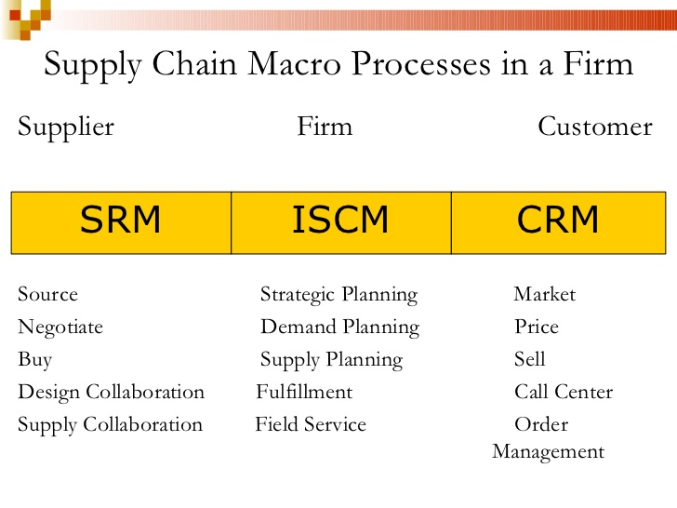
SC INTEGRATION THROUGH MACRO LEVEL PROCESS

Slide 50
BULLWHIP EFFECT
IT REFERS TO INCREASE IN VARIANCE IN THE DEMAND AS ONE MOVES UP IN THE SUPPLY CHAIN FROM RETAILERS TO WHOLESALERS TO MANUFACTURERS TO SUPPLIERS.
IT DISTORTS DEMAND INFORMATION WITHIN SC, WITH EACH STAGE HAVING A DIFFERENT ESTIMATE OF WHAT DEMAND LOOKS LIKE. THE RESULT IS A LOSS OF SUPPLY CHAIN COORDINATION.

Slide 51
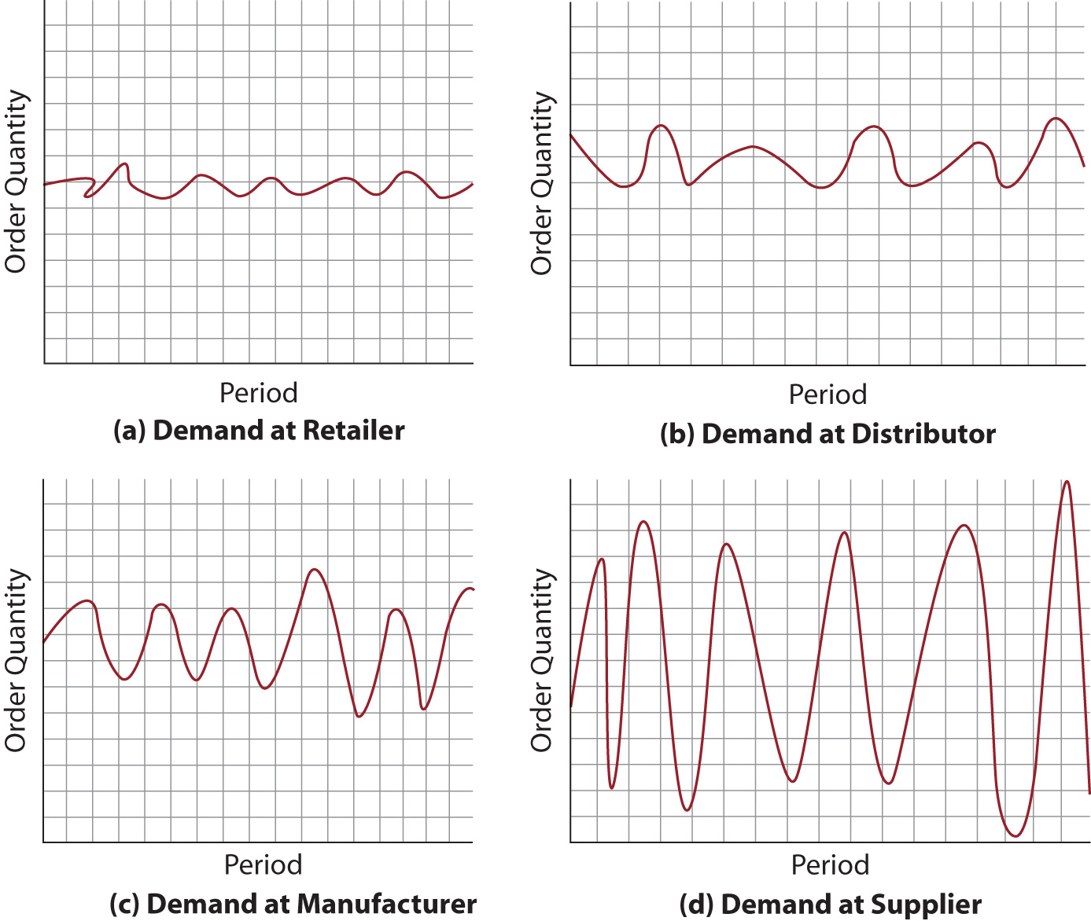
BULLWHIP EFFECT

Slide 52
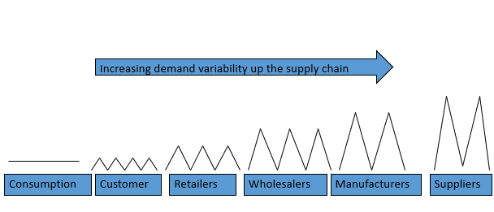
INFORMATION DISTORTION: THE BULLWHIP EFFECT

Slide 53
CAUSES FOR THE BULLWHIP EFFECT
FAULTY DEMAND FORECAST UPDATING
ORDER BATCHING
PRICE FLUCTUATIONS
SHORTAGE GAMING
LONG LEAD TIME

Slide 54
THE EFFECT OF LACK OF COORDINATION ON PERFORMANCE
Performance Measure | Impact
Manufacturing cost | Increases
Inventory cost | Increases
Replenishment lead time | Increases
Transportation cost | Increases
Labor cost for shipping and receiving | Increases
Level of product availability | Decreases
Relationships across the supply chain | Worsens
Profitability | Decreases
The bullwhip effect reduces supply chain profitability by making it more expensive to provide a given level of product availability.

Slide 55
INITIATIVES TO CONTROL BULLWHIP EFFECT
INFORMATION SHARING (POS DATA)
CHANNEL ALIGNMENT
DISCOURAGEMENT OF PROMOTIONAL PRICING
DISCOURAGEMENT OF SHORTAGE GAMING

Slide 56
THANK YOU.

