Slide 1
Material Handling Systems: For Exploiting Productivity Potential in Logistics

Slide 2
Learning Objectives
To understand role of material handling in logistics.
To understand types of material handling systems and their features.
To understand selection criteria for material handling systems and equipments.

Slide 3
Material Handling Stages
Unloading the incoming material from transport vehicle.
Moving the unloaded material to assigned storage place in the warehouse.
Lifting the material from storage place during order picking.
Moving material for inspection and packing.
Loading the boxes/cartons on the transport vehicle.

Slide 4
Material Handling Principles
Standard equipment should be preferred to keep low capital investments.
Design the system for continuous flow of material, so that idle time should be zero.
Portable or movable equipments to be preferred.
Ratio of dead-weight to pay-load should be minimum for handling equipment, and not wasting unnecessary capacity of equipment.
Gravity flow should be incorporated in the system design.
Notes:
Dead weight- the weight of the machine should not be too heavy or bilky ,reduce weight n save money.

Slide 5
Material Handling Systems
Manual
Mechanized system
Semi-automatic
Automatic
Information guides

Slide 6
Selection Criteria: Material Handling Systems
Volumes to be handled
Speed in handling
Productivity
Product characteristics—weight, size and shape
Nature of the product—hazardous, perishable and crushable

Slide 7
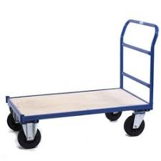
Mechanised Material Handling
Manual trolley
Versatile (Flexible)
For smaller loads
For short distance

Slide 8
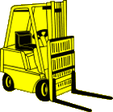
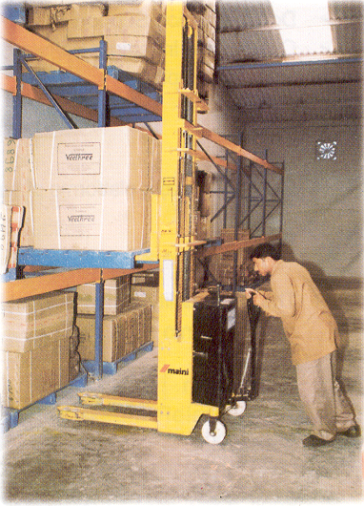
Mechanised Material Handling
Forklift
Manual or mechanized
Portable
Large distance travel
Medium and large loads handling
Vertical movement
Intermittent duty

Slide 9
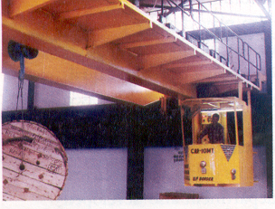
Mechanised Material Handling
Overhead crane
Carry heavy loads
Continuous duty
Size, shape no bar

Slide 10
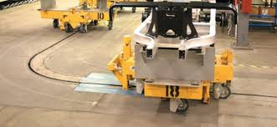
Towlines
For continuous movement of material
Towlines consists of number of trailers
Custom designed for product volume application
Notes:
Video on tow lines

Slide 11
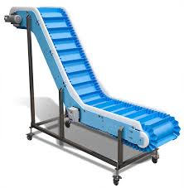
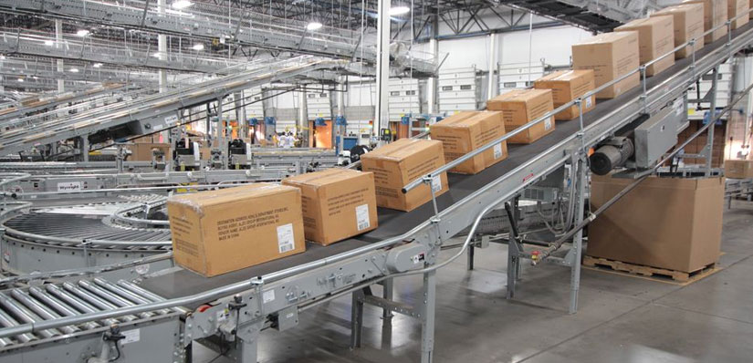
Mechanised Material Handling
Conveyors
Wheel Conveyors
Roller Conveyors
Belt Conveyors
Chain Conveyors

Slide 12
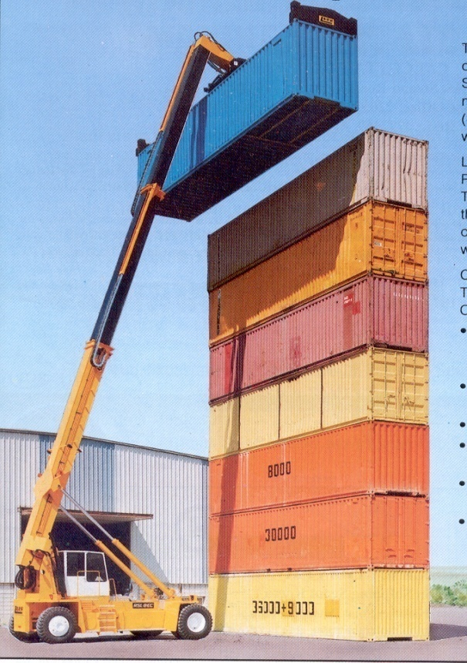
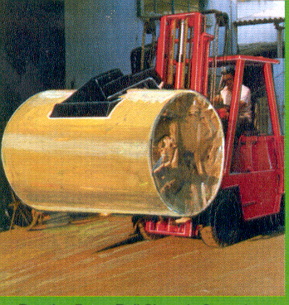
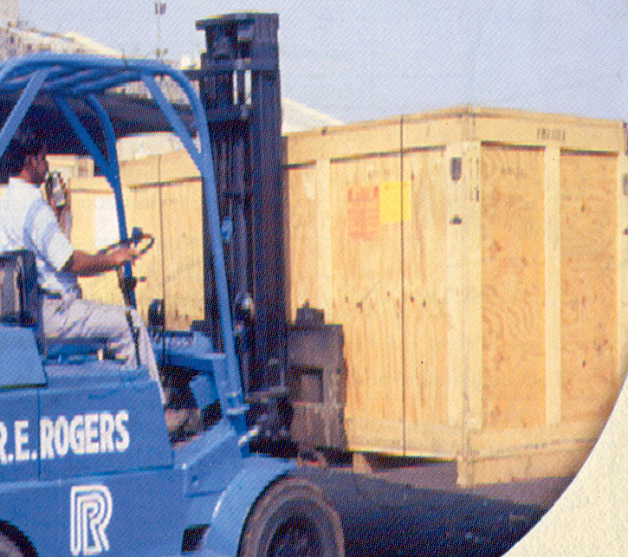
Material Handling
Material handling at sea ports

Slide 13
Advanced Material Handling Systems
Pneumatic tube system
  For handling material in powdered form
Semi-automatic system
  Sorting devices
  Robotics
Automatic guided vehicle system
  Material handling on a fixed path
  Computer operated guided vehicle
  Speed of operation 150-250 feet per minute
Automatic system
  Human factor eliminated
  Operator required for programming and controls
  Productivity
Notes:
2 videos AMHSA and tow lines

