Slide 1
Material Storage
Systems: For Space Efficiency and Storage Density

Slide 2
Learning Objectives
To understand material storage principles
To understand ‘unit Load’ storage
To understand material storage method
To understand design of storage system

Slide 3
Storage Principles
High storage density
Minimum travel distance
Maximise the utilization of available space
Ease in material movement
Ease in material storage and retrieval
Easy tracking of the material
Prevent contamination and deterioration of the goods
Provide security against fire, damage and theft
Human safety

Slide 4
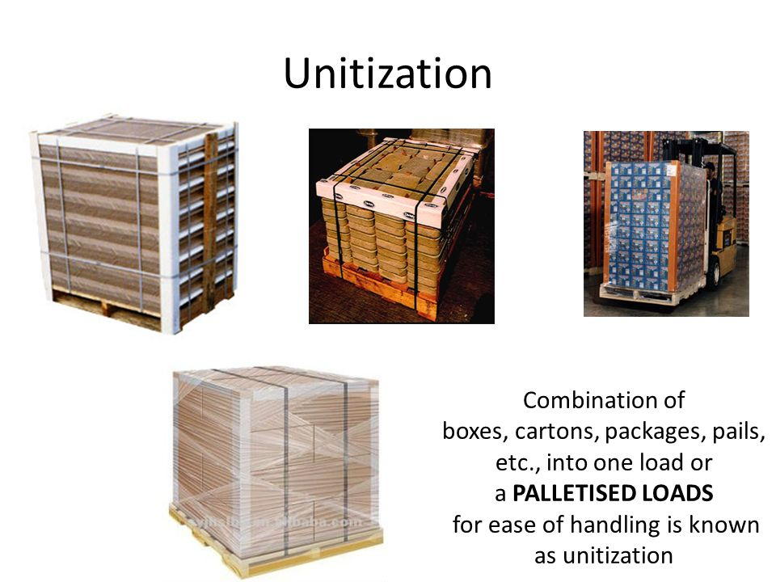
Unit Load Storage / Load Unitization
The unit load is constructed by bringing together large number of individual items of identical configuration, so as to make a large load, which ensures convenience during storage, handling and transportation.

Slide 5
Criteria for selecting the storage system
Product Characteristics
Configuration
Shelf Life
Product Variety

Slide 6
Benefits of Scientific Storage
Ensures space economy
Enhances warehouse throughput
Ease in material location and tracing
Ensures security, safety and housekeeping

Slide 7
Storage Methods
Block storage
Racking System
Shelves
Pallets
Containers
Bulk Storage - Silos
Automated Storage and Retrieval

Slide 8
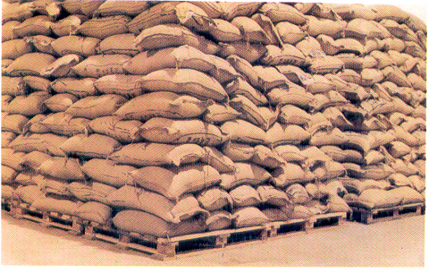
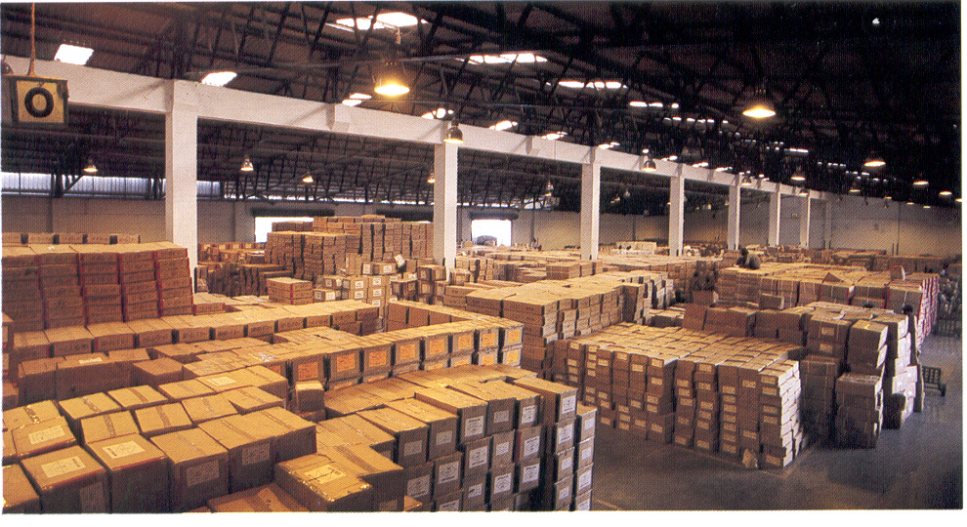
Storage Methods
Block storage

Slide 9
Block Storage
Advantages
Simplest system
No investment
Stacking on platform or floor
Wide variety of products can be stored
Disadvantages
Limitation on stack height
Loading/unloading problem

Slide 10
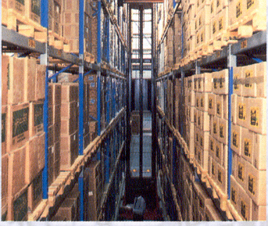
Storage Methods
Rack storage

Slide 11
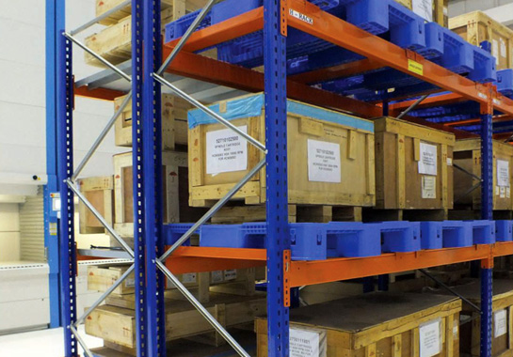
Pallet Storage

Slide 12
Pallet Storage
Advantages
Helps in optimum utilization of storage space.
Increases stability of products during transportation.
Lower handling cost due to unitizing.
Increases speed of material flow.
Reduces frequency of material handling.
Facilitates handling loads with machines.
Disadvantages
Does not give complete protection to product from environmental effects.

Slide 13
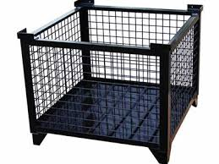
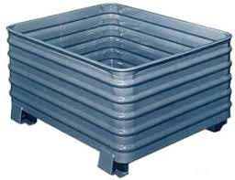
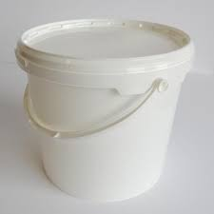
Containers
Welded Wire Containers
Corrugated Metal Containers
Plastic Containers

Slide 14
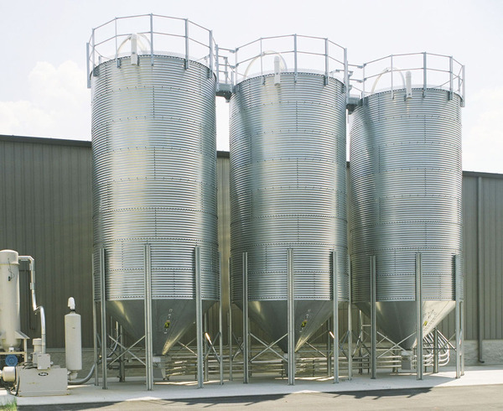
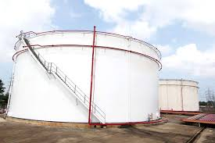
Bulk Storage - Silos

Slide 15
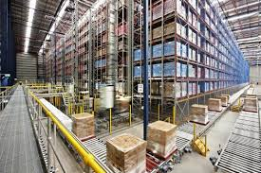
Automated Storage and Retrieval
** Video: (1) Automated storage and retrieval machine for pallets

