Slide 1
Packaging

Slide 2
What is Packaging?
Packaging is the science, art, and technology of enclosing or protecting products for distribution, storage, sale, and use.
Packaging also refers to the process of design, evaluation, and production of packages.

Slide 3
Packaging
➢What is Packaging?
    A function of logistical management
Where is it performed?
    A facility – a factory, warehouse
When is it done?
    Begins immediately on production
Why is it done?
    For product protection
    For facilitation of easy handling & movement
    For customer service

Slide 4
How is it done?
By using packaging material, equipment, human resource
Types of packaging
    Consumer packaging
    Industrial packaging

Slide 5
Consumer packaging
Attracts attention
Influences purchasing decisions of consumer
Enables the consumer to use the product more effectively, efficiently & safe

Slide 6
✓Industrial packaging
  Makes logistical activities of handling, storage & moving easy
  Reduces lead-time
  Enhances safety
  Improves product protection
  Reduces costs of movement

Slide 7
Sales functions of packaging
 Display - attraction, easy identification,
Communication - recipe, hazard, special care

Slide 8
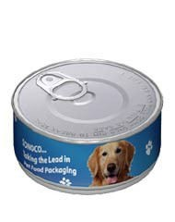
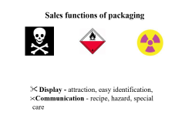
Ease of opening: easy open cans

Slide 9
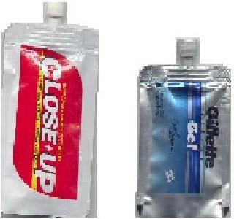
Convenience - flexi tubes, sprays

Slide 10
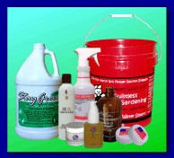
Dispensing - spouts, taps, sprays, tubes

Slide 11
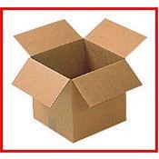
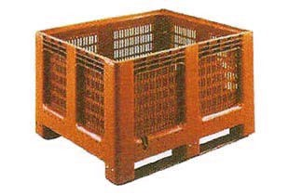
Logistical functions of packaging
1. Facilitating storage & reuse - corrugated boxes & bins of plastic, metal or wood

Slide 12
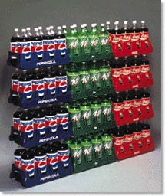
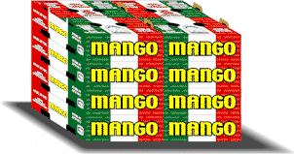
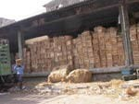
2. Grouping goods into convenient unit for distribution - mango boxes, cola bottles, cotton bales, wire rope coils

Slide 13
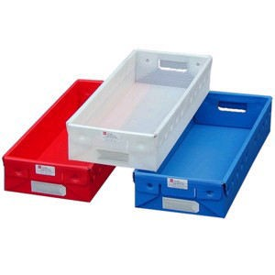

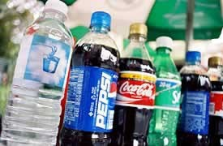
3. Weight minimization - plastic bottles, plastic crates, milk-bags

Slide 14
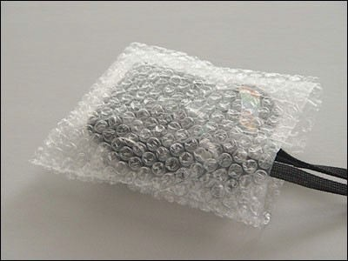
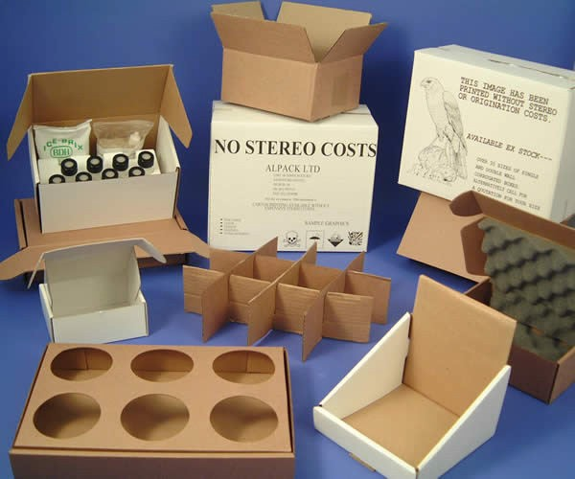
4. Protection - physical damage, bubble pack, corrugated sheet cartons, mangoes in crates

Slide 15
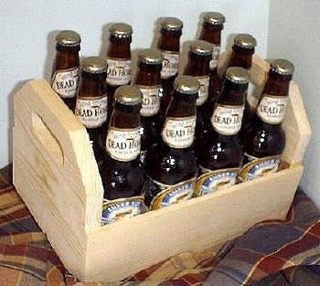
5. Cube minimization - flattened cans, square shaped bottles, soft drink concentrates, furniture in
knocked down condition, buckets or containers one inside the other, plastic chairs

Slide 16

6. Pilfer proofing - bisleri caps, cola caps

Slide 17
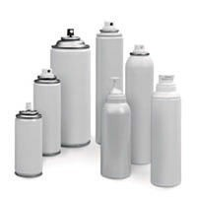


7. Facilitating handling & using – same package can be used for both activities: fruity packs, flexible tubes, aerosol
packs

Slide 18
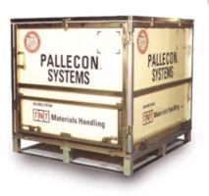
8
8. Handling – makes handling easy: pallets, straps

Slide 19
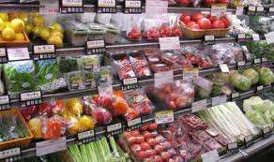
PURPOSE
Physical protection
Barrier protection
Marketing
Containment or Agglomeration
Security
Portion control
Convenience
Information transmission

Slide 20
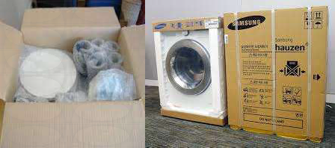
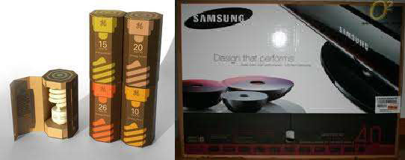
Physical protection

Slide 21
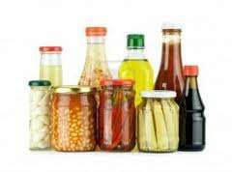

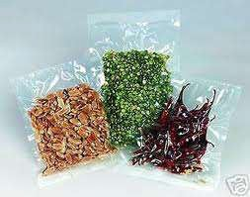
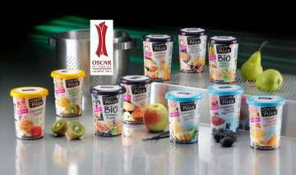
Barrier protection

Slide 22
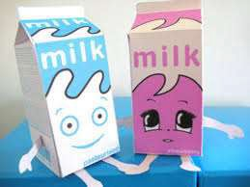
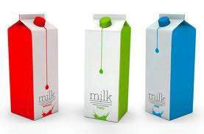
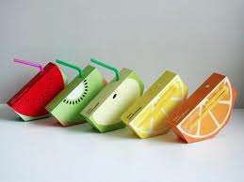

Marketing

Slide 23

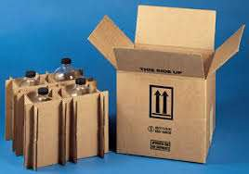
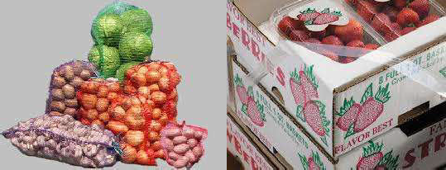
Containment
or Agglomeration

Slide 24



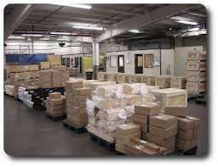

Slide 25
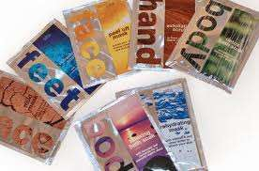
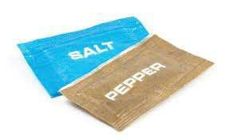
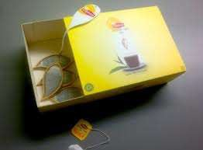
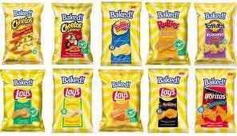
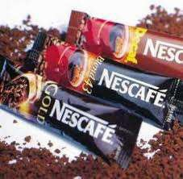
Portion control

Slide 26
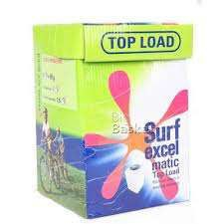
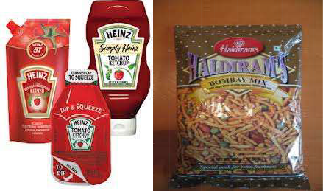
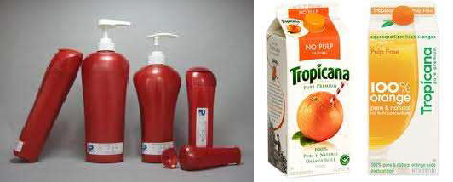
Convenience

Slide 27
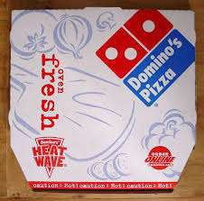
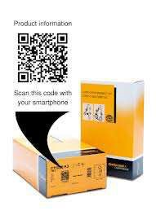




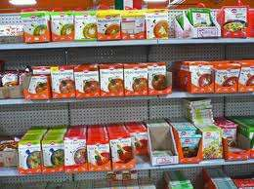
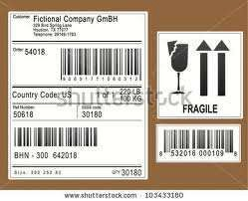

Slide 28
* Returnable Logistical Packaging
New trend in Logistical Packaging
Can be used where suppliers are located in proximity
Many industries have switched from using disposable packaging to reusable plastic storage boxes and metal packaging
Environmental responsibilities

Slide 29
* Packaging Cost
Cost of Package
Storage cost of empty package
Handling cost of empty package
Packaging operation cost (cleaning, filling, sealing, labelling, unitizing, strapping, etc.)
Package damage cost (if any)

Slide 31
**Video :
(1) Package Design Makes a Difference
(2) ROPACK- Your Trusted Packaging Partner — 2014

