Slide 1
Working Capital Estimation

Slide 2
Working Capital :- Meaning
Working capital typically means the firm’s holding of current or short-term assets such as cash, receivables, inventory and marketable securities.
These items are also referred to as circulating capital
Corporate executives devote a considerable amount of attention to the management of working capital.

Slide 3
Working capital management
Working capital management is concerned with the problems that arise in attempting to manage the current assets, the current liabilities and the interrelations that exist between them.

Slide 4
Current assets
Current assets refer to those assets which in the ordinary course of business can be, or will be, converted into cash within one year without undergoing a diminution in value and without disrupting the operations of the firm.
Examples- cash, marketable securities, accounts receivable and inventory.

Slide 5
Current liabilities
Current liabilities are those liabilities which are intended, at their inception, to be paid in the ordinary course of business, within a year, out of the current assets or the earnings of the concern.
Examples- accounts payable, bills payable, bank overdraft and outstanding expenses.

Slide 6
Definition of Working capital
Working Capital refers to that part of the firm’s capital, which is required for financing short-term or current assets such a cash marketable securities, debtors and inventories.
Funds thus, invested in current assets keep revolving fast and are constantly converted into cash and this cash flow out again in exchange for other current assets.
Working Capital is also known as revolving or circulating capital or short-term capital

Slide 7
Concepts of Working Capital
There are two possible interpretations of working capital concept:
Balance sheet concept
Operating cycle concept

Slide 8
Balance sheet concept
There are two interpretations of working capital under the balance sheet concept.
Excess of current assets over current liabilities
gross or total current asset

Slide 9
Concepts of Working Capital
1. Gross working capital (GWC)
GWC refers to the firm’s total investment in current assets.
Current assets are the assets which can be converted into cash within an accounting year (or operating cycle) and include cash, short-term securities, debtors, (accounts receivable or book debts) bills receivable and stock (inventory).
9

Slide 10
Concepts of Working Capital
Net working capital (NWC)
NWC refers to the difference between current assets and current liabilities.
Current liabilities (CL) are those claims of outsiders which are expected to mature for payment within an accounting year and include creditors (accounts payable), bills payable, and outstanding expenses.
NWC can be positive or negative.
  Positive NWC = CA > CL
  Negative NWC = CA < CL
10

Slide 11
Concepts of Working Capital
GWC focuses on
  Optimisation of investment in current
  Financing of current assets
NWC focuses on
  Liquidity position of the firm
  Judicious mix of short-term and long-tern financing
11

Slide 12
Operating Cycle
Operating cycle is the time duration required to convert sales, after the conversion of resources into inventories, into cash. The operating cycle of a manufacturing company involves three phases:
Acquisition of resources such as raw material, labour, power and fuel etc.
Manufacture of the product which includes conversion of raw material into work-in-progress into finished goods.
Sale of the product either for cash or on credit. Credit sales create account
receivable for collection.
12

Slide 13
Definition
According to Genstenberg;
“Circulating capital means current assets of a company that are changed in the ordinary course of business from one form to another, as fore example, from cash to inventories, inventories to receivables , receivables into cash”

Slide 14
Working Capital Cycle.
debtors
cash
Finished
Raw materials
Work in progress

Slide 15

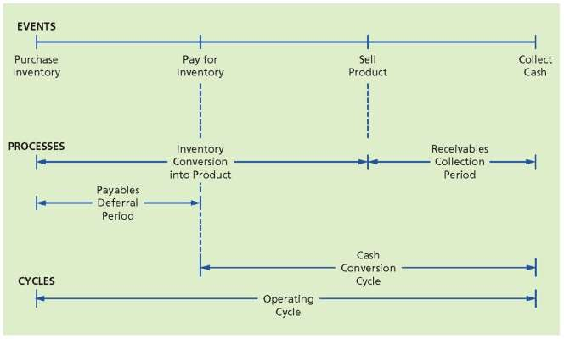

Slide 16
RMCP – Raw material Conversion Period
WIPCP – Work in progress conversion period
FGCP – Finished goods conversion period
RCP – Receivables Conversion period

Slide 17
Operating Cycles
Gross Operating Cycle = RMCP + WICP + FGCP +RCP
Net Working Capital = Gross Working Capital –Payable deferral period

Slide 18




















Classification or Kinds of Working Capital
Kinds of Working Capital
On the basis of Concept
On the basis of Time
Gross Working Capital
Net Working
Capital
Permanent /
Fixed WC
Temporary /
Variable WC
Regular WC
Reserve WC
Seasonal WC
Special W C

Slide 19
Permanent And Variable Working Capital
Permanent or fixed working capital
A minimum level of current assets, which is continuously required by a firm to carry on its business operations, is referred to as permanent or fixed working capital.
Fluctuating or variable working capital
The extra working capital needed to support the changing production and sales activities of the firm is referred to as fluctuating or variable working capital.
19

Slide 20
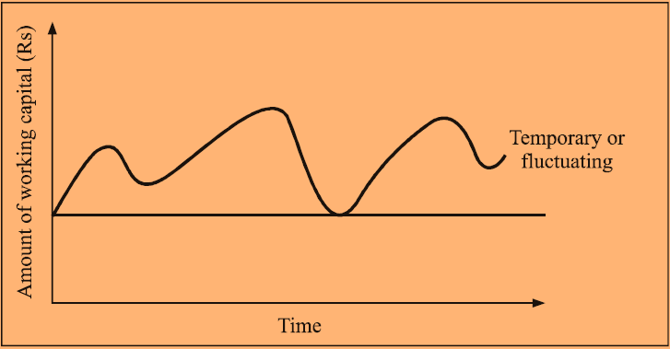
Permanent and temporary working capital
20

Slide 21
Importance or advantages of adequate working capital
Solvency of business
Goodwill
Easy loans
Cash discounts
Regular supply of rawmaterials
Regular payment of salaries, wages and other day to day expense
Exploitation of favourable market condition
Ability face crisis
Quick and regular return on investment

Slide 22
Dis-advantages of redundant or excessive WC
Idle funds – earns no profit
Leads to unnecessary purchase
Implies Excessive debtors and defective credit policy
Leads to overall inefficiency of the firm
Bad relationship with bank and financial inst.
Due to low return , share price may fall
Paves way for speculative transactions

Slide 23
Dis advantages of Inadequate WC
Cannot pay short term obligations in time
Loose of goodwill
Cannot avail discounts and other benefits (Economies of scale)
Difficult for the firm to exploit favorable market condition
Rate of return on investment fall with the shortage of working capital
Difficult to pay day to day expenses of operations

Slide 24
Determinants of Working Capital
Nature or Character of business
Size of the business and scale of operation
Production policy
Length of production cycle
Seasonal variation
Working capital cycle
Rate of stock turnover
Credit policy
Business cycles
Rate of growth of business
Price level changes
24

Slide 25


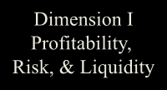




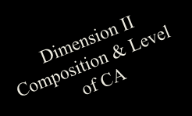
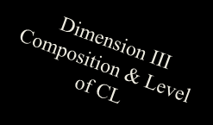
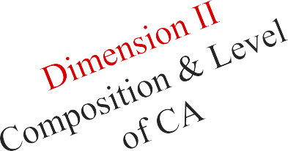
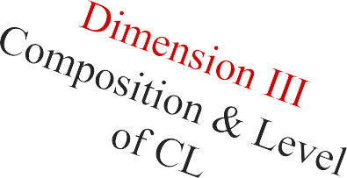
Nature of Working Capital Management
Dimension I Profitability, Risk, & Liquidity

Slide 26
Working Capital Financing Mix
Approaches to Financing
Mix
The Hedging or Matching Approach
The Conservative Approach
The Aggressive Approach

Slide 27
The Hedging approach
Hedging approach refers to a process of matching maturities of debt with the maturities of financial need . In this approach maturity of source of fund should match the nature of asset to be financed
This approach is also known as matching approach.
The hedging approach suggests that the permanent working capital requirement should be financed with fund from long term sources while the temporary working capital requirement should be financed with short term funds.

Slide 28
Hedging approach to asset financing
Total Assets
Short-term
Debt
Fluctuating Current Assets
Long-term Debt + Equity Capital
Permanent Current Assets
Fixed Assets
Time

Slide 29
Conservative Approach
This approach suggested that the entire estimated investments in current asset should be finance from long term source and short term should be use only for emergency requirement

Slide 30
Conservative approach to asset financing
Total Assets
Short-term
Debt
Fluctuating Current Assets
Long-term Debt + Equity capital
Permanent Current Assets
Fixed Assets
Time

Slide 31
Aggressive approach
The aggressive approach suggests that the entire estimated requirement of current asset should be financed from short-term sources and even a part of fixed asset investment be financed from short - term sources
This approach make the finance mix :
More Risky
Less costly
More Profitable

Slide 32
Aggressive approach to asset financing
Total Assets
Short-term
Debt
Fluctuating Current Assets
Long-term Debt + Equity capital
Permanent Current Assets
Fixed Assets
Time

Slide 33


