Slide 1
Primary and Secondary Banking Services
Dr.Rajashree Yalgi

Slide 2
Primary Services:
Primary Services
Accepting Deposits
Current Deposit
Saving Deposit
Advancing Loans
Cash Credit
Term Deposit
Demand Loans

Slide 3
Secondary Services:
Secondary Services
Overdraft Facility
Discounting BoE
Agency Functions
General Utility Functions

Slide 4
1. Overdraft Facility
It refers to a facility in which a customer is allowed to overdraw his current account upto an agreed limit. This facility is generally given to respectable and reliable customers for a short period. Customers have to pay interest to the bank on the amount overdrawn by them.
A credit agreement made with a financial institution that permits an account holder to use or withdraw more than they have in their account, without exceeding a specified maximum negative balance. Establishing an overdraft facility with a bank can help an individual or small business with short term cash flow problems, although the negative balance typically needs to be repaid within a month.
Notes:
What is the difference between Overdraft and Cash Credit?

Slide 5
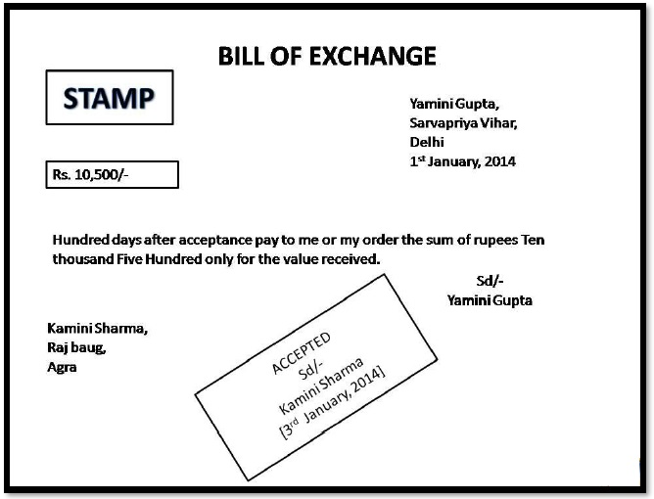
2. Discounting of Bill of Exchange
It refers to a facility in which holder of a bill of exchange can get the bill discounted with bank before the maturity. After deducting the commission, bank pays the balance to the holder. On maturity, bank gets its payment from the party which had accepted the bill.

Slide 6



3.Agency Services:
1.
2
3
Transfer of Funds
Collection and Payment of Various Items
Carrying out Currency Exchanges

Slide 7



Agency Services Contd…
4.
5.
6.
Purchase and Sale of Securities
Income Tax Consultancy
Trustees and Executor

Slide 8
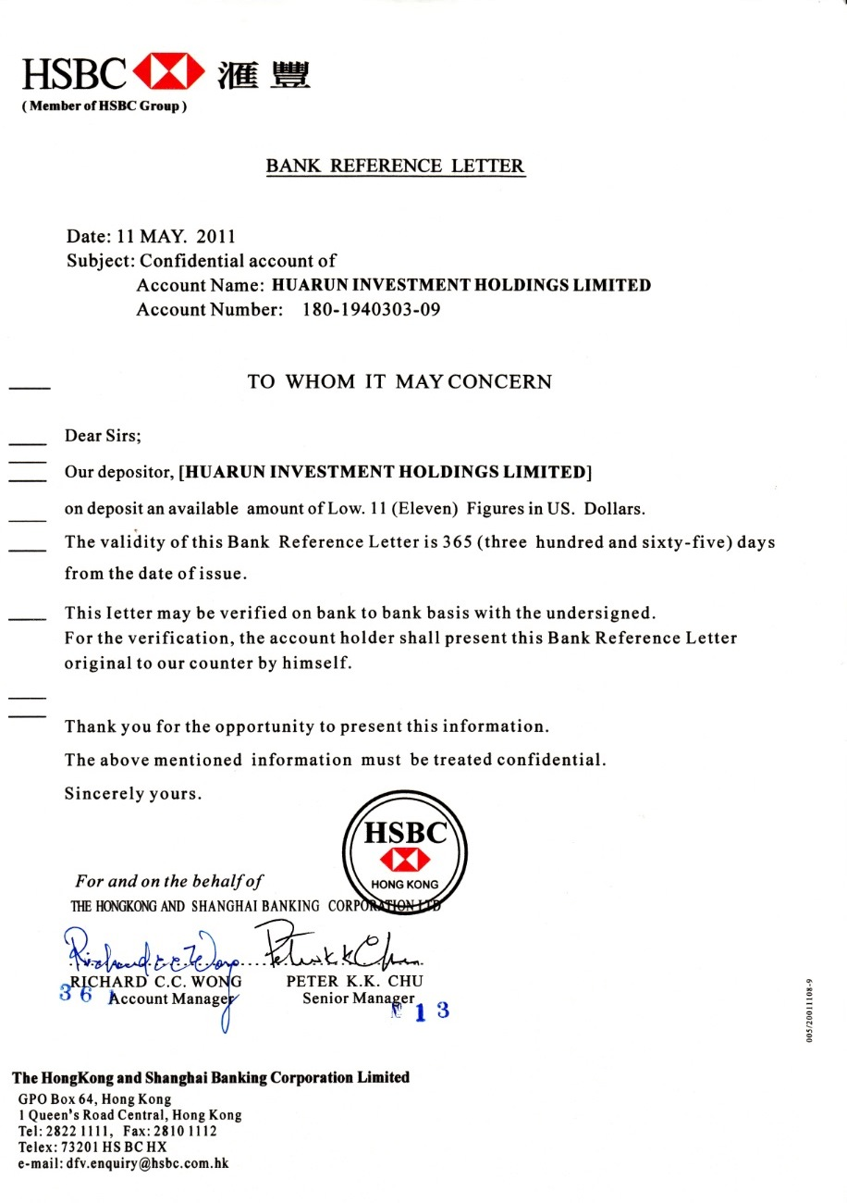
Agency Services Contd…
7.
Letter of Reference

Slide 9
4. General Utility Services:
Locker Facility - Commercial banks provide facility of safety vaults or lockers to keep valuable articles of customers in safe custody.
Travelers' Cheque - Commercial banks issue traveler’s cheques to their customers to avoid risk of taking cash during their journey.
Letter of Credit - They also issue letters of credit to their customers to certify the creditworthiness of customers.
Underwriting Securities - Commercial banks also undertake the task of underwriting securities. As public has full faith in the creditworthiness of banks, public do not hesitate in buying the securities underwritten by banks. It is the process by which investment banks raise investment capital from investors on behalf of corporations and governments that are issuing securities (both equity and debt capital). The services of an underwriter are typically used during a public offering in a primary market.

Slide 10
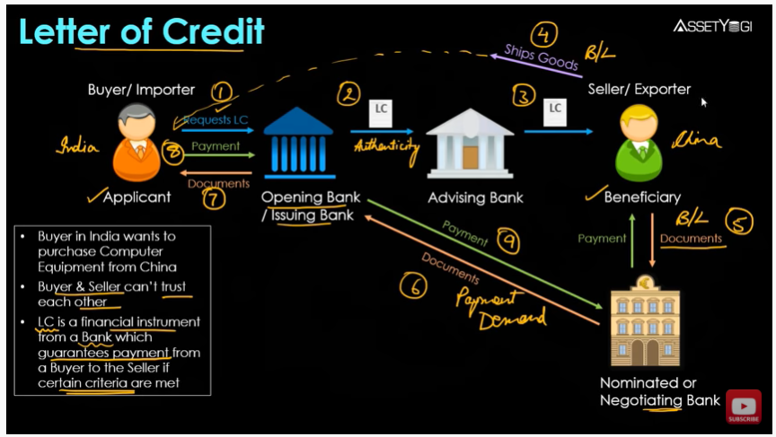

Slide 11
4. General Utility Services:
5. Locker Facility - Commercial banks provide facility of safety vaults or lockers to keep valuable.
Collection of Statistics - Banks collect and publish statistics relating to trade, commerce and industry. Hence, they advice customers on financial matters. Commercial banks receive deposits from the public and use these deposits to give loans. However, loans offered are many times more than the deposits received by banks. This function of banks is known as ‘Money Creation’.

Slide 12
Calculation of maturity amount….
A 2 years fixed deposit of Rs.50,000 with Bank RBL carries contracted interest rate of 10.5 percent.
What should be the interest amount if payments are made on a quarterly, half yearly and annual basis?
What would be the effective interest rate if the interest is withdrawn every month and transferred to the savings bank account? Assume a re-investment rate at 0.04.

Slide 13
Calculation of Maturity amount…
Bank B offers following interest rates on term deposits – 8.5% for one year, 10% for two years and 12 % for 3 years. What will be the maturity amount for investment of Rs.1,00,000 for a period of 2 years, if depositor does not want periodic interest to be paid out during the period and the bank reinvests the amount quarterly?

Slide 14
Calculation of maturity amount
A depositor requires Rs.1 lakh after 1 year. If the current interest rate is 12 percent per annum, what should be the issue price of the cash certificate that would give the investor the required amount in year’s time?

