Slide 1
Securities for Bank Advances
Dr.Rajashree Yalgi

Slide 2
Some Important exposure norms
Central Banks try to limit credit risk concentration in their banking system by limiting exposure to certain sectors or activities.
Exposure is defined as including credit exposure (funded and non funded credit limits) and investment exposure is taken to be the higher of sanctioned limits or outstanding advances. In the case of term loans that have been fully drawn up to the sanctioned limit, the outstanding will be considered the ‘exposure’.
Computing the credit exposure of derivative products(most of these would be denoted as ‘contingent liabilities’ on bank’s balance sheets) such as interest rate and foreign exchange derivative transactions and gold will be done using the ‘ Current Exposure Method’.

Slide 3
Some Important exposure norms
Current credit exposure is the sum of positive MTM values of the contracts. It is therefore obvious that these values require periodical recalculation.
Potential future credit exposure is determined by multiplying the notional principle amount of each of these contracts by the relevant add-on factor indicated in the quoted circular according to the nature and residual maturity of the instrument.

Slide 4

Credit Exposure comprises of the following:
All types of funded and non funded credit limits.
Facilities extended by way of equipment leasing, hire purchase finance and factoring services.

Slide 5

NPAs – Non Performing Assets
In the balance of bank , financial assets comprise more than 95 % of total assets of the bank. These assets primarily include loans, advances, bill discounted, and investments, cash balance with RBI and at its own investments etc.
Loans and advances form nearly 60 % of the total assets and investments nearly 28 to 30 % of total assets. Therefore, management of assets and investments assumes more significance.
The RBI has issued detailed guidelines for effective management of these assets.

Slide 6
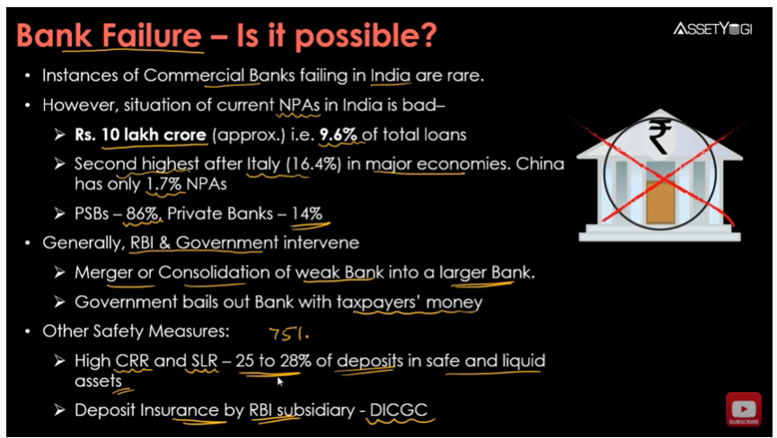

Slide 7
NPA Classification
Loss Assets
Doubtful Assets
Substandard Assets

Slide 8
Standard Assets
Standard Asset is one which does not disclose any problems and which does not carry more than normal risk attached to the business. The operation in the loan account in terms of timely repayment of principal and installment, availability of security, no adverse features in the operations of the account, etc. are satisfactory.

Slide 9
2. Sub-Standard Assets
When repayment of principal or interest or both remains overdue for more than 90 days, such assets are classified as sub standard assets. It remains in this category for a period less than or equal to 12 months.
In such cases, the current net worth of the borrower /guarantor or the current market value of the security charged is not enough to ensure recovery of the dues to the bank in full.
Such asset may cause loss to bank in future.

Slide 10

3. Doubtful Assets
If asset has remained in the sub-standard category for a period of 12 months.
Has all the weaknesses inherent in assets that were classified as substandard.
The liquidation of liability an account of inherent weaknesses is also doubtful.
Bank can take all steps including legal remedy to recover its dues as long as asset remains in this category.
This Photo by Unknown Author is licensed under CC BY-NC-ND

Slide 11


Loss Assets

Slide 12
Loss Assets
A loss asset is one where loss has been identified by the bank or internal or external auditors or under the RBI inspection but the amount has not been written off fully. In this case, if feasible to carry the asset as there are no / remote chances of recovery, and, therefore, the loan could be wiped off. Since the loan liability is written off in full, it is called loss asset.

Slide 13
Guidelines for Classification of Assets:
Classification of assets into above categories should be done taking into account the degree of well defined credit weaknesses and extent of dependence on collateral security for realization of dues.
The bank may fix a minimum cut off points to decide what would constitute a high value account depending upon their respective business levels. The cut off point should be valid for the entire accounting year.
The availability of security or net worth of borrower/ guarantor should not be taken into account for the purpose of treating an advance as NPA.

Slide 14
Guidelines contd…
4. A working capital borrowal account will become NPA if such irregular drawings are permitted in the account for a continuous period of 90 days even though the unit may be working or the borrower’s financial position is satisfactory.
5. If arrears of interest and principal are paid by the borrower in the case of loan accounts classified as NPAs, the account should no longer be treated as non performing and may be classified as ‘standard’ accounts.

Slide 15
Provision norms for NPAs -
Loss Assets – Loss Assets should be written off. If loss assets are permitted to remain in the books for any reason, 100 percent of the outstanding liability should be provided for.
Doubtful Assets – 100 percent of the extent to which the advance is not covered by the realizable value is estimated on a realistic basis.
Period for which the advance has remained in ‘doubtful’ category | Provision Requirement (%)
Up to one year | 25
One to three years | 40
More than three years | 100
Note – Valuation of security for provisioning purposes.

Slide 16
C) Sub-standard Assets –
A general provision of 15 percent on total outstanding should be made without making any allowance for ECGC guarantee cover and availability of securities. The ‘unsecured exposures’ which are identified as ‘substandard’ would attract additional provision of 10%, i.e. a total of 25% on the outstanding balance.
The provisioning requirement for unsecured ‘doubtful’ assets is 100 %. Unsecured exposure is defined as an exposure where the realizable value of the security, as assessed by the bank / approved values/ Reserve Bank’s inspecting officers, is not more than 10 %, ab initio, of the outstanding exposure.

Slide 17
D) Standard Assets – The provisional requirements for all types of standard assets are as follows:
Direct advances to agricultural and small and micro enterprises sectors at 0.25 %.
Advance to commercial real estate sector 1 %.
Housing loans extended at teaser rates and restructured advances.
All other loans and advances not included in (i), (ii), (iii) above at 0.40 %.
The provisions on standard assets should not be reckoned for arriving at net NPAs.

Slide 18
vi) The provisions towards Standard Assets need not be netted from gross advances but shown separately as ‘Contingent Provisions against Standard 21 Assets’ under ‘other liabilities and provisions’ in schedule 5 of the balance sheet.
vii) Medium Enterprises will attract .40% standard asset provisioning.

Slide 19

Criteria of NPA for Different types of assets:
Term Loan
Bill Discounting
Other Accounts
Cash Credit / Overdraft Account
Agriculture Account
This Photo by Unknown Author is licensed under CC BY

Slide 20

Effects of NPA on Bank’s Performance
Banks cannot account for the interest income to their p & l a/c as they cannot debit interest of the loan account unless recovery is actually affected in the same year.
Interest or other charges already debited but not recovered have to be provided for and provision on the amount of gross NPAs is also to be made.
All loan accounts of the borrower would be treated as NPA, if one account is NPA.
This Photo by Unknown Author is licensed under CC BY-SA-NC

Slide 21

More than 50 per cent of banks’ operating profit are transferred to provisions.
Carrying of additional capital on account of NPAs increases cost of funds to banks.
It also affects the credit deposit ratio(CD ratio) of banks as they are not able to extend fresh credit as the funds remain blocked in NPAs
There remains an excessive focus on credit risk management. A large amount of bank’s machinery /cost is involved in regular monitoring and control of NPAs.
There is also an element of reputational risk due to greater disclosure on quantum of NPAs and provisioning.
The increased level of NPAs also causes higher interest cost to borrowers. The cost of funds becomes higher, the base rate is higher and banks also have higher margin on account of NPA. All this cost shifted to non borrowers.

Slide 22
Situation Analysis:
Suppose ABC bank has operating profit of Rs.1000 crore before making provisions for NPAs. The bank falls under the tax bracket of 35 percent. If bank is required
To make a provision of Rs.400 crore for NPAs and
Make provision of Rs.200 crore for NPA and write off Rs.200 crore.

Slide 23
Strategies for reduction in NPAs
Cash Recovery
Compromise settlements
Recovery through legal recourse
Recovery through debt recovery tribunals
Corporate Debt Restructuring (CDR)

Slide 24

This Photo by Unknown Author is licensed under CC BY-SA-NC

