Slide 1

An Overview of Financial Derivatives

Slide 2
Lecture 3 and 4

Slide 3
Futures Contract-Meaning
A futures contract is a legal agreement to buy or sell a particular commodity asset, or security at a predetermined price at a specified time in the future.
The underlying asset of a futures contract is commonly either a commodity, stock, bond, or currency.
A futures contract is a forward contract, which is traded on an Exchange.

Slide 4
Key terms
Underlying Security
Lot Size
Contract Value
Expiry Date
Margin
Marked to Market

Slide 5
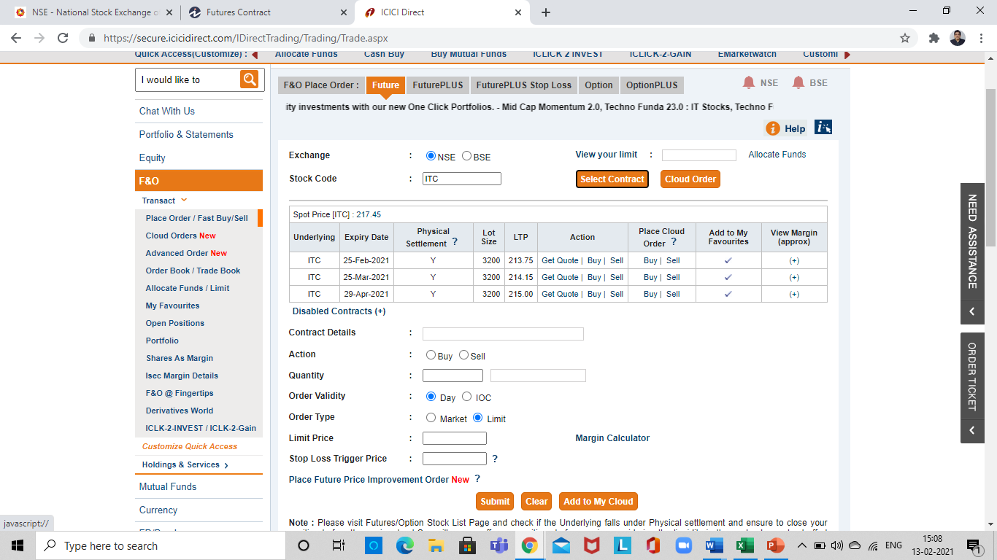
Source: ICICI Securities

Slide 6
Explanation of Key Terms
Underlying : Symbol of underlying security
Expiry date : Date of contract expiry
Lot Size- A fixed quantity of units. If ITC has lot size of 3200, this means that transaction can be done only in 3200 and multiple of 3200.
Contract Value: Market price of an underlying multiplied by Lot Size. If lot size of ITC is 3200 and market price of ITC in future market is 230, then contract value is 3200*230.
Margin: An upfront payment made to enter into a contract. It is usually a percentage of contract value. Margin amount depends on risk of a stock.
Marked to Market: Processing of marking position of a trader to the current market price. This helps in identifying daily gains/losses for position taken by a trader.

Slide 7
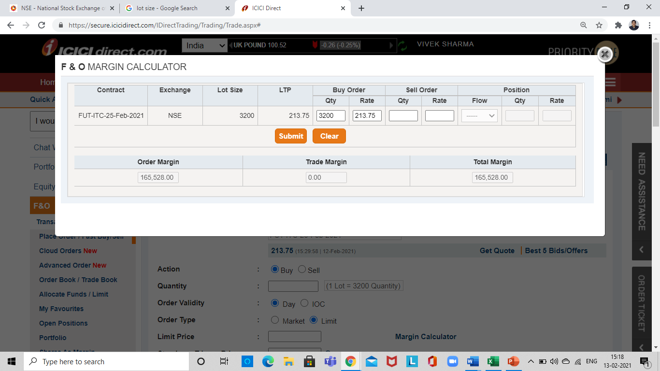
Margin
If a person buys one lot of ITC (Lot size) 3200 and market price of future contract is 213.75, then margin charged by the exchange is, 165,528
Diagram Source: ICICI Securities

Slide 8
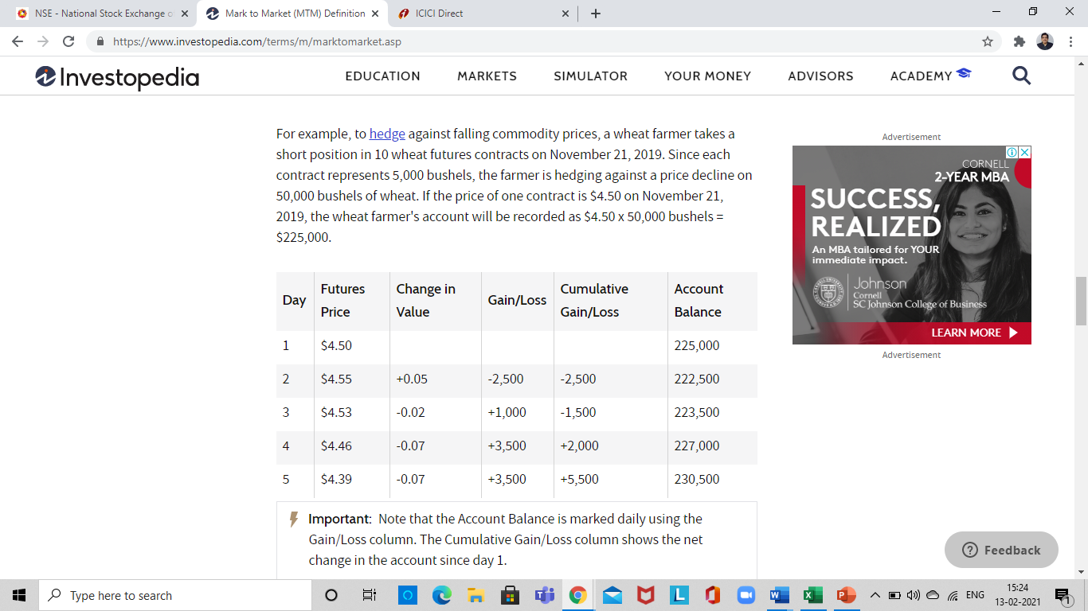
Marked to Market -Example
To hedge against falling commodity prices, a wheat farmer takes a short (selling) position in 10 wheat futures contracts on November 21, 2019. Since each contract represents 5,000 bushels, the farmer is hedging against a price decline on 50,000 bushels of wheat. If the price of one contract is $4.50 on November 21, 2019, the wheat farmer's account will be recorded as $4.50 x 50,000 bushels = $225,000.
Source:Investopedia

Slide 9
Key Terms
Cost of Carry
Open Interest

Slide 10
Cost of Carry
Cost of Carry or CoC is the cost to be incurred by the investor for holding certain positions in the underlying market till the futures contract expires. The risk-free interest rate is included in this cost. Dividend payouts from the underlying are excluded from the CoC.
CoC is the difference between the futures and spot price of a stock or index. The Cost of Carry is important because higher the value of CoC, higher is the willingness of the traders to pay more money for holding futures.
Future Price (F)= S(1+r)^t
Future Price for a Dividend Paying Stock= S( 1+r-y)^t
Here S is the SPOT PRICE, R is risk free rate of rate, Y is dividend % and t is time.

Slide 11
Open Interest
Open interest indicates the total number of option contracts that are currently out there. These are contracts that have been traded but not yet liquidated by an offsetting trade or an exercise or assignment.
In the above case A has bought one lot of 100 (XYZ stock), B has also purchased one lot of 100 (XYZ Stock) C has purchased two lots of 100 (XYZ stock) and D has sold four lots of 100 (XYZ Stock). Since all four have their positions open and assuming that there are four participants in the market, then open interest is 400. (Total of buy or sell across particpants)
A | B | C | D
100 (Buy) | 100 (Buy) | 2*100 (Buy) | 4*100 (Buy)

Slide 12
Lecture-4

Slide 13
Forward Rate Agreement
A forward rate agreement (FRA) is a cash-settled OTC contract between two counterparties, where the buyer is borrowing (and the seller is lending) a notional sum at a fixed interest rate (the FRA rate) and for a specified period of time starting at an agreed date in the future.
An FRA is basically a forward-starting loan, but without the exchange of the principal. The notional amount is simply used to calculate interest payments. By enabling market participants to trade today at an interest rate that will be effective at some point in the future, FRAs allow them to hedge their interest rate exposure on future engagements.

Slide 14
Need for Forward Rate Agreement
A company knows that it will need to borrow £1 million in three months’ time for a twelve-month period. It can borrow funds today at LIBOR + 50 basis points.
LIBOR rates today are at 5% but the company’s treasurer expects rates to go up to about 6% over the next few weeks.
So the company will be forced to borrow at higher rates unless some sort of hedge is transacted to protect the borrowing requirement.
This creates need for Forward Rate Agreement transaction.

Slide 15
Benefits of Forward Rate Agreement
The treasurer decides to buy a 3X15 (“threes-fifteens”) FRA to cover the twelve-month period beginning three months from now. A bank quotes 5½% for the FRA which the company buys for a notional £1 million.
Three months from now rates have indeed gone up to 6%, so the treasurer must borrow funds at 6½% (the LIBOR rate plus spread), however she will receive a settlement amount which will be the difference between the rate at which the FRA was bought and today’s twelve-month LIBOR rate (6%) as a percentage of £1 million, which will compensate for some of the increased borrowing costs.

Slide 16
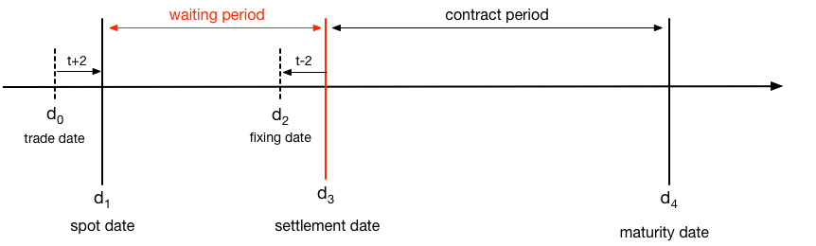
Key dates in FRA contract

Slide 17
Notional sum: The amount for which the FRA is traded.
Trade date: The date on which the FRA is dealt.
Settlement date: The date on which the notional loan or deposit of funds becomes effective, that is, is said to begin. This date is used, in conjunction with the notional sum, for calculation purposes only as no actual loan or deposit takes place. 
Fixing date: This is the date on which the reference rate is determined, that is, the rate to which the FRA dealing rate is compared.  Maturity date: The date on which the notional loan or deposit expires. 
Contract period: The time between the settlement date and maturity date. 
FRA rate: The interest rate at which the FRA is traded.  Reference rate: This is the rate used as part of the calculation of the settlement amount, usually the LIBOR rate on the fixing date for the contract period in question. 
Settlement sum: The amount calculated as the difference between the FRA rate and the reference rate as a percentage of the notional sum, paid by one party to the other on the settlement date.

Slide 18
Practice Questions for Lecture-3

Slide 19
1. For a person/trader wanting to transact in a futures contract, he/she can start his/her transaction by __________ the contract. ( Buying /Selling / Buying or Selling).
2. If Mr. X purchases one lot of futures contract from Mr. Y and Mr. Y sells one lot to Mr. X, total traded lot is __________ (One/Two/Cannot be determined).
3. If Mr. X has sold one futures contract of ITC, how can he close his contract? ( By buying a contract/ He cannot start his transaction by selling a contract, so it is a mistake)
4. __________ is paid to enter into a futures contract. (Margin/Premium)
5. __________ order is an order in which buyer or seller accepts market price. (Market/Limit)
6. To determine daily gains and losses of buyers and sellers, clearing house compares buy or sell price of a contract with daily _____________ price.
7. Buyer will gain when the market goes _______ after he has done the transaction and seller will gain when the market goes __________.
8. When the only difference in the value of contract is exchanged, it is called as ________ settlement. (Cash/Physical).
9. Total value of a futures contract is Lot Size of an underlying multiplied by market price of underlying. (True/False).
10. Contracts in stocks on NSE can be __________ settled, while contracts on NIFTY are ______ settled. ( Cash/Physical/ Cash or physical)

Slide 20
Answer to Practice Questions
1) Buying or selling
2) One
3) By buying a contract
4) Margin
5) Market Order
6) Closing price
7) UP and Down
8) Cash
9) True
10) Cash or physical and cash

Slide 21
Practice Question for Lecture-4
1) Buyer of an FRA pays ______________ rate and receives ______ rate.
2) FRA contract helps in mitigating ____________ _________ risk.
3) FRA contract starts on a __________ date, ______ date is typically two days before settlement date and cash flow difference is exchanged on _______ date.
4) Last date in an FRA contract is ___________ date.
5) Buyer of an FRA agrees to pays fixed rate of 5% and receives floating rate based on LIBOR with a spread of 50 basis point. At what rate of LIBOR, his net cash flow will be zero.

Slide 22
Answer to Practice Questions
1) Fixed, Floating
2) Interest Rate
3) Trade Date, Fixing Date and Settlement Date
4) Maturity date
5) 4.5% LIBOR

Slide 23
Numerical
1) If a person sells 3 futures contract=, lot size 3000 and future price 250. What will be his gain/loss, when future price is 230.
Answer: Gain of 1,80,000
Explanation= (250-230)*3*3000
2) If the spot price is 200, risk free rate of interest is 5% p.a. and time to maturity is 3 months, what should be the future price based on cost of carry concept.
Answer F= S(1+r)^t
F= 200 (1+5%)^(3/12)
F= 202.45

Slide 24
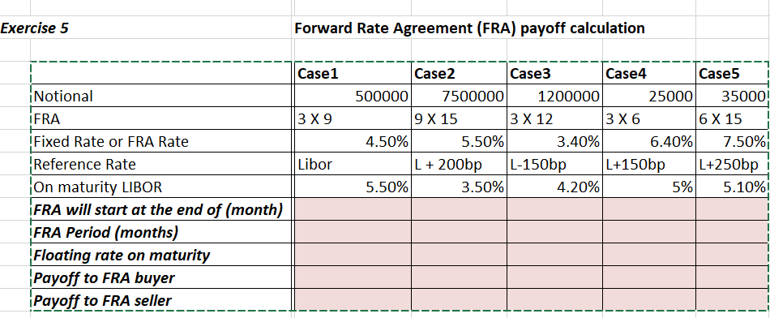
Assignment for students: Discuss solution with Vivek Sharma

Slide 25

Thank you
VIVEKSHARMA95@REDIFFMAIL.COM
9930076474

