Slide 1
Introduction to Risk Management
By Prof. Samie

Slide 2
Risk : Definition And Essentials
RISK as defined in the Oxford Dictionary:
  “The chance or possibility of damages, loss, injury or other adverse consequences.”
Characteristics:
  Chance
    Future ‘chance’, ‘likelihood’ or ‘probability’ of an event happening
    Event yet to occur – is one of a number of possible outcomes
    May occur in the future
    Possibility of taking action today to reduce chance of occurrence

Slide 3
CFA Institute definition of risk
Risk arises out of uncertainty.
It can be defined as the effect of uncertain futures events on a company or on the outcomes the company achieves.
One of these outcomes is the company’s profitability, which is why the effects of risk on profits and rate of return are often assessed.

Slide 4

The Black Swan Phenomenon :
The Impact Of The Highly Improbable
“No amount of observations of white swans can allow the inference that all swans are white, but the observation of a single black swan is sufficient to refute that conclusion.”
What is a Black Swan?
  It is an Event
  Hard to predict based on historical data
  After the event – many people saw it coming
Stress testing models must assume black swan events to ensure greater predictive power.

Slide 5
Black Swan Event
Before the discovery of Australia, people in the old world were convinced that all swans were white, an unassailable belief as it seemed completely confirmed by empirical evidence. The sighting of the first black swan might have been an interesting surprise for a few ornithologists, but that is not where the significance of the story lies. It illustrates a severe limitation to our learning from observations or experience and the fragility of our knowledge. One single observation can invalidate a general statement derived from millennia of confirmatory sightings of millions of white swans. All you need is one single black bird.

Slide 6
Fooled by Randomness
“No matter how sophisticated our choices, how good we are at dominating the odds, randomness will have the last word.”
― Nassim Nicholas Taleb, Fooled by Randomness: The Hidden Role of Chance in Life and in the Markets

Slide 7
TYPES OF RISK
RISK | DESCRIPTION
Operational risk | Risk which refers to the risk of losses from inadequate or failed people, systems, and internal policies and procedures, as well as external events that are beyond the control of the firm but that affect the operations of the firm. Examples of operational risk include human errors, internal fraud, system malfunctions, technology failure etc.
Compliance risk | Risk which relates to the risk that a company fails to follow all applicable rules, laws and regulations and faces sanctions as well.
Investment risk | Risk which is the risk associated with investing that arises from fluctuation in the value of investment. Although it is an important risk for investment professionals, it is less important for individuals involved in support activities, so it receives less coverage than operational and compliance risk.

Slide 8
Investment Risk – Companies in investment industry
RISK | DESCRIPTION
Market risk | Risk which is caused by changes in market conditions affecting prices.
Credit risk | Risk for a lender that a borrower fails to honor a contract and make timely payment of interest and principal.
Liquidity risk | Risk that an asset or security cannot be bought or sold quickly without a significant concession in price.

Slide 9
Company Risks – Some examples
Product Market Risk
Customer Loss
Product obsolescence
Competition increases
Product demand decreases
Operational Risk
Machinery breaks down
Product defects increase
Weather destroys plant
Inventory obsolescence
Input Risk
Input prices increase
Labor strikes
Key employees leave
Supplier fails
Financial Risk
Capital costs change
Exchange rate changes
Inflation
Covenant violation
Default on debt
Company
Risks
Tax Risk
Income tax increases
Sales tax increases
Tax disputes
Legal Risk
Product liability
Restraint of trade changes
Shareholder lawsuits
Employee discrimination
lawsuits
Regulatory Risk
Environmental laws change
Stricter anti-trust enforcement
Price supports end
Import protection ceases
Physical Risk
Fire
Natural Disaster
Physical security
Terrorism
Thefts

Slide 10
Risks in Financial Services

Slide 11
Definition of Risk Management
Risk Management (CIMA) is:
  ‘A process of understanding and managing the risks that the entity is inevitably subject to in attempting to achieve its corporate objectives. For management purposes, risks are usually divided into categories such as operational, financial, legal compliance, information and personnel. One example of an integrated solution to risk management is enterprise risk management.’
GARP defines Risk Management as the process by which financial risks are identified, assessed, measured, and managed in order to create economic value.

Slide 12
Risk versus return for investors
As all fund managers know, there is a trade-off between risk and return when money is invested.
The greater the risks taken, the higher the return that can be realized.
The trade-off is actually between risk and expected return, not between risk and actual return.
The term “expected return” sometimes causes confusion and in everyday language an outcome that is “expected” is considered highly likely to occur.

Slide 13
Research on risk return
One of the first attempts to understand the trade-off between risk and expected return was by Markowitz (1952).
Later, Sharpe (1964) and others carried the Markowitz analysis a stage further by developing what is known as the capital asset pricing model.
This is a relationship between expected return and what is termed “systematic risk.”
In 1976, Ross developed the arbitrage pricing theory which can be viewed as an extension of the capital asset pricing model to the situation where there are several sources of systematic risk.

Slide 14
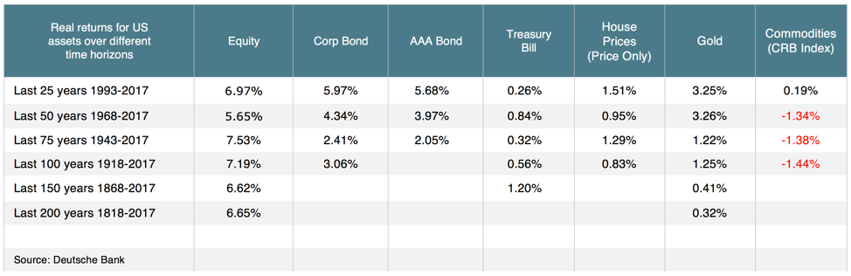
Historical returns of asset classes

Slide 15
Capital Asset Pricing Model
The Capital Asset Pricing Model (CAPM) is a model that describes the relationship between expected return and risk of investing in a security.
It shows that the expected return on a security is equal to the risk-free return plus a risk premium, which is based on the beta of that security.
The CAPM formula is used to calculate the expected return on investable asset and it is based on the premise that investors have assumptions of systematic risk (also known as market risk or non-diversifiable risk) and need to be compensated for it in the form of a risk premium – an amount of market return greater than the risk-free rate.
By investing in a security, investors want a higher return for taking on additional risk.

Slide 16
CAPM Model
The CAPM was introduced by Jack Treynor (1961, 1962), William F. Sharpe (1964), John Lintner (1965a,b) and Jan Mossin (1966) independently, building on the earlier work of Harry Markowitz on diversification and modern portfolio theory.

Slide 17
Assumptions of CAPM
Assumptions of CAPM
  The financial markets are competitive
  All investors plan to invest over the same time horizon
  There is no distortionary taxes or transaction costs (markets are frictionless)
  The investments are limited to publicly traded assets with unlimited borrowing and lending at the risk-free rate and the market portfolio consists of all publicly traded assets.
  All investors like overall portfolio reward (expected return) and dislike overall portfolio risk (variance or standard deviation of return)
  Everyone either has quadratic utility or has homogeneous beliefs concerning the distribution of security returns.

Slide 18
Arbitrage Pricing Theory
Arbitrage pricing theory can be viewed as an extension of the capital asset pricing model.
In the capital asset pricing model, an asset’s return depends on just one factor.
In arbitrage pricing theory, the return depends on several factors. (These factors might involve variables such as the gross national product, the domestic interest rate, and the inflation rate.)
By exploring ways in which investors can form portfolios that eliminate exposure to the factors, arbitrage pricing theory shows that the expected return from an investment is linearly dependent on the factors.

Slide 19
APT – more generalized CAPM
The APT is a more generalized version of CAPM that allows extension of the CAPM by proposing addition of further macroeconomic factors to the model.
The APT can be termed as an open-source model which can incorporate as many factors as possible.
The reason is that the APT does not specify either the number or identity of the factors that drive the expected returns of an asset.
This is a lack of factors influencing asset expected returns is a limitation of the model.

Slide 20
Markowitz Efficient Frontier - MPT
It is an investment theory based on the idea that risk-averse investors can construct portfolios to optimize or maximize expected return based on a given level of market risk, emphasizing that risk is an inherent part of higher reward.
Modern Portfolio Theory (MPT) assumes that investors are risk averse, meaning that given two portfolios that offer the same expected return, investors will prefer the less risky one.
Thus, an investor will take on increased risk only if compensated by higher expected returns and an investor who wants higher expected returns must accept more risk.
The exact trade-off will be the same for all investors, but different investors will evaluate the trade-off differently based on individual risk aversion characteristics.

Slide 21
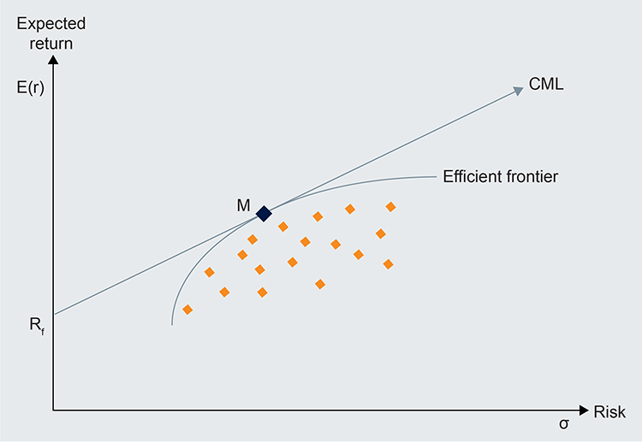
Efficient Frontier

Slide 22


Slide 23
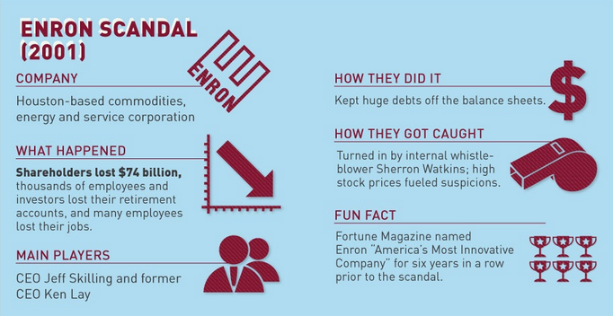
The case of Enron

Slide 24
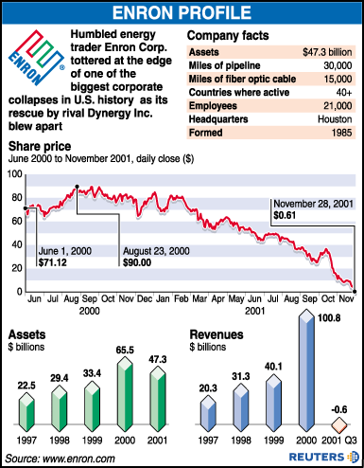

Slide 25
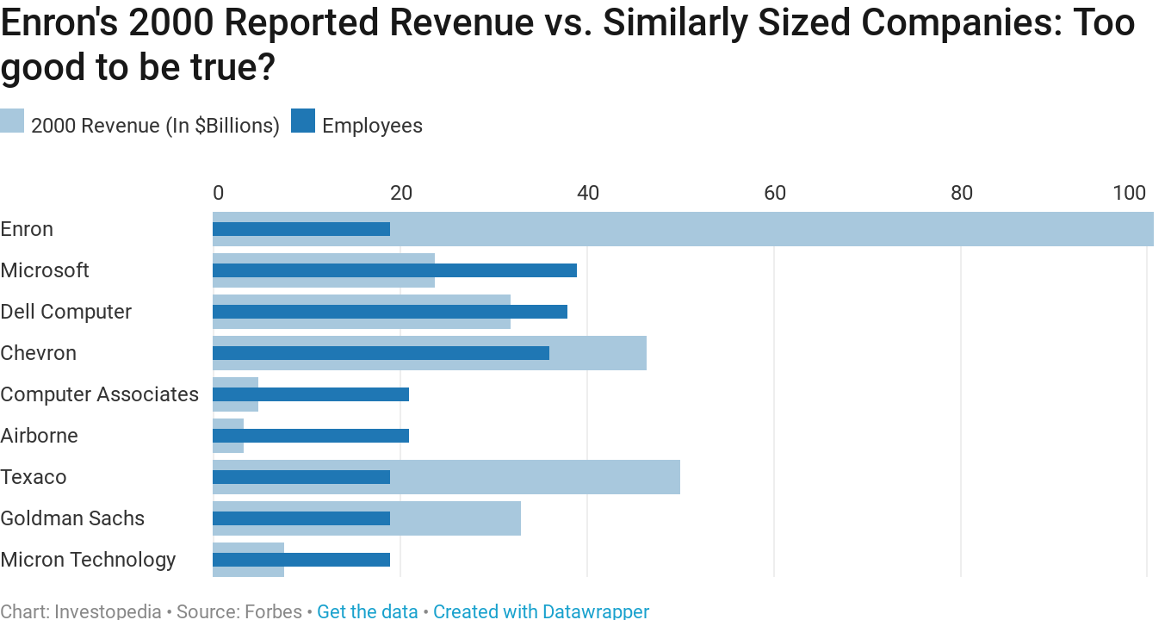

Slide 26
The reasons for Enron collapse
It transferred the losses from its books to a partnership, which was funded by Enron.
Enron used advanced accounting tools to keep the share price high and its growth by making investments; and transferring debts to the partnership for potential income.
Enron’s auditor, Arthur Andersen, suggested to change the accounting method for the partnership.
It inflated its profits by hiding debts in the complicated partnership arrangements.

Slide 27
Bank Concentration in US

Slide 28
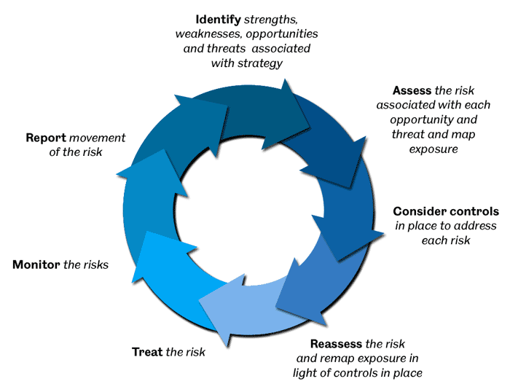
Steps in risk management

Slide 29
Risk Governance Structure - Barclays

Slide 30
Risk Management Framework - Barclays

Slide 31
Benefits of risk management
Enables quantifying of risk
Helps identify extremely risky situations
Improves risk awareness
Enables performance measurement

Slide 33
Managing the environment
Political Risk
Legal Risk
Settlement Risk

Slide 34
Political Risk
Political risk is the risk that a change in the ruling political party of a country will lead to changes in policies that can affect everything from monetary policy (money supply, interest rates, and credit) and fiscal policy (taxation) to investment incentives, public investments, and procurement.
Some industries are heavily influenced by governments that, for example, control natural resources or set prices of raw material input.

Slide 35
Legal risk
Legal risk is the risk that an external party will sue the company for breach of contract or other violations.
A company should consider how it identifies and conforms to all legal commitments it has undertaken.
The role of an in-house legal expert is crucial to controlling legal risk.
Most areas of a company have dealings with external parties, such as deal counterparties, business partners, suppliers, and service providers and an important control in managing the legal risk of these external relationships is to have legal experts review every contract.

Slide 36
Settlement Risk
Settlement risk (or counterparty risk) is the risk that when settling a transaction, a company performs one side of the deal, such as transferring a security or money, but the counterparty does not complete its side of the deal as agreed, often because it has declared bankruptcy.
This risk is sometimes also called Herstatt risk because of an incident in 1974 when the German Herstatt Bank ceased operations after counterparties had honoured their obligation to transfer Deutsche Marks to Herstatt, but before Herstatt honoured its obligation to transfer the equivalent amount in US dollars back to these counterparties.

Slide 37
Compliance Risk
Examples of Compliance risk
  Corruption
  Tax Reporting
  Insider Trading
  Anti-money laundering

Slide 38
Corruption
Corruption, which is defined as the abuse of power for private gain, has received heightened attention because of tightened laws and regulations on bribery and increased regulatory scrutiny, investigations, prosecutions, and fines.
Some national authorities may apply these laws extra-territorially, even to foreign entities.
Firms that operate through agents and other third parties should be aware that their responsibility for preventing corruption extends to the actions of these third parties.
Ignoring the practices of third parties does not constitute a defence in the event of a regulatory investigation.

Slide 39
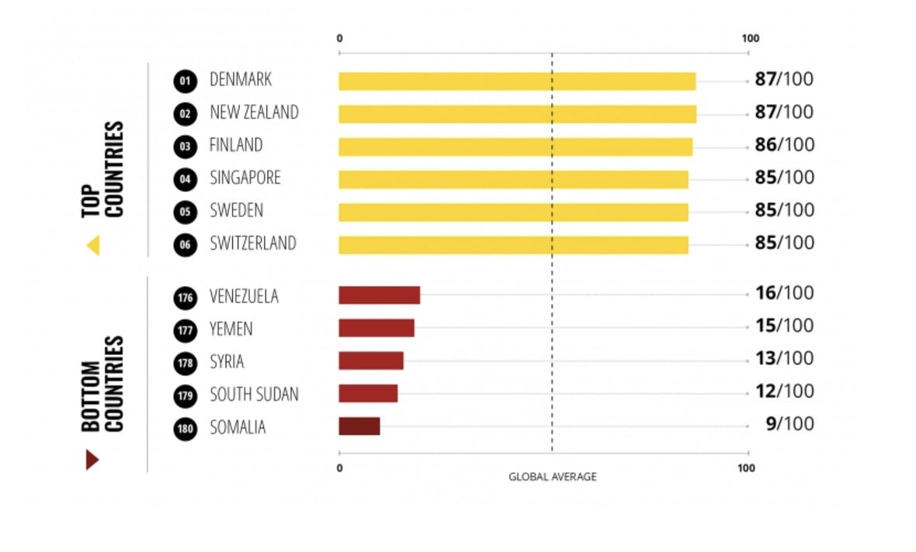
Corruption Perceptions Index 2019 – Transparency International

Slide 40
Tax reporting
Compliance with tax regulations is complicated because the principles and rules vary considerably by jurisdiction.
Companies are continuously developing financial and legal structures, often with the intention of minimising taxes overall.
Uncertainty exists in how tax authorities will apply their rules, which is compounded by the fact that rules change regularly.
A conservative approach is to conform to tried-and-tested precedents and a more aggressive approach is to seek to exploit loopholes in the tax code, low-tax jurisdictions (so-called offshore tax havens), and other grey areas.

Slide 41
Insider Trading
There are laws that prohibit the trading of a security when in possession of important confidential information pertaining to the security in question.
Most markets have recently tightened laws regulating insider trading.
Another trend is an increase in investigations of insider trading; some such investigations are even relying on techniques similar to those used in investigations of organised crime cases—including tapping telephones, using evidence already collected to make peripheral suspects co-operate, and gradually closing in to catch the central participants of the scheme.

Slide 42
Anti Money Laundering
Anti-money-laundering legislation is a set of rules to prevent money derived from criminal activities from entering the financial system and acquiring the appearance of being from legitimate sources.
These rules require companies in the financial services industry, including those in the investment industry, to obtain sufficient original or certified documentation to perform a formal risk assessment on each client and counterparty; the procedures of such an assessment are called know-your-customer procedures.

Slide 43
MCQ on Value at Risk
A $10 million 10-day VAR figure with 95% confidence means:
  there is only a 5% chance that we will gain more than $10 million in 10 days.
  the VAR over the next day is $1 million with 95% confidence.
  the loss over the next 10 days is expected to be at most $10 million in 95% of the cases.
  the minimum loss over the next 10 days is expected to be at least $10 million in 95% of the cases.

Slide 44
Solution MCQ
A $10 million 10-day VAR figure with 95% confidence means:
  there is only a 5% chance that we will gain more than $10 million in 10 days.
  the VAR over the next day is $1 million with 95% confidence.
  the loss over the next 10 days is expected to be at most $10 million in 95% of the cases.
  the minimum loss over the next 10 days is expected to be at least $10 million in 95% of the cases.

Slide 45
MCQ on interest rate risk
When maturities of liabilities and assets are mismatched and risk incurred by financial intermediaries then this risk is classified as
  Interest rate risk
  Channel rate risk
  Economic risk
  Global system risk

Slide 46
MCQ on interest rate risk
When maturities of liabilities and assets are mismatched and risk incurred by financial intermediaries then this risk is classified as
  Interest rate risk
  Channel rate risk
  Economic risk
  Global system risk

Slide 47
Expected Loss from default
Calculate the 1 year expected loss of a US$100 million portfolio comprising of B-rated issuers. Assume that 1 year probability of default for each issuer is 6% and the average recovery value for each issuer in the event of default is 40%.

Slide 48
Expected loss from default
= 100*(0.06*0.6)
= US$3.6 million

Slide 49
Probability of default
A company has a constant 7% per year probability of default. What is the probability the company will be in default after three years?

Slide 50
Solution
Probability of not getting default for the first year = (0.93)
Probability of not getting default for the first two years = (0.93) *(0.93) = (0.93)²
Probability of not getting default for the first three years = (0.93)³
Probability of getting default after three years
= 1- (Probability of not getting default for the first three years)
= 1-(0.93)³ = 1-(0.804) = 0.1956 = 19.56%

