Slide 1
INTEREST RATE DERIVATIVES
BY PROF. SAMIE

Slide 2
Introduction – DERIVATIVES
In the Indian context the Securities Contracts (Regulation) Act, 1956 (SC(R)A) defines "derivative" to include –
  A security derived from a debt instrument, share, loan whether secured or unsecured, risk instrument or contract for differences or any other form of security or
  A contract which derives its value from the prices, or index of prices, of underlying securities
There are three main categories of derivatives based on the nature of the instrument:
  OTC derivatives, Exchange traded derivatives and Cleared Derivatives
The OTC derivatives market is the largest derivatives market with an outstanding value of US$558.5 trillion in H2 2019.
Interest rate derivatives dominate OTC derivatives market with an outstanding value of US$449 trillion in H2 2019.

Slide 3
Interest rate derivatives break – up – dec 2019

Slide 4
Forward rate agreement
A forward rate agreement (FRA) is an OTC derivative instrument that trades as part of the money markets.
It is essentially a forward-starting loan, but with no exchange of principal, so that only the difference in interest rates is traded.
By definition, an FRA is an agreement to borrow or lend a notional cash sum for a period of time lasting up to twelve months, starting at any point over the next twelve months, at an agreed rate of interest (the FRA rate).
The “buyer” of an FRA is borrowing a notional sum of money while the “seller” is lending this cash sum.

Slide 5
FRA contract details
Deal date or the transactions date, is the date when the transaction is initiated.
Contract period is the period from the settlement date to the maturity date.
Settlement date is two days prior to the beginning of the contract period of the liability or the asset and the date on which the settlement sum is paid.
Maturity date is date at which the contract ends.
Settlement sum is the amount of money either paid or received in compensation as per the terms of the FRA, on the settlement date.
Fixing Date is the date on which the reference rate of the FRA is decided. This date is generally 2 working dates before the settlement date, however the same can be decided mutually by both the counter-parties.

Slide 6
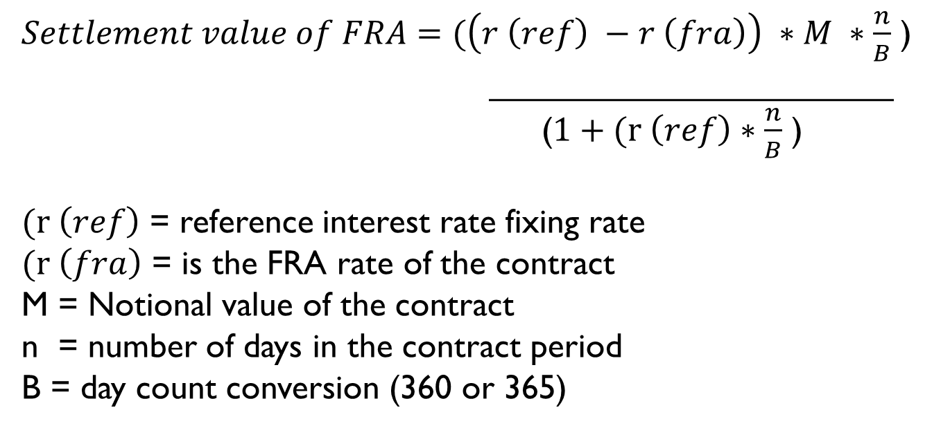
Fra formula
$Settlement value of FRA=(\left(r \left(ref\right) −r \left(fra\right)\right) ∗M ∗\frac{n}{B}$ )
_____________________
($1+(r \left(ref\right)∗\frac{n}{B}$ )
$(r \left(ref\right)$ = reference interest rate fixing rate
$(r \left(fra\right)$ = is the FRA rate of the contract
M = Notional value of the contract
n = number of days in the contract period
B = day count conversion (360 or 365)

Slide 7
Fra example 1
REYNOLD Constructions is expecting to receive an order to build a bridge for which it requires working capital of Rs. 15 crores. The current borrowing for the firm is PLR + 3% and PLR is currently 10%. It is expected that PLR will rise over the next 3 months and to protect itself from rise in interest rates REYNOLD Corporation plans to use FRA. A bank has offered REYNOLD Corporation 3 v 9 FRA at 9.0% based on MIBOR which is closely linked to PLR of banks. If the company plans to use FRA to hedge its position, what would be the effective cost of borrowing for the company if i) MIBOR rises to 11% or ii) MIBOR falls to 8%. Assume equal changes in MIBOR and PLR.

Slide 8
Fra example 1 solution
13% in both cases

Slide 9
Fra example 2
Pro Investment Bank is expecting a receipt of Rs. 10 crores for 3 months investment after 3 months. The yield for contemplated investment is currently 7% but is likely to fall. Another bank has offered 3 v 6 or (3 / 6) FRA at 7.0% based on 3 month MIBOR rate as benchmark. Find the effective return for Pro Investment Bank if the FRA contract has been executed and MIBOR rate 1) falls to 6% 2) rises to 9%. Assume equal changes in MIBOR and investment yields and 90 days in 3 months and 360 day count conversion.

Slide 10
Fra example 2 solution
Answer = 7% in both cases

Slide 11
T-BILL FUTURES
Futures that have interest rate as underlying and are traded on the exchange are called as interest rate futures (IRF).
Like any other derivative contract, the value of IRF contract changes with change in interest rates.
IRF are classified normally by maturity of the underlying instruments over which they are written.
FRA’s offer perfect hedge due to the possibility of having a tailor-made contract while IRF may offer approximate hedge because the contract size is decided by the exchange.
(Let’s review pricing of T-bills)

Slide 12
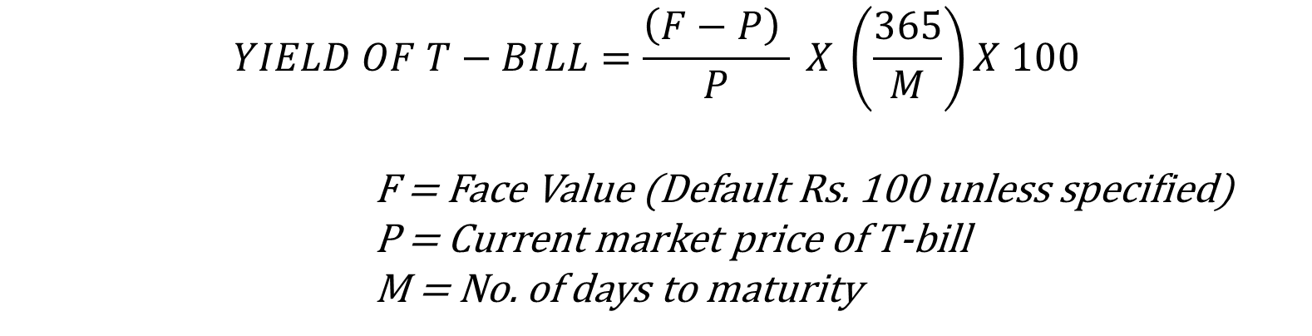
T-BILL formula
$$YIELD OF T−BILL=\frac{\left(F−P\right) }{P} X \left(\frac{365}{M}\right)X 100$$
            F = Face Value (Default Rs. 100 unless specified)
            P = Current market price of T-bill
            M = No. of days to maturity

Slide 13
T-bill problem 1
FV (Rs.) | 100
Trade Date | 17-09-2020
Days | 91
Price | 98.53
Calculate yield of 91-day T-bill issued by RBI with details mentioned above.

Slide 14
T-BILL EXAMPLE 1 SOLUTION
T-bill yield | 0.0598

Slide 15
T-bill futures example 1
A fixed income trader sells 5 contracts for 91-day T-bill futures contracts at a price of Rs. 95.30. Subsequently, T-bill futures fell to Rs. 95. The contract value is Rs. 2,00,000 and T-bill futures has face value of Rs. 100. Calculate the gain or loss for the trader. If exits his position now.

Slide 16
T-bill futures example 1 solution
Rs. 730

Slide 17
T-bill futures example 2
Assume that the yield on 161-day T-bill is 5.75% and that on a 70-day T-bill is 4.95%. At what price should a 91-day T-bill future trade given these spot market rates?

Slide 18
T-bill futures example 2 solution
Price of 91-day T-bill future 70 days from now will be Rs. 93.69.

Slide 19
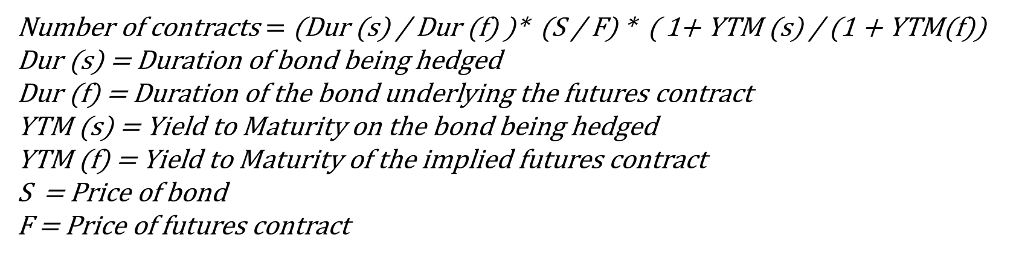
Kolb-chiang PRICE-SENSITIVITY MODEL
The model employs duration, which is comprehensive measure of security’s sensitivity to interest rates.
This model determines the number of futures contracts which will make the value of a portfolio consisting of fixed incomes securities hedged by interest rate futures contracts invariant to small changes in interest rates.
The optimum number of futures contracts to be sold is:
Number of contracts $=$ (Dur (s) / Dur (f) )* (S / F) * ( 1+ YTM (s) / (1 + YTM(f))
Dur (s) = Duration of bond being hedged
Dur (f) = Duration of the bond underlying the futures contract
YTM (s) = Yield to Maturity on the bond being hedged
YTM (f) = Yield to Maturity of the implied futures contract
S = Price of bond
F = Price of futures contract

Slide 20
T-BOND FUTURES EXAMPLE 1
In Jan 2020, a fixed income portfolio manager believes that he may be required to liquidate the fund’s long-term bond holdings in mid-May. The bond portfolio has an aggregate face value of Rs. 100 million, average coupon rate of 12.5%, average maturity of 15 years and currently valued at Rs. 103 million. The estimated YTM on the bond portfolio is 12.05% and its duration is 7.56 years. The bond future that trade on NSE has 6% coupon, 10 year bond as underlying and he is considering hedging the portfolio against interest rate changes by going short in June bond futures contracts that are currently trading at F(0) = 67.6177 with a duration of 7.25 years and YTM of 11.65%. Determine how many contracts the portfolio manager needs to sell to hedge his position. Assume each bond future contract has 2000 underlying bonds.

Slide 21
T-bond futures example 1
N = 797 contracts

Slide 22
Interest rate swaps
An interest rate swap is a transaction involving an exchange of one stream of interest obligation for another.
Typically, it results in an exchange of fixed rate interest payment for floating rate interest payments.
Occasionally, it involves an exchange of one stream of floating rate interest payments for another.
Interest rate swaps are a useful tool for hedging against variable interest rate risk.

Slide 23
Principal features of interest rate swaps
It effectively translates a floating rate borrowing into a fixed rate borrowing and vice versa. – the net interest difference is paid or received as the case may be.
There is no exchange of principal repayment obligations.
It is structured as a separate contract distinct from the underlying loan agreement.
It is applicable to new as well as existing borrowings.

Slide 24
Swaps problem 1 – ois
Southern Bank (SB) enters into a 7-day OIS with Northern Bank (NB), where SB pays 7-day fixed rate @5.75% and receives overnight NSE MIBOR. The notional amount of the transaction is Rs. 100 crores. The other terms are mentioned below. Calculate cash flows for respective parties.
Trade date | 21-Jan-2003
Day count basis | Actual / 365
Start date | 22-Jan-2003
End date | 28-Jan-2003
O/N Benchmark | NSE O/N MIBOR ACUTAL / 365
Interest computation | Fixed rate is simple compounding while the floating rate would be compounded every Mumbai business day
Interest settlement | Settlement is on net basis
Date | MIBOR rate
22-Jan-2003 | 6.13%
23-Jan-2003 | 6.04%
24-Jan-2003 | 5.94%
25-jan-2003 | 5.64%
26-Jan-2003
27-jan-2003 | 5.60%
28-jan-2003 | 5.59%

Slide 25
Swaps problem 1 – ois solution
SB will receive Rs. 9574

Slide 26
Swaps problem 2 – valuation of swaps
Suppose that a Financial Institution has agreed to pay six-month LIBOR and receive 8% per annum (with semi-annual compounding) on a notional principal of US$100 million. The swap has a remaining life of 1.25 years. The LIBOR rates with continuous compounding for 3-month / 9-month / 15-month maturities are 10%, 10.5% and 11% respectively. The 6-month LIBOR rate at the last payment date was 10.2% (with semi-annual compounding). Find the value of the swap. (Hint : Value of swap = Value of fixed rate bond – Value of floating rate bond)

Slide 27
Swaps problem 2 – valuation of swaps SOLUTON
Value of swap = - US$4.267
If the financial institution was on the opposite position of paying fixed and receiving floating, the value of the swap would be +US$4.267.

