Slide 1
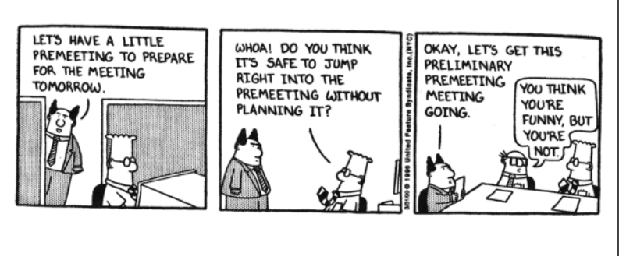
Notes:
Begin the session by showing this picture and let them come up with the plan that we do before the meeting is conducted.
So here the main motive is that they should come up with the word agenda, notice, invitation , planning and etc.

Slide 2
Agenda and Minutes of a Meeting

Slide 3
Learning objectives
Identify key elements of conducting successful meetings
Write specific agenda items with clear outcomes
Identify key components of meeting minutes
Prepare a set of meeting minutes

Slide 4

What is a meeting?
A meeting takes place when people come together (whether for work, clubs, sports, school, volunteer organizations, etc.) for a purpose.
Notes:
Show slide two and define the term meeting. A meeting takes place when people come together (whether for work, clubs, sports, school, volunteer organizations, etc.) for a purpose.

Slide 5


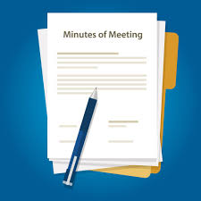
Pre meeting
  Set Agenda
Meeting
  Use Agenda
  Take Notes
Post Meeting
  Minutes
Notes:
Pre-Meeting — meeting preparation, agenda preparation
Meeting — provide advice, document relevant discussion and decisions made
Post-Meeting — prepare the minutes, follow-up actions arising from the meeting, records management

Slide 6
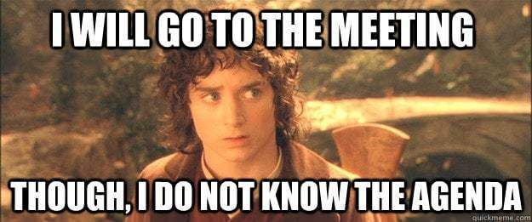

Slide 7

Agenda

Slide 8
Agenda
An agenda is a statement of the business that:
Clarifies the objectives of the meeting
Provides direction and focus for discussions
Notes:
An agenda is a list of activities to be done in an ordered sequence. In meetings, business agenda refers to the activities and topics that need to be discussed or performed at a particular time or the things to achieve during a meeting. The agenda is also used to determine the goal of a meeting

Slide 9
Why is Agenda important?
Sets clear expectations for what needs to occur before and during a meeting.
It helps team members prepare, allocates time wisely, quickly gets everyone on the same topic, and identifies when the discussion is complete.
A well-designed agenda increases the team’s ability to effectively and quickly address problems.

Slide 10
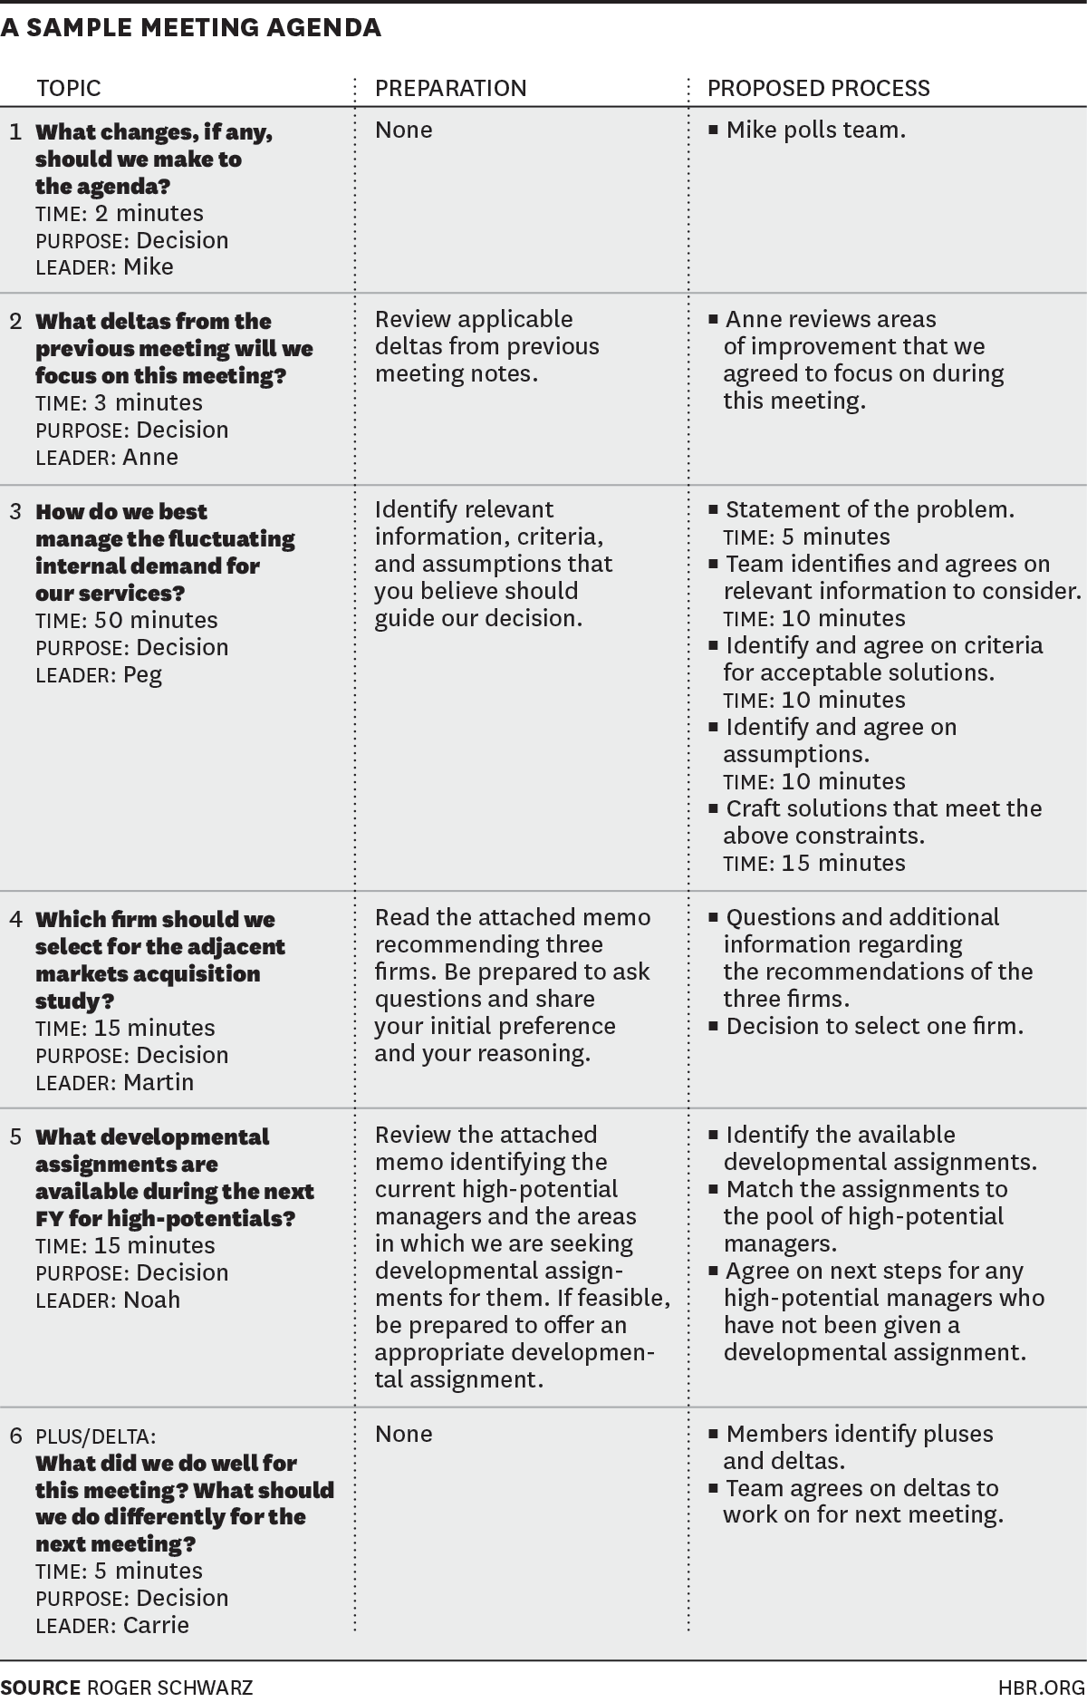
Notes:
The trainer shows a sample meeting agenda and asks the students to observe and share the elements included in the agenda

Slide 11
Notes:
The trainer shows a sample meeting agenda and asks the students to observe and share the elements included in the agenda

Slide 12
Format of an agenda
5. Attendee
The topics/activities (Topic, Presenter, Time allocation)
Plus / Delta
The title of the agenda
Purpose
Date
Time
Notes:
The title of the agenda. The titles are important in any agenda example as it can be used as identification.
The objective of the meeting. The objective of the meeting should also be included in the meeting to remind the participants about what the meeting is all about and what it hopes to achieve.
The topics and/or activities. The agenda should list all the topics or activities to be addressed in a meeting.
The time allocation. Every topic and/or activities must have a time allocation so that it will be followed accordingly.

Slide 13
Nokia Mobiles
A meeting of the regional managers of Nokia Mobiles will be held on
Monday, May 21, 2012 in the Head Office Bangalore at 11:00AM.
The following will participate in the meeting:
Mr. Ramnath Goyal Managing Director Nokia Mobiles
Mr. Syed Kaamil Manager Nokia Mobiles, Bangalore
Ms. Mona Dsozuza Sub Manager Nokia Mobiles
Ms. Rita Malhotra Manager Nokia Mobiles,
The purpose of the meeting is to discuss:
1. Salary structure of the employees
2. Energy crisis
3. Improvement in service
4. Launching the new products

Slide 14
ABC Software Promotion
Purpose: To get creative ideas for ABC software
Date: Monday, May 11, 2012
Place: Conference Room E
Time: 9:30 a.m.–11:00 a.m.
Attendees: New Products Manager, Software Engineering
Manager and Designers, Technical Publications Manager,
Technical Training Manager
Topic Presenter Time
ABC Rahul 9:30–9:45
Campaign Priya 9:45–10:00
Design Amit 10:00–10:15
Discussion Led by Preeti 10:15–11:00

Slide 15
ABC Software Promotion
Purpose: To get creative ideas to promote & increase sales of ABC software
Date: Monday, May 11, 2012
Place: Conference Room E
Time: 9:30 a.m.–11:00 a.m.
Attendees: Product Manager, Designer team, Technical Publications Manager, Sales Manager and team
Topic Presenter Time
1. Sales ideas for ABC software Rahul 9:30–10
2. Campaign Strategy Priya 10:5–10:30
3. Design Strategy Amit 10:35–10:50
Discussion to be led by Preeti

Slide 16
Agenda
Specific
Result Oriented
Realistic
Timed
Notes:
tell students that before a meeting takes place, an agenda should be written out and distributed. Agendas are a powerful form of writing because they help groups structure communication activity. o help people stay focused and on task. o provide a checklist of what exactly needs to be accomplished. ensure that meeting activities run according to time constraints. o generally make meetings more organized and productive.

Slide 17
Dos of an Agenda
Plan and prepare the agenda ahead of time
Give your agenda a title
Include all the necessary information in your agenda
Follow a standard agenda format
Make your agenda clear and well-written

Slide 18
Don’ts of an Agenda
Distribute it during the actual meeting
Not preparing adequately
Providing irrelevant, unnecessary, and insignificant information
Using unfamiliar terminologies and jargon that are not familiar with the company
Providing unorganized and disordered agenda

Slide 19
Agenda Assignment 1
Prepare an agenda for Melange meeting which will be held on 5th September 2020
Events:
Online promotion
Video Editing
Presentation
Mega Event
Creative

Slide 20
Agenda Assignment 2
Prepare an agenda for Melange meeting which will be held on 5th September 2020
Events:
Online promotion
Video Editing
Presentation
Mega Event
Creative

Slide 21
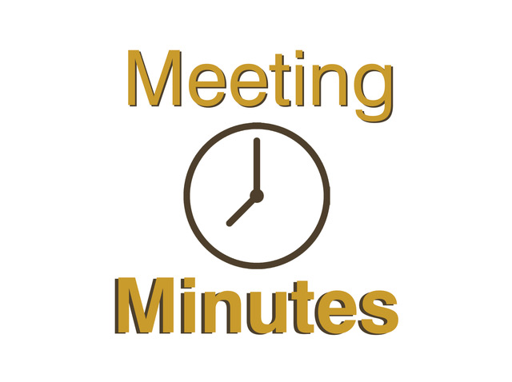

Slide 22
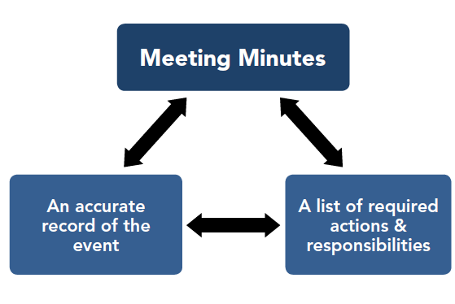
The minutes are the formal record of a meeting

Slide 23
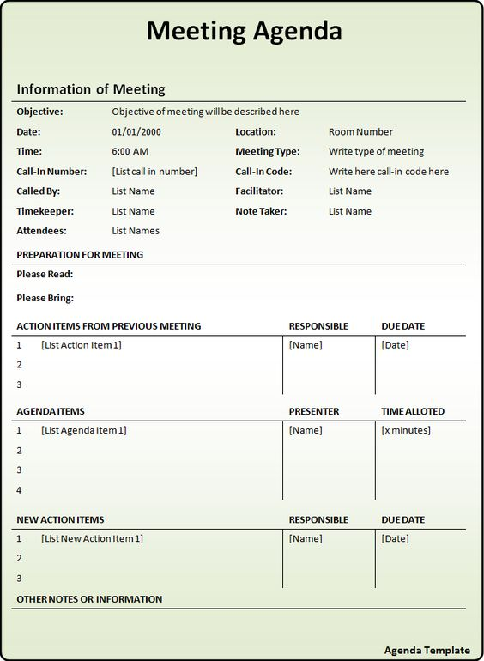
https://iusd.org/sites/default/files/documents/imported/sampleschoolsitecouncilminutes.pdf

Slide 24
Heading: Title
Date
Time
Chair- Mr. A
Members Present:
Mr. A
Ms. B
Mr. C
Minutes of the Meeting
Sr. No. | Particular | Action | Suggestions | Time lines
1
2
Notes:
Agenda – an exact copy of the meeting agenda, including allotted times o Attendees – who attended, who was absent, who came as a guest o Summaries of each agenda item discussed – detailed enough so that anyone who was not present would get the gist by reading the minutes o Action items – the next steps agreed upon during the meeting, including what needs to be done by who and by when

Slide 25
Essential Elements Of Meeting Minutes
Time, Date & Location
Announcements
Sign Off Signature
Approval Previous Minutes
Action Items
Next Meeting Details
All attendees

Slide 26
Format
Heading - name of group, date, time and place
Attendees
Guest
Action items
Date of next meeting
Signature line

Slide 27
Check list
When and where was the meeting?
Who attended?
Who did not attend?(Include this information if it matters)
What topics were discussed?

Slide 28
Check list
5. What actions were agreed upon?
6. Who is to complete the actions and by when?
7. Were the materials distributed at the meeting? If so, are copies or link available?
8. Is a follow up meeting scheduled? If yes, then what’s the date and time and venue?

Slide 29
MOM records in writing what was discussed in a meeting and what action items came out of the meeting.
Contains a point-form summary of the key discussion points that occurred during a meeting and any conclusions stated, or decisions made.
Should be prepared for any formal meeting that takes place, at any level of an organization.
The minutes should NOT be a long verbatim “he said” – “she said”. It should record only major points discussed and/or major decisions reached from a “bottom line” perspective.

Slide 30
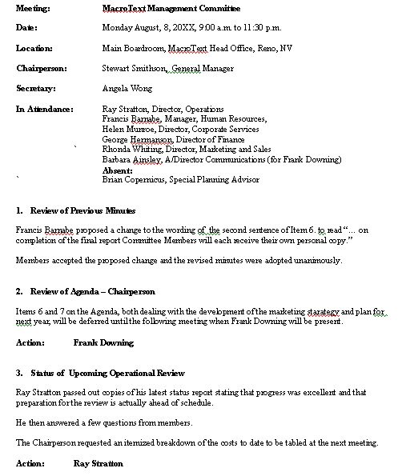

Slide 32
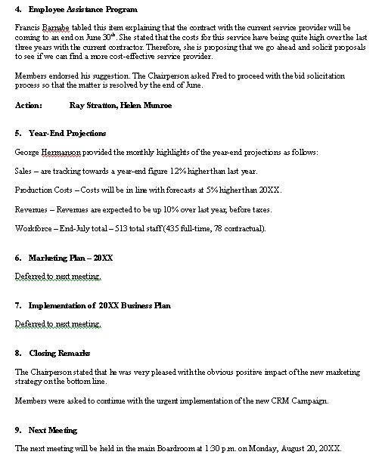

Slide 33

Prepare the minutes of meeting for Melange

Slide 34
Questions

Slide 35


