Slide 1

Theory of Influence

Slide 2
eLearning
Learning Objectives
To understand the purpose of “Theory of Influence”.
Analyzing various influencing styles
7 Ways to create Influence in the Workplace
Practicing the art of influencing people

Slide 3
What is Influence ?
To change someone or something in an indirect but usually important way.
The act or power of producing an effect without
apparent exertion of force or direct excercise of
command

Slide 4
What's the Purpose?
The theory helps individuals to influence other people's decision to his/ her own advantages.
Teaches art of discretion (More basic and powerful tool to influence public opinions).
Helps an individual to be more likable, accepted and persuasive in a society.

Slide 5
The 6 principles of influence that will
help you persuade others.

Slide 6


Slide 7

Scarcity

Slide 8

Authority

Slide 9

Consistency

Slide 10

Liking

Slide 11

Consensus

Slide 12
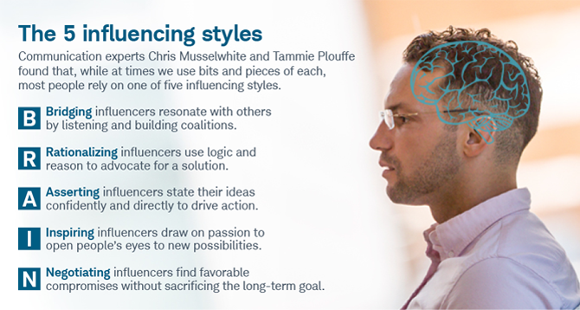

Slide 13
How do you influence others
Give them what they want
Make others feel important
Connect with emotions
Empower them
Respect other people's opinion
Be a leader, not a boss
Show sympathy

Slide 14
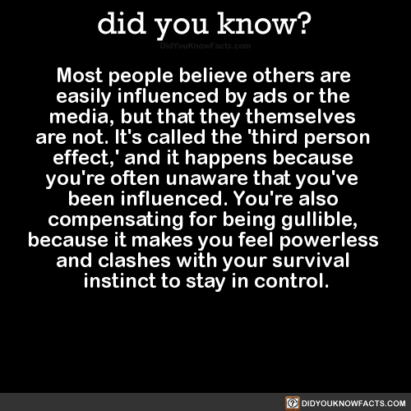

Slide 15
7 Ways to Build Influence in the Workplace
Build Trust With Your Co-Workers
Cultivate Reliability Through Consistency
Be Assertive, Not Aggressive
Be Flexible
Be Personal
Focus on Actions Rather Than Argument
Listen to Others

Slide 16
Top 5 habits to avoid if you don't want to be easily influenced.
Communicate assertively
Stop looking for approval
Avoid being insincere
Avoid being defensive
Stop making excuses

Slide 17
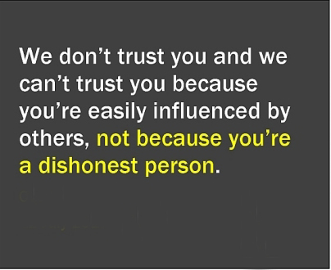

Slide 18
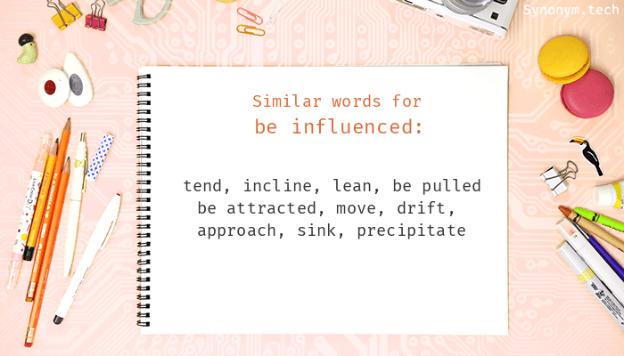

Slide 19
CC
Class Activity

Slide 20


