Slide 1
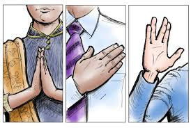
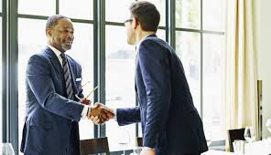
Business Etiquette

Slide 2
Objectives of the session
Explain different types of business etiquette.
Demonstrate effective self introduction with exchange of business cards and proper handshake.
Successfully navigate the business deal on business dining with proper dining etiquette.
Understand do’s and don'ts of Telephone etiquette

Slide 3

What is Etiquette?
“Etiquette is about being comfortable around people and making people comfortable around you”

Slide 4

What is Business Etiquette?
Business Etiquette is the set of written or unwritten rules of conduct that facilitate interaction between people in the workplace in the work world by setting standards for appearance and behavior.

Slide 5







Different types of Etiquette
PROFESSIONAL AND MEETING ETIQUETTE
BUSINESS CARD EXCHANGE ETIQUETTE
TELEPHONE ETIQUETTE
EMAIL ETIQUETTE
DRESS CODE & GROOMING
CUBICLE ETIQUETTE
DINING ETIQUETTE

Slide 6
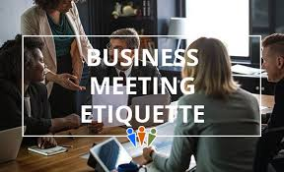
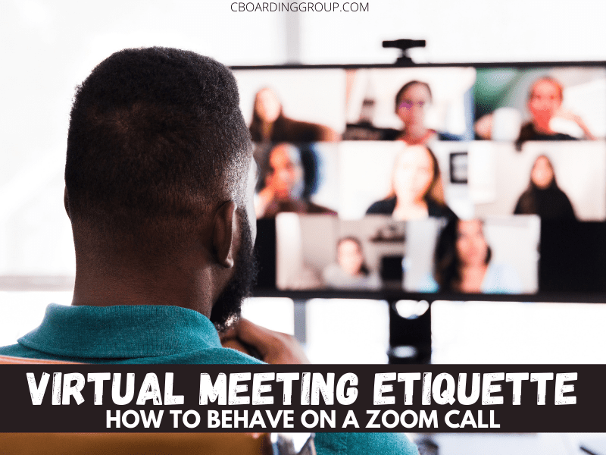
Professional & Meeting Etiquette

Slide 7

Meeting Etiquette
Before the Meeting
  Arrive early.
  Introduce new member to others.
  If you are the host, Stand near the door, acknowledge and thank people for coming.
During the Meeting
  Express your ideas and points.
  Listen to others as well.
  Preview the agenda and set time frame, including the end time.
  Encourage non-contributing and shy members.
After the Meeting
  Summarize upon the agreed Action.
  Thank and Acknowledge people for contribution and time.
  Minutes to the concerned people.

Slide 8
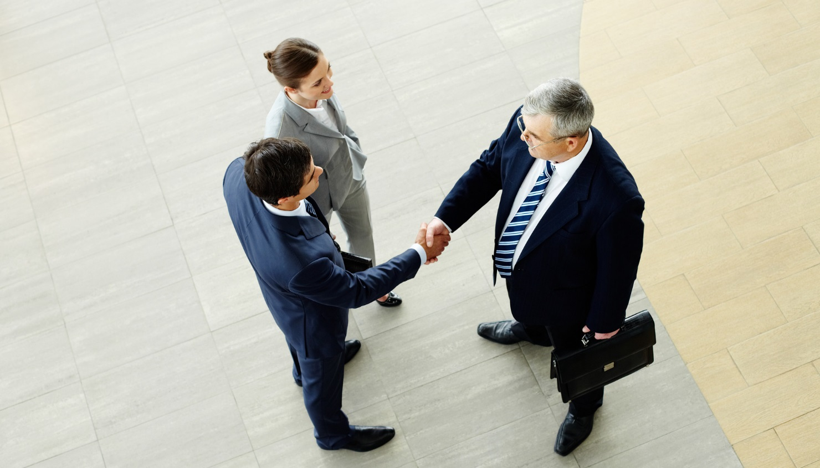
Introducing Yourself
Confident Self Introducing.
State Full name & Positions.
Repeat Your Name if & when Necessary.
On failing to recall someone’s name.
How to Introduce another person.

Slide 9
Handshake
The shaking of hands. It sounds simple enough: Two hands meet and greet and do a little shake. Easy, right?
Not so fast.
Unfortunately, there are quite a few ways a handshake can go south.
From an overly moist hand to a bone-crushing grip, handshakes come in all shapes and sizes — and only the best will hit the right note.
Handshakes are especially important in Business, where you are constantly meeting customers-new and existing.
Making a strong (and positive!) initial impression is not only good for your business, but it also reflects positively on who you are as well.

Slide 10
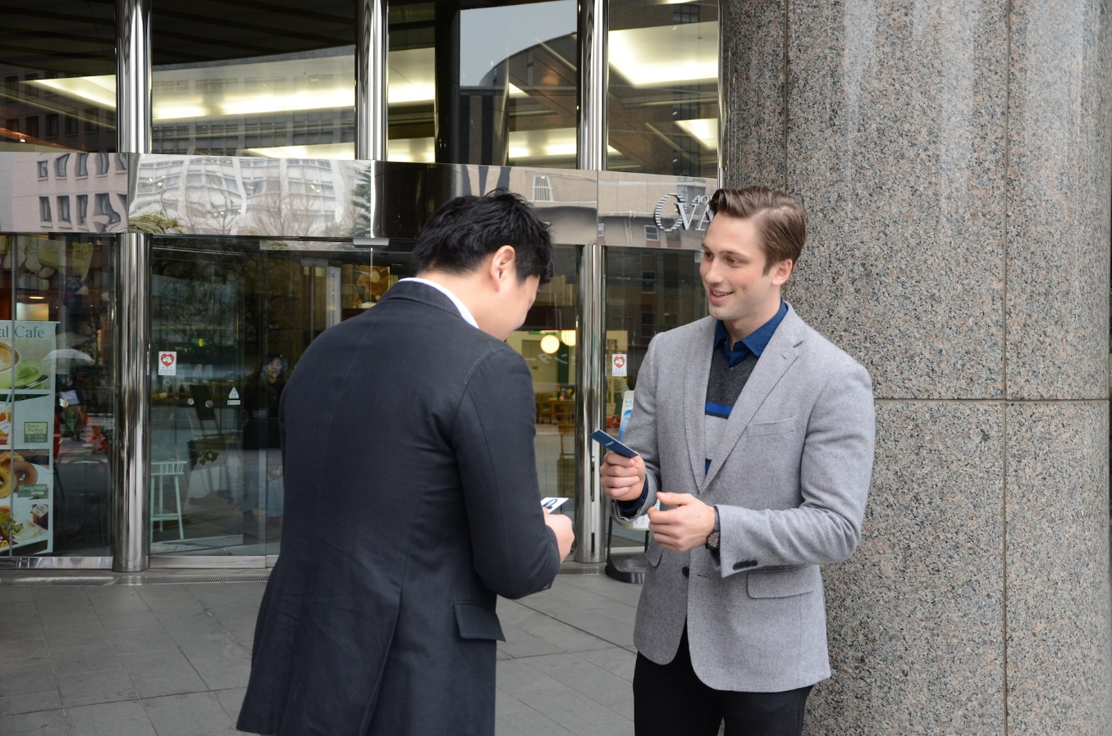
Exchanging Business Cards
When someone hands you his business card, Hold the card by its edges, Thank the person and read the card.
Reading what is on the card not only displays that you are interested, but it also gives you a chance to learn something about the person and the company that could help you lead the conversation meaningfully.
At work, at meetings, traveling for work, always carry business cards with you.
Do not place them in your wallet. Have them in a business card holder.

Slide 11
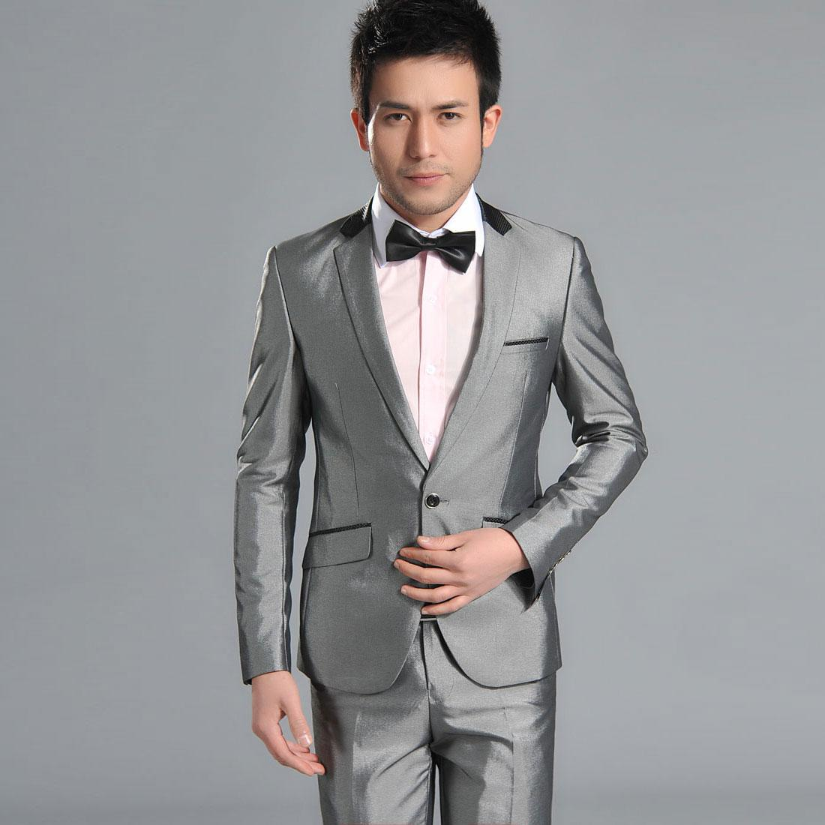
Dress code
Ties should reach your belt buckle.
Socks should cover your shin when sitting.
Wear a long sleeve shirt with a suit.
Socks match either pants or shoes.
Button suit or sport coat when standing

Slide 12
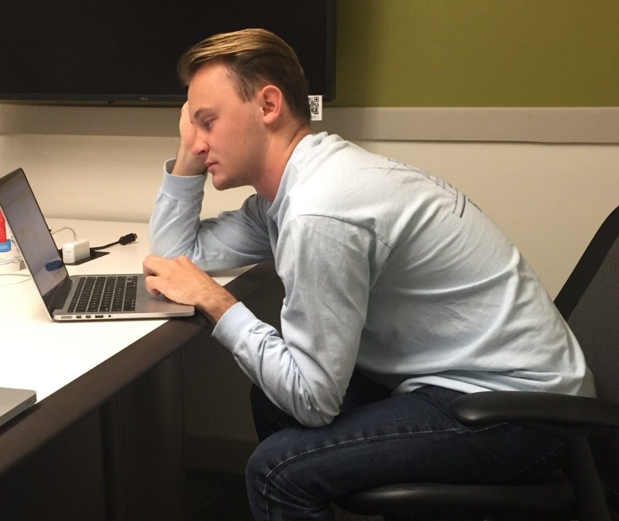
Body Language
Good posture displays confidence.
Don’t slouch – stand and sit upright.
Don’t fidget –it is annoying and a sign of boredom.
Keep hands away from your mouth when speaking.

Slide 13
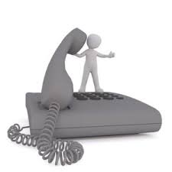
Telephone Etiquette
1. Have a decent ring tone for official
calls.
2. Keep a book and a writing pen
ready, with a glass of water.

Slide 14

Cubicle Etiquette
Avoid loud phone conversations, especially of a personal nature
Do not wear strong perfume or cologne
Do not eat smelly food (example: fish)
Do not stand in front of someone’s cubicle and carry on a conversation
Do not walk into a cubicle when someone is on the phone (leave them a note or email instead)

Slide 15

Email Etiquette
E-mail should be concise & to the point.
M-ake use of proper spelling, grammar & punctuation.
A-lways answer swiftly.
I-nclude your signature.
L-earn to read the E-mail before you send it.

Slide 16
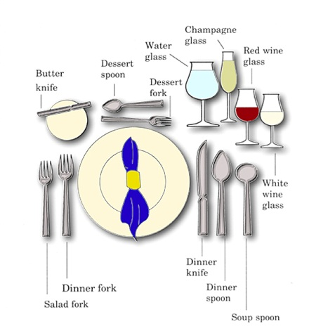
Dining etiquette
Table layout

Slide 17
Table Manners :Dos and Don’ts
Follow your host
Wish “Bon Appétit” before starting the meal
Pace your eating
Be polite and courteous to wait staff
When in doubt follow your host or hostess
Tuck your napkin in your shirt
Keep elbows on the table.
Swear
Scratch
Duck head down to the food
Play with cutlery
Point or gesture with cutlery
Start till everyone’s served

Slide 18


