Slide 1
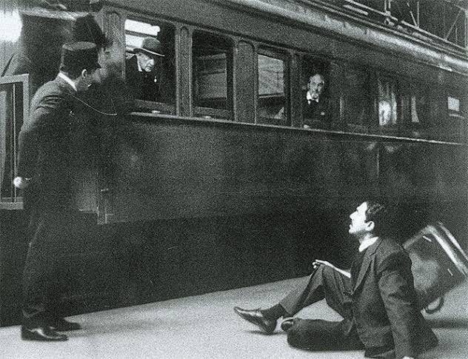

Slide 2




Slide 3
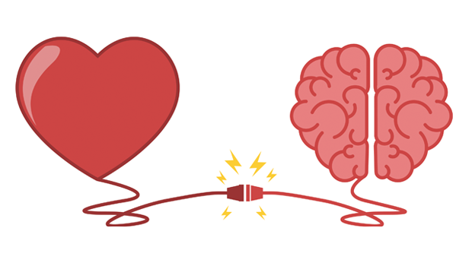
Feelings
Anger
Disappointment
Hurt
Insulted
Rationality
Controlling emotional outburst
Respond & not react
Using emotions in the right direction for producing concrete results
‹#›

Slide 4
Emotional Intelligence

Slide 5
Learning Objectives
The participants will be able to:
Understand the concept and importance of Emotional Intelligence
Identify how much they know themselves and their closer circle
Apply EI elements in a professional and personal setting
Evaluate a stand or decision on the basis of Emotional Intelligence

Slide 6
Outline
What is Emotional Intelligence ?
When to use or manage EI ?
Why is EI important ?
Skills of EI
How to build EI ? (Activities)

Slide 7
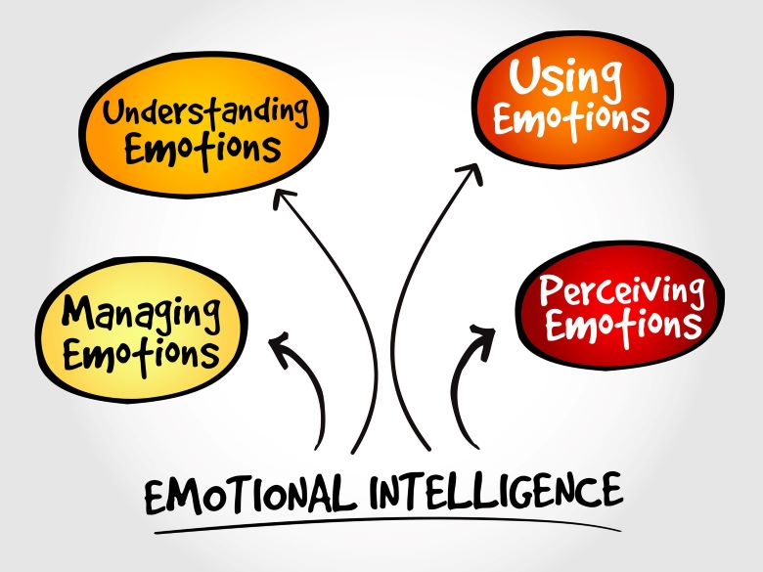

Slide 8
What is EI / EQ?
A term created by two researchers – Peter Salavoy and John Mayer – and popularized by Dan Goleman in his 1996 book of the same name.
EI or EQ is defined as the ability to:
Recognize, understand and manage our own emotions
Recognize, understand and influence the emotions of others

Slide 9


“The coronavirus panic is dumb”
Co-founder & CEO - Tesla
Notes:
After the students share the name of the personality, the trainer should ask - What is the emotion that they notice behind Musk’s tweet?? INSENSITIVITY. Also, the trainer can elaborate this example as an instance when someone channeled their emotions through social media in the form of tweet. Its an excellent example of expressing emotions, when do we need to show emotional intelligence and social media management.

Slide 10

"How to Respond to COVID-19.“
In the past week, COVID-19 has started to behave a lot like the once-in-a-century pathogen we've been worried about."
"I hope it's not that bad, but we should assume that it will be until we know otherwise
Notes:
After the students share the name of the personality, the trainer should ask - What is the emotion that they notice behind Gate’s tweet? Care/ Love/ Caution and try to bring in the contrast they noticed behind both the reactions and the posts

Slide 11
When would I need to manage my
Emotional Intelligence?
Not having enough resources
Dealing with change
Dealing with setbacks and failure
Giving and receiving feedback
Meeting tight deadlines
Dealing with challenging relationships

Slide 12

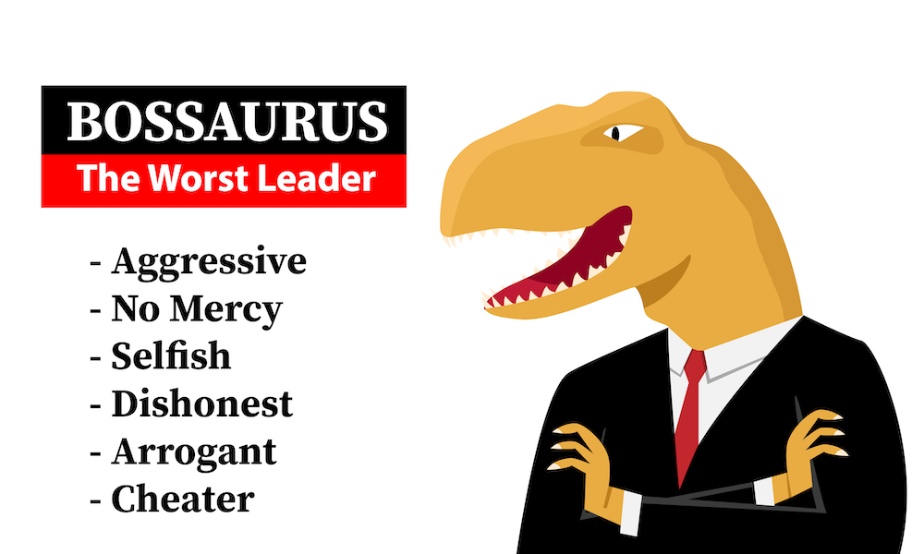
Characteristics
Easy-going
Flexible
Authentic
Open minded
Characteristics
Judgmental
Bad communication skills
Micromanager
Inflexible
Notes:
The ADJECTIVES are given only for reference. The Trainer should conduct the entire activity on BOARD bifurcating into 2 and clearly write ALL the students’ responses. Ask the whole group to brainstorm the characteristics of the “Best Boss”. It can be characteristics of a boss they worked with in the past or characteristics of a boss they wish to work with. What would be the characteristics to describe the “Best Boss”?
Encourage everyone in the group to participate and write down their ideas on the “Best Boss” Chart under the characteristics column.
It can be any. Show them the examples if they aren’t able to think.
Tell the group to move to the other “worst Boss” chart and now think about the characteristics of the worst boss they ever had or the characteristics of a boss you would not want to work for. Look for:
Judgmental, bad communication skills, unavailable, micromanager, inflexible, negative etc.

Slide 13
A large cosmetics company revised their hiring process for salespeople to choose candidates based on their emotional intelligence.
The result?
People hired with the new system sold, on average, $91,000 more than salespeople selected under the old system.
A significantly lower staff turnover among the group chosen for their emotional intelligence was observed.

Slide 14
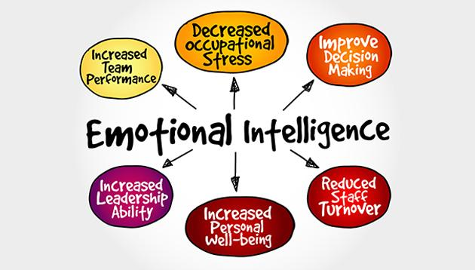
Why is EI crucial?

Slide 15
Want to build your EI?
Do you have these 5 skills ?

Slide 16
Answer a Yes or No !
Do you know what makes you happy / sad?
Do you know what social cues you send ?
Can you recognize when you’re about to lose your temper ?
Are you fully aware of your strengths ?
Are you aware of your weaknesses & steps for improvement?
Do you know what others think of you ?

Slide 17

Self Awareness
If you’ve answered YES to these questions then you possess
Key Skill 1 for Emotional Intelligence

Slide 18
The people who are self aware
Recognize & understand their mood, motivation & abilities
Understand the effects of their thoughts and behaviour on others
Know their strengths and weaknesses
Possess the following traits: self-confidence, the ability to laugh at oneself and their mistakes
Know how they are perceived by others

Slide 19
How would you react ?
Imagine yourself travelling from China to
your home country - India. You’re sitting
comfortably in your Business Class seat
when all of a sudden you start coughing
and the passengers around create a panic
saying that you’re infected with Covid 19.
They ask the pilot to throw you out of the
aircraft. Despite your pleadings that it was
due to cold water no one listens. One of
the passenger grabs your arm & throws you
& your luggage out of the craft . The
police comes over and handcuffs you.

Slide 20

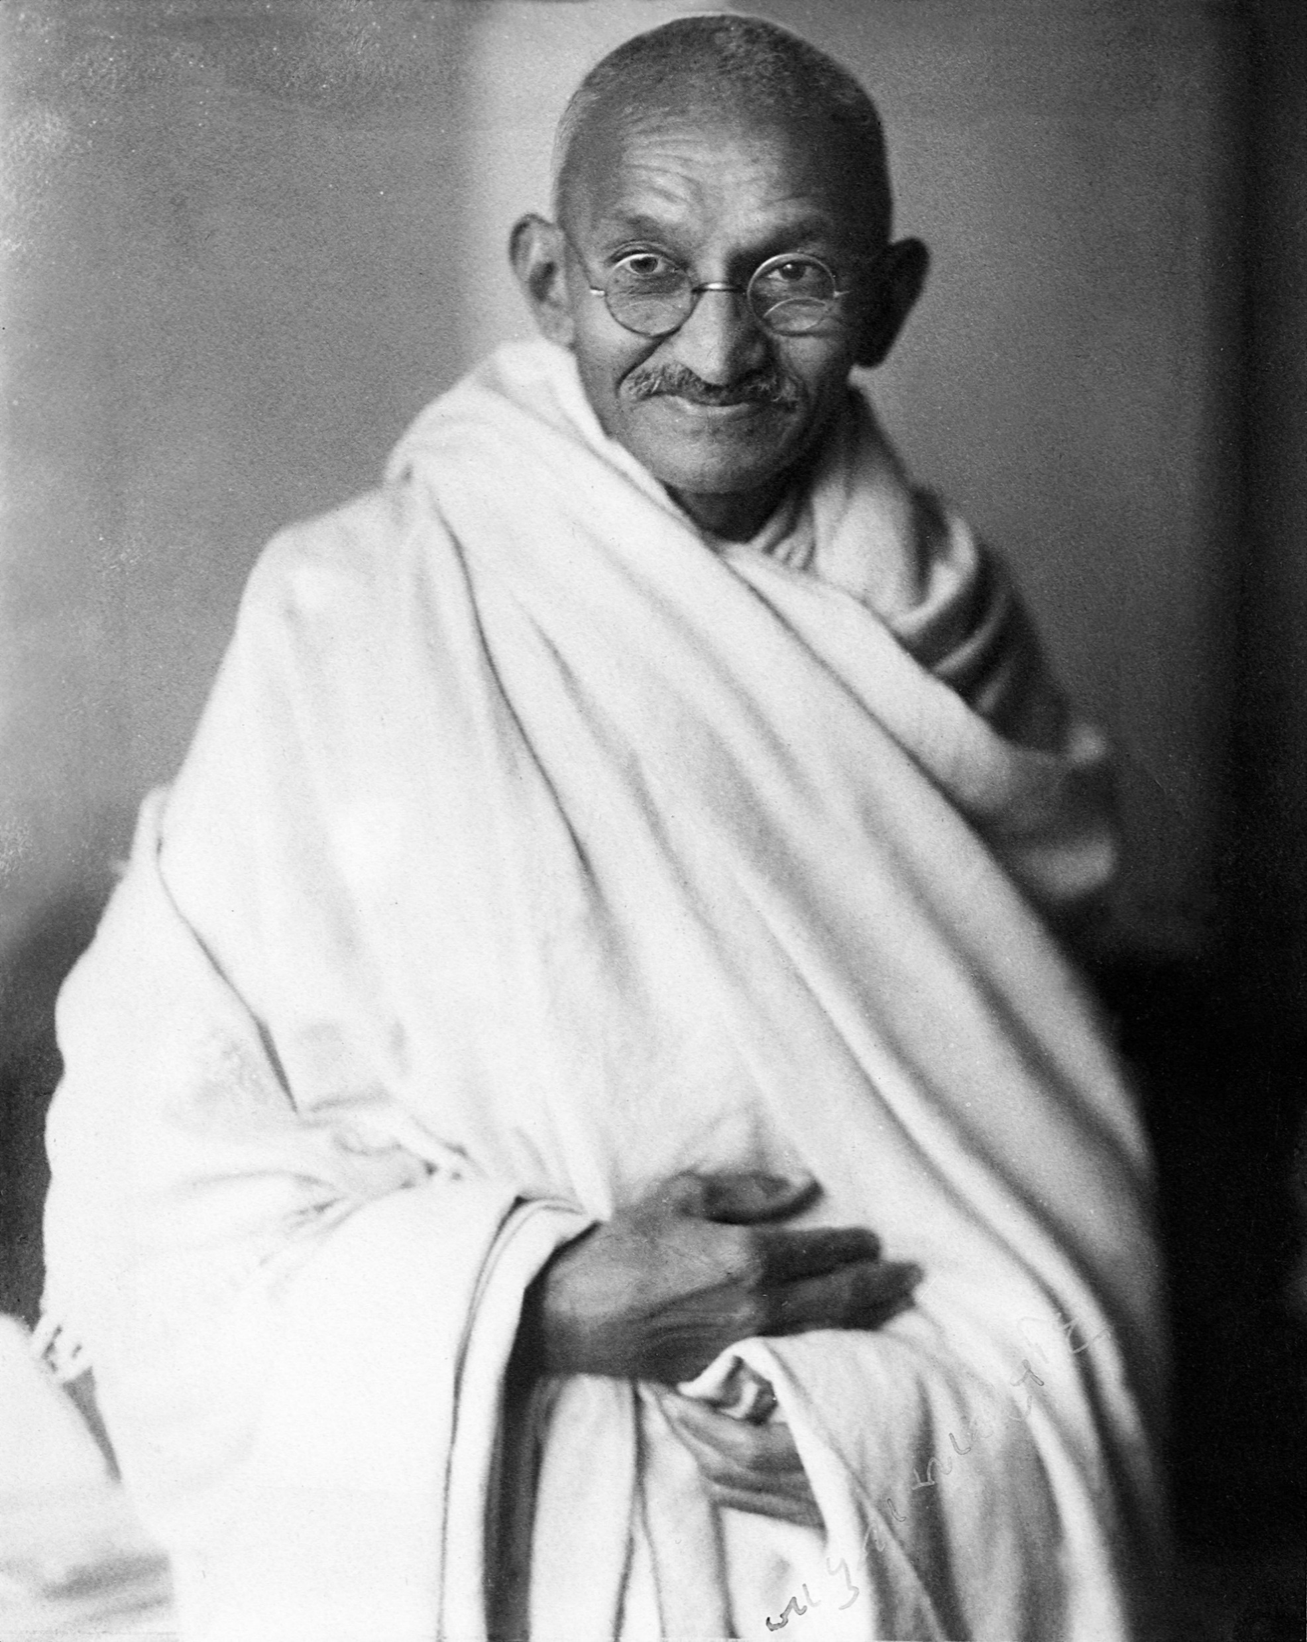
Can you be like Gandhiji and direct your emotions in the right path?

Slide 21
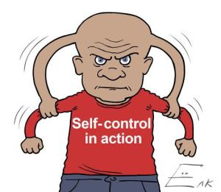
Self Regulation
If you’ve answered YES to this question then you possess
Key Skill 2 for Emotional Intelligence

Slide 22
The people who are able to self regulate
Are able to control impulsive feelings & behaviours
Adapt to changing circumstances. They think before they act.
They don't allow themselves to become too angry or jealous
Possess -thoughtfulness, conflict management & the ability to say no
Don’t lock-down on emotions & hide their true feelings.
Wait for the right time, place, & avenue to express emotions.

Slide 23
Difficult Questions!
How many of you have consistently failed at your New Year Resolution of becoming fit ?
How many of you are aware of fluency in English language as your weaknesses and doing nothing about it ?
How many of you have failed at something and gave it up for good ?
Have you ever proactively taken up a task & finished it effectively ?
How many of you are aware of your long-term goal & doing something for achieving it ?

Slide 24
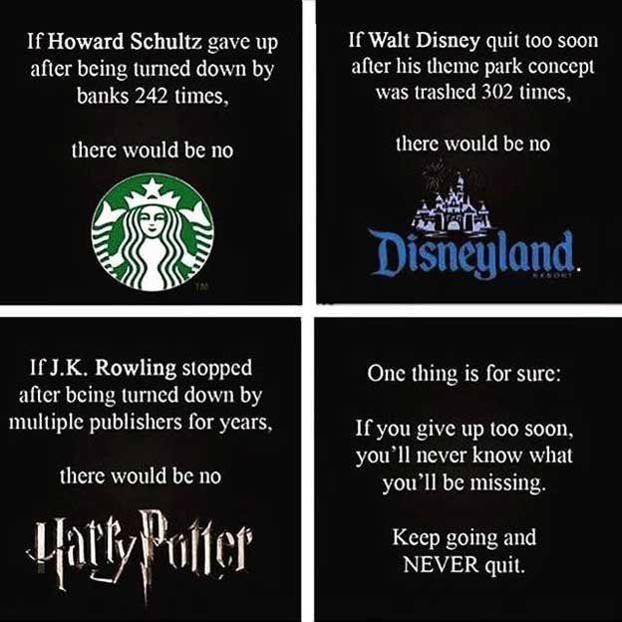
Self Motivation
If you managed to answer these difficult questions without
self embarrassment then you possess
Key Skill 3 for Emotional Intelligence

Slide 25
The people who are self motivated
Are highly productive, committed, proactive, love challenges
They set goals, have a high need for achievement, and are always looking for ways to do better
Always have an interest in learning and self-improvement & possess the strength to keep going when there are obstacles in life

Slide 26
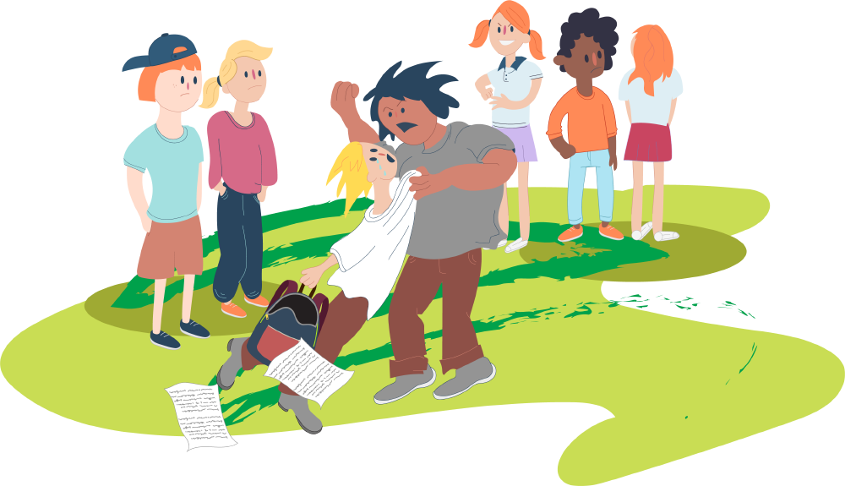
What would you say to him ?
You come to know that your room-mate
was bullied by one of your classmate in
the cafeteria. Many of your friends
were watching from a short distance but
none offered help. Depressed, your
room-mate returns to the hostel.

Slide 27
Empathy and Sympathy are DIFFERENT!
Empathy
Sympathy
I know how it feels because I was bullied too
What happened was really bad
Bullies shouldn’t be tolerated
I feel sorry for you
Try to relax. Have a fresh start

Slide 28
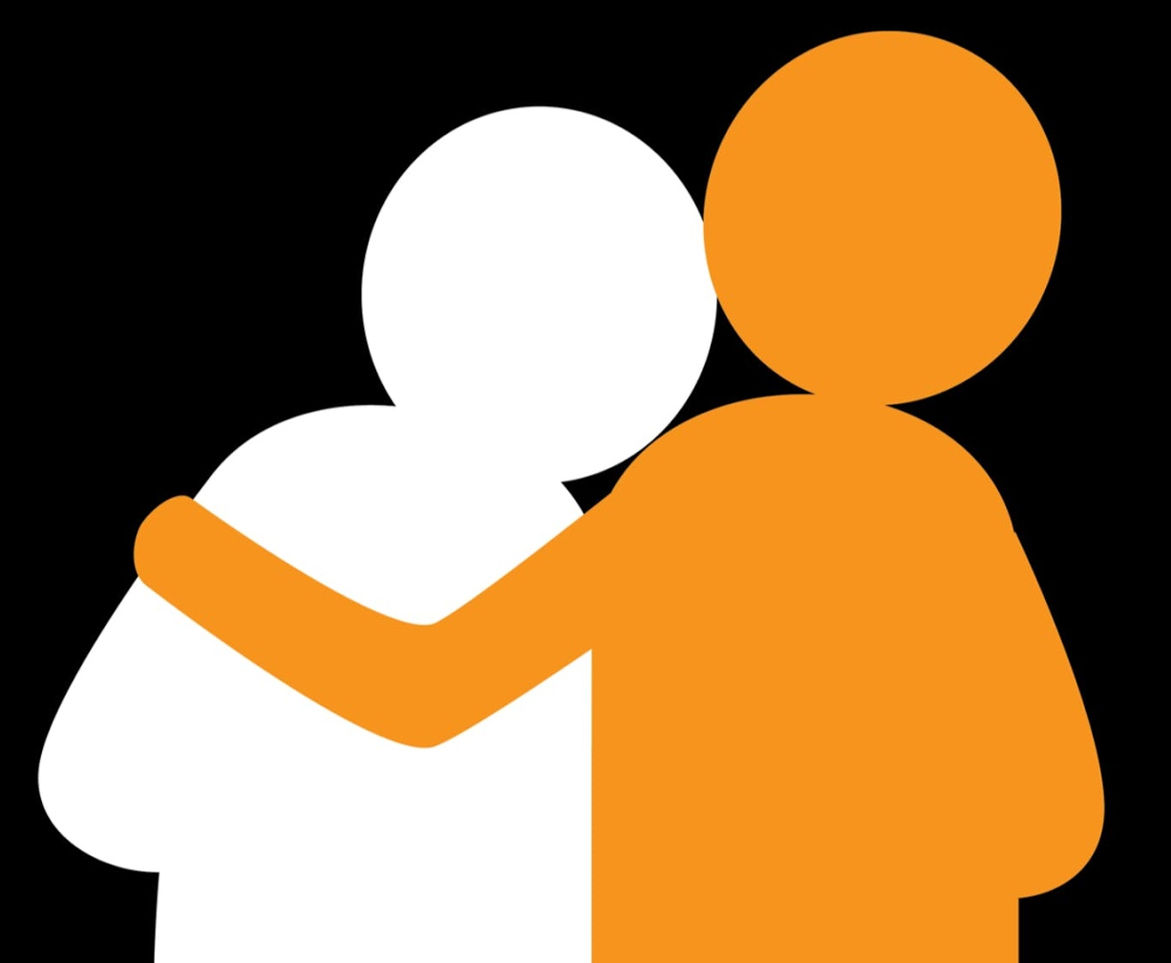
Empathy
If you consoled your room-mate by truly understanding the emotions he’s going through then you possess
Key Skill 4 for Emotional Intelligence

Slide 29
Empathetic People
Are able to identify & understand the wants, needs & viewpoints of those around them.
Instead of judging or labelling others, they work hard to see things through their eyes.
Are excellent at managing relationships , listening & relating to others.
Notes:
Empathy doesn't necessarily mean agreeing with another person's point of view. Rather, it's about striving to understand-which allows you to build deeper, more connected relationships.

Slide 30
How’s the Josh ?
Watch this video & find out the last Key Skill needed for Emotional Intelligence

Slide 31
Social Skills
If you can easily talk to people & they’re at ease talking to you
If you focus on helping others develop and shine, rather than your own success first
If you can manage disputes
If you possess excellent communication skills
If you’re a master at building and maintaining relationships
You possess Key Skill 5 of Emotional Intelligence

Slide 32
Social Skills
The ability to pick up on jokes, sarcasm, customer service, maintaining friendships and relationships, and finding common ground with others.
Some important social skills include active listening, verbal communication skills, nonverbal communication skills, leadership, and persuasiveness.
Notes:
Goleman states that emotional maturity in this component defines someone who has good communication skills, good time management, the ability to be a leader or manage a group of people, and the ability to resolve difficult situations or conflicts using negotiation or persuasion.

Slide 33
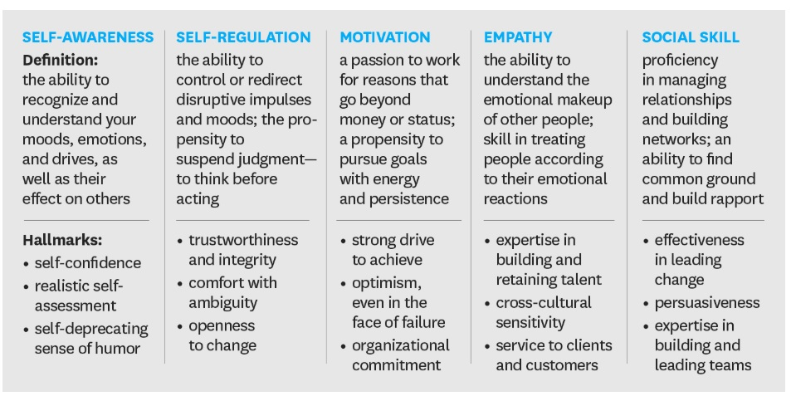

Slide 34
In a few words!
Self -Awareness: Recognising one’s own emotions.
Self -Regulation: Knowing how to control one’s emotions.
Self -Motivation: Knowing how to motivate oneself.
Empathy: Understanding other people’s emotions.
Social Skills: Knowing how to act appropriately in relation to people’s emotions.
Skills of EI

Slide 35

Homework!
Watch the movie
Come up with pointers on where you found
- High Emotional Intelligence
- Low Emotional Intelligence
Find your EI score through the test link
Notes:
https://icebreakerideas.com/emotional-intelligence-test/
The characters show self-management, commitment, empathy, social skills, and relationship building throughout the entire film. The main character’s ability to overcome circumstances that were so dire shows incredible perseverance.
There were also examples of low emotional intelligence in the film. The lack of empathy from his wife when she left them to take care of herself is a prime example. Several outbursts were understandable, yet good examples of when emotions overtake someone in crisis.

Slide 36
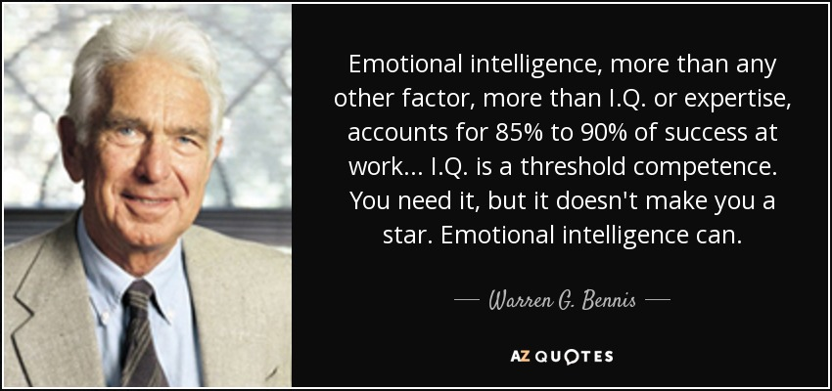

Slide 37
Session 2
Activities for building EI

Slide 38
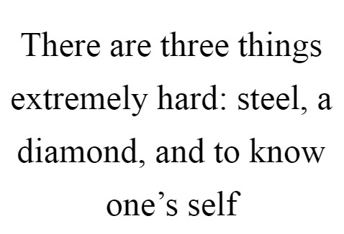

Slide 39
Activity 1- Who are you?
In one word describe yourself (15 seconds)
In three words describe yourself (1 minute)
In ten words describe yourself (Positive & Negative) (3 minutes)
Were ten words hard?
Yes, because we’re complex people
Notes:
The Tr asks the students to take up a blank sheet of paper and write WHO AM I on top and shows these questions one by one
In one word describe yourself (15 seconds)
In three words describe yourself ( 1 min)
In ten words describe yourself ( Positive & Negative) (3 mins)
Were ten words hard?
Yes, because we’re complex people
The Tr. Must be cautious of the time since it’ll give him the idea whether the students truly know themselves or not. By this activity we aim to develop KEY SKILL 1 of EI – Self Awareness

Slide 40

Be the Fog

Slide 41
Activity 2 – Regulate your emotions
Imagine you are a fog.
Act like a fog!
Ask someone you know well to criticize you at rapid speed, one after the other, and employ the fogging technique to counter it.
When you accept the criticism that is thrown your way (without actually taking it to heart), you will find that you disarm the person criticizing you.
Notes:
When someone throws a stone at you, you absorb that stone without throwing the stone back.
This is a very easy and effective technique to use against people who keep criticizing you repeatedly.”

Slide 42
For Example
Critique
Your Response
You just don’t understand
You are lazy
You are always late
You don’t feel responsible
Yes, I just don’t understand
Yes, I am lazy sometimes
Yes, I was late
Yes, I just don’t take responsibility
Notes:
The trainer may conduct this activity for 15 mins by calling 5-6 pairs one at a time.

Slide 43
Activity 3 – How well do you know your
Write names of three people (Family member, classmate, professional acquaintance)
Think what you know about each person and list 5 traits, hobbies, or features of each of them (e.g., someone runs marathons , tells funny jokes etc).
Notes:
5 have to be given for the task

Slide 44
Finally, the worksheet provides a tip if you’re having trouble
If you had trouble listing something about the people in your life, you may want to pay more attention to those around you.
Learning something unique or personal about the individuals in your life can help you maintain caring and positive relationships, eventually help in developing Social Skills

Slide 45
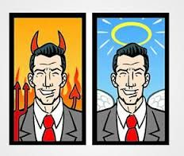
Best Boss-Worst Boss
Activity 4

Slide 46
Characteristics
Easy-going
Flexible
Authentic
Open minded
Characteristics
Judgmental
Aggressive
Micromanager
Inflexible
Feelings
Feelings
Happy
Excited
Confident
Independent
Frustrated
Stressed
Annoyed
Incompetent
Notes:
Ask the whole group to brainstorm the characteristics of the “Best Boss”. It can be characteristics of a boss they worked with in the past or characteristics of a boss they wish to work with. What would be the characteristics to describe the “Best Boss”?
Encourage everyone in the group to participate and write down their ideas on the “Best Boss” Chart under the characteristics column.
It can be any. Show them the examples if they aren’t able to think.
Tell the group to move to the other “worst Boss” chart and now think about the characteristics of the worst boss they ever had or the characteristics of a boss you would not want to work for. Look for:
Judgmental, bad communication skills, unavailable, micromanager, inflexible, negative etc.
Once everyone finished contributing their ideas, tell them now let’s go back to the other chart the “Worst Boss” chart and think of how you would feel if you were working for a manger who is judgmental, inflexible, etc. think of how you would feel if you had to deal with such a boss on a daily basis. Look for:
Frustrated, stressed, stuck and trapped, depressed

Slide 47
Characteristics
Judgmental
Aggressive
Micromanager
Inflexible
Actions
Feelings
Frustrated
Stressed
Annoyed
Incompetent
Dos Don’ts
Keep my mouth shut in meetings
Call in sick
Don’t offer any ideas or opinions
Notes:
Encourage participants to think of as many feeling and emotions they would have if they were in that situation.
Staying on the same chart “Worst Boss” ask participants to imaging they are going to work on Monday morning and they demoralized and experiencing all these negative feelings of being frustrated, trapped, stressed. Not only on Monday, but you continue to feel worthless, stuck, unproductive, defensive, hopeless, abused and stagnant on Tuesday and Wednesday and even Friday afternoon. What would that cause you to do or not do? try to be as specific as possible.
Encourage everyone to join in and share their ideas and look for things like:
Take as little risk as possible, keep my mouth shut in meetings, don’t offer any ideas or opinions, call in sick, look for another job, try to leave work as early as I can, treat internal and external customers poorly, be defensive...etc.
Once the group runs out of ideas and you have written them all down under the Actions Do/Don’t do column

Slide 48
Characteristics
Easy-going
Flexible
Authentic
Open minded
Actions
Feelings
Dos Don’ts
Work harder
Stay late
Demean about the company
Have a negative attitude towards work
Happy
Excited
Confident
Independent
Notes:
Once the group runs out of ideas and you have written them all down under the Actions Do/Don’t do column, tell participants that now let’s move back one final time to the “Best Boss” Chart and your honest, caring and supportive boss who constantly gives you credit for your effort and appreciates the kind of work you do and cares about your development. You will most certainly feel inspired and motivated to do your best on Monday morning as well as Friday afternoon so what does that make you want to do or not do?
Look for:
Work harder, stay late, come in early, stay with the company, look for ways to improve and excel, deliver more, volunteer, treat others well, speak well about the company, have a positive attitude...etc.
Once the group finish listing their high-performance actions they would do or not do on the “Best Boss” chart and you listed them on the last column (Actions), congratulate them and highlight that they have just made the case for why emotional intelligence is so important in the workplace.
Ask: So, what did we learn from this activity?
Encourage everyone to participate and share their thoughts about what they learned from the activity. Thank them for their ideas.
Look for: It’s important to recognize from this activity that, other people’s behavior can definitely influence your feelings.
Elaborate further: Just think about the last time someone jumped in-front of you at the supermarket counter or cut you off on the road. Those behaviors could have caused you anything from mild irritation to road rage. Or think about the last time at work that people expressed gratitude for your efforts. More than likely, those behaviors had some positive effect on your feeling, causing you to feel happy or proud.
Another lesson we can learn from this activity is that the way you feel influences your performance.

Slide 49
Learnings
Other people’s behaviour can definitely influence your feelings
The way you feel influences your performance
Emotions and feelings do affect our performance
Behaviours, esp. those of the leader, will have a direct effect on performance
Emotional Intelligence is highly correlated with performance improvement, so we all need to focus on emotional intelligence
Notes:
Elaborate further: Just think about the last time someone jumped in-front of you at the supermarket counter or cut you off on the road. Those behaviors could have caused you anything from mild irritation to road rage. Or think about the last time at work that people expressed gratitude for your efforts. More than likely, those behaviors had some positive effect on your feeling, causing you to feel happy or proud.
Another lesson we can learn from this activity is that the way you feel influences your performance.
Elaborate further: From the discussions in the activity it was very clear that emotions and feelings do affect our performance. In fact, if you think about your own energy and motivation level, you’ll recognize that whether at home or at work certain moods often dictate your pace, enthusiasm, and interactions with others. Nothing motivates me to clean the house or cook quite as much as the anticipated arrival of a welcome guest. What may have seemed like a chore in one state of mind suddenly becomes fun in another. The same holds true at work. If I’m feeling overwhelmed or defeated, a simple task may seem insurmountable. When my mood is lighter, I can breeze through the same task and even much more difficult ones without even noticing.
A third lesson we can pick from the activity if we take the first two lessons a step further, is that behaviors, especially those of the leader, will have a direct effect on performance. There are tons of published literature that support this. For example, The Journal of Occupation and Organizational Psychology examined the relationship between loyalty to one’s supervisor and work performance. Results indicated that work performance on and beyond the job was directly affected by loyalty to one’s supervisor. Stan Beecham and Michael Grant in an article in Supervision made that point bluntly, they state that employees don’t leave companies, they leave bosses. Bosses with high intellect and advanced emotional intelligence open up an avenue of success for their teams and their companies by attracting and keeping the most talented employees.

Slide 50
What the FBI's Best Negotiator Taught Me About Empathy

Slide 51
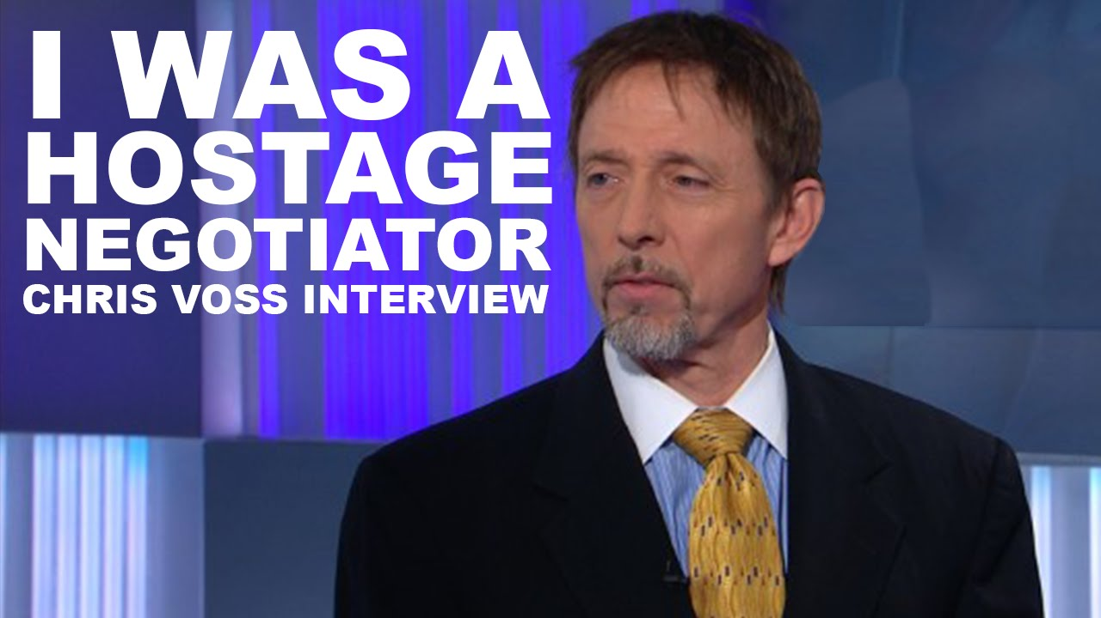
Notes:
Chris Voss may be the best negotiator in the world. Voss spent more than two decades in the FBI, during which he worked on more than 150 international hostage cases. Eventually, he was chosen among thousands of agents to serve as the FBI's lead international kidnapping negotiator--a position he held for four years. Voss fine-tuned his negotiation methods over the years, allowing him to save hundreds of lives.

Slide 52
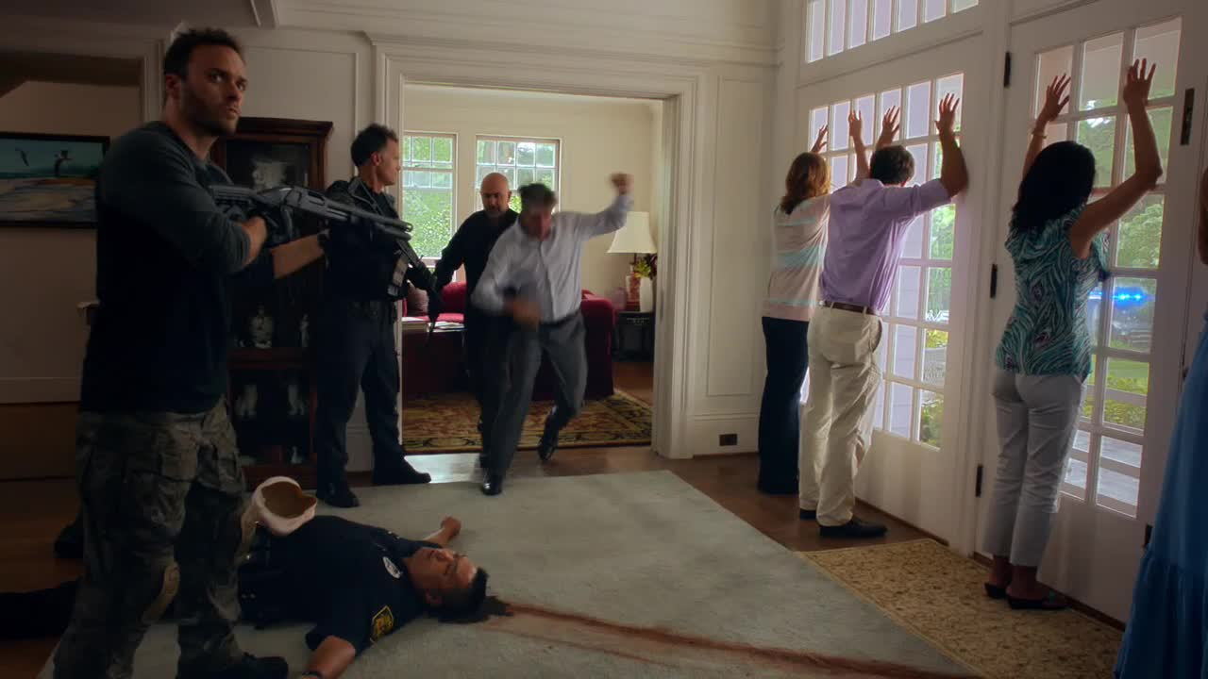
Notes:
Voss recalled one day in 1998, standing in a narrow hallway outside an apartment in Harlem in New York City. Three heavily armed fugitives were reportedly inside, the same fugitives who had engaged in a shootout with rival gang members some days before

Slide 53
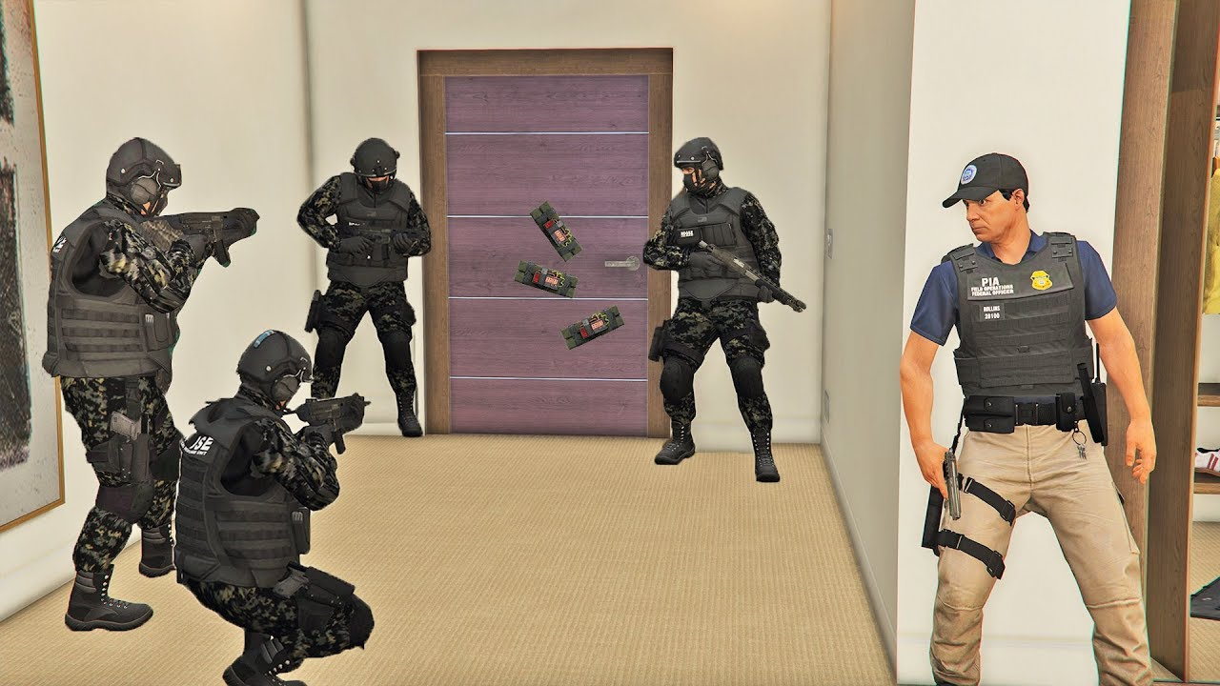
Notes:
A SWAT team stood at attention just a few steps behind Voss. Voss's job: Convince the fugitives to give up without a fight.
With no telephone number to call, Voss was forced to speak through the apartment door. He did so for six hours, with no response. He began to question if anyone was even inside.
Suddenly, the door opened. A woman walked out, followed by all three fugitives.
Not a single shot fired. No loss of life. Not even a harsh word. How did he do it?

Slide 54

Notes:
Using what he describes as his "late-night FM DJ voice," Voss repeated variations of the following: "It looks like you don't want to come out. It seems like you worry that if you open the door, we'll come in with guns blazing. It looks like you don't want to go back to jail."
Afterwards, Voss was curious as to what specifically convinced the fugitives to emerge. "We didn't want to get caught or get shot, but you calmed us down," they said. "We finally believed you wouldn't go away, so we just came out."
This story perfectly illustrates the value of emotional intelligence, the ability to identify, understand, and manage emotions.
"It's not me bringing emotion in; it's already there," Voss told me. "It's the elephant in the room. There's this monstrous creature in the middle of every communication: It's what we want, and it's based on what we care about. Each one of us, we make every single decision based on what we care about, and that makes decision-making, by definition, an emotional process."
"We didn't want to get caught or get shot, but you calmed us down," they said. "We finally believed you wouldn't go away, so we just came out."
Reasoning with empathy
Whether it's interviewing for a job, looking for a discount, or asking someone out on a date, all of us try to influence at one point or another.
But how can you persuade others to hear you out, and going further, to give you a chance?

Slide 55

Notes:
Voss likens the process of influence to a stairway.
"The tendency is to go directly at what you want," he explained. "But, in this case, the shortest distance between two points is not a straight line. It involves taking steps, and each step becomes the foundation for the next. It's about building rapport--and that requires empathy. And one step leads to another, which then puts you in a position to influence others."
The key is developing and demonstrating empathy--the ability to understand another person's feelings, motivations, and intentions. Many think they're pretty empathetic, but when they encounter someone who has a different set of beliefs or values, that empathy goes out the window.

Slide 56
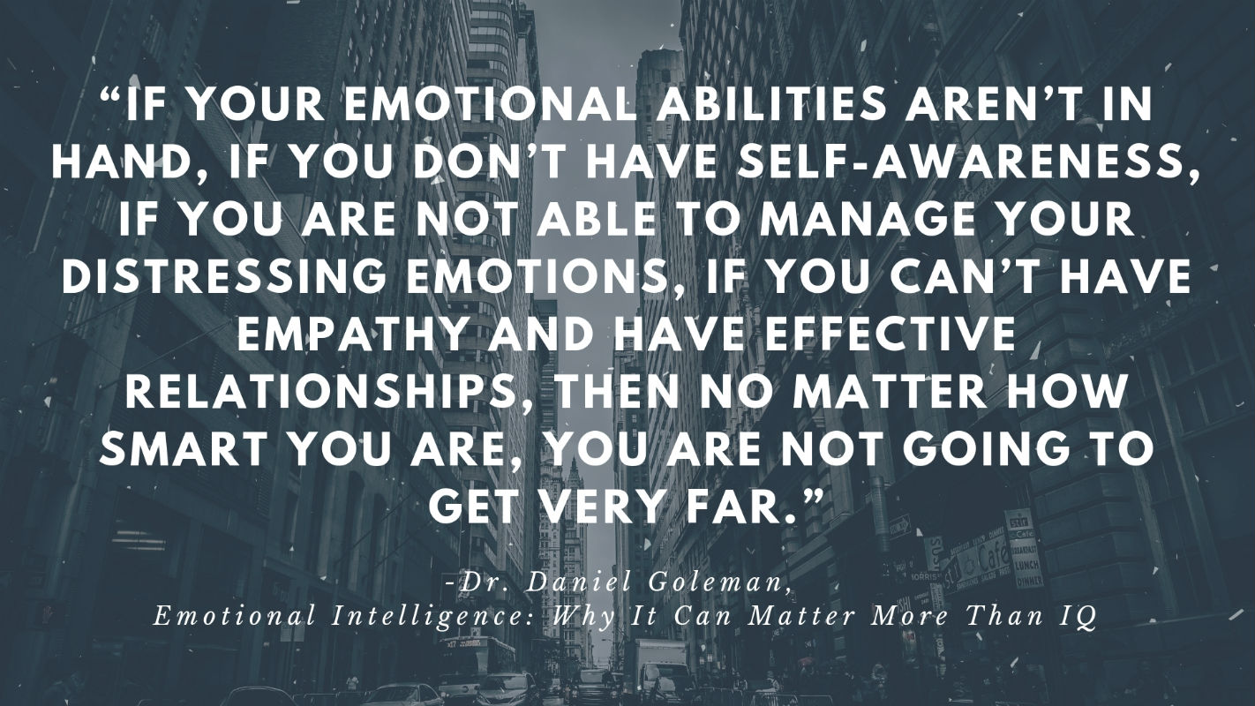

Slide 57


