Slide 1

Supplier
Bidding Process
Selection Procedure
Procurement
Preliminary

Slide 2
Learning Objectives
The participants will be able to:
Understand the importance of business proposal
Create own proposals
Identify various types of proposal and their significance

Slide 3
Definition
Written document whose purpose is to persuade an audience to accept a suggested plan.
Document sent to a prospective client in order to obtain a specific job.
Written offer from a seller to a prospective buyer.
Offer where purchasing company actively seeks proposals that meet specific need of the buyer.

Slide 4
Need for a Business Proposal
Convince the reader to see the world in the same way that you do.
Persuade the reader to make A Change that will make your proposed idea A Reality
Understand your ideas by identifying the key issues, methods, sources of your plan to develop the project.

Slide 5
Types of Business Proposal
BUSINESS PROPOSAL
Formally Solicited Proposals
Informally Solicited Proposals
Unsolicited Proposals

Slide 6
Types of Business Proposal
A formally solicited business proposal is made when you aim to respond to an official request for proposal. It is commonly known as RFP’s
Informally solicited business proposals come in where there isn't an official request for a proposal.
Unsolicited Proposals needs to demonstrate unidentified needs and also should use why one would deal with it. They are also known as Prospecting Proposals.

Slide 7
Format of Business Proposal
Title Page
Cover Letter
Table of Content
List of Illustration
Executive Summary
Introduction and Discussion
Conclusion

Slide 8
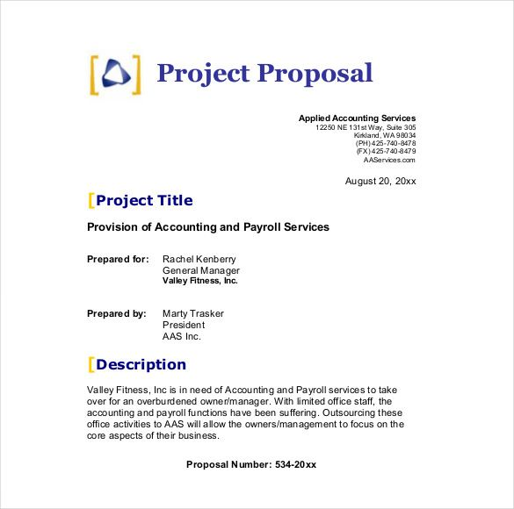
Title Page

Slide 9
Cover Letter
Cover Letter provides the reader an overview of what is to follow.
Why Are you writing?
What you are writing about?
When the action should occur?
Why that day is important?

Slide 10
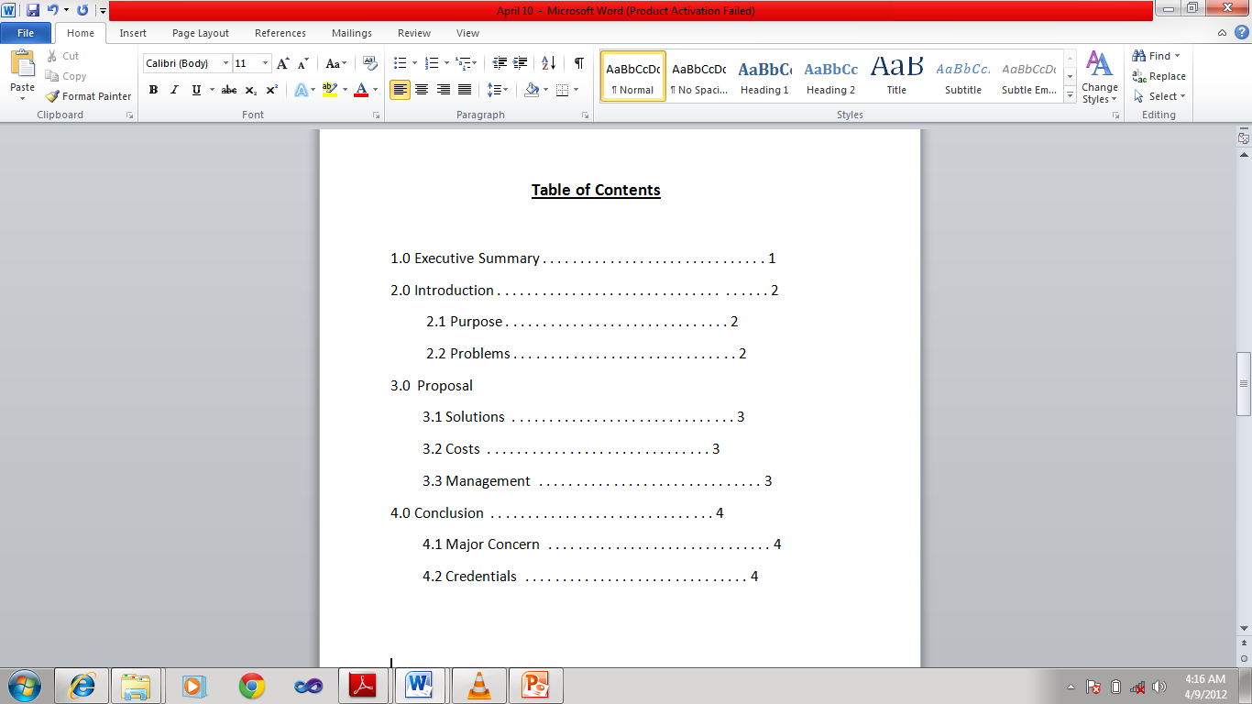
Table of Contents

Slide 11
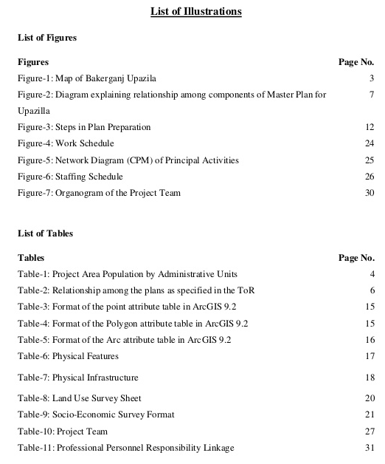
List of Illustrations

Slide 12
Abstract
Abstract is a brief overview of key points.
Abstract should focus on the following:
The Problem necessitating your proposal
Your suggested Solutions
The Benefits
Avoid High tech terminology and Concepts

Slide 13
Procedure of Proposal
The Primary Sections are:
Purpose
Problem

Slide 14
Conclusion
Sum up your proposal.
Provide your reader a sense of closure.
Be specified –state amount and percentage clearly.
Can be made accessible through highlighting techniques.

