Slide 1

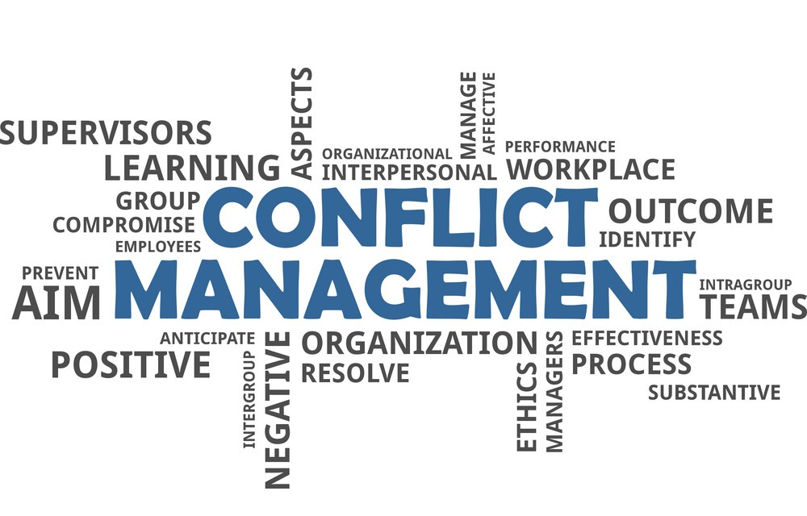
Conflict Management

Slide 2

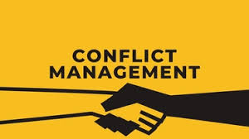
Conflict
Conflict is expressed struggle between
two interdependent parties, who perceive
that incompatible goals.
Conflict management
The opportunity to improve situations
and strengthen relationships.

Slide 3
Characteristics of conflict
Conflict is a process
Conflict is Inevitable
Conflict is a normal part of life
Perception
Opposition
Interdependence and Interaction.

Slide 4
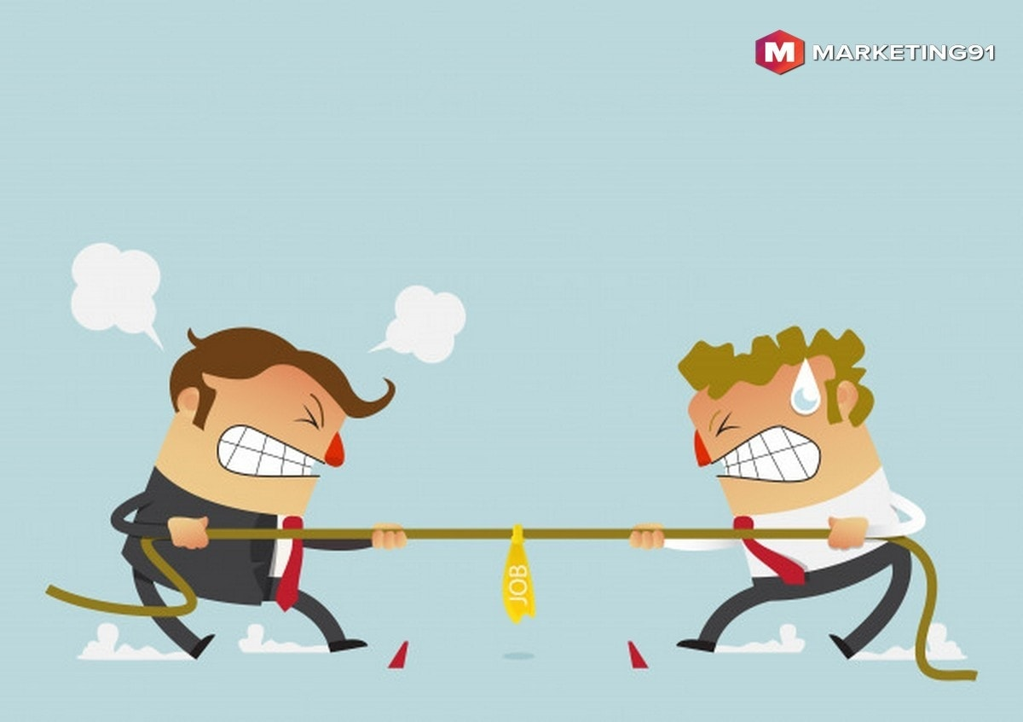
Causes of conflict
Information: Something was missing, incomplete or ambiguous.
Environment: Something in the environment leads to the conflict.
Skills: People lack the appropriate skills for doing their work.
Values: A clash of personal values leads to conflict.
Identity: The participants' sense of identity puts them at odds with each other.

Slide 5
Types of Conflict Management
Types of Conflict Management
Intrapersonal Conflict
Intragroup Conflict
Interpersonal Conflict
Intergroup Conflict
Conflict Resolution

Slide 6
Types of conflict management
Intrapersonal Conflict:
Intrapersonal conflict takes place within an individual.
Thus, it is a type of conflict that is psychological involving the individual’s thoughts, values, principles and emotions
Intragroup Conflict:
Intragroup conflict occurs among individuals within a team.
It starts from interpersonal disagreements like team members have different personalities which may lead to tension or differences in views and ideas

Slide 7
Types of conflict management
Interpersonal Conflict:
Interpersonal conflict means a conflict between two individuals.
So, it is a natural occurrence which can eventually help in personal growth or developing our relationships with others.
Intergroup Conflict:
Intergroup conflict occurs when a misunderstanding arises among different teams within an organization.

Slide 8
Identify which type of conflict each statement describes
________ occurs between two individuals with equal powers.
Ans- Interpersonal conflict
________ occurs between groups regardless of the groups size.
Ans- Intergroup conflict
________ occurs within the individual.
Ans- Intrapersonal conflict
________ occurs between individuals of the same group.
Ans- Intragroup conflict

Slide 9

Functional conflict
Works toward the goals of an organization or group.
Constructive
Increase information and ideas.
Encourages innovative thinking.
And shakers different points of view reduce stagnation.

Slide 10

Dysfunctional Conflict
Blocks and organization or group from reaching its goals
Tension, anxiety, stress
Drives out low conflict tolerant people
Reduce trust
Reduced information

Slide 11
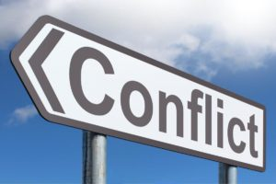
Ways to manage work place conflict
Understand the Situation
Acknowledge the Problem
Patience
Keep the Communication Open

Slide 12

How & When Conflict Arises ?

Slide 13


Conflict in organizations can be caused due to:
Status inconsistencies.
Jurisdictional ambiguities.
Communication problems.
Lack of common performance standards.
Individual differences.

Slide 14
Factors influencing organizational conflict
Unclear Responsibility: If there is lack of clarity, regarding who is responsible for which section of a task or project, conflict takes place.
Interpersonal Relationship: Every member of an organization, possesses different personality, which plays a crucial role in conflict in an organization.
Scarcity of Resources: One of the main reason for occurrence of conflict in an organization is the inadequacy of resources like time, money, materials etc.
Conflict of Interest: When there is a disorientation between the personal goals of the individual and the goals of the organization, conflict of interest arises

Slide 15
Tips for managing conflict
Avoids feeling or perceptions that imply the other person is wrong or need to change.
Communicates a desire to work together to explore a problem or seek a solution.
Exhibits behavior that is spontaneous and destruction-free.
Identifies with another team member’s problems, shares feelings, and accepts the team members reaction.

Slide 16
Conflict indicators
Body language
Colleagues not speaking to each other or ignoring each other
Deliberately undermining or not cooperating with each other to the downfall of the team
Contradicting and bad mouthing one another
Strong public statements
Increasing lack of respect
Open this agreement
Desire of power

Slide 17
Competing
Conflict Management Techniques
Collaborating
Compromising
Avoiding
Accommodating

Slide 18
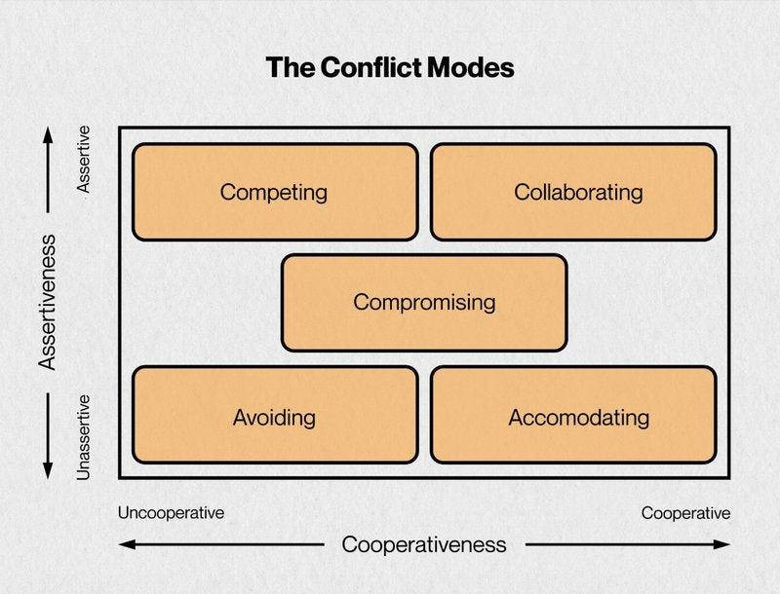

Slide 19

Competing
Emergency situations
Decisive action
Implementing unpopular change
When other methods fail

Slide 20

Collaborating
Merging experiences from people having different backgrounds
Being creative to explore solutions
Looking for solutions where there may not be much conflict

Slide 21

Compromising
To reach agreement when both sides have equal power
To find common ground when both parties have competing goals
To achieve a temporary settlement on a complex issue
To reach a solution due to time pressures

Slide 22

Avoiding
If others can resolve conflict more effectively
If both parties, see the issue as minor
If additional time is required
If both parties need a cooling off period

Slide 23

Accommodating
Preserving the relationship vs arguing the issue
When the issue is more important to the other person
When you want others to express their own point of view
When you want others to learn by their own choices

Slide 24

Collaborating
Pros
  Leads to solving the actual problem.
  Leads to a win-win outcome.
  Reinforces mutual trust and respect.
  Builds a foundation for effective collaboration in the future.
  You earn the reputation of a good negotiator.
  Cons
  Requires a commitment from all parties to look for a mutually acceptable solution.
  The process takes lots of time and energy.
  Some may take advantage of other people’s trust and openness.

Slide 25
Compromising
  Pros
  Faster issue resolution. Compromising may be more practical when time is a factor.
  Can provide a temporary solution while still looking for a win-win solution.
  Lowers the levels of tension and stress resulting from the conflict.
Cons
  Important values and long-term objectives can be derailed in the process.
  May require close monitoring and control to ensure the agreements are met.
  May not work if initial demands are too great.
  Does not contribute to building trust in the long run.

Slide 26
Accommodating
Pros
  Help to protect more important interests while giving up on some less important ones.
  Gives an opportunity to reassess the situation from a different angle.
Cons
  There is a risk to be abused.
  May negatively affect your confidence in your ability to respond to an aggressive opponent.
  It makes it more difficult to transition to a win-win solution in the future.
  Some of your supporters may not like your smoothing response and be turned off.

Slide 27
Competing
Pros
  May provide a quick resolution to a conflict.
  Increases self-esteem and draws respect.
Cons
  May negatively affect your relationship with the opponent in the long run
  May cause the opponent to react in the same way, even if the opponent did not intend to be forceful originally
  Can escalate conflict

Slide 28
Avoiding
Pros
  Withdrawing is a low stress approach when the conflict is short.
  Gives time to focus on more important or more urgent issues instead.
  Gives you time to better prepare and collect information before you act.
Cons
  Important decisions may be made by default.
  Postponing may make matters worse.

Slide 29
Conflict management strategies
Ignoring the Conflict
Physical Separation
Withdrawal
Dominance
Appeal Procedures
Forcing People to Assume another Role

Slide 30
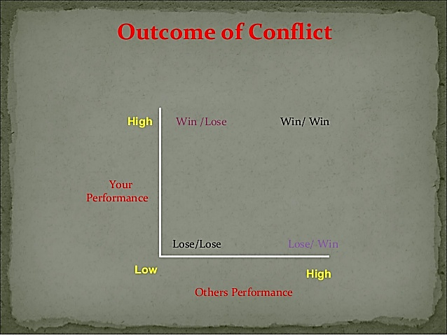
How can conflict can be managed successfully?
Lose-lose methods
Win-lose methods
Win-win methods

Slide 31
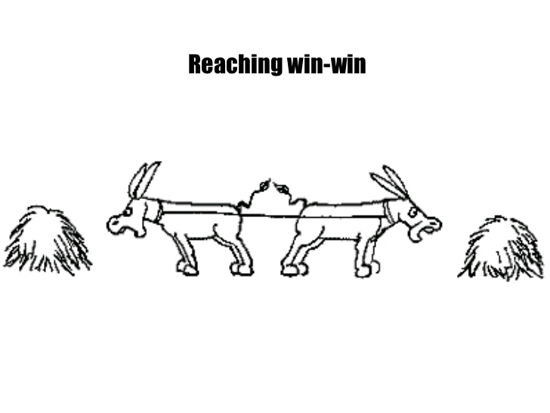
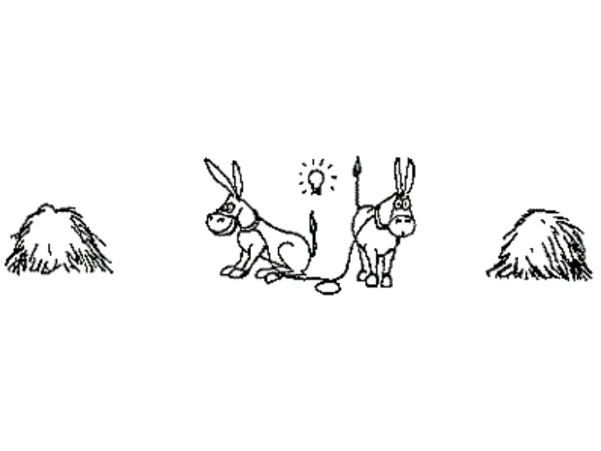
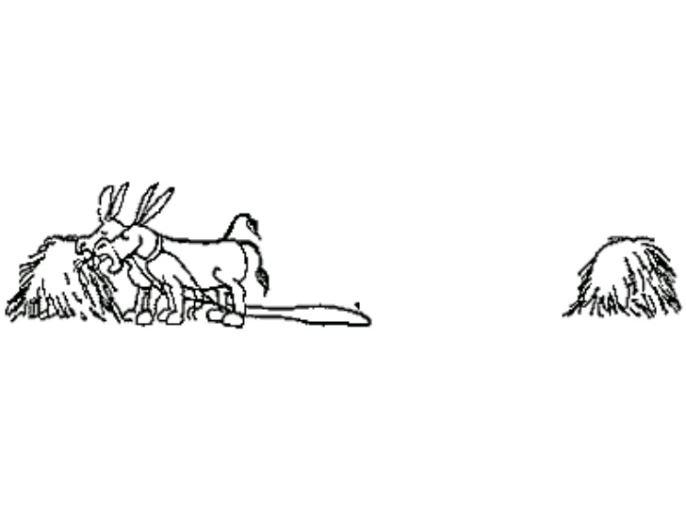
Conflict Continuum
I Win, you Lose ( Competition – A)
I lose or Give in ( Accommodate – B)
We Both get Something ( Compromise- C)
We Both “win” ( Collaborate – D)

Slide 32
Summary
Lose-lose methods: compromise
Win-lose methods: dominance
Win-win methods: problem solving

Slide 33
Conflict resolution
1. Create an Effective Atmosphere
Preparation
Allow time
Choose carefully initial comments

Slide 34
2. Focus on individual and shared needs
Always put yourself in the place of the other party
Identify areas of common interest

Slide 35
3. Look to the future not the past
Don’t let the past rule your thinking
Learn from the past

Slide 36
4. Generate options
Prepare some options in advance
Focus on options that deal with shared needs
Seek options and common ground from other party

Slide 37
5. Flexibility
Be conciliatory
Apologizing
Conceding

Slide 38
Thank You

