Slide 1
Overview of
Sales Management Process
Prof. Megha Halyalkar
ITM Business School, Kharghar

Slide 2
1. What is Sales Management?
Sales management is the process of developing a sales force, coordinating sales operations, and implementing sales techniques that allow a business to consistently hit, and even surpass, its sales targets.
Notes:
If your business brings in any revenue at all, a sales management strategy is an absolute must. When it comes to boosting sales performance for any size of operation, no matter the industry, the secret to success is always precise sales management processes.
Besides helping your company reach its sales objectives, the Sales Management Process allows you to stay in tune with your industry as it grows and can be the difference between surviving and flourishing in an increasingly competitive marketplace.

Slide 3
The Three Key Aspects of Sales Management
There are three “umbrellas” to manage within the sales process:
Sales Operations
Sales Strategy
Sales Analysis
The process will vary from business to business, especially as you work your way down the line, but Operations, Strategy and Analysis are the three key starting or focal points.

Slide 4
Sales Operations – Building the Team
The sales team is the backbone of the company; they are the direct connection between the product and the customer.
When selecting and onboarding new talent, you should take your time to be thorough in training them and developing their skills, regardless of their experience.
Salespeople shouldn’t just become great sellers, but need to be great at selling your product, and become a representative of your organization that customers want to work with.

Slide 5
Sales Strategy: Defining the Sales Process
Once you have a team and know your targets, you might be wondering: How do you actually carry out the sales?
Every business has a sales cycle, which is a series of tasks that helps a company’s product/service reach its users. Therefore, having a sales pipeline, or sales funnel, will make that easier to maneuver these deals to completion.
Sales Pipeline - A sequence of activities to achieve with each prospect, from the initial lead to the closing of the deal. It helps them stay organized and take control of their work.
REMEMBER - “There are some things you cannot control – RESULTS. That’s where managing activities comes into play.”

Slide 6
Sales Analysis: Reporting
Reporting allows you to understand how your current efforts affect your company’s success and gives you insight into what you can do to increase your efforts whether it’s hiring more salespeople or redistributing tasks.
Successful reporting involves using sales metrics, or quantifiable indicators, that tell you how each aspect of your sales operations is performing and whether you are achieving your targets.
With the standard sales funnel, you should be able to measure the following four metrics:
Number of deals in your funnel
Average size of a deal in your funnel
Close ratio, or average percentage of deals that get won
Sales velocity, or average deal lifetime before it is won
Notes:
Reference Article - https://www.pipedrive.com/en/blog/sales-management#:~:text=Sales%20management%20is%20the%20process,strategy%20is%20an%20absolute%20must.

Slide 7
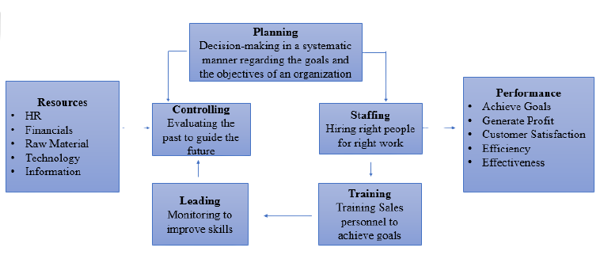
Sales Management Functions

Slide 8
Planning – Building a profitable customer-oriented sales team.
Staffing – Consists of 3 components – Acquisition, Deployment & Retention
Training - Provides frontline sales managers with proven skills, knowledge and tools they need to drive margin line performance.
Leading - Leading is done by the person who possesses the leadership quality, the ability to motivate other people and get the work done. Leading is an effective sales management force that invites the sales management executive to use practical tools and cutting-edge concepts to create an effective sales management model.
Controlling - The task assigned to the sales personnel is monitored to find out whether the organization is achieving its target or the goals as per the planning.
Controlling dwells in verifying whether everything happens in conformity with the plans adopted, instructions issued and principles authorized.
Controlling judges the deviation of actual performance from the standard performance, notices the causes of such deviations and helps in taking corrective actions.

Slide 9
Types Of Selling
Order Takers
Order Creators
Order Getters
Inside
Outside
Delivery Salespeople
Frontline Salespeople
New Business
Organizational
Consumer Salespeople
2. Sales-support Salespeople
Missionary Salespeople

Slide 10

Skills a Sales Manager should Possess

Slide 11
Skills of a Sales Manager
Team Building & Initiative Skills
Listening Skills
Problem-solving Skills
Conflict Management & Resolution Skills
Communication Skills

Slide 12
Listening Skills
A good listener welcomes new ideas, & stays informed, up-to-date in an organization.
Good listening also enhances the impact of what the salesperson speaks to the customer & increases the ability to negotiate
Three types of Listening –
Content Listening
Critical Listening
Empathetic Listening

Slide 13
Communication Skills
The ability & expertise to communicate
The ability to perceive & interpret the customer’s verbal & non-verbal clues
Building a Good long term Relationship with customers on mutual trust
Truth of Words
Predictability of Action
Competency (Ability/Knowledge/Resources)
Intent or Empathy
Likeability

Slide 14
Problem-Solving Skills
Effective problem solvers develop mindsets & habits that help them in handling difficult problems.
These habits include – Being Proactive, Beginning with an end in Mind, Putting First things First, Always thinking Win-Win, Seeking first to understand and then be understood, Synergizing and Renewal.

Slide 15
Conflict Management Skills
Conflicts are more evident in sales organizations than in any other organizations
Can be classified as Functional conflicts, Dysfunctional conflicts, Task conflicts, Relationship conflicts and Process conflicts.
Functional Conflict supports the goals of the group & improves its performance
Dysfunctional Conflict hinders group performance
Task Conflicts are the disputes over the content or goal of the work
Relationship Conflict is tussle based on interpersonal relationships.
Process Conflict is fight over how work gets done

Slide 16
Team building Skills
Make sure that the team goals are totally clear
Make sure there is complete clarity in who is responsible for what and avoid overlapping authority
Build trust with your team members
Allow your office team members build trust and openness between each other in team building activities and events
Try to involve the whole team in the decision making process
Initiative Skills
Never Stand Still
Do More Than is Required Of You
Think as a Team Member, Not An Employee
Speak Up And Share Your Ideas
Consider Every Opportunity
Always Be Prepared
Ask Too Many Questions

Slide 17
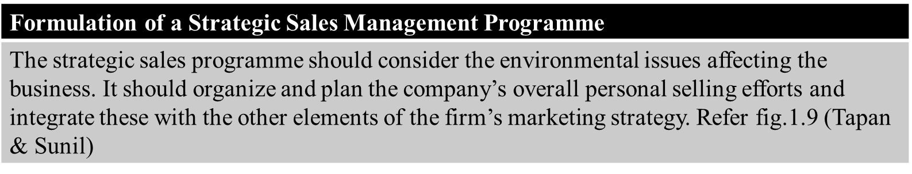
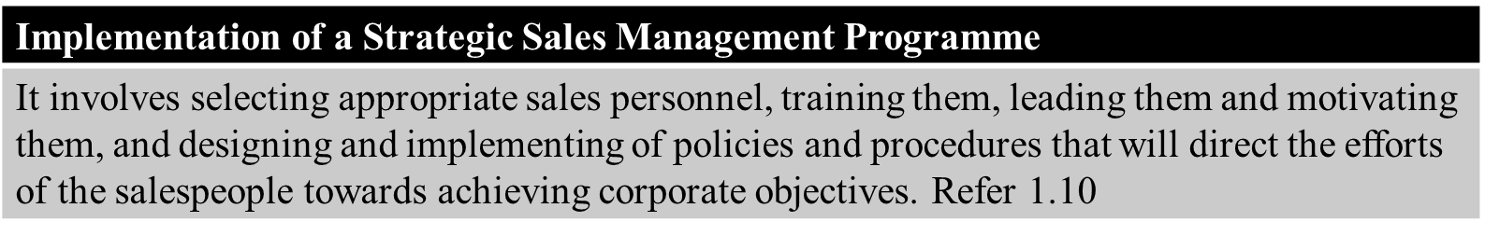
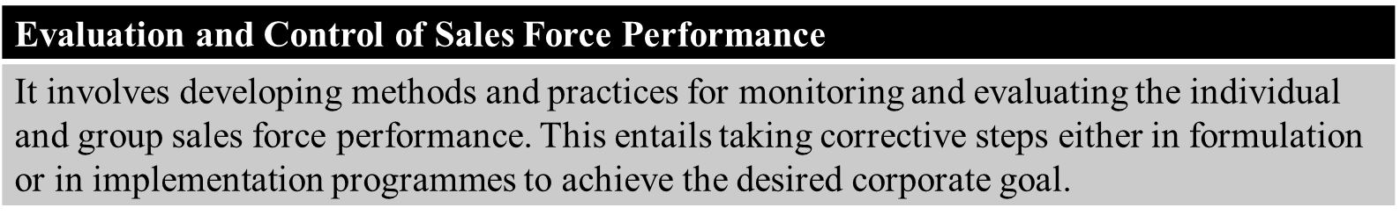
SALES MANAGEMENT PROCESS

Slide 18
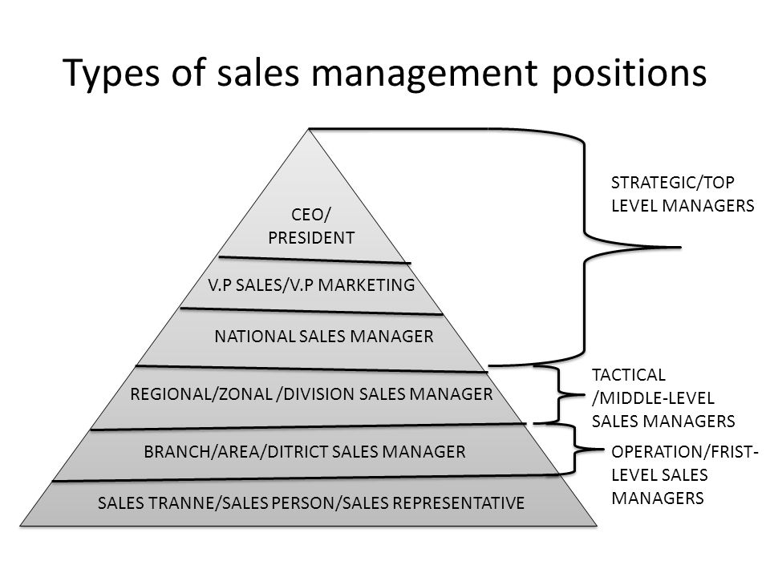
LEVELS OF SALES MANAGEMENT POSITIONS

Slide 19
RESPONSIBILITIES OF A SALESPERSON
Primary responsibility – To increase sales
Prospecting
Maintaining customer records & information feedback
Providing Service
Handling Complaints
Tour Management
Relationship Management
Notes:
Refer this link - https://www.managementstudyhq.com/responsibility-of-salesperson.html

