Slide 1
UNDERSTANDING
SALES FUNNEL
Prof. Megha Halyalkar
ITM Business School, Kharghar

Slide 2
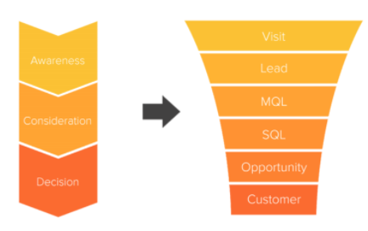
What is Sales Funnel?
A model to visualize every stage in the customer journey, from the time perspective customers learn about a brand to the moment they make a purchase.
The top of the funnel represents ‘awareness,’ when potential customers discover a brand, while the bottom represents the 'decision,' when prospects convert into actual customers. At each stage the number of prospects narrows, with only a fraction converting in the end.
Notes:
Refer the Article - https://www.hotjar.com/conversion-rate-optimization/glossary/sales-funnel/

Slide 3
Why Sales Funnels are Important?
Allows companies to visualize each step that prospects take on the path to conversion.
Each step is a micro-conversion that can be optimized to increase conversions in the end; if one of these steps shows a higher-than-expected drop-off rate, it can be analyzed to see what’s wrong and test out possible improvements.
Funnel tools like Google Analytics helps to visualize the flow of customers across your website and spot pages with high drop-off rates, displaying how many visitors exit the funnel at each step.

Slide 4
How does a Sales Funnel work?
In a traditional sales funnel, the moment of awareness is at the top: it’s the point of entry, the widest part: anyone can start from there. Once prospects enter the funnel, there are steps they can take to continue down towards the bottom, but they can also exit at any point.
Each step they take downwards is another stage of the funnel, leading them closer and closer to the narrowest point—the point of decision—which you’re hoping is the point of conversion.

Slide 5
Let’s see the Funnel from a Customer’s Perspective
They’re not traveling through a Sales Funnel, and they’re not on a customer journey: they’re simply shopping.
Rather than thinking about each stage in the sales funnel, prospective customers are experiencing each stage.
When you learn how a sales funnel works from the customer’s perspective, you can better understand drop-off points, and make improvements to each stage in the sales funnel to increase conversion rates.
Your job is to make each stage of the sales funnel as simple and painless as possible (maybe even enjoyable!) for your prospects, to motivate them to keep moving through the funnel to the point of decision.

Slide 6

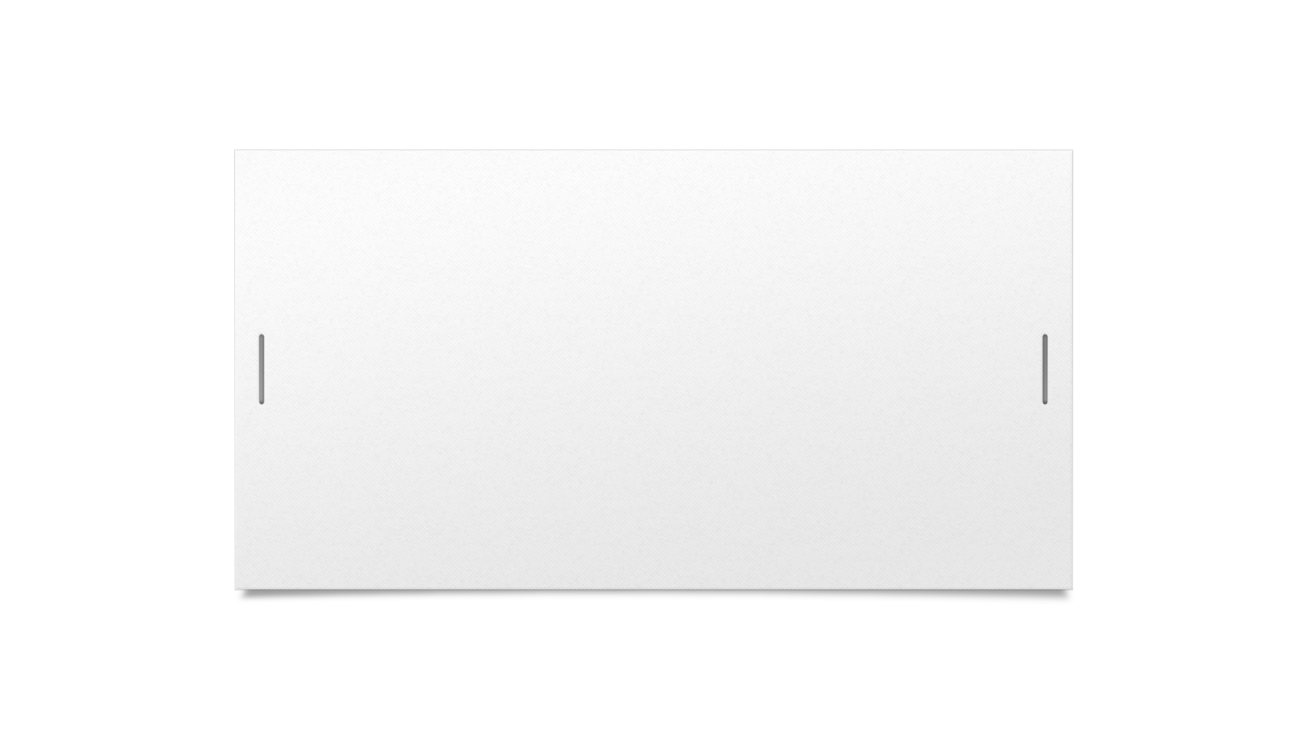
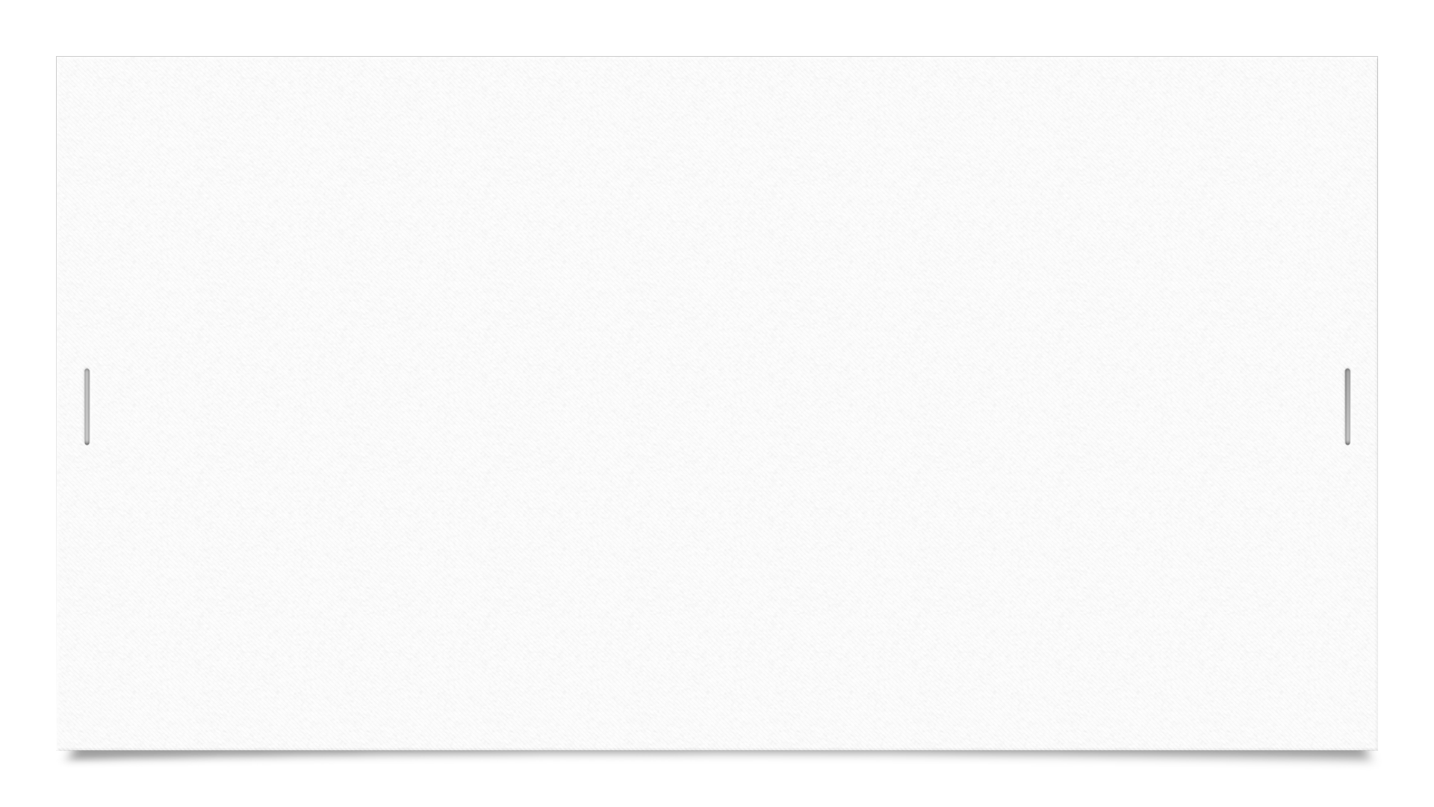
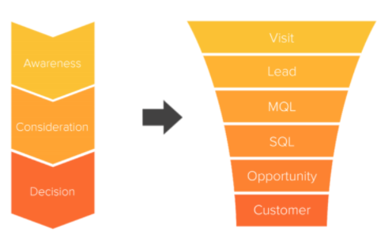


The 6 Sales Funnel Stages
Notes:
The stages of a sales funnel are traditionally split into three parts:
‘Awareness’ indicates the stage when the prospective customer has discovered your business and is aware of your product in general terms
‘Consideration’ indicates the stage when the prospective customer has shown interest in your product by browsing your site and doing product research and comparisons
‘Decision’ indicates the stage when the prospective customer reaches the point of conversion and decides to either exit the funnel or purchase your product
The magic happens when we break these three parts down into different stages, so we can identify potential drop-off points.

Slide 7
Stage 1: VISIT
At this stage, prospective customers are arriving on your landing page, and are navigating to different pages of your website. They’re at the widest point of the funnel: if they were in a brick and mortar shop and a salesperson approached them at this point, the customer would say, “I’m just looking.”
Stage 2: LEAD
When the customer sees something they like, they take a step downwards in the funnel, and they become a ‘lead.’
At this point, leads have a clear interest in your product, and they may start doing product research and comparisons. This point of the funnel is still pretty wide—the customer has a problem and is aware of your proposed solution, but it’s still unclear whether or not your product will meet their needs.

Slide 8
Stage 3: Marketing-Qualified Lead (MQL)
At this stage, your leads are going to realize one of two things: either your product has the potential to work for them, or it absolutely does not.
If you’ve done your homework, like running a market research, your unique selling proposition (USP) is clear, and you’ve tailored your sales funnel to attract ‘marketing-qualified leads’ (MQLs) based on user personas that you built from demographic and psychographic data. Don’t fret:
Leads that are exiting the funnel at this point are most likely not your ideal customers. So, No need to Fret.

Slide 9
Stage 4: Sales-Qualified Lead (SQL)
When a prospect (customers) takes the step from MQLs to SQLs (‘sales-qualified leads’), this means that they are nearing the end of the ‘Consideration/Interest’ stage and are now close to entering the ‘Decision’ stage of the sales funnel.
SQLs have researched and compared products, and have determined that yes, your product does fit the bill, and is a viable solution to their problem.
The leads that are exiting the funnel at this point are a missed opportunity—they found another solution.
The next important step is - preventing SQLs from exiting the funnel:

Slide 10
Stage 5: OPPORTUNITY
This is where your offer and call to action (CTA) take the stage.
When an SQL has made it to this point in the funnel, they are only one step away from converting (so close!). Your USP and CTA could make or break the opportunity stage of the sales funnel. Either your product is the one solution, or it is not. Your job is to put the customer at ease - be ready to answer their questions and provide social proof.
Stage 6: CUSTOMER
They made it! This point of the funnel is the final stage—where conversion happens—and prospects can now step out of the funnel as your newest official customers.
This final step presents an opportunity for you to motivate the customer to come back and browse more products—to become an advocate for your brand.

Slide 11
Tailor your funnel to your ideal customers in 3 steps
Trying to convert everyone who enters their funnel? Is not only unrealistic, but also inefficient.
A better way to increase conversions is to start at the bottom stages of your funnel (at or near the conversion stage) and work backward to improve the user experience for your ideal customers.
Step 1 – Build User Personas
Step 2 – Spot the Problem Pages
Step 3 – Understand the issues that need fixing

Slide 12
Step 1 – Build User Personas
Your ideal customers are the ones who would benefit most from what you have to offer; when you build your funnel around their needs and drives, you can quickly boost conversions.
To find your ideal customers, start by building a user persona: a semi-fictional character based on demographic and psychographic data of the people who buy your products, which answers these three questions:
Who are your customers?
What is their main goal?
What is preventing them from getting what they want?
On-page surveys to your website, Customer Interviews etc

Slide 13
Step 2 – Spot the Problem Pages
Set up a funnel tool to start collecting traffic data. A typical e-commerce funnel might look like this:
homepage > category page > product page > cart > checkout > thank you page
As you collect the data, you'll be able to identify the high-traffic, high-exit pages where visitors are leaving your website.

Slide 14
Step 3 – Understand the issues that need fixing
After you've identified your problematic pages, it's time to dig deeper. Using a combination of behavior insight and user feedback tools lets you discover how your customers actually behave and what they think of their experience:
Heatmaps, Session Recordings, On-page surveys.

