Slide 1

Integrated Digital Marketing Communication

Slide 2
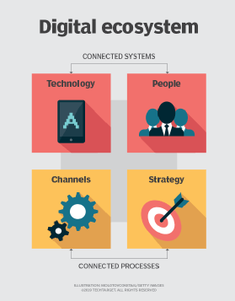
Introduction to Digital Ecosystem
A digital ecosystem is a complex network of stakeholders that connect online and interact digitally in ways that create value for all.
Example: The Modern Banking

Slide 3
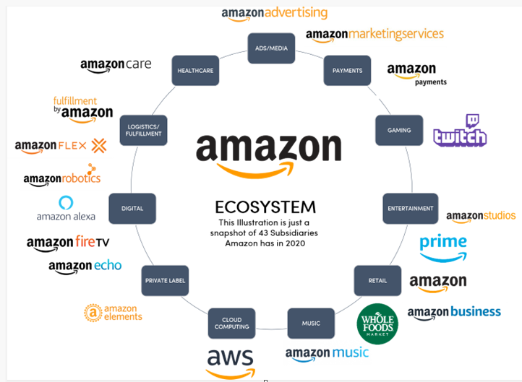
Example: Amazon

Slide 4
5 Key Characteristics of a digital ecosystem
Customer Centric
Data Driven
Automated
Global
Dynamic

Slide 5
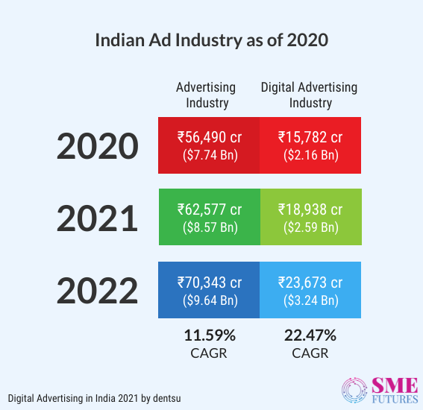
Advertising spends of the Industry (India)

Slide 6
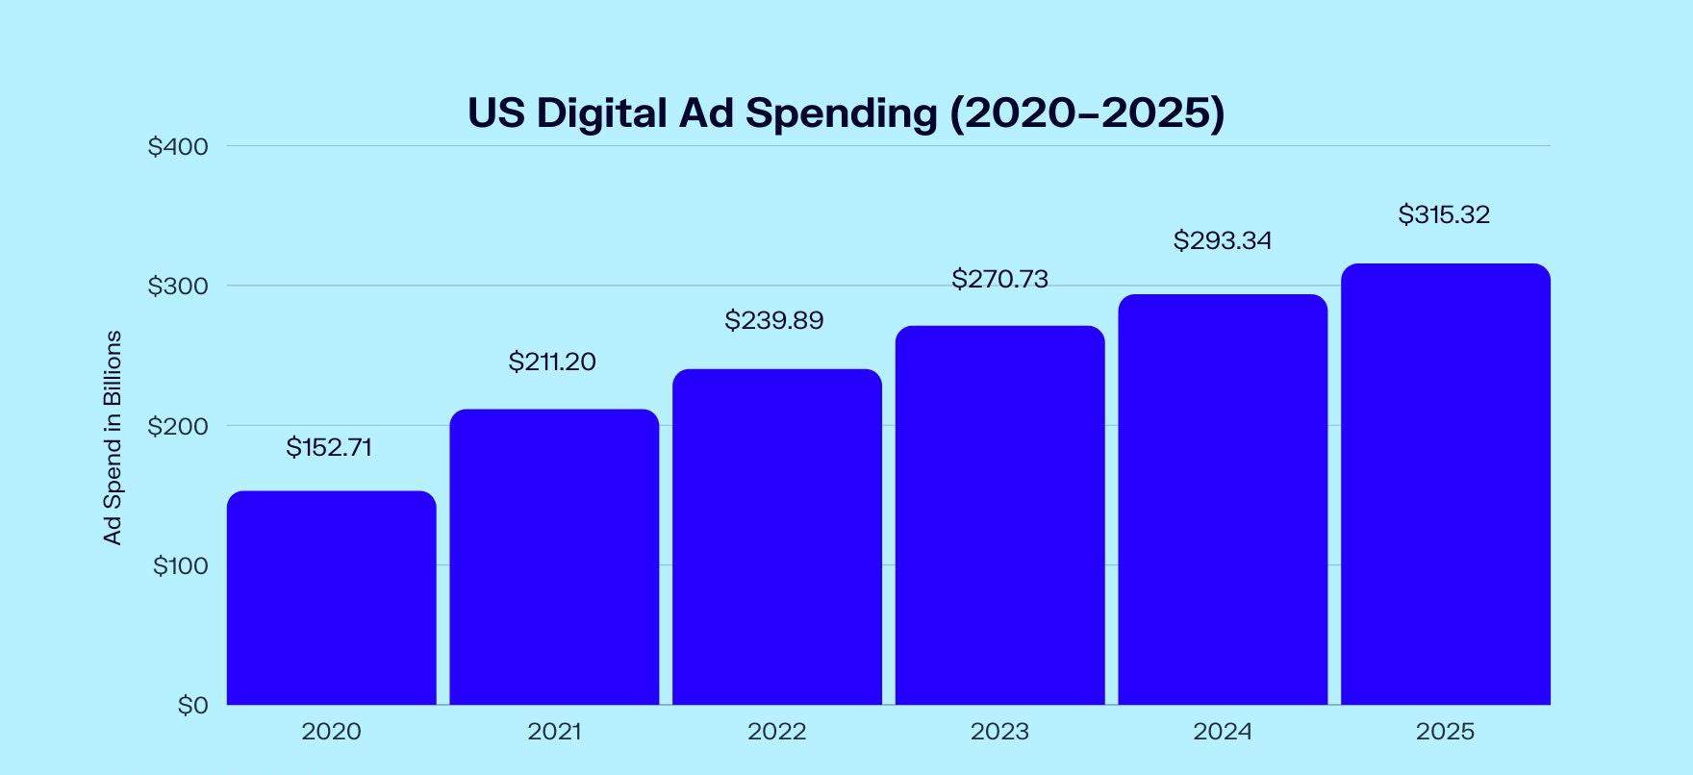
Advertising spends of the Industry (US)

Slide 7
Penetration of Programmatic advertising
Programmatic mobile video ads see 194% growth in India: InMobi report
InMobi's latest report reveals that 42% of all in-app programmatic spending is accounted by video
There was a 23% YoY growth in CTR for in-app video.
he report throws insights on the change in advertiser spends and the performance of video as a format from data analyzed on the InMobi Advertising Platform between January 2020 and January 2021.

Slide 8
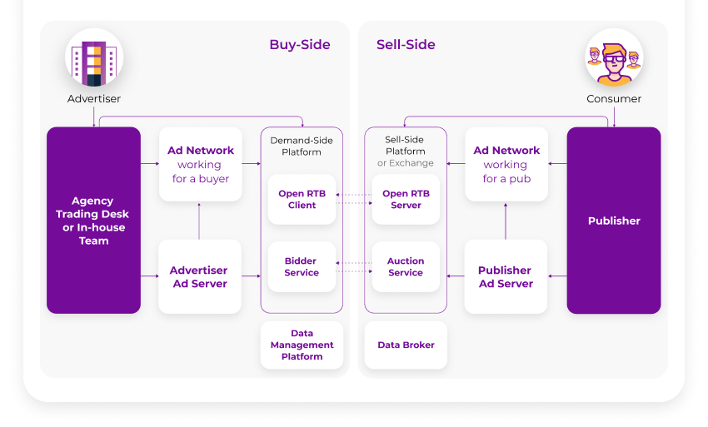
Opportunities for advertisers and publishers

Slide 9
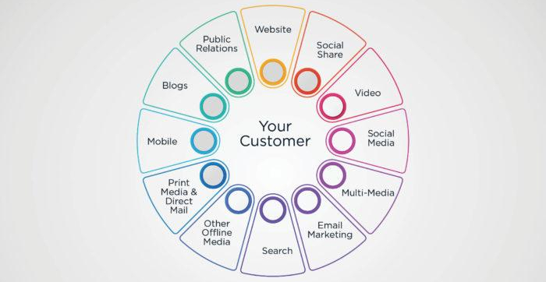
What are the channels of an Integrated Digital Marketing strategy?

Slide 10
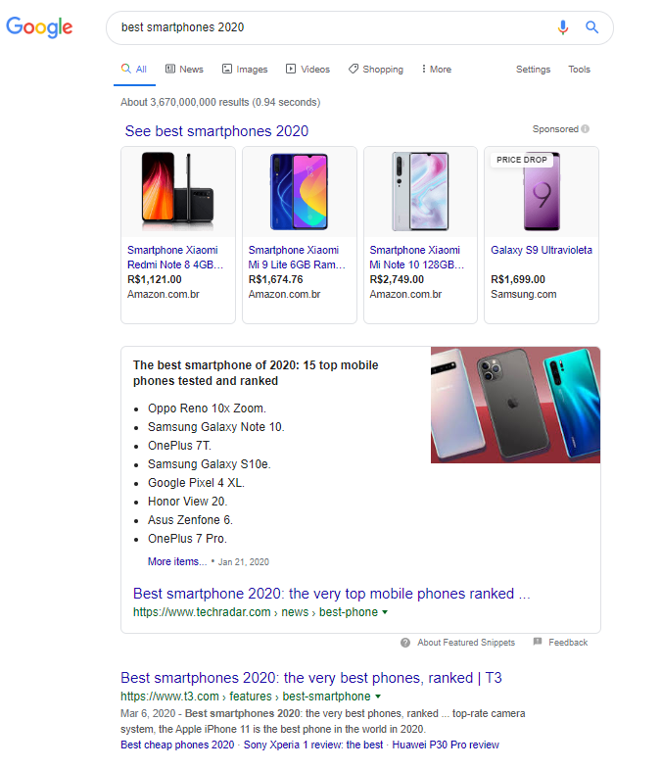
1. Organic Search
Organic search should lead prospects to pages that represent clearly who you are and what you’re offering.

Slide 11
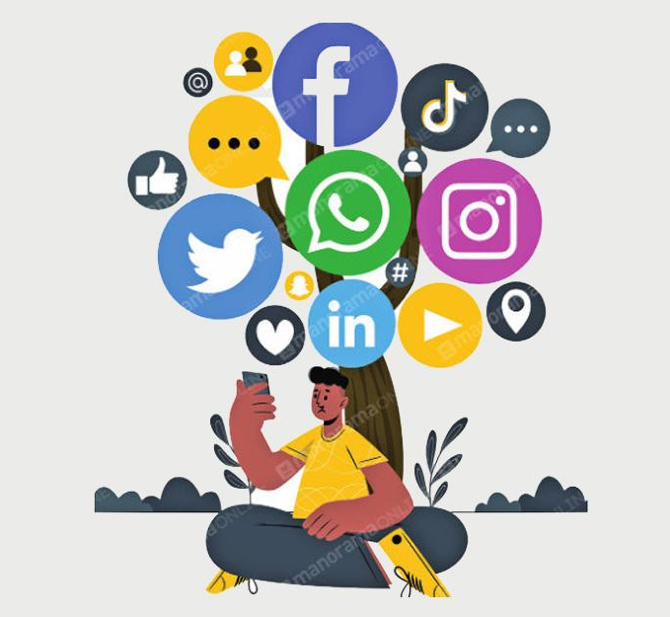
2. Social Media
Social Media is a term that encompasses many channels of communication.
It’s a set of communities that gathers 3.5 billion people, which is 45% of the world’s population, as the We Are Social study showed last year.

Slide 12
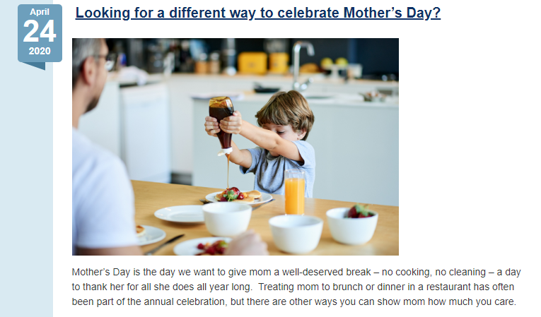
3. Content Marketing
It’s essential to focus on creating useful, powerful, interactive content, with the same language you’re speaking in all the other channels.
If your content follows your Social Media strategy, for instance, you can send people from Facebook or Instagram to sign up for more on the website.

Slide 13
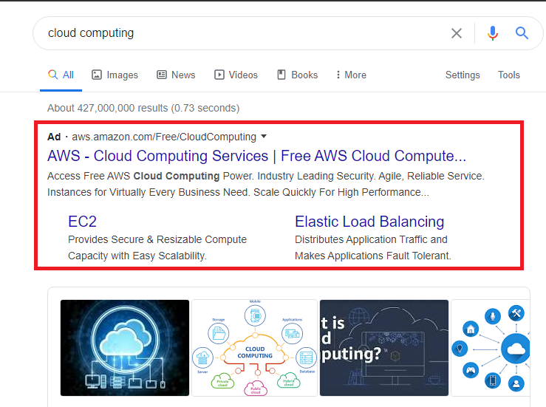
4. Paid Advertising
When it comes to paid advertising, it’s pretty much the same. This channel can complement the others. It doesn’t matter if you’re working with one of these:
paid search: pages that show up on top of Google results page;
display ads: banners that communicate through visual and text on sites/blogs;
social media ads: visual pieces created to spread on social networks.

Slide 14
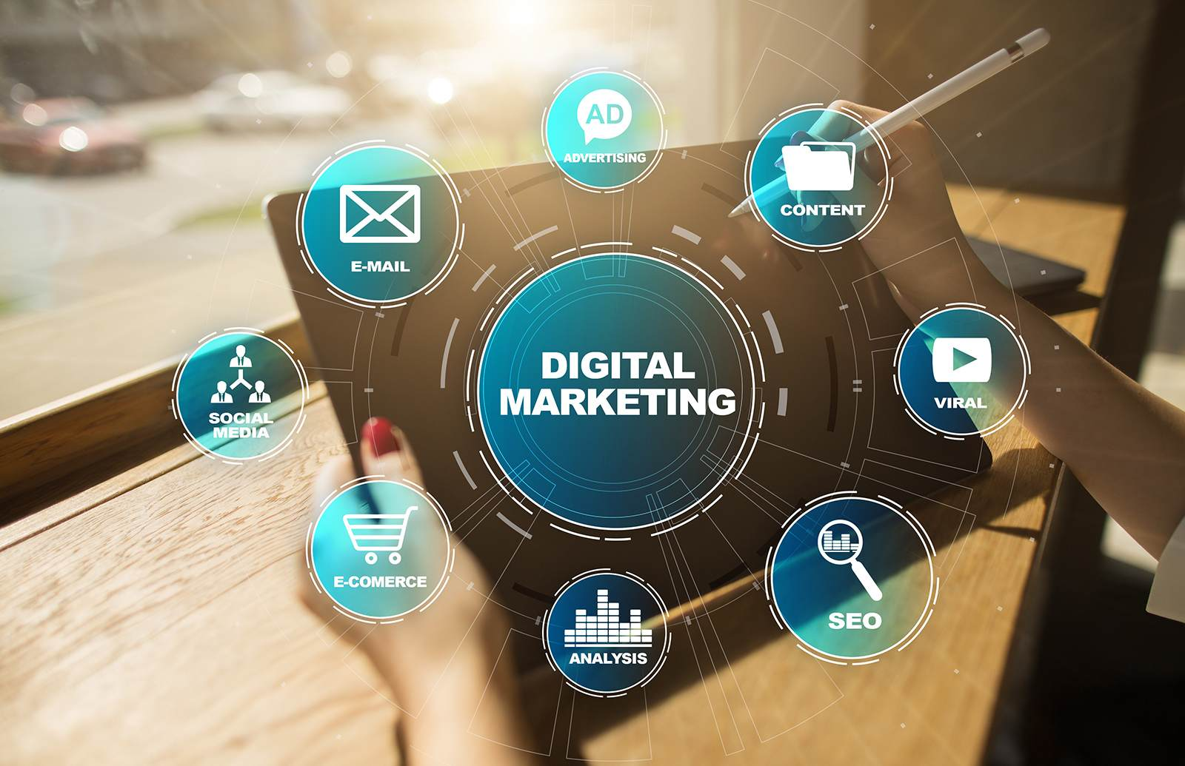
What is Digital Advertising?
Digital advertising refers to marketing through online channels, such as websites, streaming content, and more. Digital ads span media formats, including text, image, audio, and video.

Slide 15
What is programmatic advertising?
Programmatic advertising is the automated buying and selling of online advertising.
This automation makes transactions efficient and more effective, streamlining the process and consolidating your digital advertising efforts in one technology platform.

Slide 16
An Example of How Programmatic Advertising Works:
Advertiser Totally Tubular wants to sell more surfboards
It hires a programmatic advertising platform that is able to identify online consumers by things like:
demographics (male / female / 18 – 45),
geography (3 min from a beach),
interests (surfing, saltwater, California),
behaviors (consume surfing content on their lunch break),
time of day (7-10PM)
weather (sunny)
device (smartphones)

Slide 17
Benefits Of Programmatic Advertising
Better Targeting
Streamlined campaign management
Easy access to ad inventories

Slide 18
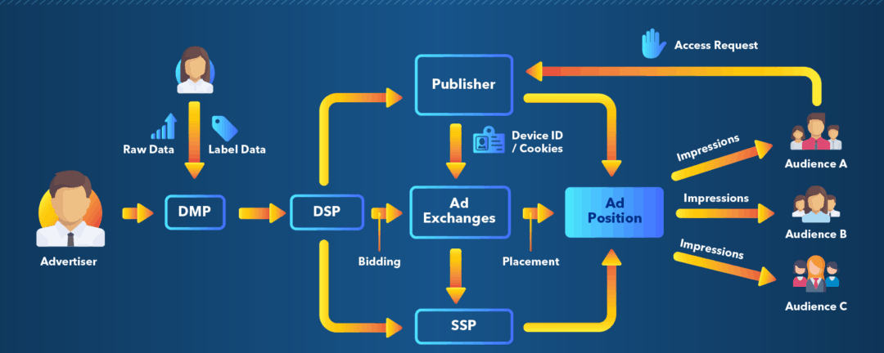
How Programmatic Advertising Works?

Slide 19
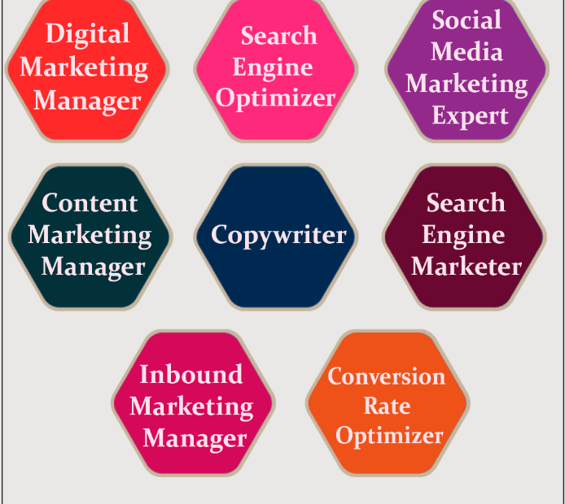
Types of Jobs and opportunities in the Industry

Slide 20
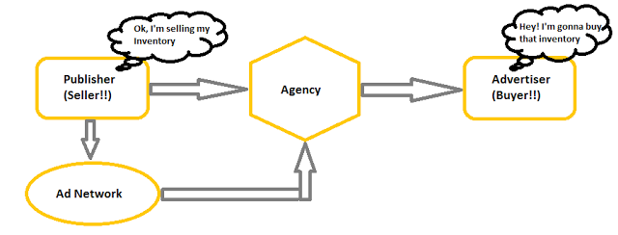
Publisher
A publisher is a place to display that message, with a viewership the advertiser is interested in converting.
It's possible to be an advertiser and a publisher at the same time. If an app is running its own advertisements while also hosting ads, it is simultaneously an advertiser and a publisher.

Slide 21
What is inventory Monetization?
Publishers typically set aside certain amounts of space within the site for affiliate, banner, text or other forms of advertising and then sell space to advertisers. The ways in which the sites, or blogs, make money from content is known as monetizing inventory.
Examples:
Selling ad placements, including display, native, affiliate, and text ads.
Launching sponsored content, written or produced on behalf of a brand partner.
Offering paid membership subscriptions, such as for a monthly or yearly fee.

Slide 22
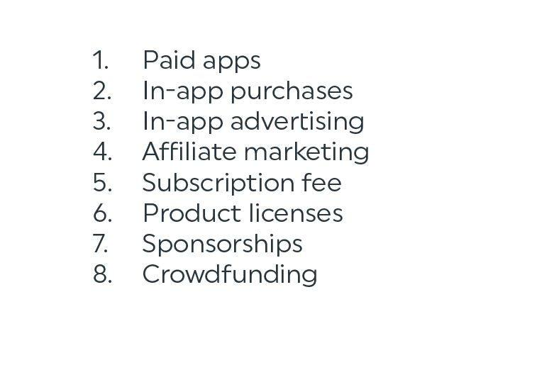
Types of Monetization

Slide 23
How to monetize Inventory?
Content Media
Social Media
Ad Types
Sales Approaches
Sponsored Content
Membership Website

Slide 24
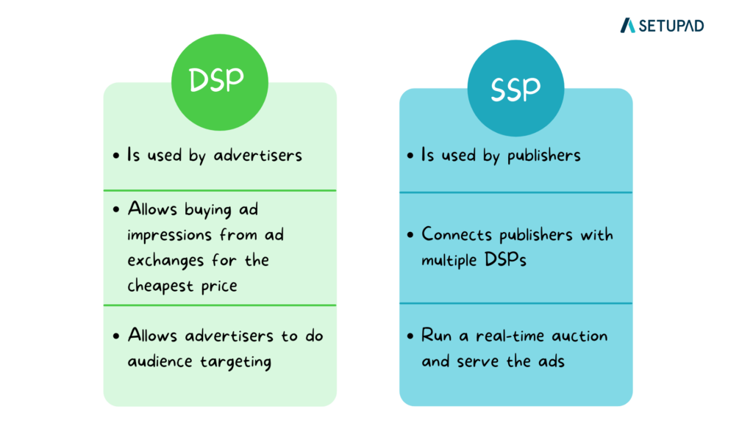
Direct advertiser’s vs SSPs

