Slide 1

Ad Network

Slide 2
Introduction
An online advertising network or ad network is a company that connects advertisers to websites that want to host advertisements. The key function of an ad network is an aggregation of ad supply from publishers and matching it with advertiser's demand.
Examples: Google AdSense, Media.Net, BuySellAds and Conversant.

Slide 3
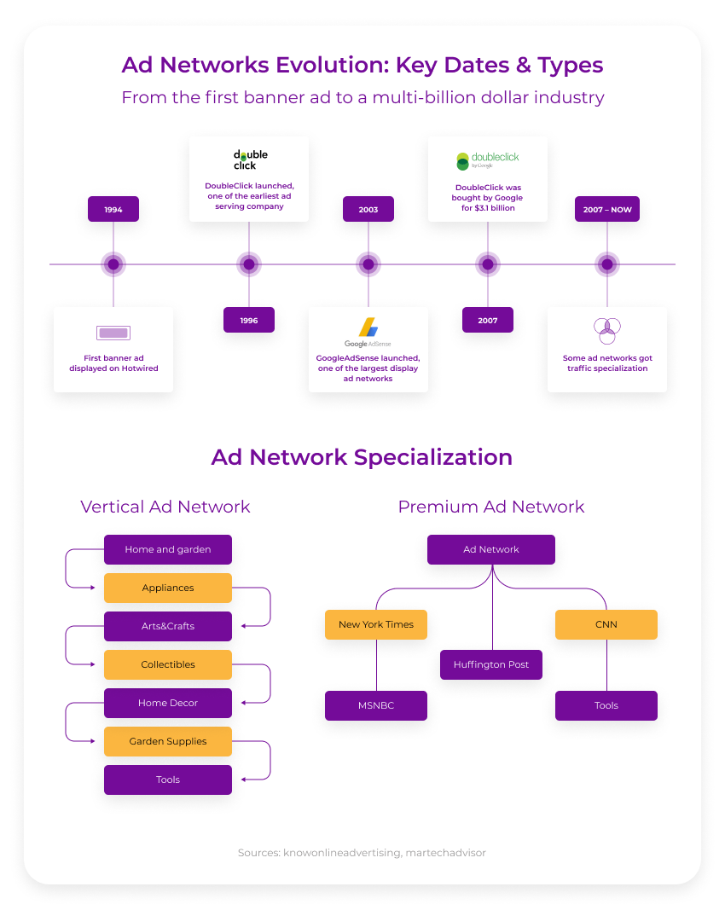
Ad Networks Evolution

Slide 4
Types of Ad Network
Vertical Networks
Premium Networks
Inventory-specific networks: Ad networks that provide a specific type of ad inventory, such as video or mobile.
Horizontal Networks

Slide 5
Vertical Network
Ad networks that are topic-specific, such as fashion, automotive, or business.

Slide 6
Premium Networks
Ad networks that offer inventory from popular publishers.

Slide 7
Inventory-specific networks
Ad networks that provide a specific type of ad inventory, such as video or mobile.
Ad networks traditionally collect unsold ad inventory from multiple publishers and offer this pool of impressions to advertisers at a much lower price than a publisher's direct sales. This kind of inventory is often referred to as non-premium, or remnant.

Slide 8
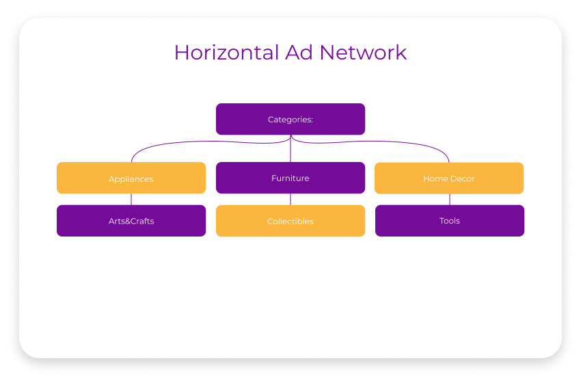
Horizontal Networks
Horizontal ad networks offer higher scale, reach and multiple targeting capabilities for advertisers.

Slide 9
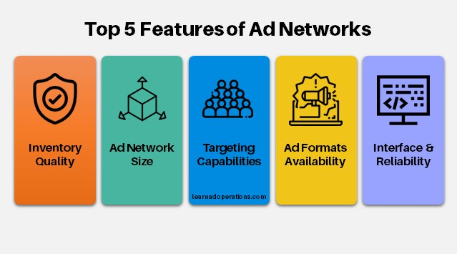
Features of Ad Networks

Slide 10
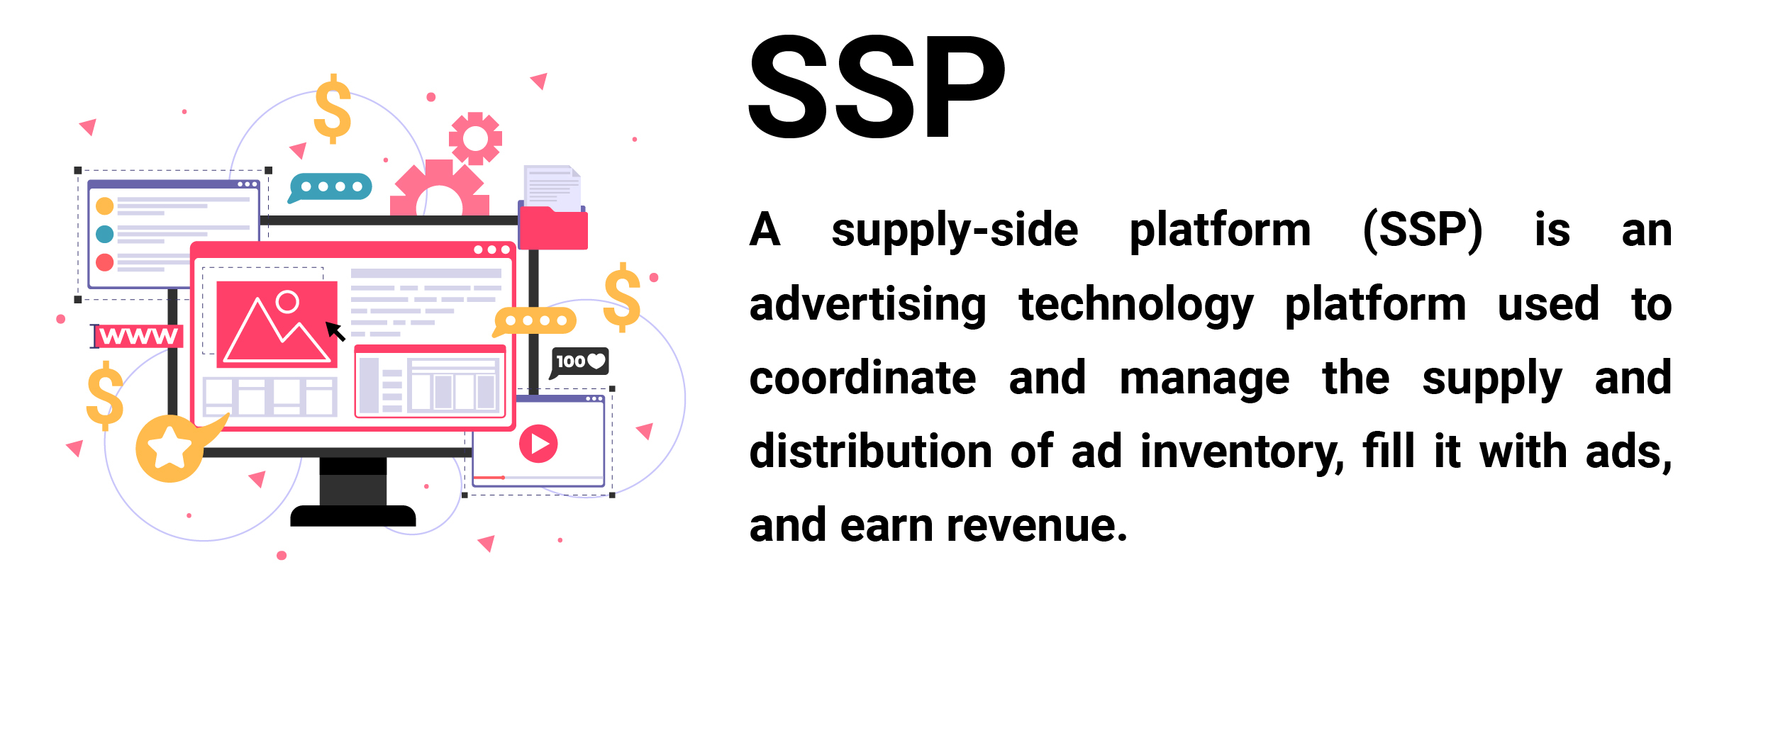
Supply Side Platform

Slide 11
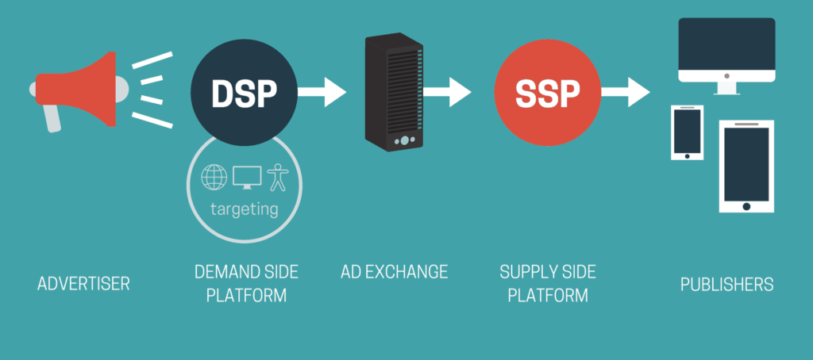
How Does A Supply-Side Platform (SSP) Work?

Slide 12
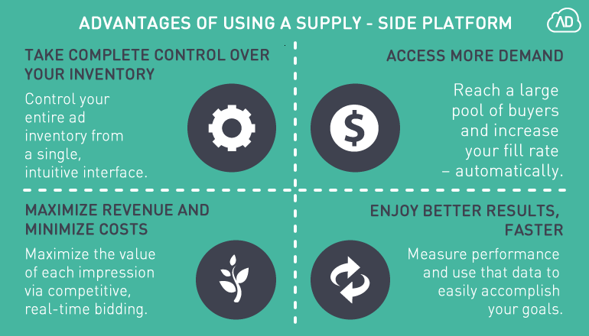
Benefits of SSP for publishers

Slide 13
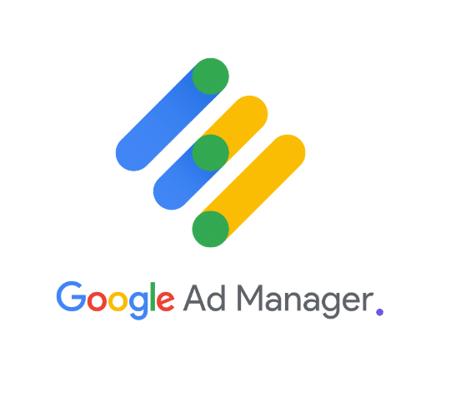
Examples of SSP
Google Ad Manger
Google Ad Manager is both a supply side platform and an ad exchange. It’s free for publishers that have over 5 million pages views and offers full capabilities for managing ad inventory for video, native, and custom ad formats

Slide 14
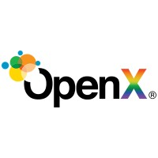
OpenX
OpenX offers products for both publishers and advertisers. The supply side platform includes OpenX Bidder for real-time bidding, OpenX Mobile and OpenX Video for direct access to quality mobile and video advertisers, and OpenX Private Marketplaces for direct access to premium advertisers.

Slide 15
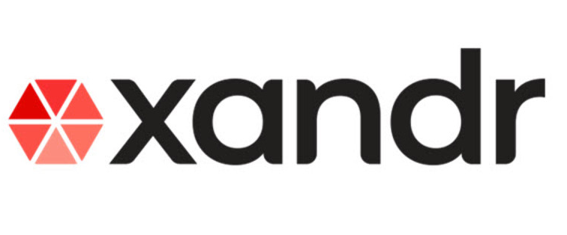
Xandr (formerly AppNexus)
Xandr has a broad offering of solutions from an SSP to a DSP and ad exchange. It includes Xandr Invest, a DSP and connected TV offerings; Xandr Monetize, its SSP solution, and MonetizeTV, a connected TV solution for media companies.

Slide 16
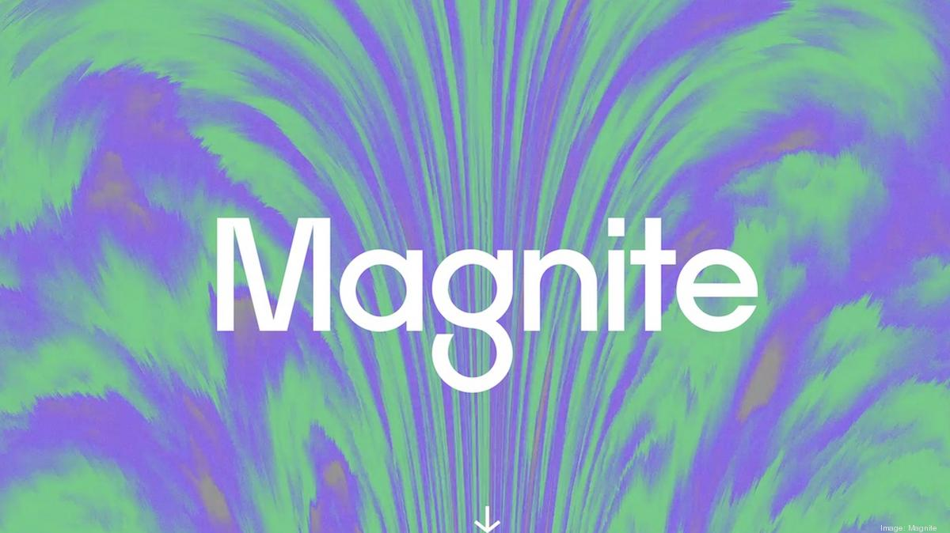
Magnite (formerly Rubicon Project)
Magnite provides both an SSP for publishers and a DSP for advertisers. It also offers a private marketplace (PMP) and Programmatic Guaranteed (PG) and Auction Package capabilities that give publishers complete control over their inventory and audiences.

Slide 17

PubMatic
PubMatic is an SSP for publishers and agencies. It includes private marketplaces, a premium header bidder solution, and support for real-time bidding. Another key feature of PubMatic is its suite of ad quality tools that help publishers ensure the best ads are placed on their properties (it has strategic partnerships with ad quality enterprises, The Media Trust, and Confidant).

Slide 18
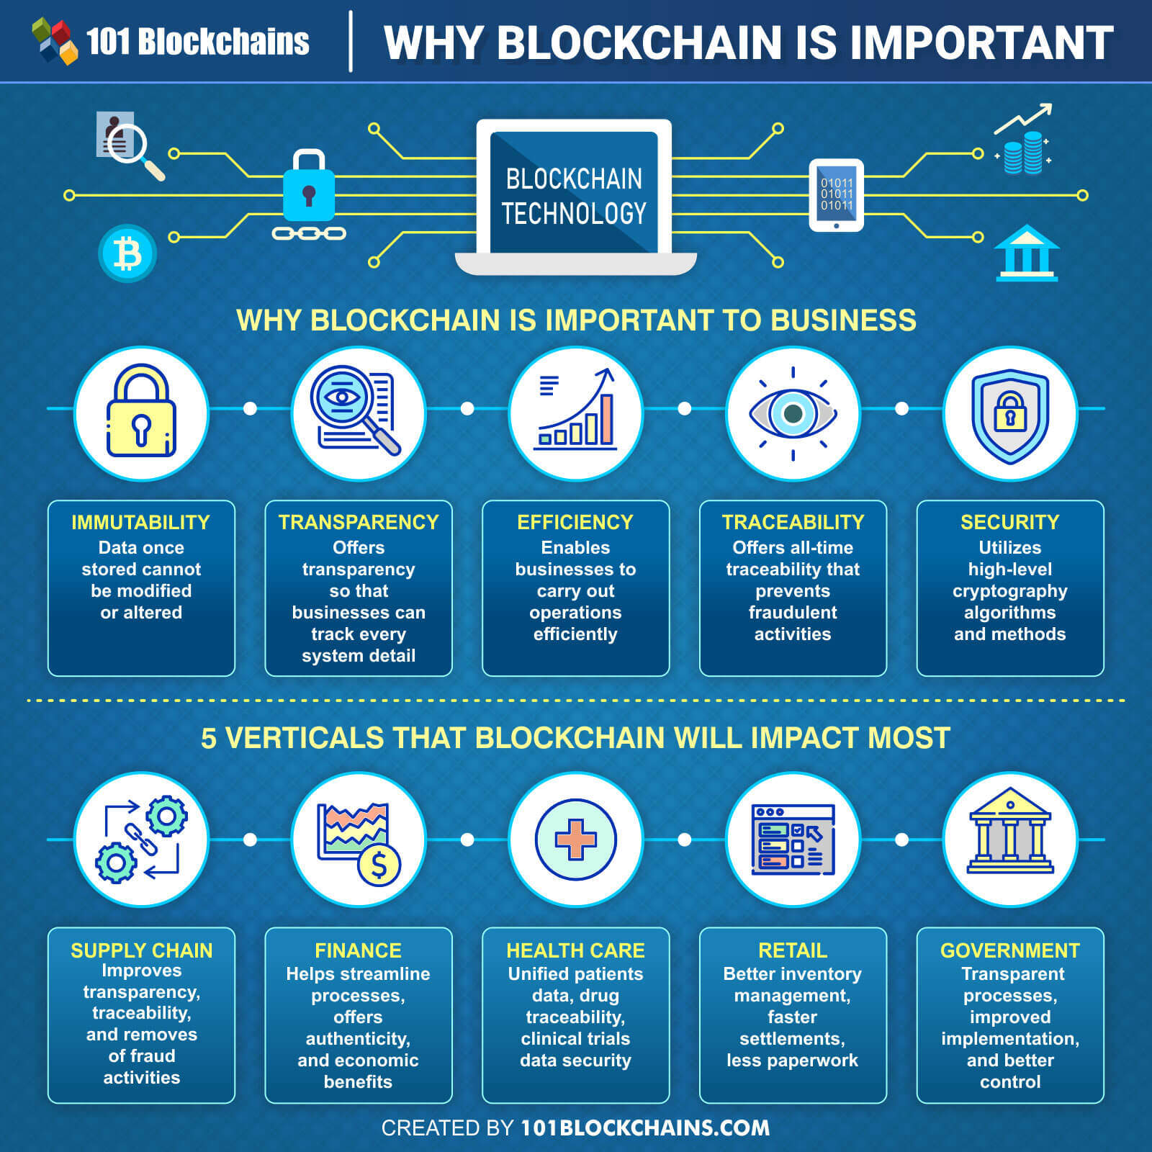
Block Chain
Blockchain is a system of recording information in a way that makes it difficult or impossible to change, hack, or cheat the system.
Example: Bitcoin

Slide 19

Cloud Computing
Cloud allows network-based access to communication tools like emails and calendars. WhatsApp is also a cloud-based infrastructure as it comes in communication it is also one of the examples of cloud computing. All the messages and information are stored in service providers hardware.

Slide 20
Top 10 emerging technologies
Artificial Intelligence (AI)
5G
Internet of Things (IoT)
Serverless Computing
Biometrics
Augmented Reality & Virtual Reality
Robotics
Blockchain
Natural Language Processing
Drones
3D Printing

Slide 21
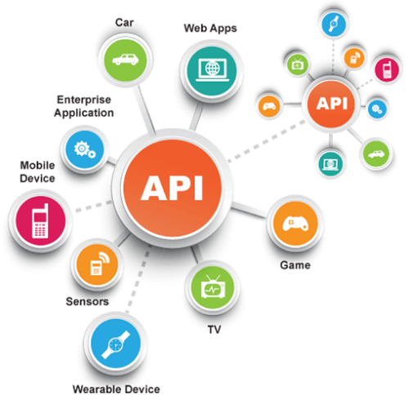
Application Program Interfaces (API)
An application program interface (API) is code that allows two software programs to communicate with each other.
Examples: Google Maps API and Twitter API

Slide 22

Smart Devices

