Slide 1

Advanced Monetization

Slide 2
Introduction
Advanced monetization is the process of monetizing your mobile app via advertising revenue. On the face of it, this is extremely simple: insert ads into the app and collect revenue. However, maximizing ad monetization revenue can be extremely challenging for app businesses.

Slide 3
Key Features
Simplified application and onboarding: By completing a single application, your Page can become eligible for our full suite of monetization products.
Understandable eligibility: You can easily track which of your Pages can be used to earn money briefly from either Creator Studio or the Meta for Creators website.
Single surface analytics: You can track your earnings, payouts and other monetization metrics from the Monetization Overview tab in Creator Studio.

Slide 4
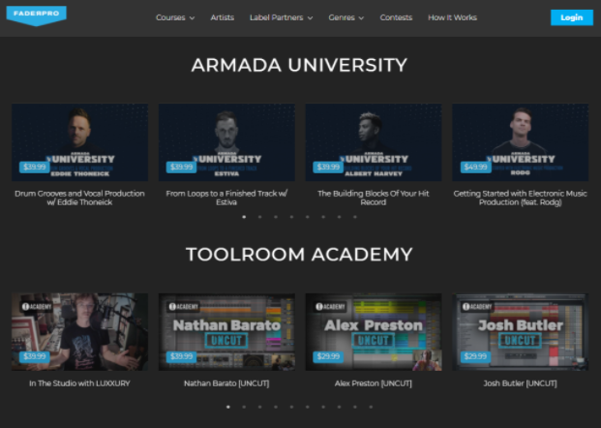
Video Monetization Models
Transactional Video-on-Demand:
For example, FaderPro

Slide 5
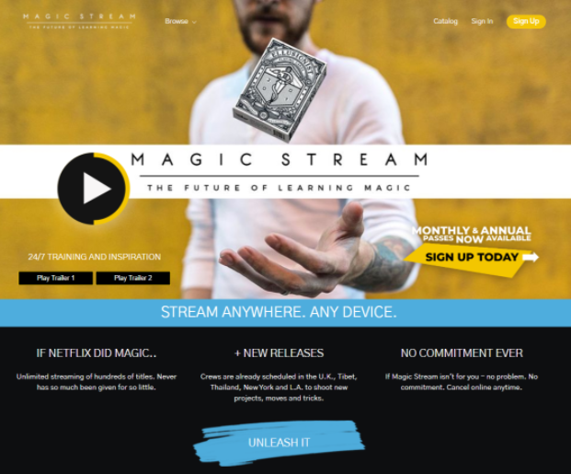
Subscription Video-on-Demand:
Example: Amazon Prime, Magic Stream

Slide 6
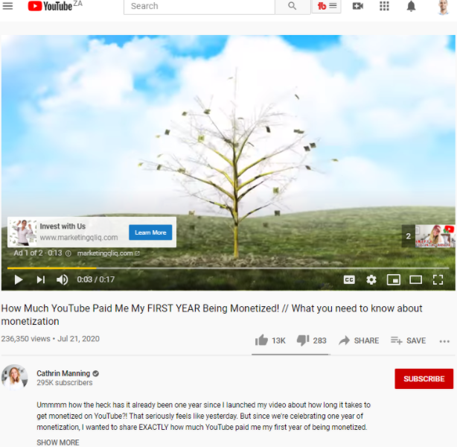
Advertising Video-on-Demand
Example: YouTube Ads

Slide 7
Waterfall model
The Waterfall Model was the first Process Model to be introduced. It is also referred to as a linear-sequential life cycle model.
Definition: The waterfall model is a classical model used in system development life cycle to create a system with a linear and sequential approach. It is termed as waterfall because the model develops systematically from one phase to another in a downward fashion.

Slide 8
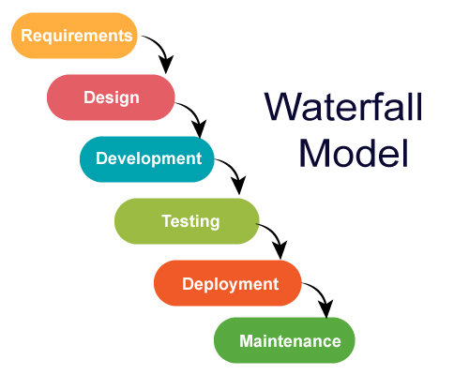
Stages of Waterfall Model

Slide 9
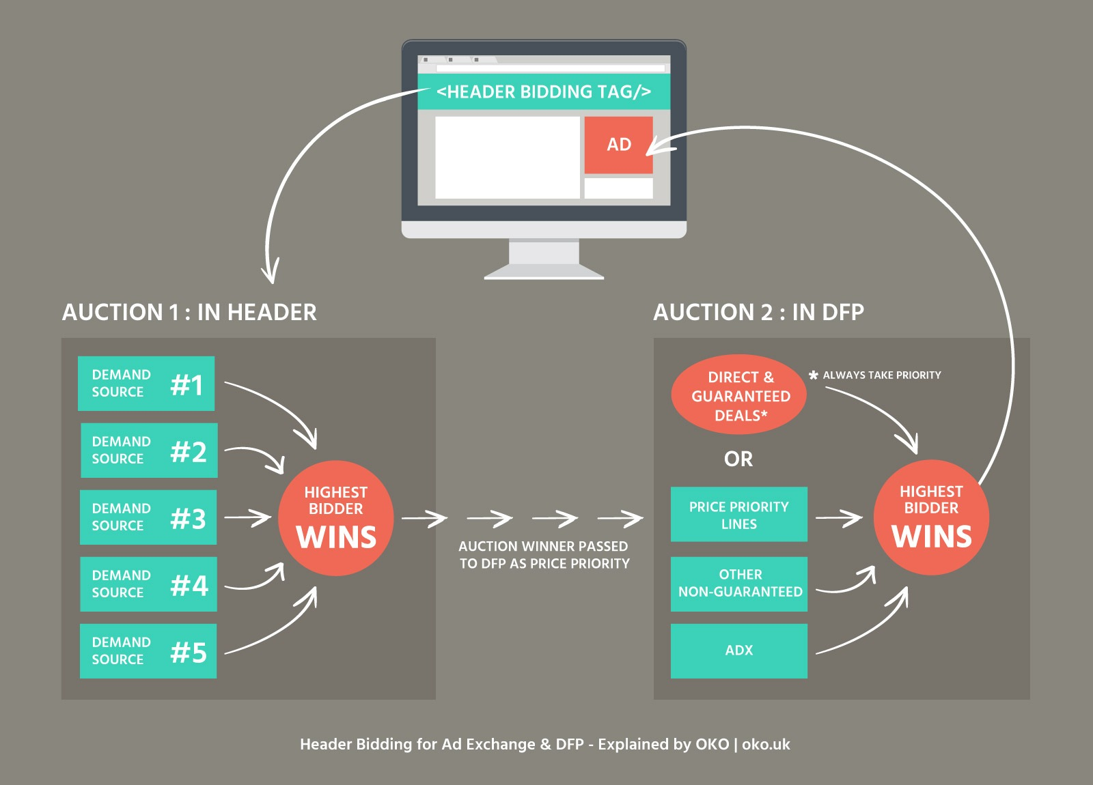
Header Bidding
Header bidding is an advanced programmatic advertising technique that serves as an alternative to the Google “waterfall” method.

Slide 10
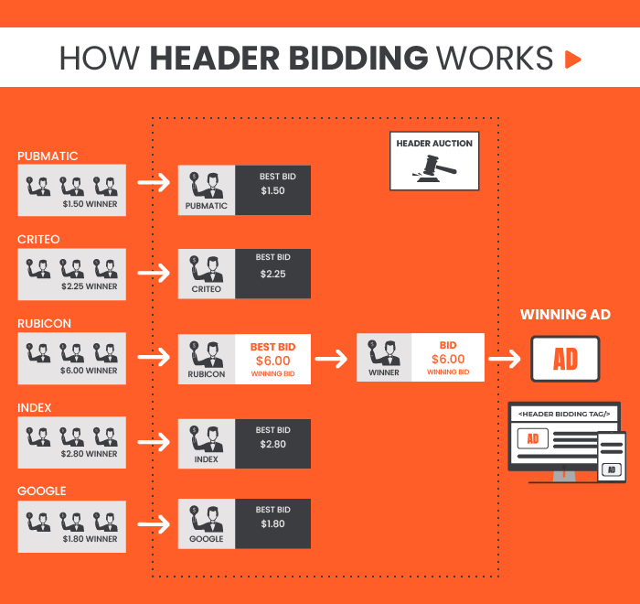
How Header Bidding Works?

Slide 11
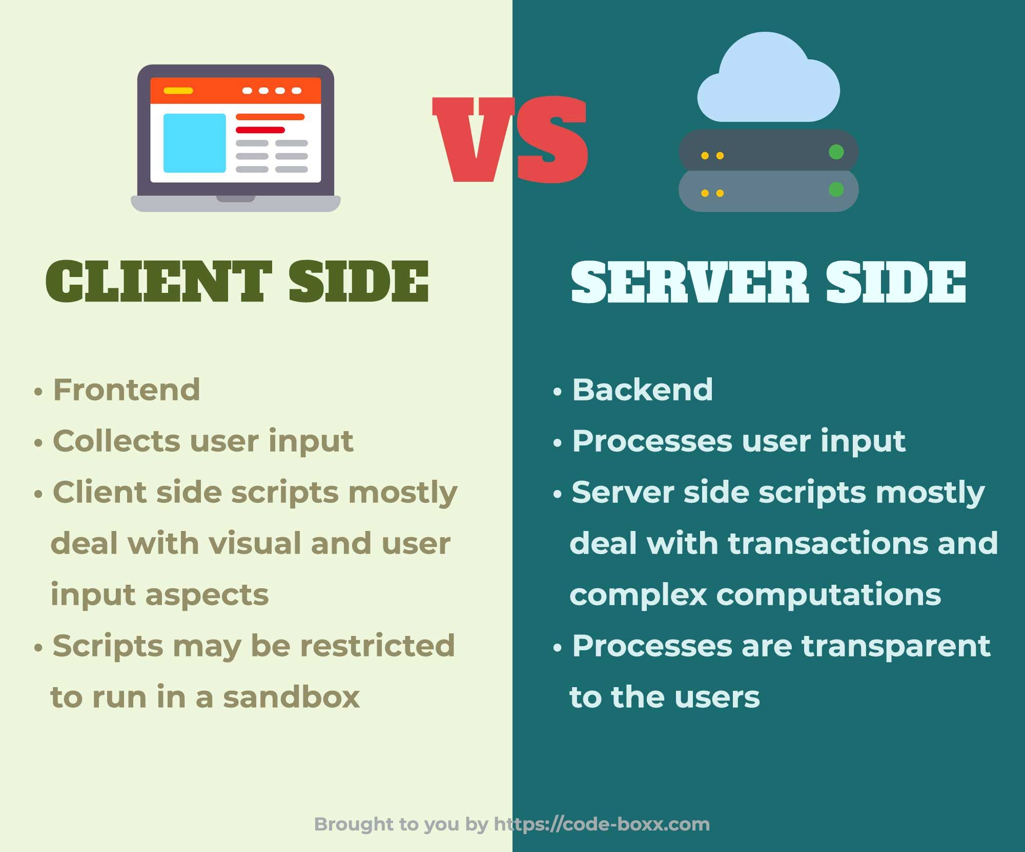
Client/Browser side vs Server Side

Slide 12
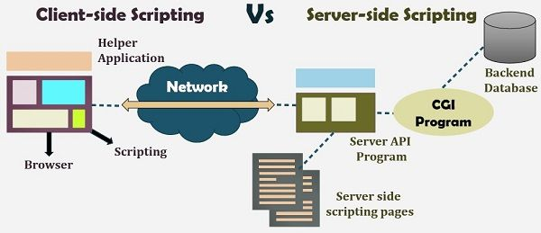

Slide 13
Setting up programmatic Deals
Select advertisers, a default advertiser, and a campaign.
Assign creatives.
Assign a Floodlight activity.
Set a margin.
Adjust the partner revenue model.
Adjust the partner costs.

Slide 14
Mobile Measurement Partners- MMPs
A mobile measurement partner (MMP) is a company that acts as a third-party provider to attribute, collect, and organize app data to deliver a unified overview of a brand's campaign performance.

Slide 15
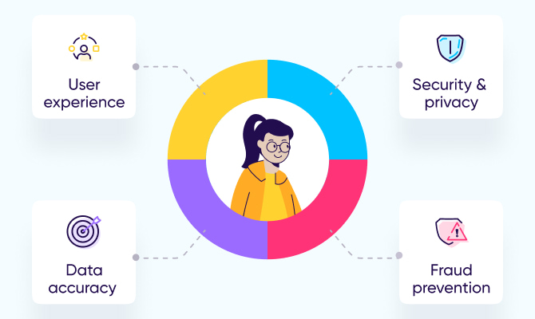
How to choose an MMP?

Slide 16
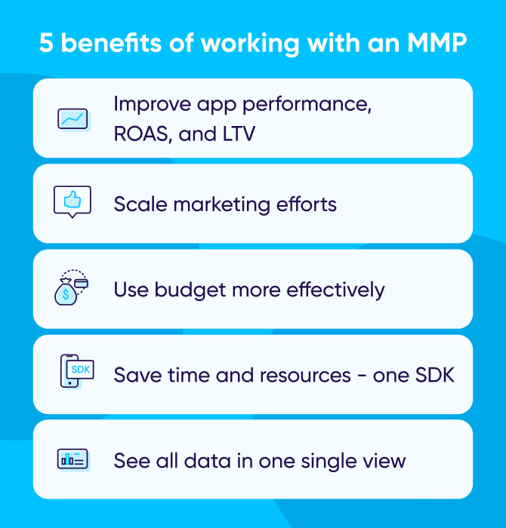
Benefits of a Mobile Measurement Partner

