Slide 1
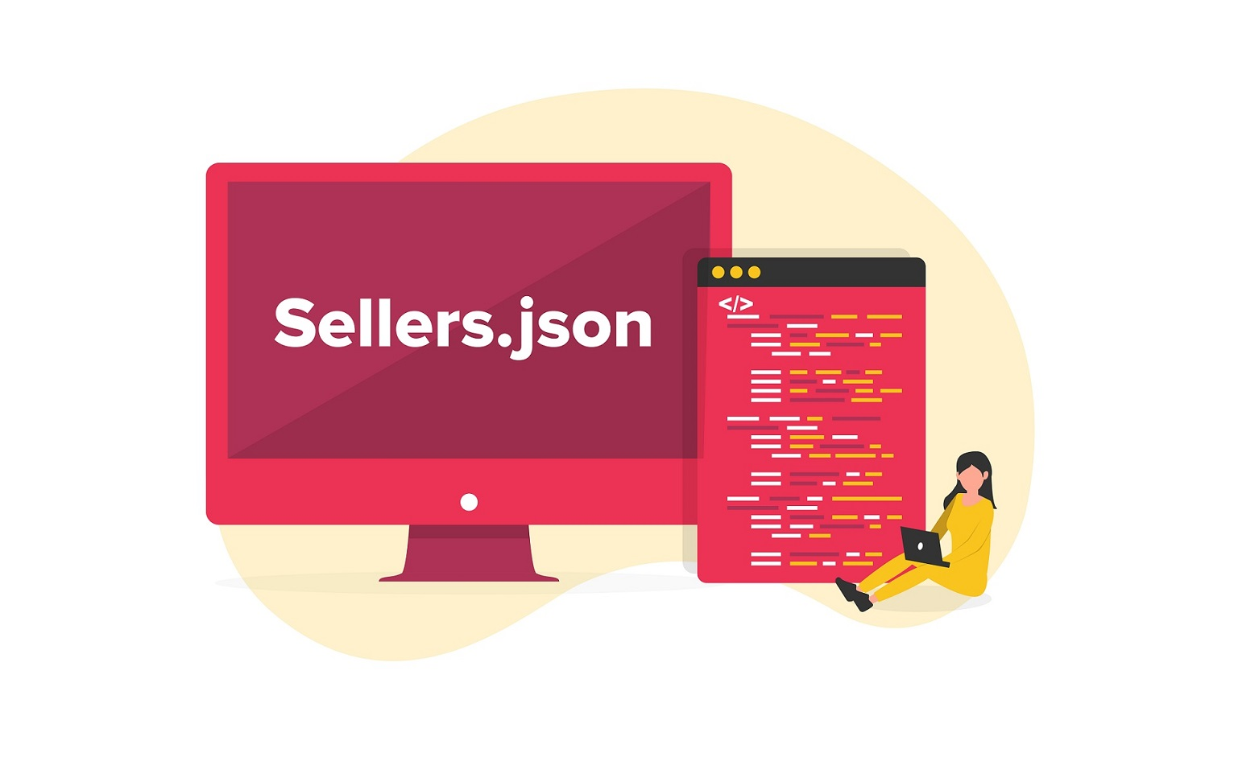

Slide 2
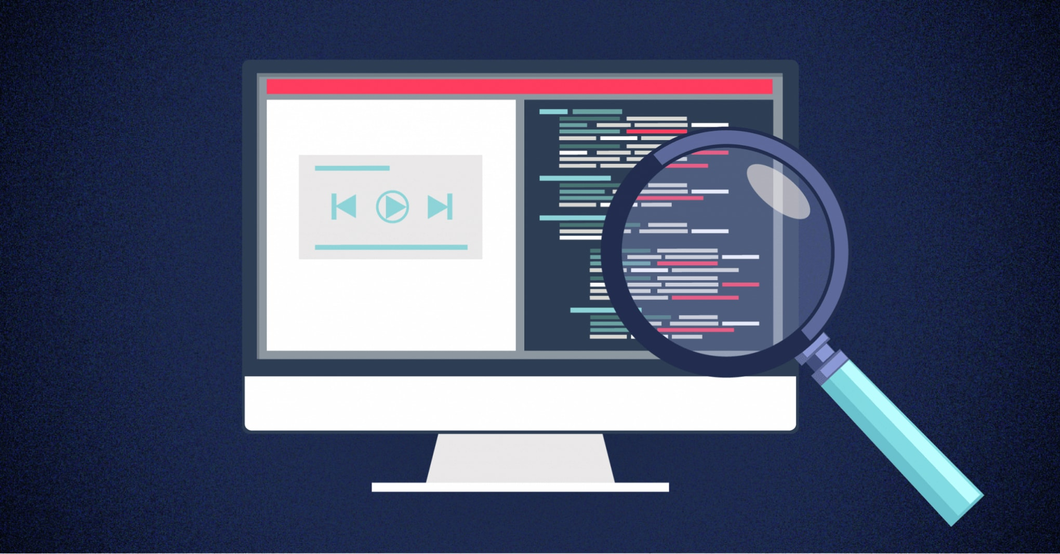
What is Sellers. Json?
Sellers. json is an IAB provided standard to allow buyers to discover and verify the entities who are either direct sellers of or intermediaries in the selected digital advertising opportunity for purchase. This includes verifying publisher identities, including the name, domain name, and seller ID.

Slide 3
4 Reasons Why Sellers.json Is So Important
Transparency
Supply Path Optimization (SPO)
Publishers Receive Much Needed Ad Revenue
Focusing on Value

Slide 4
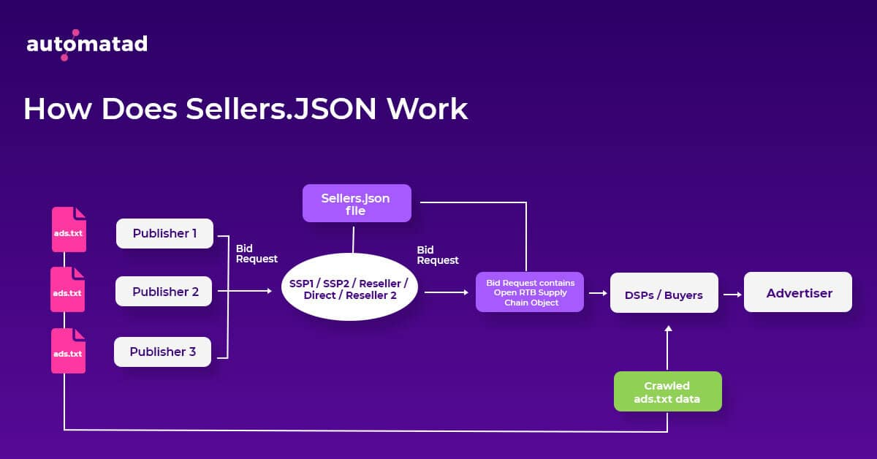
How Does Sellers. Json Work?

Slide 5
Ads.Txt
Ads.txt is an initiative developed by the IAB Tech Lab, aimed at combating certain types of ad fraud, mainly domain spoofing and illegitimate inventory arbitrage, and providing transparency in what is a highly opaque industry.
Released in May 2017

Slide 6
Common ads.txt errors
1. Ads.txt file is not found
2. Google Publisher ID is incorrectly formatted or missing
3. Ads.txt has been uploaded but AdSense is still asking to create one
4. Ads.txt has not been uploaded to the root domain of your website
5. Ads.txt file contains syntax errors
6. Ads.txt file has not been validated

Slide 7
Best practices for managing ads.txt
1. Regularly review ads.txt files
2. Do not assume
3. List companies carefully
4. Only add partners that matter
5. Invest in granular reporting
6. Automate

Slide 8
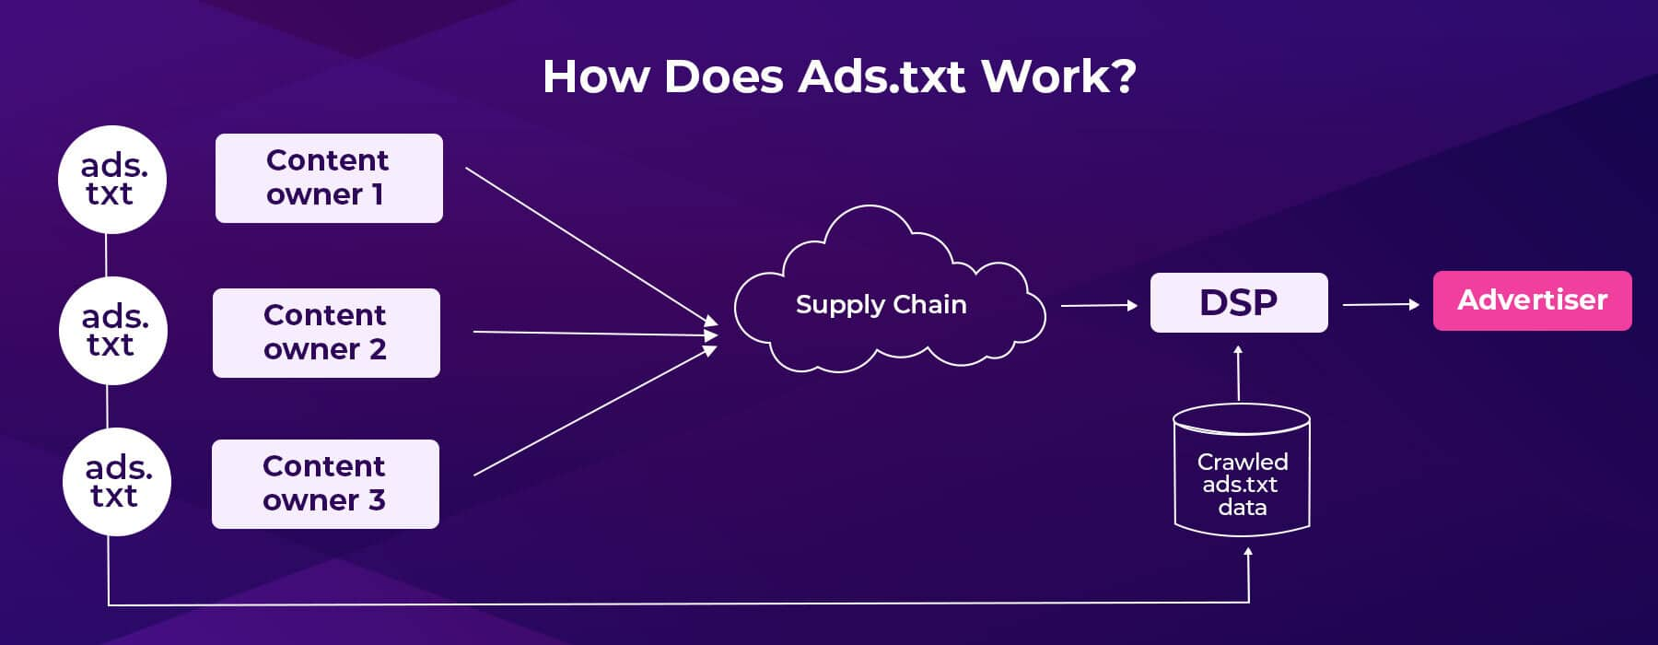
How Does Ads. Txt Work?

Slide 9
Types of Ad Inventories
Inventory type identifies the kind of inventory or medium in which an ad serves.
Inventory types include:
Display
Mobile in-app
In-stream video and audio
Mobile in-app out-stream video
Display out-stream video

Slide 10
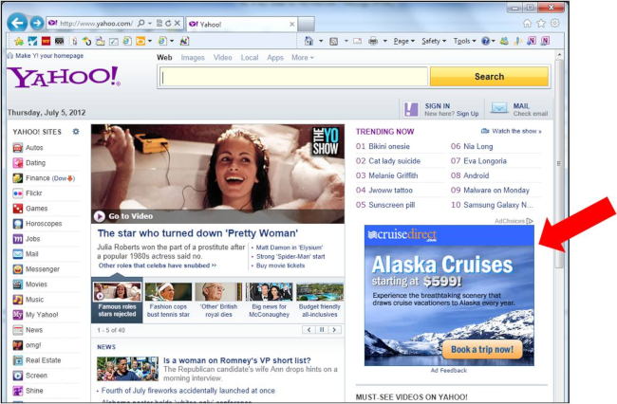
Google Adsense
Google AdSense provides a way for publishers to earn money from their online content.

Slide 11
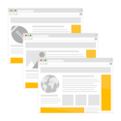
How AdSense works
1. You make your ad spaces available
You make your ad spaces available by pasting ad code on your site and choose where you want the ads to appear.

Slide 12

2. The highest paying ads appear on your site
Advertisers bid to show in your ad spaces in a real-time auction. The highest paying ads show on your site.

Slide 13
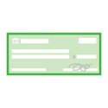
3. You get paid
We handle the process of billing all advertisers and networks for the ads on your site, to make sure you receive your payments.

Slide 14
How to Create a money-making strategy?
Focus your content
Advertise yourself
Place ads in visible places
Don’t break the rules

Slide 15
How to create an Adsense account?
Visit https://www.google.com/adsense/start.
Click Get started.
Sign in to your Google Account.
Enter the URL of the site that you want to show ads on.
Choose whether you'd like AdSense to send you customized help and performance suggestions. Google recommend that you choose Yes so they can help you get more out of AdSense. You can change your contact settings later.
Select your payment country or territory

Slide 16
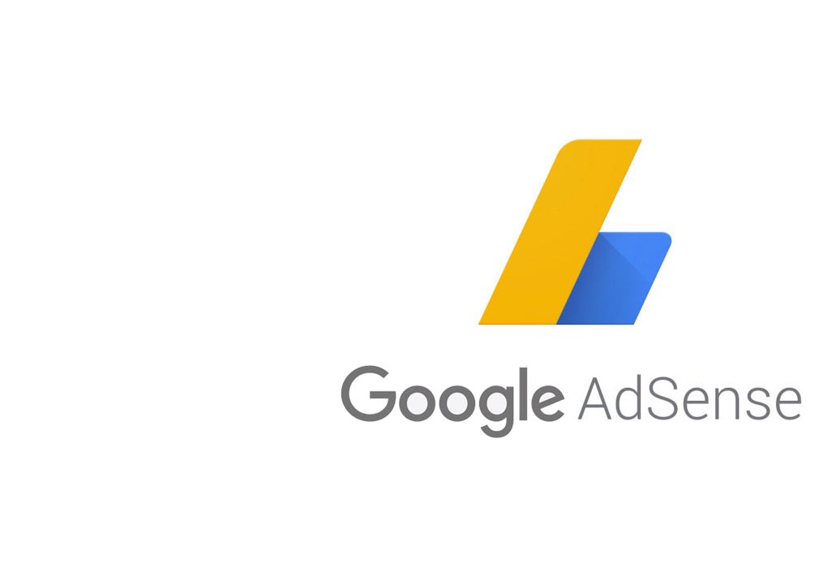
7. Review and accept the AdSense Terms and Conditions.
8. Click Start using AdSense

