Slide 1

Social Media Marketing
Session 1 & 2

Slide 2
Our Subject
Let’s see what all is going to happen in 32 sessions
What will you learn?
How will you learn all of this?
Organic/Paid Marketing strategies
Ad Managers – FB/IG, Twitter, LinkedIn, Quora, YouTube,
Platform features and when and how to leverage them
Social media listening (managing ORM)
Creating a social media plan
Theory: 20%
Practical: 50%
Live Project: 15%
Case Studies: 15%

Slide 3
What is SMM?
Use of social media platforms to connect with your audience to build your brand, increase sales, drive website traffic etc.
36.64%
27.01%
6.82%
Facebook
YouTube
Twitter
5.10%
2.47%
21.96%
Reddit
Instagram
Rest of the platforms

Slide 4

Facebook
Monthly worldwide users: 2.96 Billion
Largest social media network where ads can be shown
Age Distribution: 18 – 24 yrs: 25%, 25 – 34 yrs: 32% and 35 – 54 yrs: 25%
Globally: 57% male & 43% female
India: 78% male and 22% female
Excellent platform for Brand Awareness, B2C Leads, B2C Traffic, Small businesses who want to market locally.
Not efficient for B2B organizations or driving final conversions (purchases).

Slide 5
Facebook: Objectives
All the following objectives are available in the ad manager
Brand Awareness
Reach
Website Traffic
Leads
Messages
Video Plays
App Installs
Engagement
Conversions
Catalogue Sales
Store Traffic

Slide 6
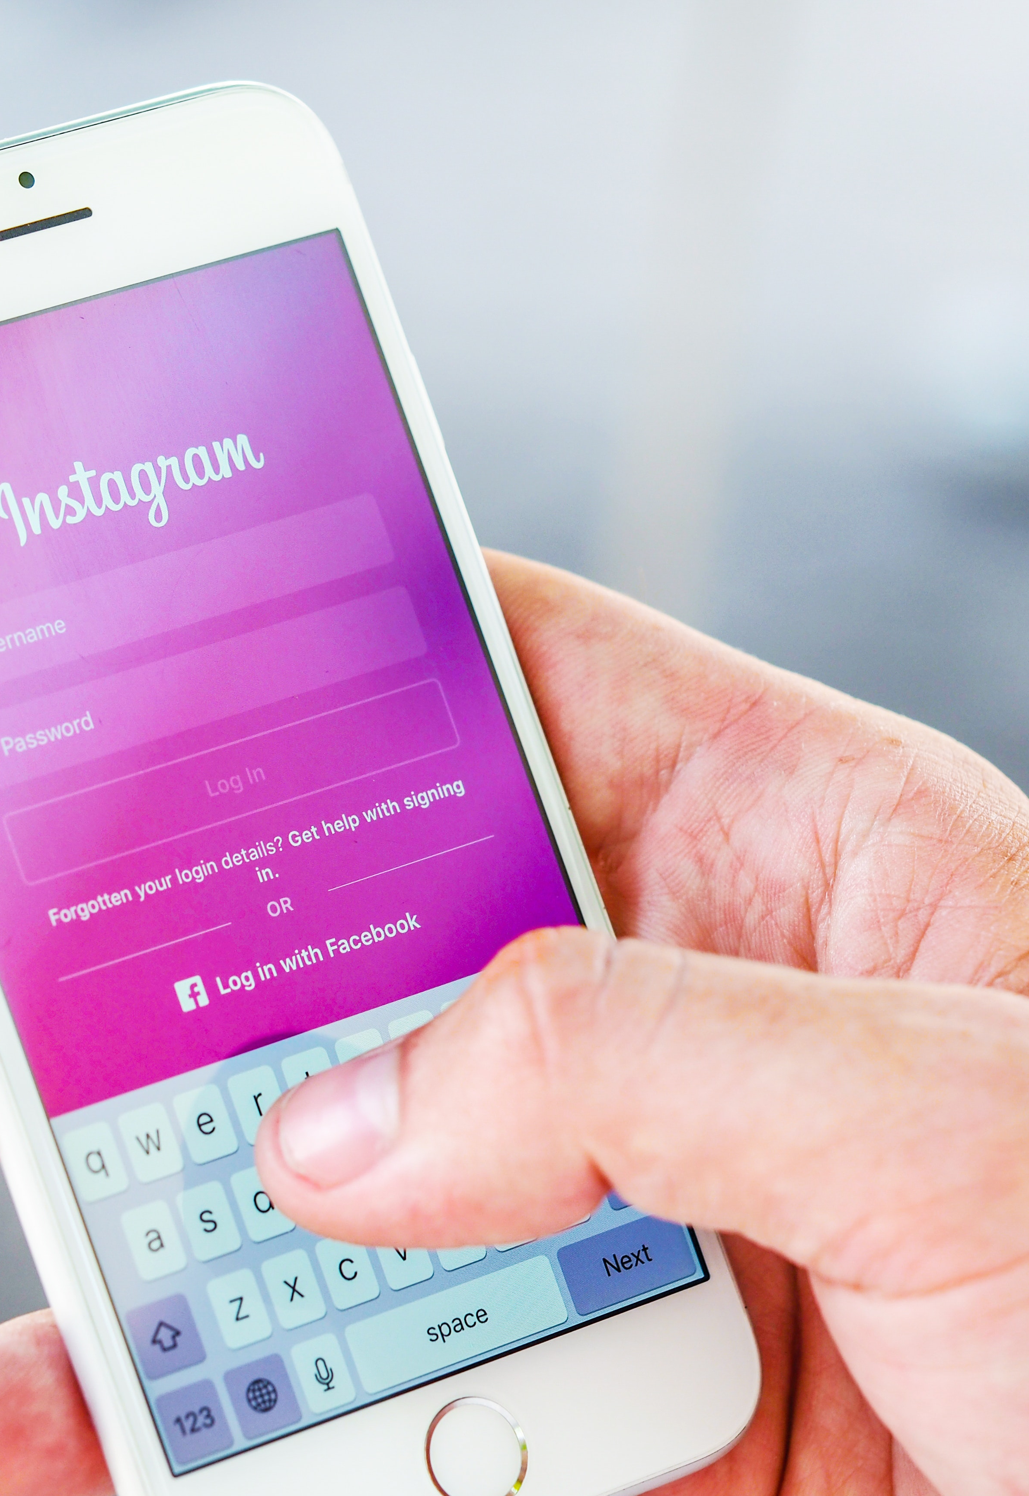
Instagram
Monthly active users: 500+ Million
Owned by Facebook and primarily used by organizations for Branding purposes.
Excellent platform for Influencer Marketing.
Excellent tool for visual marketing.
Serves as a tool to get new audience easily, with the use of user generated content.

Slide 7

LinkedIn
Monthly active followers: 875 Million
Owned by Microsoft and primarily used by B2B organizations for Branding and lead generation.
Excellent platform for Thought Leadership.
Excellent tool for visual marketing.
Serves as a tool to get quick attention of possible investors!
Hyper-targeting options available for running ads.
One of the most effective platforms for product/brand launches
15-25 years old: 16%, 26-35 years old: 27%, 36-45 years old: 34%, 46-55 years old: 37%, 56+ years old: 29%

Slide 8
LinkedIn Objectives
All the following objectives are available in the ad manager
Brand Awareness
Website Visits
Engagement
Video Views
Lead Generation
Website Conversions
Job Applicants

Slide 9
Business Objectives
Why do brands use social media marketing?
Branding
Awareness
Leads
Rebranding
For better ad recalls
To get user generated content (UGC)
Sales / lower cost per acquisition
Offline Store visits
Repositioning
To get visible in front of investors
To start conversations
To search for partners/distributors
Acts as modern era customer support

Slide 10
How do brands know about their customers?
Heard about Consumer Persona?
A Customer Persona is a fictitious model of an ideal customer. It generally includes demographics (age, gender, location, and occupation) as well as psychographics (motivations, likes, dislikes, and pain points)
What is included in a consumer persona?
Demographics
Likes/dislikes
How do they get influenced
Aspirations
Pain Points
Motivations etc. the list is endless.

Slide 11
Brand: Whitehat Jr.
Consumer Persona
Age: 30-55 yrs.
Location: Tier 1,2 cities
Gender: M/F
Career: Has a white collar job in a reputed MNC
Salary: INR 60,000+/month
Parental Status: Parents of 6+ yr kids
Goal: A better future for kids
Challenges: Less time to take care of their kid’s studies
Fear: Kid will not be able to compete with others in the real world, he/she will not get a suitable job/career
Source Of Information: Google, FB, Email
Motivation: Kid gets to learn something new i.e coding, learns 21st century skills needed for the future.

Slide 12

THANK YOU!

