Slide 1
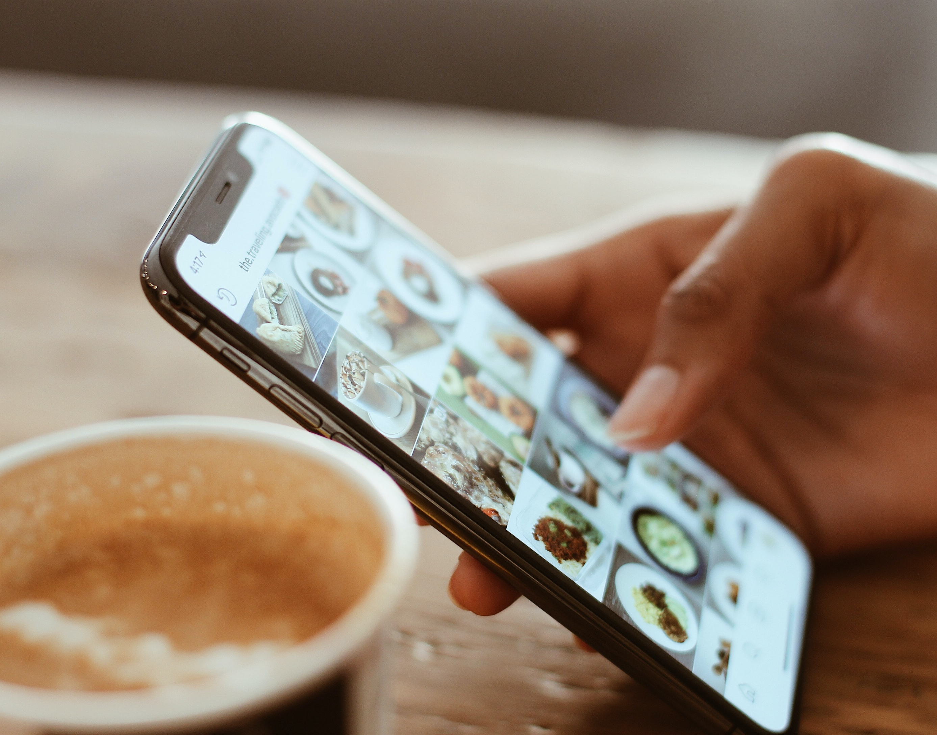
Social Media Marketing
Session 9 & 10

Slide 2
Case Study 1
How Samsung Promoted Galaxy S6 In Latin America
Campaign Duration: 1 month prior to the launch
What did they do: Ran targeted video ads that highlighted the phone’s design, camera, and long battery life respectively. In the 4th week, Samsung launched more traditional video and photo ads about the product. These ads were specifically targeted to people who'd engaged with the videos and their lookalike audiences.
Results: Samsung received 500% ROI from the month-long campaign and a 7% increase in new customers.
Takeaways: For launching an upgraded product, users of the previous product would be the first ones to try it out. Target them first and then go with a full blown campaign using Lookalike Audience.

Slide 3
Case Study 2
Airtel India - Driving incremental reach and impact with Facebook ads to gain postpaid users
Goal: Reassert itself as the market leader in postpaid mobile and sell more postpaid plans.
What did they Do: Ran targeted ads in 6 metropolitan cities across India for males in the age group – 22-35 yrs. The ads were a series of 30 to 45 sec videos to introduce their new plans and a 10 sec video to drive and reinforce awareness. Also, they used eye catching GIFs that linked to the airtel website where potential customers could learn about the new plan and sign up. The ads were showed twice a week in all 6 cities.
Result: 20X more cost-efficient reach from Facebook than from TV, 12X return on ad spend (highest among all media platforms), 41% of brand image uplift attributable to Facebook (highest among all media platforms).

Slide 4
Case Study 3
HealthKart: Pumping up sales with simultaneous Facebook ad campaigns
Goal: HealthKart wanted to connect with a wider audience, grow awareness of its MuscleBlaze Whey Gold product and encourage more sales.
What they did: The brand used a “full-funnel” campaign strategy to guide people from product discovery to consideration to conversion. HealthKart ran 2 campaigns at the same time: one with an awareness objective to promote discovery and the other with a conversion objective to encourage purchases. Both campaigns reached out to fitness enthusiasts aged 18–65.
For awareness, they created video ads that showcased inspiring fitness journeys of some of its customers as well as the benefits of the new product.
For the conversion campaign, HealthKart used information from the Facebook pixel installed on its website to build Custom Audiences of people who had viewed its product videos, visited its website and purchased its products. The brand also created lookalike audiences based on these visitors to reach new customers. After clicking on the carousel format ads, people would be taken to HealthKart’s website or other platform to make purchases.
Results: 50% increase in sales for MuscleBlaze, 11%lift in ad recall, 6% lift in brand preference

Slide 5
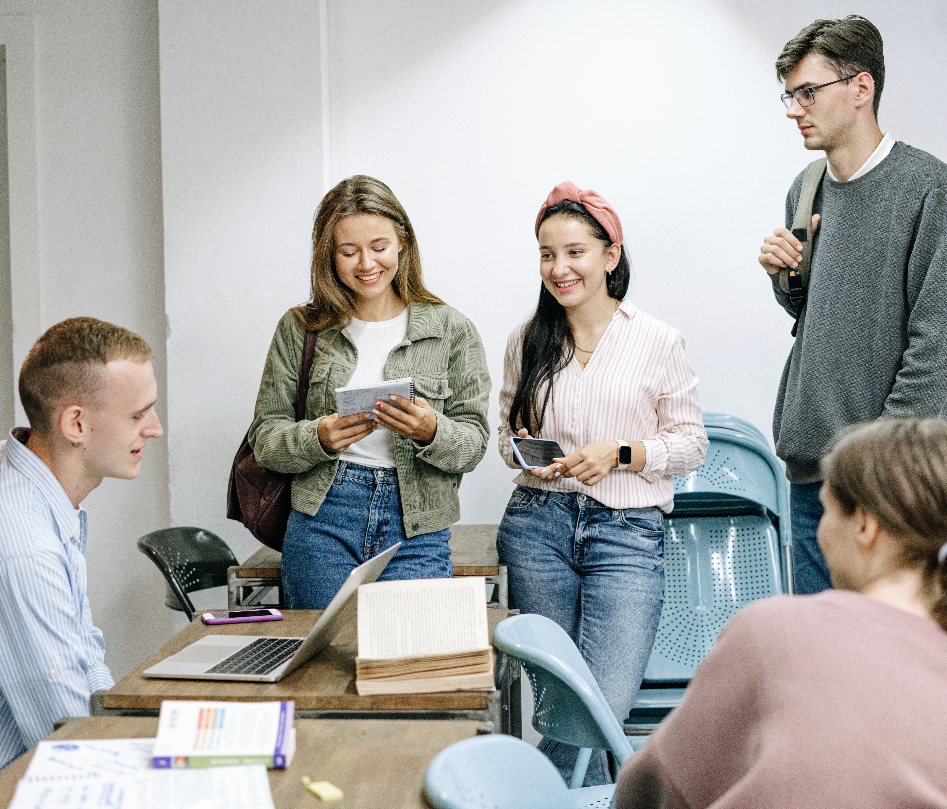
THANK YOU!

