Slide 1

VIDEO ADVERTISING

Slide 2
YOUTUBE ADVERTISING
The most widely used formats are –
Display Ads
Overlay Ads
Skippable Video Ads
Non Skippable Video Ads
Mid-roll Ads
Bumper Ads
Native Mobile Ads
Discovery Ads

Slide 3
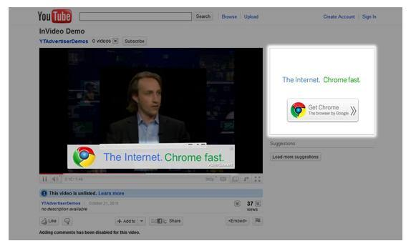
Display Ads
Appears Next to your video while you are using YouTube on a laptop or desktop. (Not available on mobile devices
Can be purchased in both CPC & CPM formats

Slide 4


Overlay Ads
Rectangular format in bottom 20% of the video. Available only Laptop or desktop not on mobile
Viewers can dismiss the ad anytime and can be purchased only in the CPC Model.

Slide 5
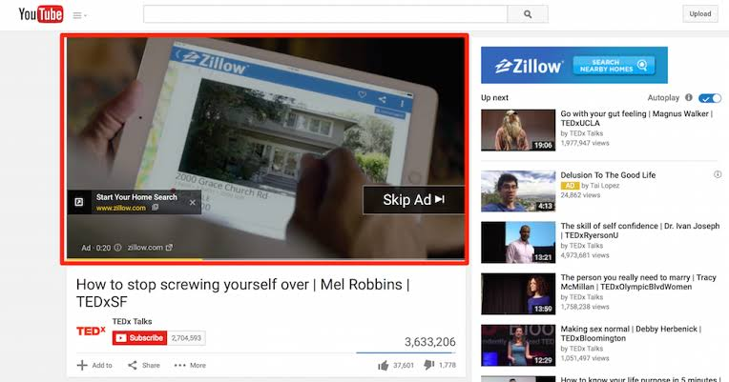
Skippable Video Ads
Viewers can skip the ad after watching it for 5seconds.
It can be inserted before, during or after the video
Available on Laptops, Desktops and Mobile devices.

Slide 6
Non-Skippable Video Ads
Are 15-20-second-long video ads which can be inserted before, during or after the Youtube Video.
For these ads, the publisher gets paid only when a user fully watches the ad.
Mid-roll Ads
Mid-roll advertising refers to a video ad that plays in the middle of content, rather than before or after the publisher’s video content.
Available only for videos over 10-12 minutes.
Available only on desktops and mobile versions.
Bumper Ads
Lightweight, non-skippable ads upto 6 seconds long
Specially optimized for mobile devices
Publisher is paid only when user fully watches the videos
Native Mobile Ads
Similar to mobile ads just that it is available only on mobile devices.
Discovery Ads
You are charged whenever a user clicks on a video ad thumbnail or title and begins watching your video.
Youtube skippable Ads & Discovery Ads that come in the search results are True View Ads as users choose to see the ad by their own.

Slide 7
BUYING MODELS
BIDDING MODEL - Standard Auction based model
Cost Per View (CPV)
Amount you pay for your true video ads.
A view is counted when user watches 30 seconds of your video ad or interacts with the ad, whichever comes first
Actual CPV
You always do not pay the max CPV amount. You might often strike deals at a lower price relative to your max CPV.
This price at which you strike a deal is called the actual CPV.
The actual CPV depends on 2 factors – Quality Score & Ad Rank
AdRank = Max CPC * Quality Score
Notes:
CPV example –
Consider you set up an upper limit of Rs.40 as your CPV i.e. your maximum CPV is Rs. 40.
The viewer watches your ad completely (if less than 30seconds) or watches atleast 30 seconds of your ad (if more than 30s.
The viewer performs a desired action on the ad ie clicks on the ad.
You are billed a max of Rs.40 for either of the 2 actions , whichever occurs first.
Quality Score is a measure of how relevant your ad is to a customer and includes multiple performance factors such as view rates or click rates.

Slide 8
RESERVED MEDIA PLACEMENT
This model follows a fixed pricing model wherein you buy placements on a reservation basis instead of auction basis.
Highly useful to build an instant Brand Awareness
The reservation media placements can be bought mainly in 2 modes –
Cost Per Milli (CPM)
You are billed for every 1000 impressions. Booked 6 business days in advance
Ad formats – Standard In-Stream and In-Stream Select
Cost Per Day (CPD)
Ad format fall under CPD are –
Desktop Custom Masthead
Desktop Universal Video Masthead
Mobile Video Masthead
Notes:
Standard In-Stream- Non Skippable video ads that play before the user streams the actual video. Can be of 15-30 seconds
In-Stream Select – Skippable Ads which appear before the actual video. Can be upto 60s long and allowed to skip the video after 5 secs and an impression is recorded, irrespective of user skipping the video.
CPD – Amount charged to publish your ad for an entire day. The CPD Campaign has to be booked couple of weeks in advance and creatives have to be delivered 9 business days in advance.

Slide 9
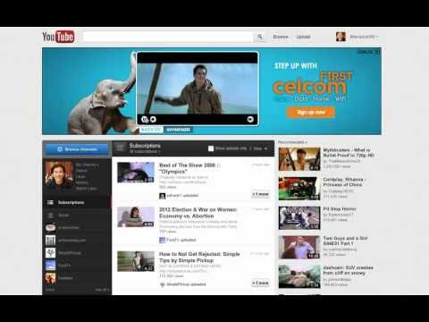
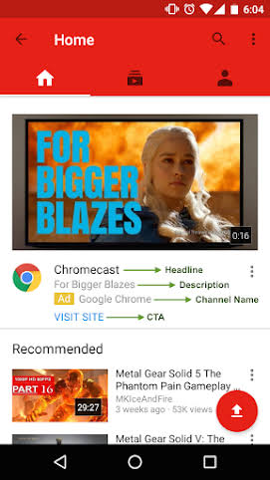

Slide 10
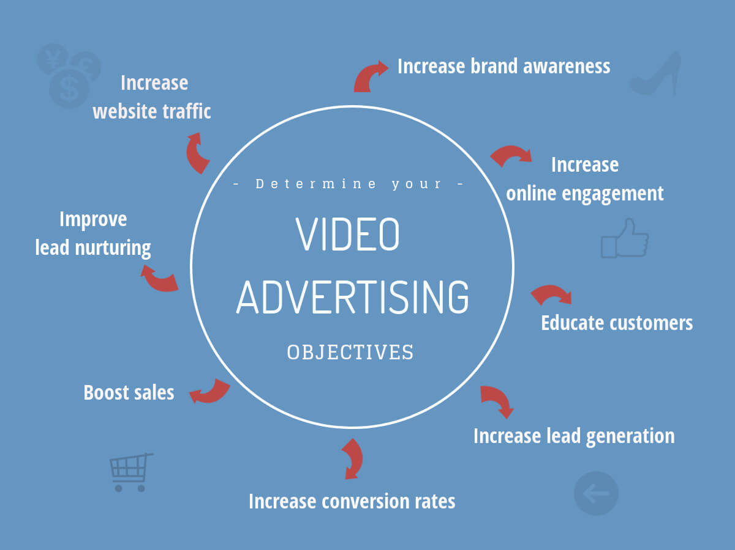
Video Advertising Objectives

