Slide 1

Social Cognitive Theory of Career Development

Slide 2


Slide 3
What Does this Mean
Social Cognitive Theory is an approach to understanding people through the perspective of the interactions of people’s thoughts and social behavior.
Career is a job which you are trained or have an inclination for and which you expect to do all your life

Slide 4
Role of the Person on Career Choice
People help construct their own career outcomes
People’s beliefs about themselves, their environments, and possible career paths play key roles in this process
People are not merely beneficiaries (or victims) of this intrapsychic, temperamental, or situational forces
But people’s behavior is often flexible and susceptible to change efforts
Therefore it is always said career choice and not career destiny

Slide 5
Other Factors that Impact on Careers
However, career development is not just a cognitive or a volitional enterprise
There are often potent (external and internal) barriers to choice, change, and growth
Social and economic conditions promote or inhibit particular career paths for particular persons
Affective reactions influence rational thought processes
People differ in their abilities and achievement histories
Complex array of factors such as culture, gender, genetic endowment, socio-structural considerations, and disability or health status work along with people’s cognitions to impact career possibilities

Slide 6
What is Social Cognitive Theory
Traces the complex connections between persons and their career related contexts
Brings out the links between cognitive and interpersonal factors
Figures out connections between self-directed and externally imposed influences on career behavior
Assumes humans’ capacity to influence their own development and surroundings

Slide 7
“People’s level of motivation, affective states, and actions are based more on what they believe than on what is objectively the case’’
Albert Bandura

Slide 8
Bandura’s Triadic-Reciprocal Model of Causation
The following operate as interlocking mechanisms that affect one another bi-directionally
  Personal attributes, such as internal cognitive and affective states, and physical characteristics
  External environmental factors
  Overt behavior (as distinct from internal and physical qualities of the person)

Slide 9
Reciprocal Determinants of Human Functioning
Overt Behavior/Human Development
State of economy; available opportunities; changes in technology, exposures duirng school & college
Personal
Factors
Environmental Factors
Cognitive, Affective
(including belief’s),
And Biological
Events
Within this triadic system, people become both “products and producers of their environment”, with the potential for self-regulation

Slide 10
Social Cognitive Career Theory
(Lent, Brown & Hackett, 1994, 2000, 2002)
Contextual Influences
Proximal to Choice Behavior
Person Inputs
- Predispositions
- Gender
- Race/ethnicity
- Disability/
Health status
Self-efficacy
Expectations
Learning Experiences
Interests
Goals
Actions
Background
Background
Contextual
Affordances
Outcome
Expectations

Slide 11
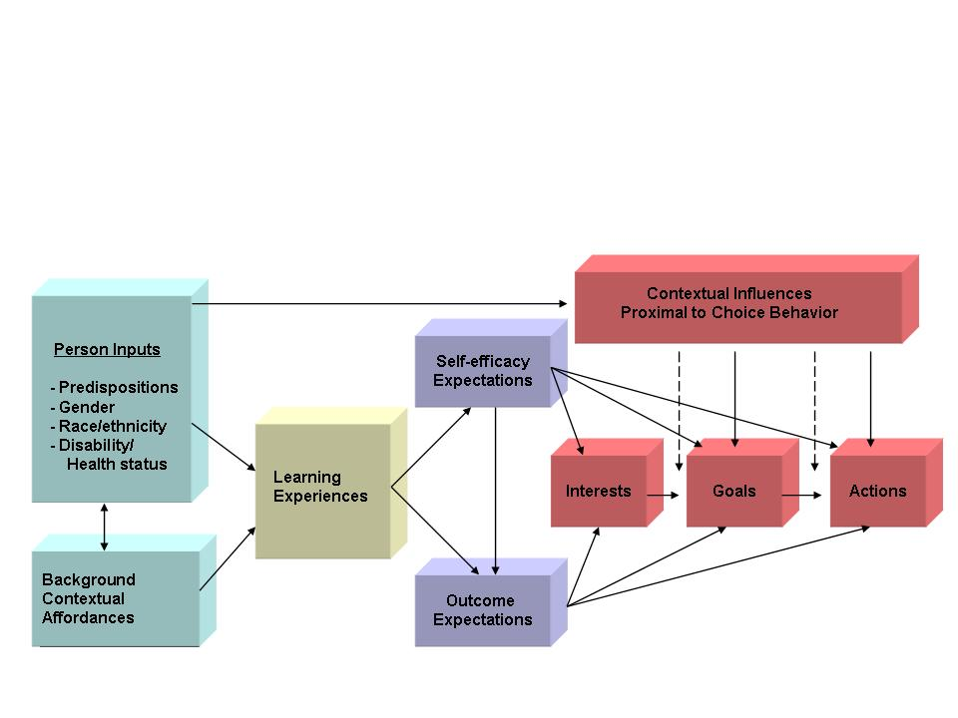
SCCT Model
Person Inputs and background context
Person Inputs
- Predispositions
- Gender
- Race/ethnicity
- Disability/
Health status
Learning Experiences
Background
Contextual
Affordances

Slide 12
Distal Influences
Person Inputs
  Race/ethnicity, gender
  Physical appearance, health, disabilities
  Special abilities, e.g., intelligence, musical ability, artistic ability, muscular coordination

Slide 13
Proximal Influences
Environmental conditions & events
  Socioeconomic status
  Job & training opportunities
  Social policies & procedures for selecting trainees & workers
  Rate of return for various occupations (ROI)
  Labor laws, union rules
  Physical events (e.g., earthquakes, hurricanes, droughts, floods)
  Availability & demand for natural resources
  Technological developments (e.g., computers, web)
  Changes in social organizations
  Family training experiences & resources, neighborhood & community influences (e.g., family religion, values, expectations, women’s roles, availability of models, etc.)
  Education system

Slide 14
SCCT Model: Learning effects on efficacy and outcome expectations
Self-efficacy
Expectations
Learning Experiences
Outcome
Expectations

Slide 15
Learning Influences:
Sources of Self-Efficacy Information
Prior Performance
Accomplishment
Vicarious
Learning
Self-Efficacy
Social Persuasion
Physiological and
Affective Reactions

Slide 16
Building Self-efficacy expectations
Performance Accomplishments
  Most powerful influence
  Attributions of performance important for take-away message
Vicarious Learning
  Importance of model similarity along dimensions of importance to the observer
  Observation of consequences of model’s behavior
Social Persuasion
  Best when source of persuasion is credible
  Most commonly used but least powerful source of information
  Couple with other informational sources
Physiological States and Affective Reactions
  Weak efficacy beliefs can produce anxiety, and high levels of anxiety undermine performance
  Anxiety reduction can enhance performance & self-efficacy

Slide 17
Attributions of Performance
Attributions of Success
  Internal – Due to my own skills, abilities:- likely to increase efficacy, performance
  External – Easy test or course:- likely to undermine or have no effect on efficacy, performance
Attributions of Failure
  Internal – Due to my lack of ability: undermining efficacy, performance
  External – Due to the Instructor being a hard grader: No effect on efficacy, performance

Slide 18
SCCT Model: Contextual influences on interests, goals and actions
Contextual Influences
Proximal to Choice Behavior
Self-efficacy
Expectations
Interests
Goals
Actions
Outcome
Expectations

Slide 19
Key Components of Social Cognitive Theory
Self-Efficacy: Beliefs in one’s capability to organize and execute the courses of action required to manage prospective situations
    OR cognitive appraisals of one’s capacity to perform specific behaviors in the future
    Can you do this? How confident are you that you can do this?
    Efficacy beliefs determine initiation, choice of activities, effort expended, & persistence in the face of obstacles
Outcome Expectations: Beliefs about the consequences of given actions
    What will happen if I do this?
    Consequences of successful performance
Goals: Determination to engage in a particular activity or to produce a particular outcome
    What do I choose to do?
    By setting personal goals, people help to organize, guide, and sustain their own behavior

Slide 20
Contextual Influences on Career and Academic Behavior
Objective and perceived aspects of the environment influence beliefs, intentions, & actions
  Environmental barriers can erode efficacy and interests
  Conversely, strong efficacy can enable an individual to surmount obstacles and persist in the face of barriers
Three Primary Paths of Contextual Influences
  Distal (early) effects on acquisition of SE [self-efficacy] and OE [outcome expectations]
  Moderators of interest-choice relations
  Direct influences on choice

Slide 21
Social Cognitive Career Theory
Contextual Influences
Proximal to Choice Behavior
Person Inputs
- Predispositions
- Gender
- Race/ethnicity
- Disability/
Health status
Self-efficacy
Expectations
Learning Experiences
Interests
Goals
Actions
Background
Contextual
Affordances
Background
Outcome
Expectations

Slide 22
Activity: Shaping of Your Academic Career
Break up into teams of 5 to 6 each
Choose a team leader
All team leaders must meet the faculty separately for instructions before the start of the activity
Read the instructions in the handout
Start thinking, reflecting and writing your own story – 20 mins
Share your influences with your team members – 25 mins
Team leaders to share team patters with the larger audience - 2 mins for each team

Slide 23
Activity: Emerging Patterns
Personal Inputs : 1; 13; 14
Environmental conditions : 2; 3; 6; 7; 8; 11
Self efficacy factors
  Personal accomplishments : 13
  Vicarious learning : 12
  .Social Persuasion : 10
  Affective Reactions : 5; 14
Outcome expectation : 4;
Goals : 9;

Slide 24
Research Supports SCCT’s Assumptions About
Interests are strongly related to one’s self-efficacy and outcome expectations.
Performance accomplishments in a specific endeavor lead to interests in that endeavor to the extent that they foster a growing sense of self-efficacy
Self-efficacy and outcome expectations affect career-related choices largely (though not completely) through their influence on interest.
Past performance affects future performance partly through people’s abilities and partly through the self-efficacy percepts they develop, which presumably help them organize their skills and persist despite setbacks.

Slide 25
How Does SCCT Helps?
Provide opportunities to build competencies
Strengthen self-efficacy beliefs via the four sources of information
  Realistic self- appraisal of performance accomplishments
    Engage in mastery experiences
    Recognize strong performance
    Develop accurate attributions of performance (success and failure)
  Couple verbal/social persuasion with other information sources
  Address undermining anxiety related to performance and choice
Strengthen & expand vocational interests in high aptitude areas
  Link education to work/careers via career exploration (from written/visual information through simulations, modeling, & job shadowing to practice & internships, research & work experience)
Address unrealistic outcome expectations
Minimize barriers & enhance facilitators
Clarify academic & career goals

Slide 26
Thank You

