Slide 1


TOTAL QUALITY MANAGEMENT (TQM)

Slide 2
TOTAL QUALITY MANAGEMENT
TOTAL QUALITY MANAGEMENT (TQM) IS A PHILOSOPHY THAT INVOLVES EVERYONE IN AN ORGANIZATION IN A CONTINUAL EFFORT TO IMPROVE AND ACHIEVE CUSTOMER SATISFACTION.

Slide 3
TOTAL QUALITY MANAGEMENT - DEFINITION
“TQM IS A MANAGEMENT APPROACH OF AN ORGANIZATION, CENTERED ON THE PARTICIPATION OF ALL ITS MEMBERS AND AIMING AT LONG TERM SUCESS THROUGH CUSTOMER SATISFACTION AND BENEFITS TO THE MEMBERS OF ORGANISATION AND SOCIETY”.
-ISO 8402/IS 13999

Slide 4
SIX BASIC CONCEPTS OF TQM
COMMITTED AND INVOLVED MANAGEMENT
UNWAVERING FOCUS ON THE CUSTOMER, BOTH INTERNAL AND EXTERNAL.
EFFECTIVE INVOLVEMENT AND UTILIZATION OF THE ENTIRE WORKFORCE.
CONTINUOUS IMPROVEMENT
TREATING SUPPLIERS AS PARTNERS.
ESTABLISH PERFORMANCE MEASURES FOR THE PROCESSES.

Slide 5
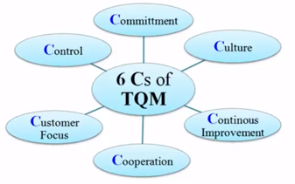
SIX C’S OF TQM

Slide 6
SALIENT FEATURES OF TQM APPROACH
FIND OUT WHAT THE CUSTOMERS WANT. CUSTOMERS INCLUDE INTERNAL EXTERNAL CUSTOMER.
DESIGN A PRODUCT OR SERVICE THAT WILL MEET OR EXCEED WHAT CUSTOMERS WANT.
DESIGN A PRODUCTION PROCESS THAT FACILITATES DOING THE RIGHT JOB RIGHT THE FIRST TIME.
TRACK THE RESULT AND ALWAYS TRY TO IMPROVE.
EXTEND THESE CONCEPTS TO SUPPLIERS AND DISTRIBUTORS.

Slide 7
BASIC PRINCIPLES OF TQM
CUSTOMER SATISFACTION
EMPLOYEE INVOLVEMENT
CONTINUOUS IMPROVEMENT IN QUALITY (LEAN KAIZEN OR LEAN MANAGEMENT).

Slide 8
BASIC PRINCIPLES OF TQM
THE THREE CORE PRINCIPLES OF TQM NAMELY
CUSTOMER SATISFACTION
EMPLOYEE INVOLVEMENT
CONTINUOUS IMPROVEMENT IN QUALITY
ARE SUPPORTED AND IMPLEMENTED BY
AN INTEGRATED ORGANIZATIONAL INFRASTRUCTURE
A SET OF MANAGEMENT PRACTICES
A WIDE VARIETY OF TOOLS AND TECHNIQUES.

Slide 9
OTHER PRINCIPLES
PRIMARY RESPONSIBILITY LIES WITH TOP MGMT.
THE CUSTOMER IS THE CRITERION OF QUALITY.
IMPROVE THE PROCESS OR SYSTEM
QUALITY CAN'T BE INSPECTED, MAKE IT RIGHT THE FIRST TIME.
QUALITY MUST BE MONITORED TO IDENTIFY PROBLEMS QUICKLY AND CORRECT QUALITY PROBLEMS IMMEDIATELY.
COMPANIES MUST WORK WITH AND EXTEND TQM PROGRAMS TO THEIR SUPPLIERS TO ENSURE QUALITY INPUTS.

Slide 10
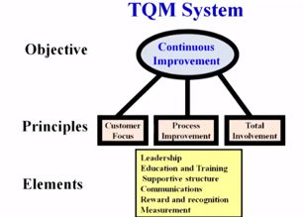
TQM SYSTEM

Slide 11
WHY TQM PROGRAMS FAILS?
LACK OF COMMITMENT FROM THE TOP MANAGEMENT.
FOCUSING ON SPECIFIC TECHNIQUES RATHER THAN ON THE SYSTEM.
NOT OBTAINING EMPLOYEE PARTICIPATION.
PROGRAM STOPS WITH TRAINING.
EXPECTING IMMEDIATE RESULTS, NOT A LONG TERM PAY- OFF.
FORCING THE ORGANIZATION TO ADOPT METHODS THAT ARE NOT PRODUCTIVE OR COMPATIBLE WITH ITS PRODUCTION SYSTEM AND PERSONNEL.

Slide 12
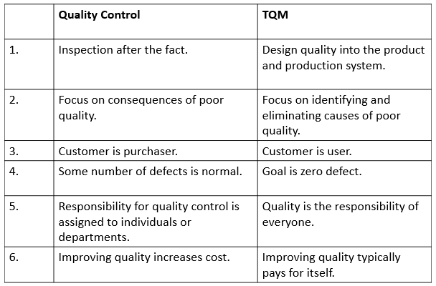
QUALITY CONTROL VERSUS TOTAL QUALITY MANAGEMENT

Slide 13
THANK YOU.

