Slide 1


OPERATION PLANNING AND CONTROL

Slide 2
OPERATIONS PLANNING AND CONTROL
PLANNING, DIRECTION AND CO-ORDINATION OF THE FIRM’S FACILITIES TO ACHIEVE THE PREDETERMINED PRODUCTION OBJECTIVES IN THE MOST ECONOMICAL MANNER.

Slide 3
OPERATIONS PLANNING AND CONTROL
DEFINATION( PPC)
"PRODUCTION PLANNING AND CONTROL IS THE CO-ORDINATION OF SERIES OF FUNCTIONS ACCORDING TO A PLAN WHICH WILL ECONOMICALLY UTILIZE THE PLANT FACILITIES AND REGULATE THE ORDERLY MOVEMENT OF GOODS THROUGH THE ENTIRE MANUFACTURING CYCLE FROM THE PROCUREMENT OF ALL MATERIALS TO THE SHIPPING OF FINISHED GOODS AT A PREDETERMINED RATE.”
-CHARLES A. KOEPKE

Slide 4
OPERATIONS PLANNING OVERVIEW
LONG-RANGE PLANNING
GREATER THAN ONE YEAR PLANNING HORIZON
INTERMEDIATE-RANGE PLANNING
SIX TO NINE MONTHS
SHORT-RANGE PLANNING
ONE DAY TO LESS THAN SIX MONTHS

Slide 5
LEVELS OF OPERATIONS PLANNING
STRATEGIC PLANNING: A PROCESS OF THINKING THROUGH THE ORGANIZATION'S CURRENT MISSION AND ENVIRONMENT AND SETTING FORTH A GUIDE FOR FUTURE DECISIONS AND RESULTS (STRATEGIC PLANNING IS DONE BY TOP MANAGEMENT TO DEVELOP LONG TERM PLANS).
TACTICAL PLANNING: PLANNING OVER A MEDIUM RANGE TIME HORIZON BY MIDDLE LEVEL MANAGEMENT.
OPERATION PLANNING DONE OVER A SHORT-TIME SPAN BY THE JUNIOR LEVEL MANAGEMENT, MAINLY CONCERNED WITH THE UTILIZATION OF FACILITIES.

Slide 6
OPERATION PLANNING AND CONTROL FUNCTION- PHASES
PPC FUNCTION ARE:
PLANNING PHASE
ACTION PHASE
CONTROL PHASE

Slide 7
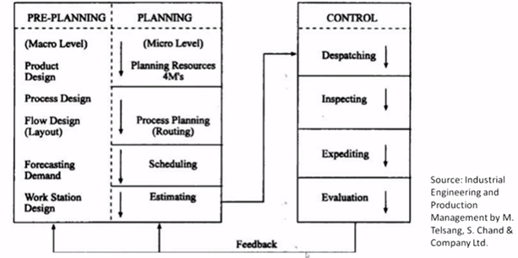
OPERATION PLANNING AND CONTROL FUNCTION- PHASES

Slide 8
OPERATION PLANNING AND CONTROL FUNCTIONS
THE FUNCTIONS OF PPC CAN BE CLASSIFIED UNDER THE FOLLOWING :
MATERIALS
METHODS
MACHINES AND EQUIPMENT'S
ROUTING(SEQUENCE OF PROCESS)
ESTIMATING
LOADING AND SCHEDULING (BASED UPON CAPACITY, IN LINE WITH ROUTING)

Slide 9
OPERATION PLANNING AND CONTROL FUNCTIONS
THE FUNCTIONS OF PPC CAN BE CLASSIFIED UNDER THE FOLLOWING :
DISPATCHING
EXPEDITING OR PROGRESSING
INSPECTION
EVALUATING OR CONTROLLING

Slide 10
OPERATIONS PLANNING - INPUTS
QUANTITIES OF EACH PRODUCT GROUP THAT MUST BE PRODUCED IN EACH PERIOD.
DESIRED INVENTORY LEVELS.
RESOURCES OF EQUIPMENT, LABOR, AND MATERIAL NEEDED IN EACH PERIOD.
AVAILABILITY OF RESOURCES.

Slide 11
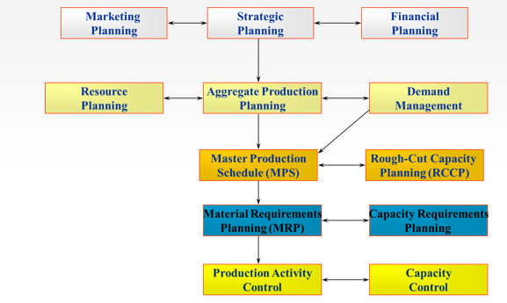
PRODUCTION PLANNING AND CONTROL

Slide 12
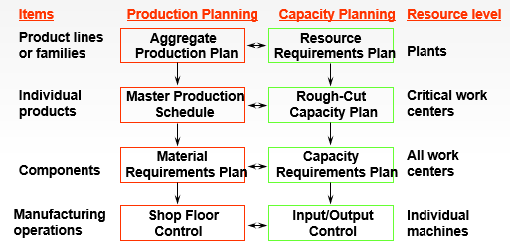
HIERARCHICAL PLANNING PROCESS

Slide 13
AGGREGATE PLANNING
AGGREGATE PLANNING INVOLVES PLANNING THE BEST QUALITY TO PRODUCE IN THE INTERMEDIATE-RANGE HORIZON (6 MONTHS TO ONE YEAR)
AGGREGATE PRODUCTION PLANNING IS THE PROCESS OF DETERMINING OUTPUT LEVELS OF PRODUCT GROUPS OVER THE NEXT 6 TO 12 MONTHS PERIOD.
OBJECTIVES OF AGGREGATE PLANNING
THE OVERALL OBJECTIVE IS TO BALANCE CONFLICTING OBJECTIVES INVOLVING CUSTOMER SERVICE, WORK FORCE STABILITY, COST AND PROFIT.
TO ESTABLISH COMPANY-WIDE STRATEGIC PLAN FOR ALLOCATING RESOURCES.
TO DEVELOP AN ECONOMIC STRATEGY TO MEET CUSTOMER DEMAND.

Slide 14
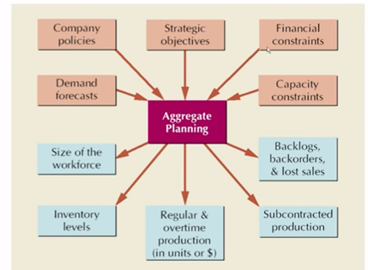
AGGREGATE PLANNING: INPUT AND OUTPUT

Slide 15
DEMAND MANAGEMENT -TYPES OF DEMAND
MAKE-TO-STOCK (MTS)
ASSEMBLE-TO-ORDER (ATO)
MAKE-TO-ORDER (MTO)

Slide 16
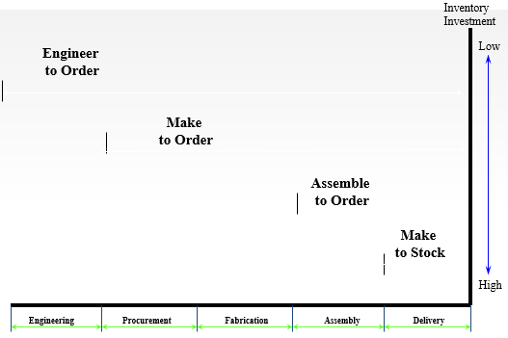
TYPES OF DEMAND VS LEAD TIME

Slide 17
MASTER PRODUCTION SCHEDULING
OBJECTIVES OF MASTER PRODUCTION SCHEDULING
TO SCHEDULE END ITEMS TO BE COMPLETED PROMPTLY AND WHEN PROMISED TO CUSTOMERS.
TO AVOID OVERLOADING OR UNDERLOADING THE PRODUCTION FACILITY SO THAT PRODUCTION CAPACITY IS EFFICIENTLY UTILIZED AND LOW PRODUCTION COSTS RESULT.

Slide 18
FUNCTIONS OF MPS
TRANSLATING AGGREGATE PLANS
EVALUATING ALTERNATIVE MASTER SCHEDULES
GENERATING MATERIAL AND CAPACITY REQUIREMENTS
FACILITATING INFORMATION PROCESSING
MAINTAINING PRIORITIES
UTILIZING THE CAPACITY EFFECTIVELY.

Slide 19
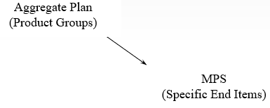
MASTER PRODUCTION SCHEDULE (MPS)
TIME-PHASED PLAN SPECIFYING HOW MANY AND WHEN THE FIRM PLANS TO BUILD EACH END ITEM

Slide 20
GUIDELINES FOR MASTER SCHEDULING
WORK FROM AN AGGREGATE PRODUCTION PLAN
SCHEDULE COMMON MODULES WHEN POSSIBLE
LOAD FACILITIES REALISTICALLY
RELEASE ORDERS ON A TIMELY BASIS
MONITOR INVENTORY LEVELS CLOSELY
RESCHEDULE AS REQUIRED

Slide 21
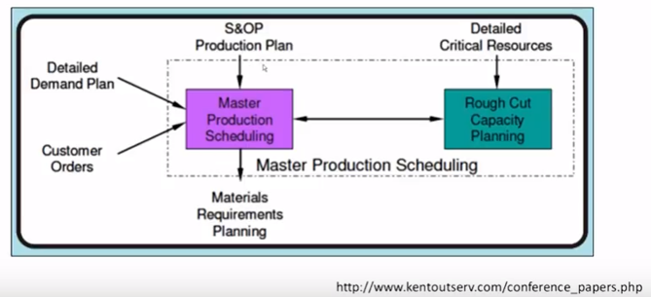
MASTER PRODUCTION SCHEDULE

Slide 22
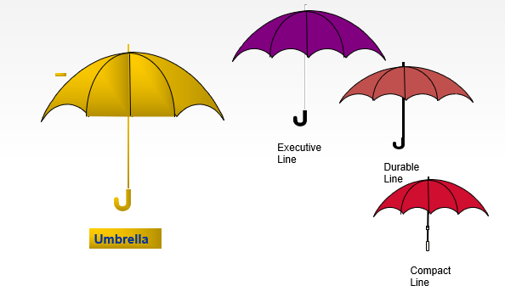
EXAMPLE

Slide 23
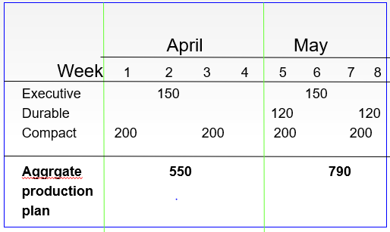
MPS FOR UMBRELLAS

Slide 24
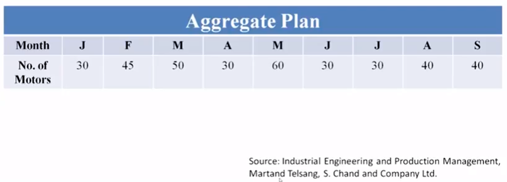
EXAMPLE

Slide 25
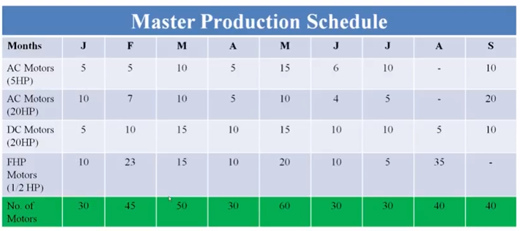
EXAMPLE

Slide 26
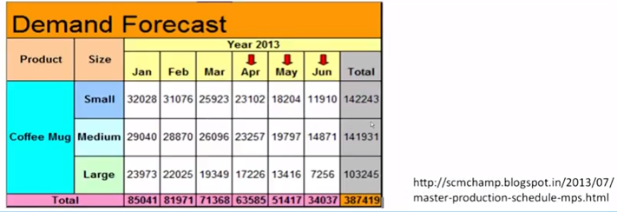
EXAMPLE

Slide 27
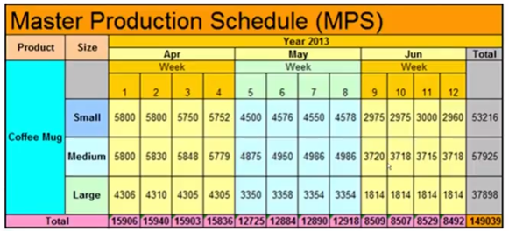
EXAMPLE

Slide 28
OUTPUT OF MPS
PRODUCTION SCHEDULE FOR A FAMILY OF PRODUCTS
MASTER PRODUCTION SCHEDULE (MPS).
IT SPECIFIES
THE SIZING AND TIMING OF SPECIFIC ITEM PRODUCTION QUANTITIES.
THE SIZING AND TIMING OF MANUFACTURED OR PURCHASED COMPONENTS.
ALLOCATION OF RESOURCES TO INDIVIDUAL OPERATIONS.

Slide 29
CAPACITY PLANNING
CAPACITY PLANNING INVOLVES ACTIVITIES SUCH AS:
ASSESSING EXISTING CAPACITY
FORECASTING FUTURE CAPACITY NEEDS
IDENTIFYING ALTERNATIVE WAYS TO MODIFY CAPACITY
EVALUATING FINANCIAL, ECONOMICAL AND TECHNOLOGICAL CAPACITY ALTERNATIVES
SELECTING A CAPACITY ALTERNATIVE MOST SUITED TO ACHIEVE THE STRATEGIC MISSION OF THE FIRM. CAPACITY PLANNING INVOLVES CAPACITY DECISIONS THAT MUST MERGE CONSUMER DEMANDS WITH HUMAN, MATERIAL AND FINANCIAL RESOURCES OF THE ORGANIZATION.

Slide 30
AGGREGATE CAPACITY PLANNING
NEED FOR AGGREGATE CAPACITY PLANNING
IT FACILITATES FULLY LOADED FACILITIES AND MINIMIZES OVERLOADING AND UNDER-LOADING AND KEEPS PRODUCTION COSTS LOW.
ADEQUATE PRODUCTION CAPACITY IS PROVIDED TO MEET EXPECTED AGGREGATE DEMAND.
ORDERLY AND SYSTEMATIC TRANSITION OF PRODUCTION CAPACITY TO MEET THE PEAKS AND VALLEYS OF EXPECTED CUSTOMER DEMAND IS FACILITATED.

Slide 31
AGGREGATE CAPACITY PLANNING : STEPS
STEPS IN AGGREGATE CAPACITY PLANNING
DETERMINE THE DEMAND (I.E., SALES FORECAST) FOR EACH PRODUCT FOR EACH TIME PERIOD (I.E., WEEKS OR MONTHS OR QUARTERS) OVER THE PLANNING HORIZON (6 TO 12 MONTHS).
DETERMINE THE AGGREGATE DEMAND BY SUMMING UP THE DEMAND FOR INDIVIDUAL PRODUCTS.
TRANSFORM THE AGGREGATE DEMAND FOR EACH TIME PERIOD INTO WORKERS, MATERIALS, MACHINES REQUIRED TO SATISFY AGGREGATE DEMAND.
IDENTIFY COMPANY POLICIES THAT ARE PERTINENT (E.G., POLICY REGARDING SAFETY STOCK MAINTENANCE, MAINTAINING STABLE WORKFORCE ETC.).

Slide 32
AGGREGATE CAPACITY PLANNING : STEPS
STEPS IN AGGREGATE CAPACITY PLANNING
DETERMINE UNIT COSTS FOR REGULAR TIME, OVERTIME, SUBCONTRACTING, HOLDING INVENTORIES, BACK ORDERS, LAYOFFS ETC.
DEVELOP ALTERNATIVE RESOURCE PLANS FOR PROVIDING NECESSARY PRODUCTION CAPACITY TO SUPPORT THE CUMULATIVE AGGREGATE DEMAND AND COMPUTE THE COST OF EACH ALTERNATIVE PLAN.
SELECT THE RESOURCE PLAN FROM AMONG THE ALTERNATIVES CONSIDERED THAT SATISFIES AGGREGATE DEMAND AND BEST MEETS THE OBJECTIVES OF THE FIRM.

Slide 33
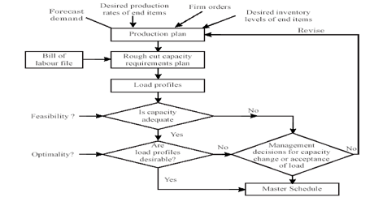
FLOW CHART FOR ROUGH-CUT CAPACITY PLANNING

Slide 34
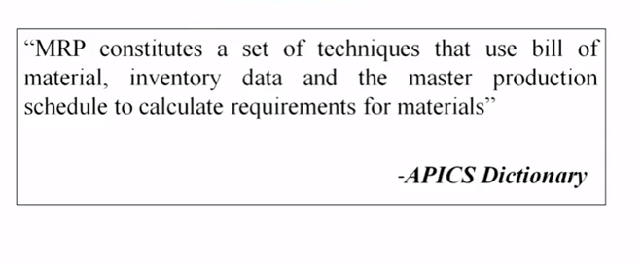
MATERIAL REQUIREMENTS PLANNING (MRP)
MATERIAL REQUIREMENTS PLANNING (MRP) IS A SYSTEM FOR PLANNING THE FUTURE REQUIREMENTS OF DEPENDENT DEMAND ITEMS.
DEFINITION

Slide 35
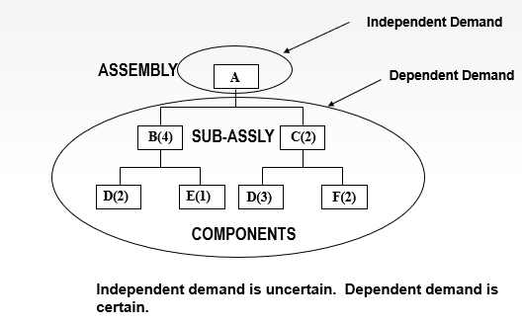
INDEPENDENT AND DEPENDENT DEMAND

Slide 36
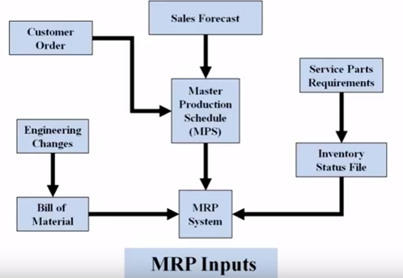
INPUTS OF MRP

Slide 37
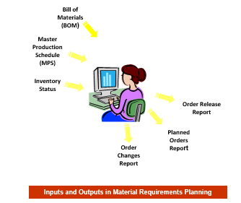
INPUTS & OUTPUTS IN MRP

Slide 38
MRP INPUTS
MASTER PRODUCTION SCHEDULE: ONE OF THE THREE PRIMARY INPUTS IN MRP, SPECIFIES WHAT END PRODUCTS ARE TO BE PRODUCED, IN WHAT QUANTITIES AND WHEN.
BILL OF MATERIALS FILE: PROVIDES THE INFORMATION REGARDING ALL THE MATERIALS, PARTS AND SUB ASSEMBLIES THAT GO INTO THE END PRODUCT.
INVENTORY STATUS FILE: GIVES COMPLETE AND UP-TO-DATE INFORMATION ON THE ON-HAND INVENTORIES, GROSS REQUIREMENTS, SCHEDULED RECEIPTS AND PLANNED ORDER RELEASES FOR THE ITEM.

Slide 39
PRODUCT STRUCTURE – BILL OF MATERIAL
A BILL OF MATERIALS OR PRODUCT STRUCTURE (BOM), IS A LIST OF THE RAW MATERIALS, SUB-ASSEMBLIES, INTERMEDIATE ASSEMBLIES, SUB-COMPONENTS, PARTS AND THE QUANTITIES OF EACH NEEDED TO MANUFACTURE AN END PRODUCT.

Slide 40
PRODUCT STRUCTURE – BILL OF MATERIAL
STANDARD TREE (MORE SUBASSEMBLIES THAN PRODUCTS AND MORE COMPONENTS THAN SUBASSEMBLIES, LARGE BOM).

Slide 41
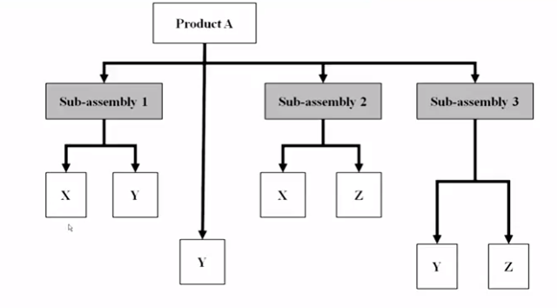
PRODUCT STRUCTURE – BILL OF MATERIAL

Slide 42
LEAD TIME
IT IS THE TIME NEEDED FOR COMPLETING THE JOB FROM THE INITIAL STAGE TO THE FINAL STAGE
ORDERING LEAD TIME : START OF PURCHASING PROCESS TO RECEIPT FROM SUPPLIERS.
MANUFACTURING LEAD TIME: PROCESSING OF PART THROUGH THE MACHINES SPECIFIED ON ROUTE SHEET.

Slide 43
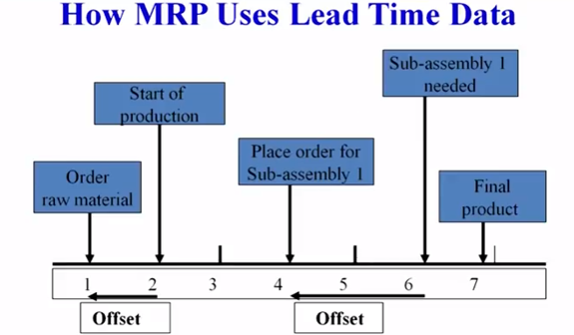
LEAD TIME

Slide 44
MRP OUTPUTS
PRIMARY OUTPUTS OF MRP SYSTEMS:
PLANNED ORDER SCHEDULE
CHANGES IN PLANNED ORDERS
SECONDARY OUTPUTS OF MRP SYSTEM:
EXCEPTION REPORTS
PERFORMANCE REPORTS
PLANNING REPORTS.

Slide 45
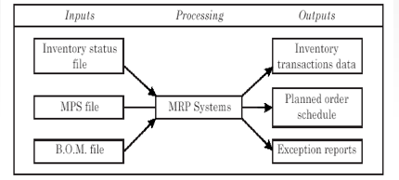
INPUTS & OUTPUTS IN MRP

Slide 46
CALCULATION OF ORDER SIZE IN MRP
THERE ARE FOUR METHODS OF CALCULATING THE ORDER SIZE IN MRP. THESE ARE:
LOT-FOR-LOT METHOD
EOQ METHOD
LEAST TOTAL COST METHOD
LEAST UNIT COST METHOD

Slide 47
STEPS IN CALCULATION OF MRP NET REQUIREMENTS
ACCESS AND VALIDATE GROSS REQUIREMENT
REVIEW OF STOCK POSITION
REVIEW OF LEAD TIME
REVIEW OF INVENTORY CONTROL POLICIES
REVIEW OF BILL OF MATERIAL

Slide 48
MRP IN SERVICES
IN AN MRP SYSTEM FOR SERVICES, THE MASTER SCHEDULE CAN REPRESENT SERVICES TO BE PROVIDED. AN EXAMPLE, OF A PRODUCT-SERVICE PACKAGE IS A FOOD CATERING SERVICE WHICH REQUIRES PREPARING AND SERVING MEALS FOR A LARGE NUMBER OF CUSTOMERS.
DISTRIBUTION REQUIREMENT PLANNING (DRP): A TIME-PHASED STOCK-REPLENISHMENT PLAN FOR ALL LEVELS OF A DISTRIBUTION NETWORK USING THE MRP PLANNING LOGIC. (QSR – JUMBO VADA PAV)

Slide 49
IMPACTS OF MRP RUN
THE CONTINUOUS MONITORING OF AVAILABLE STOCK WITHIN REORDER POINT PLANNING IS CARRIED OUT IN INVENTORY MANAGEMENT
IF WITHDRAWAL HAS CAUSED STOCK LEVELS TO FALL BELOW THE REORDER LEVEL,THE SYSTEM MAKES AN ENTRY IN THE PLANNING FILE FOR THE NEXT PLANNING RUN
IT TAKES CARE OF STOCK RETURNS WHICH INCREASES STOCK LEVELS AND DELETES PROCUREMENT PROPOSALS WHICH IS NOT REQUIRED BY MAKING AN ENTRY IN PLANNING FILE

Slide 50
IMPACTS OF MRP RUN
THE SYSTEM COMPARES THE AVAILABLE STOCK AT PLANT LEVEL (INCLUDING SAFETY STOCK) PLUS THE FIRMED RECEIPTS THAT HAVE ALREADY BEEN PLANNED (PURCHASE ORDERS, PRODUCTION ORDERS, FIRMED PURCHASE REQUISITIONS AND SO ON) WITH THE REORDER POINT
THE SYSTEM THEN CALCULATES THE PROCUREMENT QUANTITY ACCORDING TO THE LOT-SIZING PROCEDURE DEFINED IN THE MATERIAL MASTER
THE SYSTEM THEN SCHEDULES THE PROCUREMENT PROPOSAL, THAT IS, THE SYSTEM CALCULATES THE DATES ON WHICH THE PURCHASE ORDER HAS TO BE SENT, OR WHEN PRODUCTION HAS TO BEGIN AND THE DATE ON WHICH THE VENDOR HAS TO DELIVER THE GOODS OR BY WHICH PRODUCTION HAS TO HAVE THE GOODS READY.

Slide 51
MRP CONTROLLER
THE MRP CONTROLLER IS RESPONSIBLE FOR ALL ACTIVITIES RELATED TO SPECIFYING THE TYPE, QUANTITY, AND TIME OF THE REQUIREMENTS
HE SHOULD ALSO CALCULATE WHEN AND FOR WHAT QUANTITY AN ORDER PROPOSAL HAS TO BE CREATED TO COVER ABOVE REQUIREMENTS.
THE MRP CONTROLLER NEEDS ALL THE INFORMATION ON STOCKS, STOCK RESERVATIONS, AND STOCKS ON ORDER TO CALCULATE QUANTITIES, AND ALSO NEEDS INFORMATION ON LEAD TIMES AND PROCUREMENT TIMES TO CALCULATE DATES.
THE MRP CONTROLLER DEFINES A SUITABLE MRP AND LOT-SIZING PROCEDURE FOR EACH MATERIAL TO DETERMINE PROCUREMENT PROPOSALS.

Slide 52
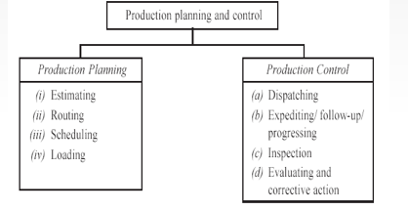
MAIN FUNCTIONS OF PRODUCTION PLANNING AND CONTROL DEPARTMENT

Slide 53
PRODUCTION PLANNING FUNCTIONS
ESTIMATING : IT INVOLVES DECIDING THE QUANTITY OF PRODUCTS TO BE PRODUCED AND COST INVOLVED IN IT ON THE BASIS OF SALES FORECAST.
ROUTING : DEFINES WHAT WORK HAS TO BE DONE, WHERE AND HOW IT WILL BE DONE.
SCHEDULING : ASSIGNING WORK TO THE FACILITY WITH THE SPECIFICATION OF TIME REGARDING WHEN TO START AND WHEN TO COMPLETE THE WORK.
LOADING : IT IS THE PROCESS OF ASSIGNING JOBS TO MACHINES OR WORKERS OR WORK CENTRES BASED ON RELATIVE PRIORITIES AND CAPACITY UTILIZATION.

Slide 54
PRODUCTION CONTROL FUNCTIONS
DISPATCHING: AN IMPLEMENTATION FUNCTION WHICH IS CONCERNED WITH GETTING THE WORK STARTED ON THE SHOP FLOORS.
EXPEDITING/FOLLOW-UP/PROGRESSING: ENSURING THAT THE WORK IS CARRIED OUT AS PER THE PLAN AND DELIVERY SCHEDULES ARE MET.

Slide 55
PRODUCTION CONTROL
CONTROL OF PLANNING
CONTROL OF MATERIALS
CONTROL OF TOOLING
CONTROL OF MANUFACTURING CAPACITY
CONTROL OF ACTIVITIES
CONTROL OF QUANTITY
CONTROL OF MATERIAL HANDLING
CONTROL OF DUE DATES
CONTROL OF INFORMATION

Slide 56
AGGREGATE PRODUCTION PLANNING - EXAMPLE
Names | Jan | Feb | Mar | Apr | May | June | Total
Beginning Inventory | 200
Demand Forecast | 500 | 600 | 650 | 800 | 900 | 800
Safety Stock(0.2 * Demand Forecast)
Production Requirement ( Dem Forecast + Safety Stock – Beg. Inv)
Ending Inventory ( Beg Inv + Prod. Req. - Dem Forecast)
Workers Required
Average Inventory
* One worker can produce 50 products per month

Slide 57
AGGREGATE PRODUCTION PLANNING - SOLUTION
Names | Jan | Feb | Mar | Apr | May | June | Total
Beginning Inventory | 200 | 100 | 120 | 130 | 160 | 180
Demand Forecast | 500 | 600 | 650 | 800 | 900 | 800
Safety Stock(0.2 * Demand Forecast) | 100 | 120 | 130 | 160 | 180 | 160
Production Requirement ( Dem Forecast + Safety Stock – Beg. Inv) | 400 | 620 | 660 | 830 | 920 | 780
Ending Inventory ( Beg Inv + Prod. Req. - Dem Forecast) | 100 | 120 | 130 | 160 | 180 | 160
Workers Required | 8 | 12.4=13 | 13.2=14 | 16.6=17 | 18.4= 19 | 15.6 = 16
Average Inventory | 150 | 110 | 125 | 145 | 170 | 170

Slide 58
THANK YOU.

