Slide 1


INTRODUCTION
TO OPERATIONS MANAGEMENT

Slide 2
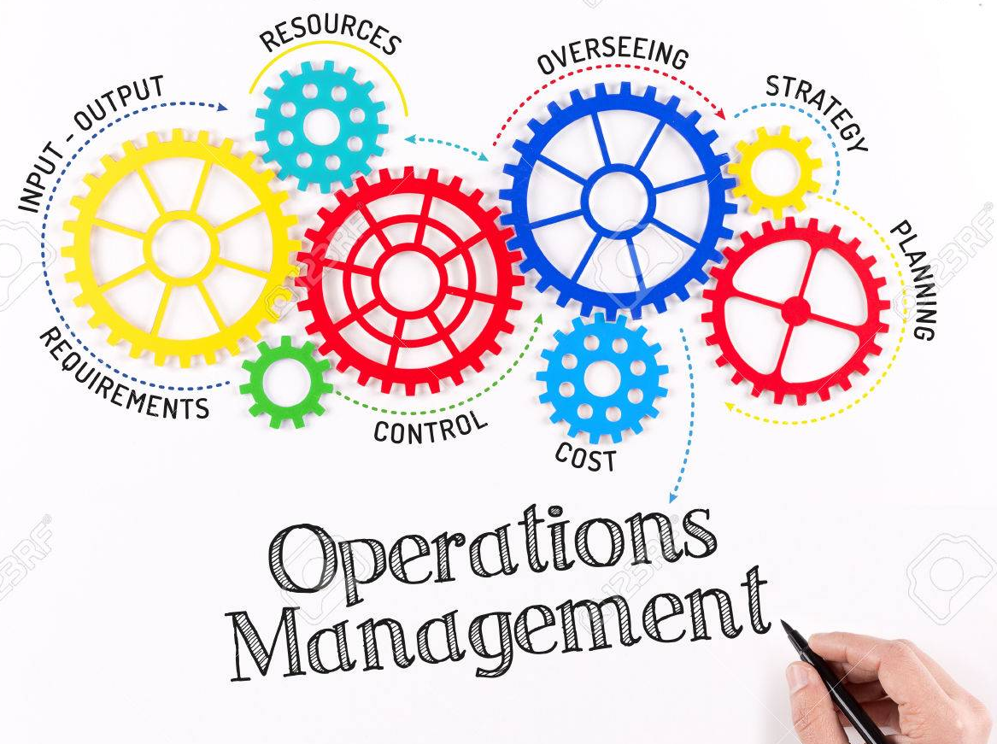
OVERVIEW
INTRODUCTION TO OPERATIONS MANAGEMENT
IMPORTANCE OF OPERATIONS MANAGEMENT
DEFINITION OF OPERATIONS MANAGEMENT
OPERATIONS AS TRANSFORMATION PROCESS
TYPES OF TRANSFORMATION PROCESS
EXAMPLES : WAL MART, OLYMPIC GAMES, MC DONALD’S
OPERATIONS MANAGEMENT : IN GOODS AND SERVICE SECTOR
ROLE OF OPERATIONS MANAGEMENT

Slide 3
WHY OPERATIONS MANAGEMENT
OPERATIONS MANAGEMENT
STUDY OF MANUFACTURING & SERVICE OPERATIONS
ESSENTIAL FOR BUSINESS EDUCATION
INTERFACE WITH OTHER FUNCTIONS – MKTG, FIN, HR
CAREER OPPORTUNITIES

Slide 4
IMPORTANCE OF OPERATIONS MANAGEMENT
DURING THE PAST COUPLE OF DECADES, MANY DOMESTIC COMPANIES SAW THEIR MARKET SHARE DECLINE DUE TO THEIR INABILITY TO COMPETE WITH FOREIGN FIRMS IN TERMS OF PRODUCT DESIGN, COST, OR QUALITY.
THEORIES TO EXPLAIN THIS DEVELOPMENT:
  CULTURAL DIFFERENCES & GOVERNMENT POLICIES
  MERGER MANIA & NEGLECT OF HUMAN RESOURCES
  INSUFFICIENT INVESTMENT IN TECHNOLOGY
WORLD-CLASS PERFORMANCE BY OPERATIONS IN DELIVERING HIGH-QUALITY, COST-COMPETITIVE PRODUCTS AND SERVICES IS ESSENTIAL FOR SURVIVAL IN TODAY'S GLOBAL ECONOMY.
OF LATE AUTO COMPONENTS, PHARMA, IT AND ITES SECTORS ARE SHOWING SIGNS OF GLOBAL COMPETITIVENESS.
NEW GOVERNMENT INITIATIVE – MAKE IN INDIA FOR INDIA.
CHINA IS SHIFTING FOCUS TO HIGH-TECH/VALUE MANUFACTURING!

Slide 5
OPERATIONS MANAGEMENT (OM)
WHAT IS OPERATIONS MANAGEMENT?
  THE ASPECT OF A BUSINESS ORGANIZATION THAT IS RESPONSIBLE FOR PRODUCING GOODS OR SERVICES
  A FUNCTION OR SYSTEM THAT TRANSFORMS INPUTS INTO OUTPUTS OF GREATER VALUE
OPERATIONS MANAGEMENT DEALS WITH
  THE DESIGN AND MANAGEMENT OF
  PRODUCTS
  PROCESS
  SERVICES
  SUPPLY CHAIN

Slide 6
DEFINITION : OPERATIONS MANAGEMENT
MANAGEMENT OF BUSINESS (TRANSFORMATION) PROCESSES
THE BUSINESS FUNCTION RESPONSIBLE FOR PLANNING, COORDINATING AND CONTROLLING THE RESOURCES NEEDED TO PRODUCE THE PRODUCTS AND SERVICES FOR A COMPANY
THE SCIENCE AND ART OF ENSURING GOODS AND SERVICES ARE CREATED AND DELIVERED SUCCESSFULLY TO CUSTOMERS

Slide 7
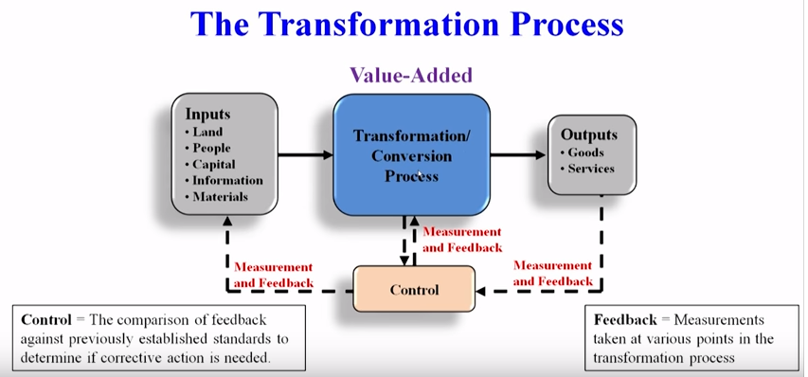
THE TRANSFORMATION PROCESS

Slide 8
TRANSFORMATION PROCESSES: TYPES
PHYSICAL MANUFACTURING
LOCATIONAL TRANSPORT/STORAGE
EXCHANGE RETAIL
PHYSIOLOGICAL HEALTHCARE
PSYCHOLOGICAL ENTERTAINMENT
INFORMATIONAL COMMUNICATIONS
INPUT
TRANSFORMATION
OUTPUT

Slide 9
EXAMPLE TRANSFORMATION PROCESS: FOOD PROCESSING PLANT
RAW VEGETABLES CLEANING CANNED
METAL SHEETS MAKING CANS VEGETABLE
WATER CUTTING
ENERGY COOKING
LABOR PACKING
BUILDING LABELING
INPUT
PROCESSING
OUTPUT

Slide 10
EXAMPLE TRANSFORMATION PROCESS: HOSPITAL
DOCTORS, NURSES EXAMINATION HEALTHY
HOSPITSL SURGERY CUSTOMERS
MEDICAL SUPPLIES MONITORING
EQUIPMENT MEDICATION
LABORATORIES THERAPY
INPUT
(PATIENTS)
PROCESSING
OUTPUT

Slide 11
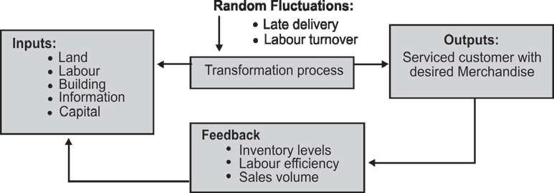
EXAMPLE TRANSFORMATION PROCESS: DEPARTMENTAL STORE
INPUT
PROCESSING
OUTPUT

Slide 12
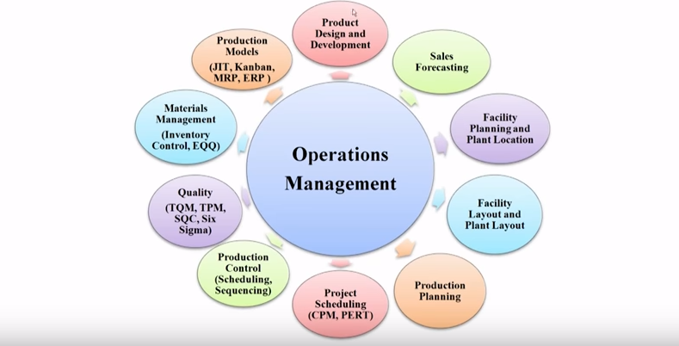
OM DEALS WITH

Slide 13
DISTINCTION BETWEEN PRODUCTION AND OPERATIONS MANAGEMENT
THE TERM PRODUCTION IS USED FOR A SYSTEM WHERE TANGIBLE GOODS ARE PRODUCED.
WHEREAS, OPERATIONS MANAGEMENT IS USED WHERE VARIOUS INPUTS ARE TRANSFORMED INTO INTANGIBLE SERVICES.
OPERATIONS MANAGEMENT WILL COVER SERVICE ORGANIZATIONS SUCH AS BANKS, AIRLINES, UTILITIES, POLLUTION CONTROL AGENCIES, EDUCATIONAL INSTITUTIONS, LIBRARIES, CONSULTANCY FIRMS, ETC.
THE SECOND DISTINCTION RELATES TO THE EVOLUTION OF THE SUBJECT. PRODUCTION MANAGEMENT PRECEDES OM IN THE HISTORICAL GROWTH OF THE SUBJECT.

Slide 14
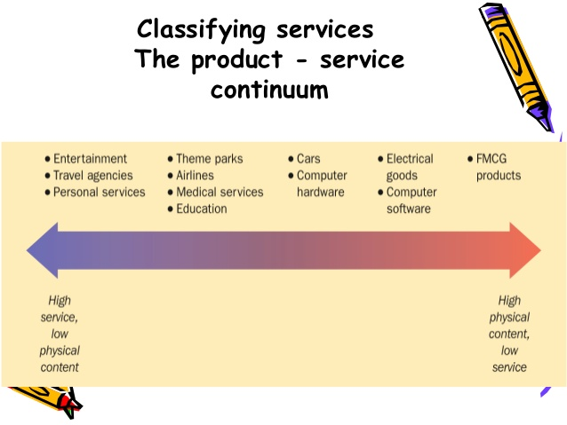

Slide 15
GOODS VS SERVICES
GOODS | SERVICES
TANGIBLE | INTANGIBLES
STANDARDIZED | HETEROGENEOUS
PRODUCTION SEPARATE FROM CONSUMPTION | SIMULTANEOUS PRODUCTION & CONSUMPTION
NON PERISHABLE | PERISHABLE
GOODS CAN BE RETURNED OR RESOLD | SERVICES CANNOT BE RETURNED OR RESOLD
IT IS EASY TO SYNCHRONIZE SUPPLY AND DEMAND | IT IS DIFFICULT TO SYNCHRONIZE SUPPLY AND DEMAND

Slide 16
Manufacturing Organizations | Service Organizations
Differences
Physical durable product | Intangible, perishable product
Output can be inventoried | Output can’t be inventoried
Low customer contact | High customer contact
Long response time | Short response time
Regional, national, Intl. markets | Local markets
Large facilities | Small facilities
Capital intensive, Technology based | Labor intensive, Knowledge and skill based
Quality easily measured | Quality not easily measured
Similarities
Is concerned about quality, productivity & timely response to its customers
Must make choices about capacity, location, layout
Has suppliers to deal with
Has to plan its operations, schedules and resources
Balance capacity with demand by a careful choice of resources
Has to make an estimate of demand

Slide 17
COORDINATION BETWEEN DIFFERENT FUNCTIONAL DEPARTMENT
Operations
Finance
Marketing
THREE PRIMARY DEPARTMENTS, WHICH CANNOT BE MUTUALLY EXCLUSIVE AND THE FUNCTIONAL OVERLAP IS UNAVOIDABLE.

Slide 18
INTERFACE BETWEEN OM AND MARKETING
WHAT OPERATIONS CAN DO RELATIVE TO MEETING DUE DATES, PRODUCT CUSTOMIZATION, NEW PRODUCT INTRODUCTION.
IN SERVICE INDUSTRIES, MARKETING AND PRODUCTION TAKE PLACE SIMULTANEOUSLY ?
ADVERTISEMENT AND SALES PROMOTION
SALES FORECAST

Slide 19
INTERFACE BETWEEN OM AND FINANCE
UNDERSTAND INVENTORY MANAGEMENT, CAPACITY UTILIZATION AND LABOR STANDARDS TO DEVELOP ACCURATE COST DATA, PERFORM AUDITS, AND PREPARE FINANCIAL REPORTS.
COST ACCOUNTANTS MUST BE AWARE OF HOW JIT WORKS.
NEED FOR CAPITAL INVESTMENTS.
FORECAST CASH FLOWS.
MAKE-OR-BUY DECISION.
PLANT EXPANSION AND/OR RELOCATION.
ECONOMIC ANALYSIS OF INVESTMENT PRODUCTS
BUDGETING AND TIMING OF FUNDS

Slide 20
INTERFACE BETWEEN OM AND HUMAN RESOURCES
HOW JOBS ARE DESIGNED?
SKILLS OF WORK FORCE.
CONVERSION OF HUMAN RESOURCE INTO HUMAN ASSET IS THE REQUIREMENT OF THE DAY
PROPER RECRUITMENT, SELECTION AND PLACEMENT OF A PERSON
PROPER TRAINING
COMPENSATION AND INCENTIVE PROGRAMS.
MOTIVATION EXPOSURE
JOB ENRICHMENT

Slide 21
INTERFACE BETWEEN OM AND IT
DESIGN AND DEVELOP SOFTWARE.
MAJOR BUSINESS APPLICATIONS OF COMPUTERS IS IN PRODUCTION PLANNING & CONTROL.

Slide 22
CONFLICTS BETWEEN PRIMARY DEPARTMENT
INVENTORY
FINANCE –LOW
OPERATIONS – LOW
MARKETING – HIGH
TRANSPORTATION
MARKETING –PROMPT DELIVERY
OPERATIONS – LOWEST TRANSPORTATION COST BY CHEAPEST ROUTE AND FULL TRUCKLOAD

Slide 23
CONFLICTS BETWEEN PRIMARY DEPARTMENT
PRODUCTION RUNS
MARKETING – SHORTER PRODUCTION RUNS TO INTRODUCE CUSTOMER PREFERENCES AND REDUCE BURDEN OF OBSOLETE INVENTORY
OPERATIONS – LONG RUNS TO AVOID FREQUENT SET-UPS AND THUS HIGH SET-UP COST
WAREHOUSE
MARKETING – SEPARATE WAREHOUSE NEAR MARKET TO FACILITATE PROMPT SUPPLY
OPERATIONS – CENTRALISED WAREHOUSE FOR PROPER CONTROL

Slide 24
EMERGING ROLE OF OPERATIONS MANAGER
TAKE PART IN STRATEGIC DECISION MAKING
TAKE DECISIONS REGARDING OUTSOURCING OF BUSINESS PROCESSES
ACT AS MEMBER OF ENGINEERING TEAM FOR NEW PRODUCT DESIGN AND DEVELOPMENT
TAKE CARE OF ISSUES RELATING TO SERVICE OPERATIONS MANAGEMENT
IMPLEMENT THE ENVIRONMENTAL AND POLLUTION NORMS
ACT AS SUPPLY CHAIN MANAGER FOR FORGING LONG TERM STRATEGIC RELATIONSHIP WITH SUPPLIERS
TECHNOLOGY MANAGEMENT DUE TO JVS WITH MNCS
OVERSEE TIMELY IMPLEMENTATION OF PROJECTS TO MEET INCREASED COMPETITION.
MAN MANAGEMENT, LEADERSHIP ROLE AND MENTORING.

Slide 25
OPERATIONS MANAGEMENT CHALLENGES
COMPETITIVE PRESSURES DUE TO ECONOMIC REFORMS
FALLING PRICES
THE ON ROAD PRICE OF A HYUNDAI SANTRO HAS NOT CHANGED MUCH BETWEEN 2000 AND NOW…
SHRINKING DELIVERY QUOTE
TEXTILE MANUFACTURERS ARE EXPECTED TO CUT THEIR LEAD TIME FROM ORDER PLACEMENT TO FINAL DELIVERY DOWN TO 2 MONTHS
BUILD-TO-ORDER REQUIREMENTS
NEED SYSTEMS THAT ALLOWS CUSTOMERS TO SELF-CONFIGURE, CUSTOMIZE AND VISUALIZE THEIR OWN VERSION OF PRODUCTS & SERVICES

Slide 26
OPERATIONS MANAGEMENT CHALLENGES
GROWING CUSTOMER EXPECTATIONS
TARIFF PLANS AND OPTIONS PROVIDED BY MOBILE OPERATORS, OPTIONS IN PASSENGER CAR
CUSTOMERS TEND TO DEMAND MORE AND REFINE THEIR EXPECTATIONS
MANUFACTURING & SERVICE ORGANIZATIONS MUST LEARN TO RESPOND TO THESE EXPECTATIONS
NEED TO DEVELOP CAPABILITIES TO BRING NEWER PRODUCTS AND SERVICES FASTER AND YET PROFITABLY

Slide 27
OPERATIONS MANAGEMENT CHALLENGES
RAPID TECHNOLOGICAL ADVANCEMENTS
ATMS & INTERNET BANKING.
BUYING A TRAIN TICKET. HTTP://WWW.IRCTC.CO.IN/ TICKET BOOKING AND CANCELLATION AT LEISURE.
PROCUREMENT OF GOODS & SERVICES. REVERSE AUCTION ON THE INTERNET, THE BEST SUPPLIER CAN BE LOCATED.
NEW PRODUCT DEVELOPMENT. A TEAM OF DESIGN PERSONNEL FROM ACROSS DIFFERENT GEOGRAPHICAL LOCATIONS CAN PARTICIPATE USING TECHNOLOGICAL TOOLS.

Slide 28
OPERATIONS MANAGEMENT CHALLENGES
ENVIRONMENTAL ISSUES
GROWING INDUSTRIALIZATION RAISES CONCERNS REGARDING THE DEPLETION OF NATURAL RESOURCES AND THE WASTE GENERATED FROM PRODUCTION SYSTEMS AND END-OF-LIFE PRODUCTS.
GROWING URBANIZATION CREATES SOCIETAL PROBLEMS ARISING OUT OF SCARCITY OF AVAILABLE RESOURCES AND GENERATION OF SOLID WASTES.
CONSUMPTION OF ENERGY AND WATER IN COUNTRIES LIKE INDIA IS ON THE RISE. SUCH A SITUATION REQUIRES BETTER PRACTICES AND NEWER METHODS OF ADDRESSING THESE REQUIREMENTS USING BETTER OPERATIONAL PRACTICES.
INCREASINGLY, FIRMS ARE UNDER PRESSURE TO TAKE RESPONSIBILITY OF RESTORING, SUSTAINING, AND EXPANDING THE PLANET’S ECOSYSTEM INSTEAD OF MERELY EXPLOITING IT.
OM PRACTICES MUST ADDRESS ENVIRONMENTAL CONCERNS IN ORDER TO ENSURE A SUSTAINABLE WORLD.

Slide 29
OPERATIONS MANAGEMENT CHALLENGES
INCREASINGLY, FIRMS ARE UNDER PRESSURE TO TAKE RESPONSIBILITY OF RESTORING, SUSTAINING, AND EXPANDING THE PLANET’S ECOSYSTEM INSTEAD OF MERELY EXPLOITING IT.
OM PRACTICES MUST ADDRESS ENVIRONMENTAL CONCERNS IN ORDER TO ENSURE A SUSTAINABLE WORLD.

Slide 30
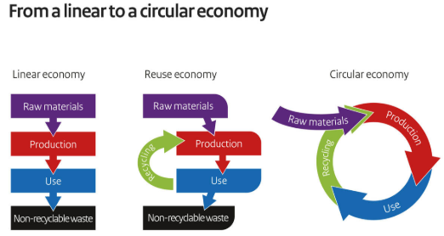
OPERATIONS MANAGEMENT CHALLENGES

Slide 31
CAREERS IN OPERATIONS AND SUPPLY CHAIN MANAGEMENT
Plant manager
Hospital administrator
Branch manager
Department store manager
Call center manager
Supply chain manager
Purchasing manager
Business process improvement analyst
Quality control manager
Lean improvement manager
Project manager
Production control analyst
Facilities manager
Chief operating officer

Slide 32
THANK YOU.

