Slide 1


FACILITY LAYOUT

Slide 2
PLANT LAYOUT
PLANT LAYOUT IS A FLOOR PLAN
FOR DETERMINING & ARRANGING MACHINERY, EQUIPMENT & OTHER INDUSTRIAL FACILITIES SUCH AS RECEIVING & SHIPPING DEPARTMENT, TOOL ROOMS, MAINTENANCE ROOMS & EMPLOYEE AMENITIES
FOR THE PURPOSE OF ACHIEVING THE QUICKEST & SMOOTHEST PRODUCTION AT THE LEAST COST.

Slide 3
OBJECTIVES
PROVIDE ENOUGH PRODUCTION CAPACITY.
REDUCE MATERIAL HANDLING COSTS.
REDUCE CONGESTION THAT PREVENTS THE MOVEMENT OF PEOPLE OR MATERIAL.
REDUCE HAZARDS TO PERSONNEL.
UTILIZE LABOR EFFICIENTLY.
INCREASE EMPLOYEE MORAL.
REDUCE ACCIDENTS.
UTILIZE AVAILABLE SPACE EFFICIENTLY & EFFECTIVELY.

Slide 4
OBJECTIVES
PROVIDE VOLUME & PRODUCT FLEXIBILITY.
PROVIDE CARE OF SUPERVISION.
FACILITATE COORDINATION & FACE TO FACE COMMUNICATION.
PROVIDE EMPLOYEE SAFETY & HEALTH.
ALLOW HIGH MACHINE/ EQUIPMENT UTILIZATION.
IMPROVE PRODUCTIVITY.

Slide 5
FACTORS AFFECTING PLANT LAYOUT
MATERIALS
PRODUCT
WORKER
MACHINERY
TYPE OF INDUSTRY
LOCATION
MANAGERIAL POLICIES

Slide 6
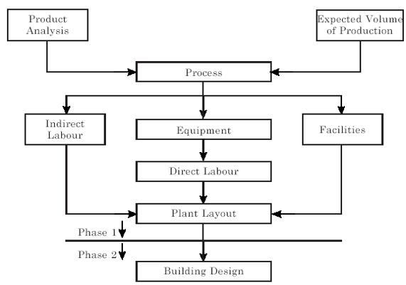
STEPS IN LAYOUT PLANNING AND DESIGN

Slide 7
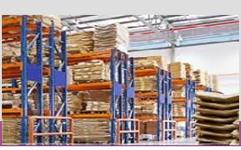
LAYOUT FOR WAREHOUSE OPERATIONS
WAREHOUSE DESIGNING IS A COMPLEX METHOD OF ARRANGING AND DISPLAYING THE GOODS IN THE STORES FOR EASY, SAFE AND LESS COSTLY MATERIAL HANDLING.
ALONG WITH WAREHOUSE LAYOUT DECISIONS, INVENTORY LOCATION DECISION ARE MADE TO FACILITATE FAST STORAGE & RETRIEVE MATERIALS.

Slide 8
FACTORS CONSIDERED FOR LAYOUT FOR WAREHOUSE
EASY RECEIPT, STORAGE AND ISSUE OF MATERIAL
MINIMUM HANDLING AND MOVEMENT OF MATERIALS
EASY SUPERVISION OF MATERIALS AND PERSONNEL.
PROPER AND OPTIMUM USE OF SPACE BOTH HORIZONTALLY AND VERTICALLY
PROPER LIGHTING FOR EASY OPERATIONS
CONTROL MECHANISM LIKE CCTV TO CONTROL THEFT
SAFETY OF MATERIAL AND PERSONNEL

Slide 9
TYPES OF WAREHOUSE DESIGN
COMB TYPE LAYOUT : WAREHOUSE DESIGN IN WHICH STOCKING ON ONE SIDE OF AISLE.
TREE TYPE LAYOUT : WAREHOUSE DESIGN IN WHICH STOCKING IS ON BOTH SIDES OF AISLE.

Slide 10
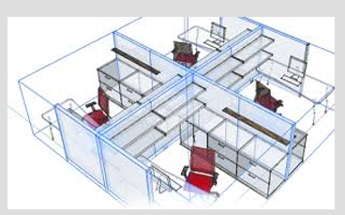
OFFICE OPERATIONS
OFFICE LAY OUT TREND NEEDS TO BE FOLLOWED.
AVOIDING FIXED WALLS TO MAKE TEAM WORK EASIER.
HIGHLIGHTS THE COMPANY IMAGE.
FASTER COMMUNICATION.

Slide 11
SERVICE OPERATIONS
SERVICE FACILITIES EXIST TO BRING TOGETHER CUSTOMERS AND SERVICES.
EASY ENTRANCE REQUIRED.
LARGE, WELL ORGANIZED AND AMPLY LIGHTED PARKING AREAS.
BECAUSE OF DIFFERENT DEGREE OF CUSTOMER CONTACT, TWO TYPES OF SERVICE FACILITY LAYOUTS EMERGE
CUSTOMER RECEIVING AND SERVICING FUNCTIONS, SUCH AS BANKS.
ANOTHER DESIGNED AROUND THE TECHNOLOGIES, PROCESSING OF PHYSICAL MATERIALS AND PRODUCTION EFFICIENCY.

Slide 12
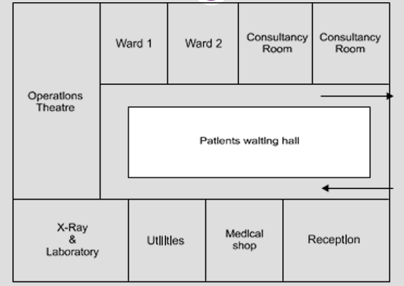
LAYOUT FOR HOSPITAL SERVICE

Slide 13
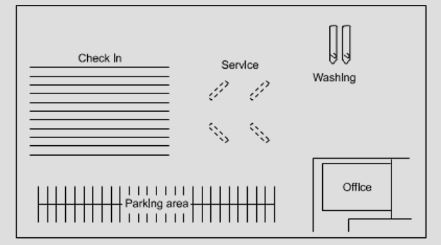
LAYOUT FOR CAR SERVICING

Slide 14
PRINCIPLES OF PLANT LAYOUT
PRINCIPLE OF MINIMUM TRAVEL
PRINCIPLE OF SEQUENCE
PRINCIPLE OF USAGE
PRINCIPLE OF COMPACTNESS
PRINCIPLE OF SAFETY & SATISFACTION
PRINCIPLE OF FLEXIBILITY
PRINCIPLE OF MIN INVESTMENT

Slide 15
TYPES OF PLANT LAYOUT
PROCESS LAYOUT
PRODUCT LAYOUT
FIXED POSITION LAYOUT
CELLULAR MANUFACTURING LAYOUT OR GROUP TECHNOLOGY LAYOUT

Slide 16
PROCESS LAYOUT
FUNCTIONAL GROUPINGS OF MACHINES OR ACTIVITIES THAT DO SIMILAR WORK IN BATCHES.
CAN HANDLE WIDE VARIETY OF PRODUCTS/SERVICES.
TYPICALLY LOW VOLUME, HIGH VARIETY STRATEGY.
FLEXIBILITY IN EQUIPMENT AND LABOUR ASSIGNMENTS.
COMPARED TO PRODUCT LAYOUT, IT REQUIRES LESS INVESTMENT.

Slide 17
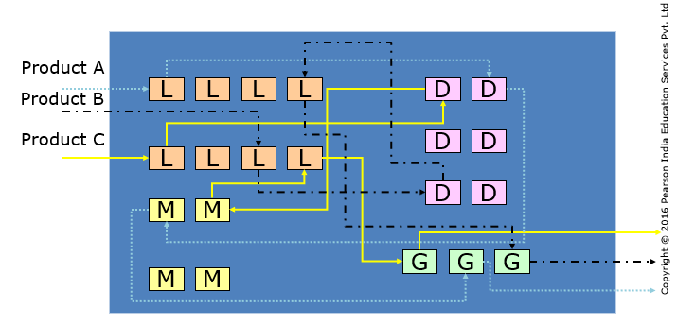
PROCESS LAYOUT

Slide 18
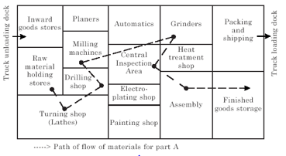
PROCESS LAYOUT OR FUNCTIONAL LAYOUT OR JOB SHOP LAYOUT

Slide 19
PRODUCT OR LINE LAYOUT
LAYOUT BY SEQUENCE
MATERIAL FLOW IS UNIDIRECTIONAL AND AT STEADY RATE
ORGANIZED AROUND PRODUCT.
HIGH VOLUME, LOW VARIETY
SPECIALIZED MACHINES USED.
EXAMPLE – CEMENT, PAPER, CHEMICALS

Slide 20
ASSUMPTIONS
ADEQUATE VOLUME FOR HIGH EQUIPMENT UTILIZATION.
PRODUCT DEMAND IS STABLE ENOUGH TO JUSTIFY HIGH INVESTMENT IN SPECIALIZED EQUIPMENT.
PRODUCT IS STANDARDIZED.
SUPPLIES OF RAW MATERIALS AND COMPONENTS ARE ADEQUATE AND OF UNIFORM QUALITY.

Slide 21
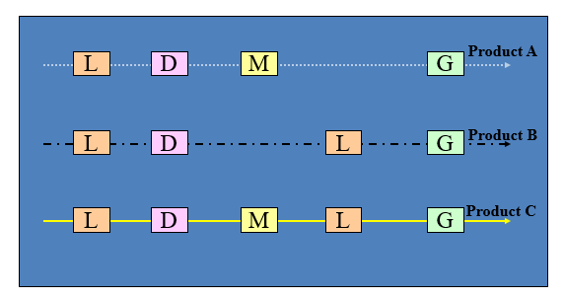
PRODUCT LAYOUT

Slide 22
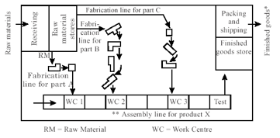
PRODUCT LAYOUT OR LINE LAYOUT

Slide 23
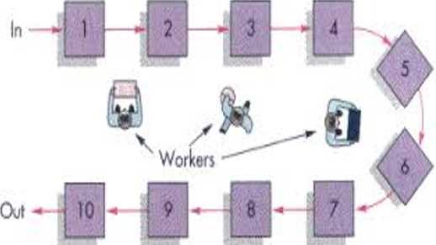
PRODUCT LAYOUT

Slide 24
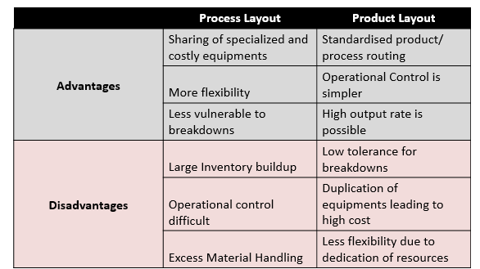
PRODUCT & PROCESS LAYOUT

Slide 25
FIXED POSITION LAYOUT
INVOLVES THE MOVEMENT OF MEN AND MACHINES TO THE PRODUCT WHICH REMAINS STATIONARY.
THE MOVEMENT OF MEN AND MACHINES ARE ADVISABLE BECAUSE THE COST OF MOVING THEM WOULD BE LESS THAN THE COST OF MOVING THE PRODUCT WHICH IS VERY BULKY.

Slide 26
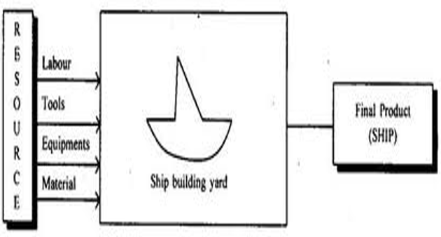
FIXED POSITION LAYOUT

Slide 27
CELLULAR LAYOUT
PRODUCT LAYOUT IS DESIRABLE, BUT THE LOW VOLUME AND THE VARIETY DOES NOT WARRANT IT.
HENCE GO FOR OLD BATCH PROCESSING OR PROCESS LAYOUT.
AN INTERMEDIATE SOLUTION IS CELLULAR LAYOUT
MACHINES ARE GROUPED INTO CELLS, AND THE CELLS FUNCTION SOMEWHAT LIKE A PRODUCT LAYOUT.

Slide 28
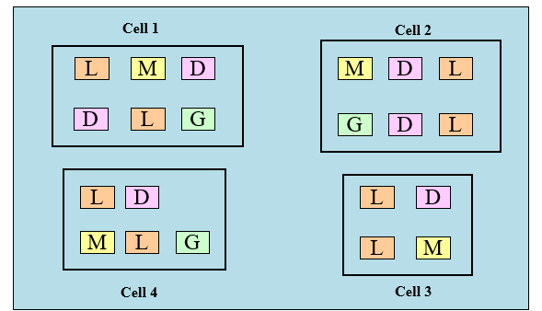
CELLULAR LAYOUT

Slide 29
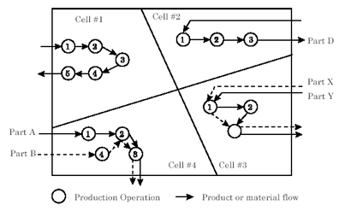
CELLULAR LAYOUT

Slide 30
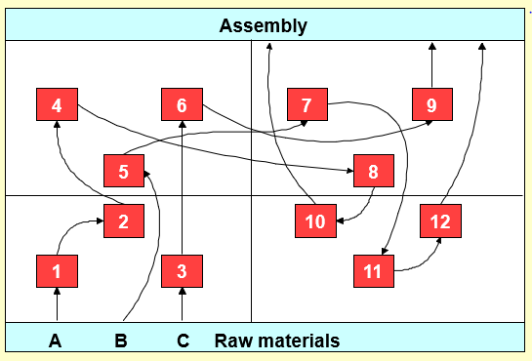
ORIGINAL LAYOUT

Slide 31
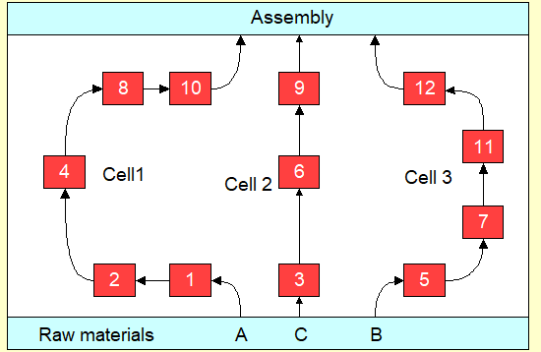
REVISED LAYOUT

Slide 32
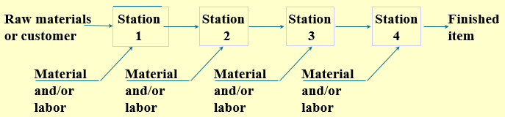
ASSEMBLY LINE

Slide 33
INPUTS FOR AN ASSEMBLY LINE, ARE…
A SET OF OPERATIONS TO BE PERFORMED.
A PRECEDENCE RELATIONSHIP AMONG THE OPERATIONS.
ZONING RESTRICTIONS.

Slide 34
LINE BALANCING
LINE BALANCING IS THE PROCESS OF ASSIGNING TASKS TO WORKSTATIONS IN SUCH A WAY THAT THE WORKSTATIONS HAVE APPROXIMATELY EQUAL TIME REQUIREMENTS.

Slide 35
OBJECTIVE : LINE BALANCING
MINIMIZE THE NUMBER OF STATIONS FOR A GIVEN CYCLE TIME (OR OUTPUT RATE).
MINIMIZE PROCESS TIME FOR A GIVEN NUMBER OF STATIONS.
FIND AN OPTIMAL COMBINATION OF THE FLEXIBLE CYCLE TIME AND THE FLEXIBLE NUMBER OF STATIONS

Slide 36
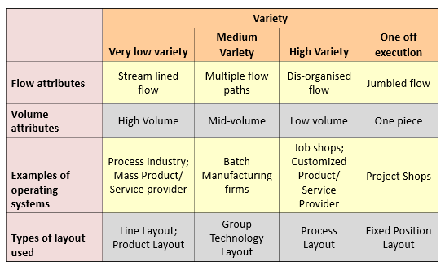
VOLUME – VARIETY – FLOW IMPLICATIONS FOR LAYOUT PLANNING

Slide 37
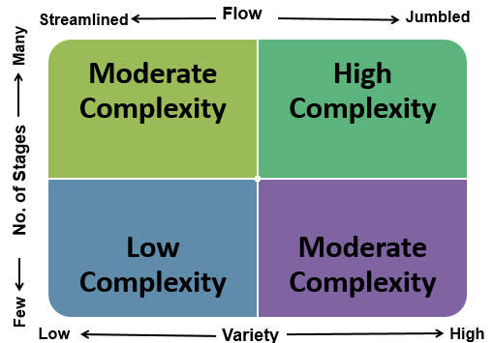
FACTORS AFFECTING THE COMPLEXITY OF OPERATIONS MANAGEMENT

Slide 38
THANK YOU.

