Slide 1


TYPES OF PRODUCTION SYSTEMS

Slide 2
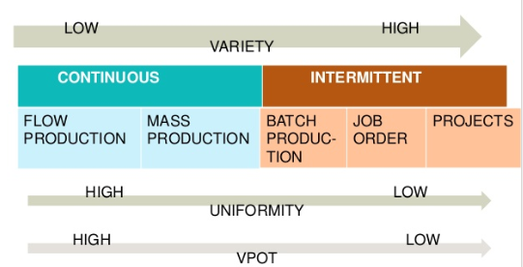
PRODUCTION SYSTEM: CLASSIFICATION

Slide 3
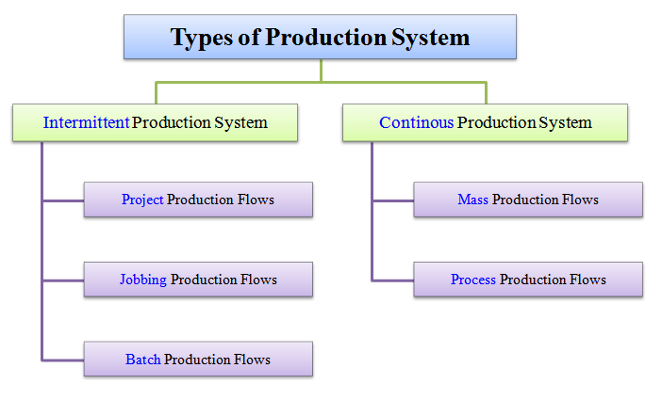
PRODUCTION SYSTEM: TYPES

Slide 4
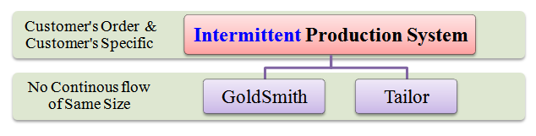
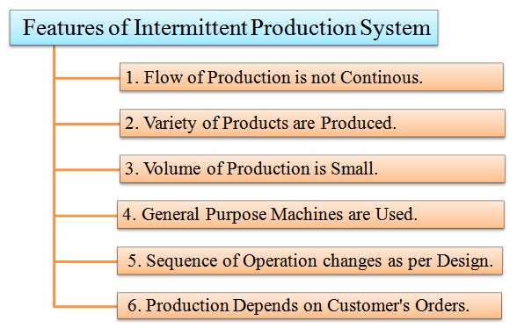
PRODUCTION SYSTEM: INTERMITTENT TYPE

Slide 5
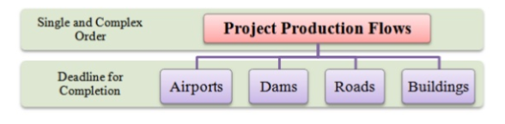
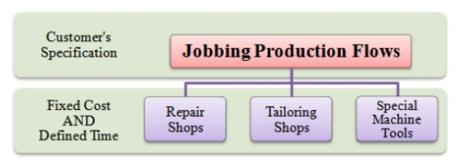
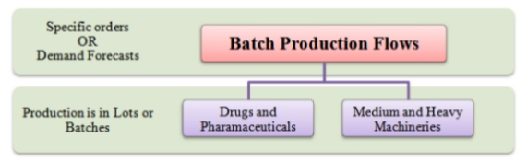
PRODUCTION SYSTEM: INTERMITTENT TYPE

Slide 6
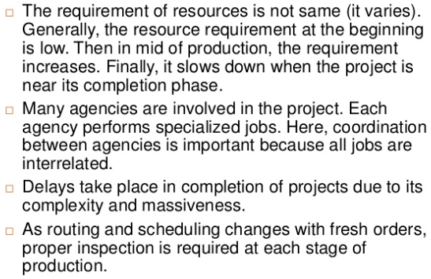
CHARACTERISTICS OF PROJECT PRODUCTION TYPE

Slide 7
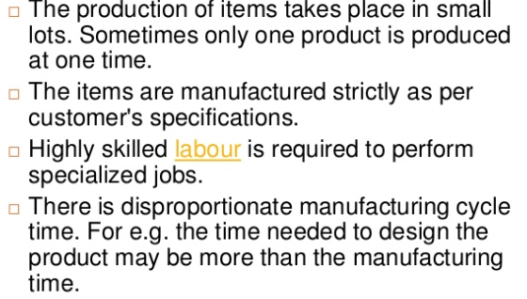
CHARACTERISTICS OF JOB PRODUCTION TYPE

Slide 8
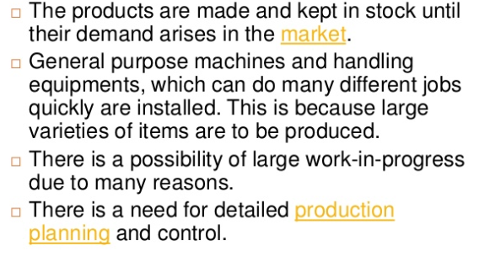
CHARACTERISTICS OF BATCH PRODUCTION TYPE

Slide 9
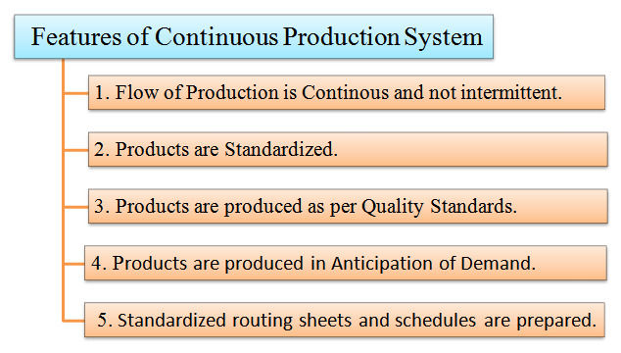
PRODUCTION SYSTEM: CONTINUOUS TYPE
EXAMPLE OF CONTINUOUS PRODUCTION SYSTEM
PETROLEUM
CEMENT PRODUCTION

Slide 10
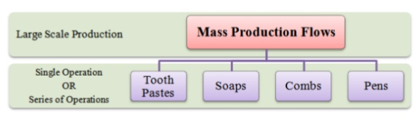
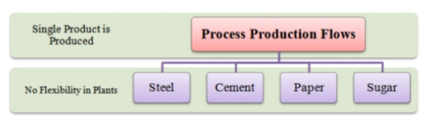
PRODUCTION SYSTEM: CONTINUOUS TYPE

Slide 11
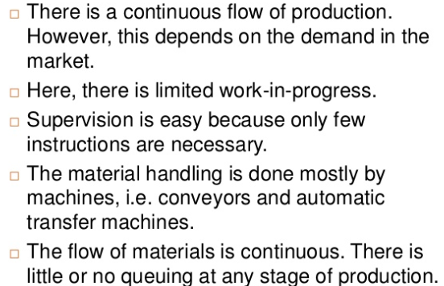
CHARACTERISTICS OF MASS PRODUCTION TYPE

Slide 12
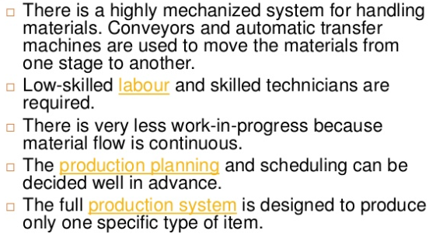
CHARACTERISTICS OF PROCESS PRODUCTION TYPE

Slide 13
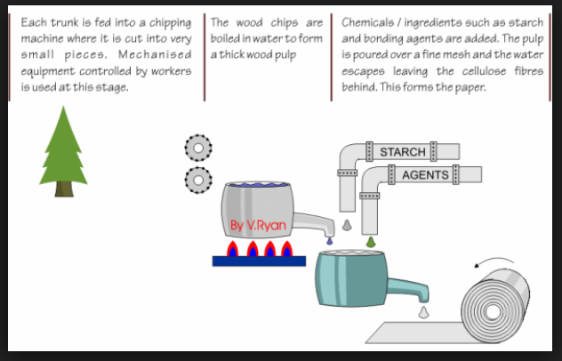
PRODUCTION SYSTEM: CONTINUOUS TYPE(PAPER INDUSTRY)

Slide 14
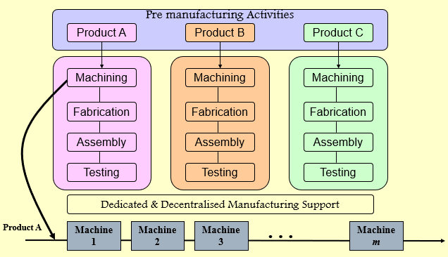
PROCESS DESIGN FOR MASS PRODUCTION SYSTEM

Slide 15
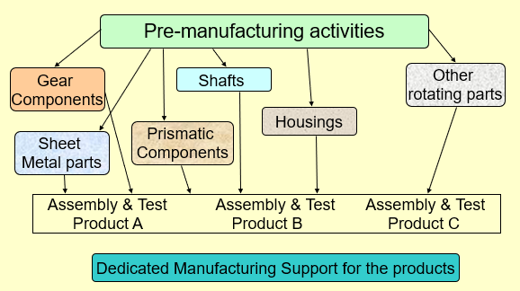
PROCESS DESIGN FOR INTERMITTENT SYSTEM

Slide 16
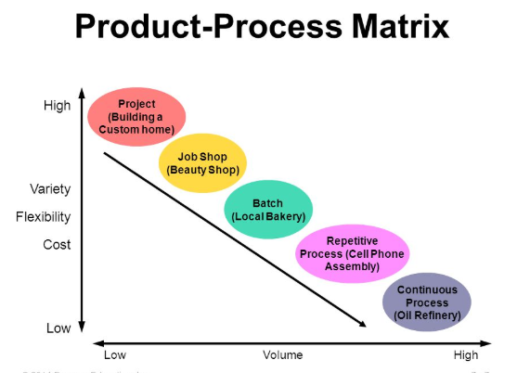
PRODUCT-PROCESS MATRIX

Slide 17
FACTORS INFLUENCING PROCESS CHOICES
VOLUME: AVERAGE QUANTITY OF THE PRODUCTS PRODUCED IN A MANUFACTURING SYSTEM
  LOW VOLUME: TURNKEY PROJECT MANAGEMENT FIRMS SUCH AS L&T AND BHEL
  HIGH VOLUME: CONSUMER NON-DURABLE AND FMCG SECTOR FIRMS, AUTOMOBILE, CHEMICAL PROCESSING
  MID-VOLUME: CONSUMER DURABLES, WHITE GOODS AND SEVERAL INDUSTRIAL PRODUCTS
VARIETY: NUMBER OF ALTERNATIVE PRODUCTS AND VARIANTS OF EACH PRODUCT THAT IS OFFERED BY A MANUFACTURING SYSTEM
  VARIETY OF PRODUCT OFFERINGS IS LIKELY TO INTRODUCE VARIETY AT VARIOUS PROCESSES IN THE SYSTEM; ALTERNATIVE PRODUCTION RESOURCES, MATERIALS, AND SKILL OF WORKERS
FLOW: FLOW INDICATES THE NATURE AND INTENSITY OF ACTIVITIES INVOLVED IN CONVERSION OF COMPONENTS AND MATERIAL FROM RAW MATERIAL STAGE TO FINISHED GOODS STAGE

Slide 18
PRODUCTION SYSTEM
INTERMITTENT | CONTINUOUS
SAME PRODUCT IS NOT PRODUCED CONTINUOUSLY | SAME PRODUCT IS PRODUCED CONTINUOUS
ITEMS PRODUCED AS PER CUSTOMER ORDER | ITEMS PRODUCED FOR STOCK
PRODUCTION PROCESS FLEXIBLE | PROCESS NOT FLEXIBLE
UNITS OF PRODUCTION-LOW | UNITS OF PRODUCTION-HIGH
PLANNING AND CONTROL PROCESS COMPLICATED | P&C PROCESS IS SIMPLE
COST OF PRODUCTION(PER UNIT) MAY BE HIGH | COST OF PRODUCTION(PER UNIT) MAY BE LOW
FUNCTIONAL TYPE OF ORGANISATION | DIVISIONAL TYPE OF ORGANISATION
REQUIRES STAFF OF HIGH TECHNICAL SKILL AND ABILITY | REQUIRES MODERATE TO LOW SKILLS
PRODUCT AND PROCESS NOT STANDARDISED | STANDARDISED PROCESS AND PRODUCT
MORE DETAILED AND TOO MANY INSTRUCTIONS REQUIRED DURING EXECUTION | SIMPLE/REPETITIVE INSTRUCTIONS

Slide 19
THANK YOU.

