Slide 1
Cloud Computing & Data Analytics
Prof. Kalpana S Kumaran, HOD
PGDM Digital Marketing & Transformation
ITM Business School
Navi Mumbai

Slide 2
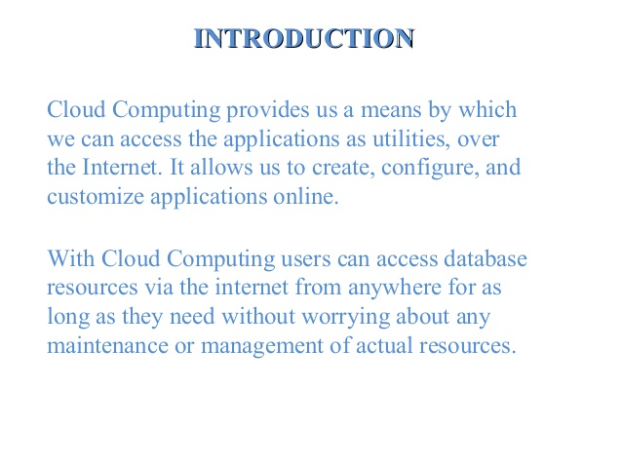

Slide 3
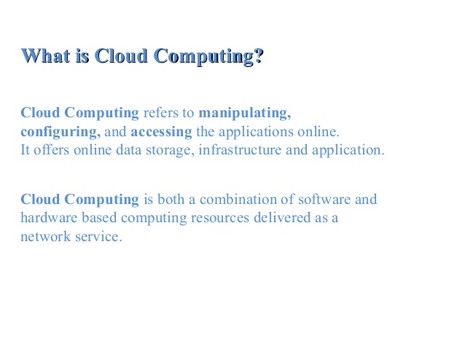

Slide 4
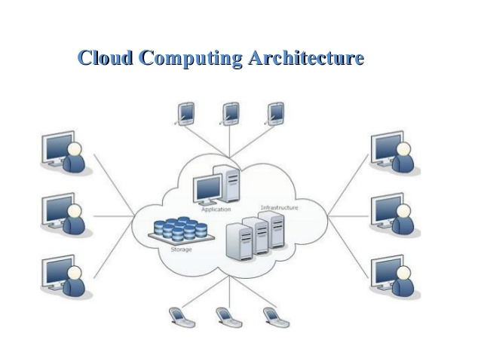

Slide 5
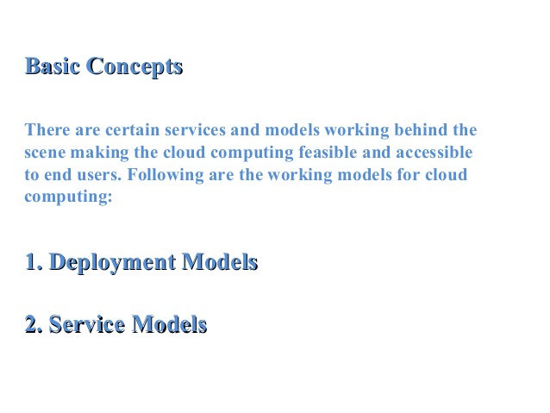

Slide 6
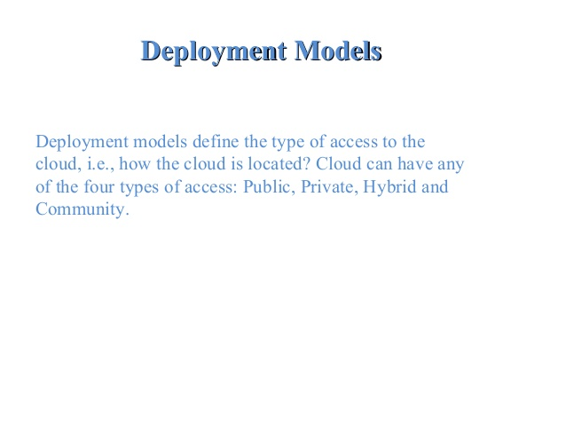

Slide 7
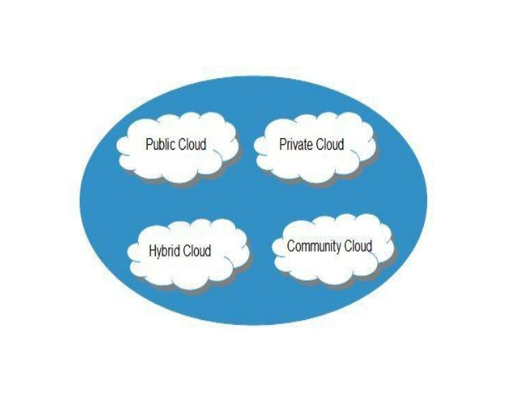

Slide 8
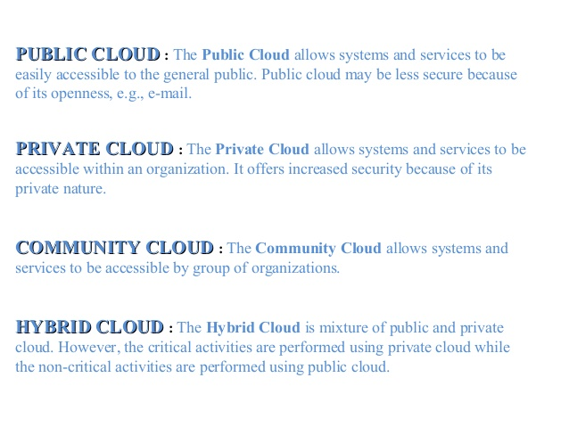

Slide 9
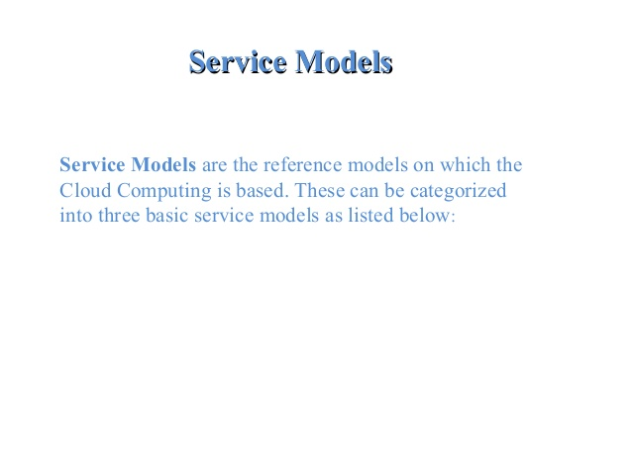

Slide 10
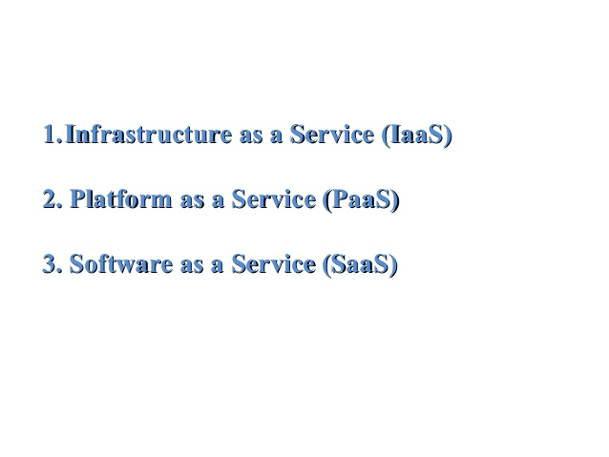

Slide 11
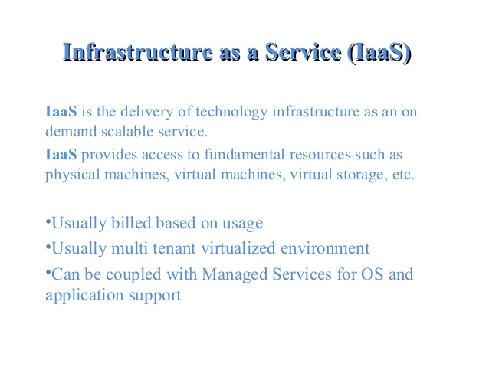

Slide 12
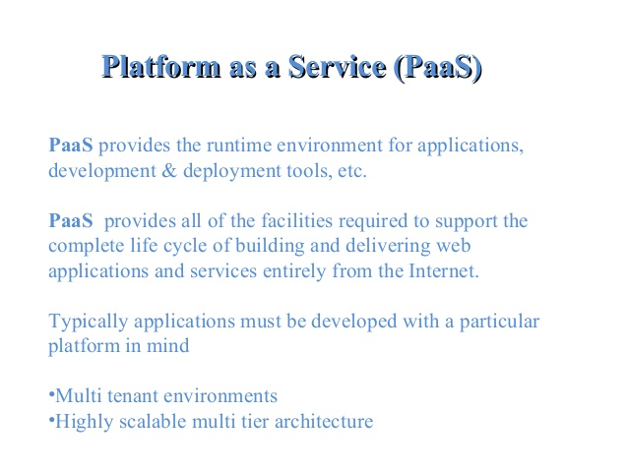

Slide 13
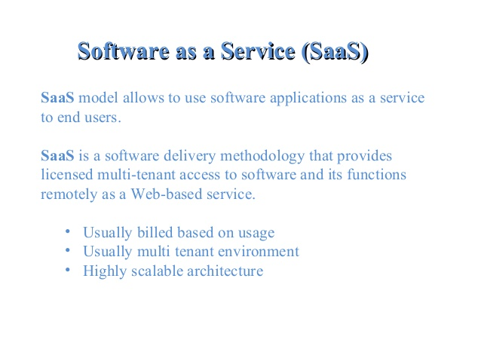

Slide 14
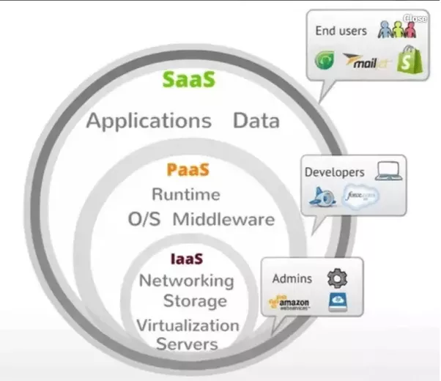

Slide 15
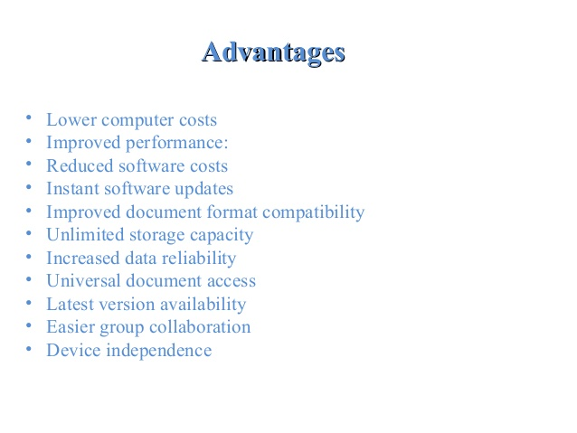

Slide 16
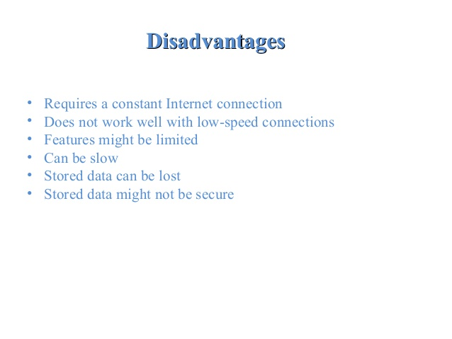

Slide 17
Data Analytics

Slide 18
500 Million Tweets sent each day!
More than 4 Million Hours of content uploaded to Youtube every day!
3.6 Billion Instagram Likes each day.
4.3 BILLION Facebook messages posted daily!
5.75 BILLION Facebook likes every day.
40 Million Tweets shared each day!
6 Billion daily Google Searches!
Source : www.gwava.com

Slide 19
8 Bits = 1 Byte
1024 Byte = 1 Kilobyte
1024 Kilobyte = 1 Megabyte
1024 Megabyte = 1 Gigabyte
1024 Gigabyte = 1 Terabyte
1024 Terabyte = 1 Petabyte
1024 Petabyte = 1 Exabyte
1024 Exabyte = 1 Zettabyte
1024 Zettabyte = 1 Yottabyte
1024 Yottabyte = 1 Brontobyte
1024 Brontobyte = 1 Geopbyte
Bronto Byte = 1 followed by 27 zeros

Slide 20
Business Intelligence
Business Analytics
Big Data Analytics

Slide 21
Business Intelligence is like reading the newspaper. Works with structured data
Business Analytics focus more on real-time events and predicting tomorrow’s headlines. Works with structured, semi-structured & unstructured data

Slide 22
Business Analytics
Tools and applications for tracking, storing, analysing, and modelling data in support of decision-making processes.
Applications
Marketing, Advertising, Finance, Banks, Insurance, Stock market, CRM,ERP,SCM, Operations, Healthcare, Telecom……..It goes on……………………. .
Leads to Business Development

Slide 23
Data ----> To ----> Data Visualization
http://dataconomy.com/2016/02/best-ted-talks-on-why-data-is-beautiful/

Slide 24
IOT – Internet of Things
Leads to more data -> Leads to more Analytics

Slide 25
Digital Data in the world
Three Types,
Structured
Semi-Structured – CSV, JSON
Unstructured

Slide 26
Analytics with Unstructured Data
Turning unstructured customer comments into actionable insights
Finding nuggets of insight in text data that will improve our business

Slide 27


Unstructured Text Processing
Facebook Page
Twitter
Page
Customer Sat Survey Comments
Call
Center
Notes,
Voice
Services
Quality
Cost
Friendliness
Competitors’ Facebook
Pages
Public Web Sites,
Discussion Boards, Product Reviews
Email
Blogs
Alerts,
Real-time Action
Adhoc Feedback

Slide 28
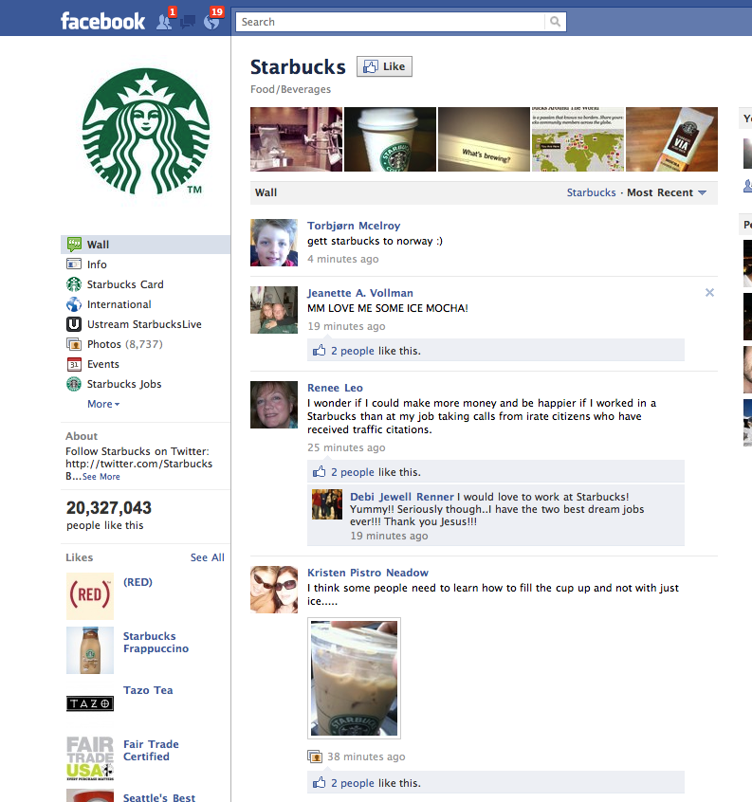

Slide 29
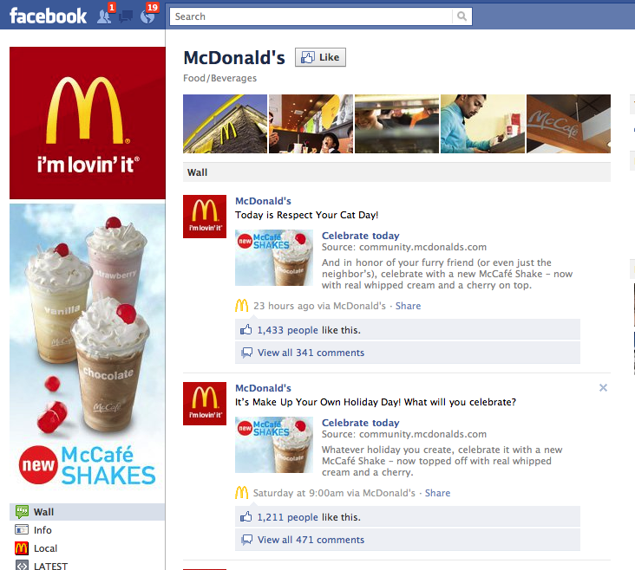

Slide 30
Business Analytics begins with the collection, organization, and manipulation of data
Three major components of Business Analytics
Descriptive Analytics
Predictive Analytics
Prescriptive Analytics

Slide 31
Descriptive Analytics
Most business start with this and commonly used
Use the data to understand the past & current business performance
& make a informed decisions
Summarise data into meaningful charts & reports then drill down
( Sales, Revenues, Costs)
How much did we sell in each region?
What was each Quarter profits ?
What types of complaints we resolve?

Slide 32
Predictive Analytics
Predict the future by examining historical data
finds hidden patterns or relationships
Uses advanced technologies
What is the risk of loosing money in new business venture
Predict the response of different customer segments to an
advertising campaign
Short term changes in commodity prises
Next season’s demand for Nike’s colour and size

Slide 33
Prescriptive Analytics
Selects the optimum one when we have too many choices.
Uses optimization
Best pricing strategy to maximise the revenue
Best advertising strategy to maximise the revenue
Optimal amount of cash to store in ATMs
Uses statistical techniques combined with optimization
How much should we produce to maximise profit?

Slide 34
Big Data Analytics
Data sets that are so big and complex that traditional data processing application software are inadequate to deal with them.
Challenges
Capturing the data
Data Storage
Data Analysis
Querying
Visualization

Slide 35
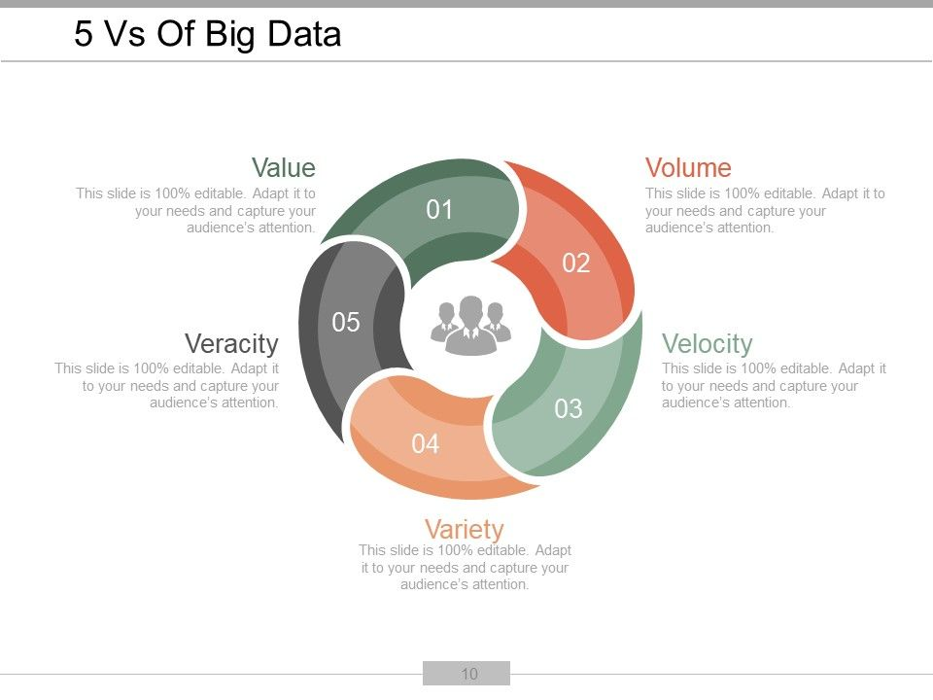
Big Data Analytics
The 5 Vs are
Volume
Variety
Velocity
Veracity
Value

Slide 36
Tools & Technologies
Open Source Tools
BI Technologies,Hadoop & HDFS, Pig, Hive, Scala, Spark, R, Rapid Miner, Python….
Commercial Tools
SAS, Excel Analytics

Slide 37
Examples
Market Basket Analytics
Customer Analytics
Customer Segmentation/Clustering
Tailored Product Assortments
Inventory Forecasting
Collaborative Filtering Recommender System
Credit Card Analytics

