Slide 1
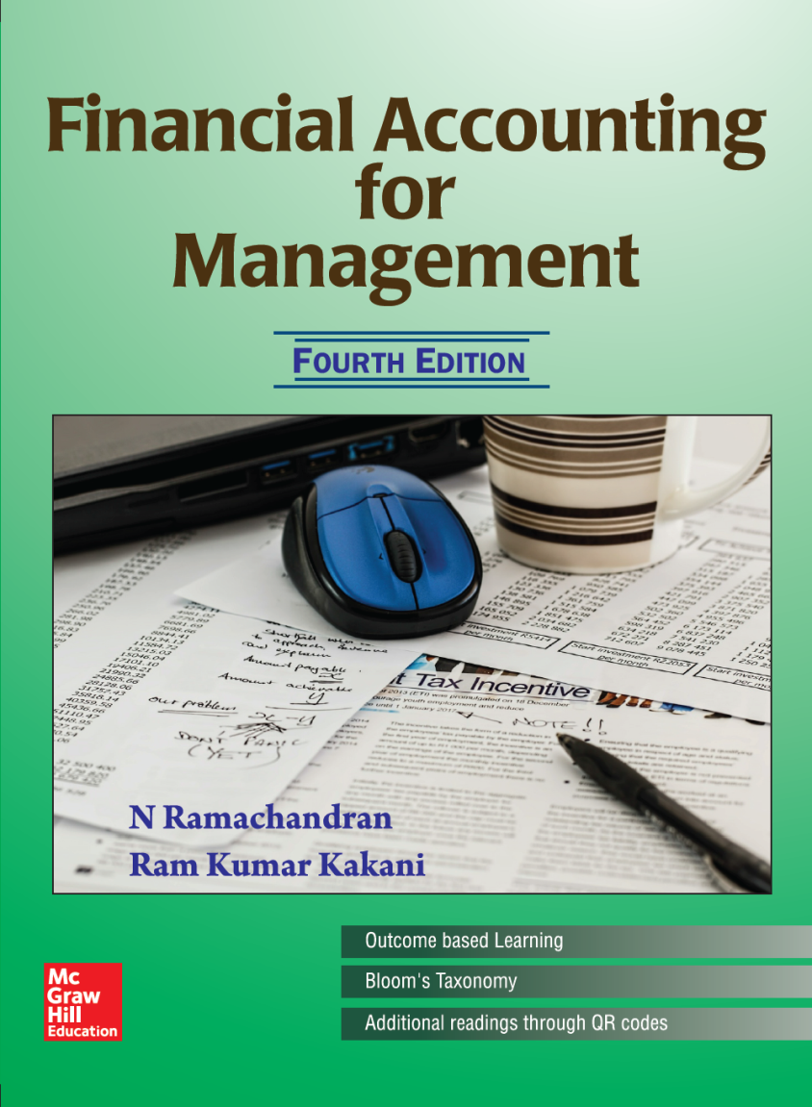
Chapter 7
Financial Statement Analysis
Prof. N. Ramachandran
Prof. Ram Kumar Kakani

Slide 2
Financial Statements – Basic Relationships
Financial Statements
Balance Sheet
Profit & Loss Account
Cash Flow Statement
Primary

Slide 3
Financial Statements
Balance Sheet
The entity in order to achieve its objectives has arrived at a decision to apportion the resources and deployed it in fixed assets and in current assets.
The proportions of funds that are borrowed on short term, on long term as well as what is the contribution of owners towards the total financial requirement of the entity.
Profit & Loss Account
Gives the cost structure of the business and the relationship of costs to the revenues.
It gives the information relating to margin available on the sales.

Slide 4
Steps to Analyze Financial Statements
Establish the objectives of analysis of the firm.
Study the industry, in which the firm operates, the dynamics therein, and the impact on the objective of analysis.
Based on the objectives of analysis, decide on the appropriate financial tools.
Know about the firm(s) and their management styles; and take the same into account at the time of making your interpretations.
Thus, the resources used for financial analysis would compulsorily include: (a) Published Financial Statements; (b) Auditors’ Report plus Report on Corporate Governance; and (c) Report of the Directors plus Management Discussion & Analysis.
Notes:
Usual sources of data such as CMIE PROWESS, ISI Emerging Markets, ReportJunction.com, Bloomberg, Securities.com, and Cline could be hinted upon … but stress should be made on also going through the annual reports or sources which give qualitative insights into the company and the industry.

Slide 5
Relation and Comparison of Data
Accounting data in absolute terms do not provide much meaning – the analysis involves comparison and relation.
Ratio → Whenever one item is expressed (as a fraction or a decimal fraction or an integer) in terms of another item
Example: A firm earns a net profit of INR 2,000 on a sale of INR 50,000. We could express this relationship as ____?
Comparisons could be made with:
  Company’s past performance
  Competing Firms
  An Absolute Standard
  Industry/Economy trend
  Budgets (Planning and Control)
Notes:
Stress that absolute figures do not tell much … and hence focus shifts towards proportions, percentages, and ratios … to make things comparable and relative.

Slide 6
But…
In most cases, there are no standards against which a particular ratio value could be tested.
We make relative conclusions by comparing the ratios with industry averages.
Thus, at best the conclusions could be ‘better than’ or ‘worse than’ or ‘average’.
Possible pitfalls in these comparisons could be the different accounting conventions:
  Inventory valuation (LIFO vs. FIFO).
  Different methods of depreciation.
  Typical items (e.g.,, Retirement benefits).

Slide 7
Common Size Financial Statements
A financial statement presented by representing each item as a percentage to the total amount of which it is a part.
Example: X had a sale of INR 150 mn during the year and cost of goods sold of INR 120mn, whereas Y has a sale of INR 80 mn and cost of goods sold of INR 48 mn.
The above is not amenable to direct understanding.
Cost of goods sold of X is 80% of sales and for Y it is 60% of sales.
This is more lucid and meaningful. Useful while dealing with many companies in the same industry.

Slide 8
Common Size Financial Statements
Profit and Loss Account
Here we show the net sales as 100% and each of the components of expenses and profits as a percentage of net sales.
When there are other revenues and expenses of a non-operating nature, it may be advantageous to treat them separately.

Slide 9
Tools & Tools Ltd.
Common Size Profit & Loss Account
For the year ended Dec 31,20X7
 | 20X7 |  | 20X6
 | INR Million | % | INR Million | %
Sales | 300 | 100 | 280 | 100
Cost of Goods Sold | 148 | 49.33 | 140 | 50.00
Gross Profit | 152 | 50.67 | 140 | 50.00
Selling Expenses | 25 | 8.33 | 22 | 7.86
General Expenses | 60 | 20.00 | 58 | 20.71
Total Operating Expenses | 85 | 28.33 | 80 | 28.57
Operating Income | 67 | 22.33 | 60 | 21.43
Interest Expense | 14 | 4.67 | 13 | 4.64
Net Income before tax | 53 | 17.67 | 47 | 16.79
Income Tax | 26 | 8.67 | 23 | 8.21
Profit After Tax | 27 | 9.00 | 24 | 8.57
Dividends | 2 | 0.67 | 2 | 0.71
Profits retained | 25 | 8.33 | 22 | 7.86
Notes:
One can explain this chapter through either Tools & Tools illustration OR through the illustration given in Section 7.8 … comparing two Indian FMCG Players, namely, Colgate Palmolive (India) & Marico with a four years data.

Slide 10

Tools & Tools Limited Dis-aggregation of change in Net Income
 | % Change in expenses and net income in relation to sales
Decrease in cost of goods sold | 0.67
Decrease in general expenses | 0.71
Total decrease in the cost increasing net income | 1.38
Increase in selling expense | 0.47
Increase in interest expense | 0.03
Increase in income tax | 0.46
Cost increases decreasing net income | 0.96
Net change in net income | 0.42
Copyright © 2016 by McGraw Hill Education (India) Private Limited
Interpretation:
Net profit earned by the company has increased from 8.6% to 9.0%.
Dis-aggregation of change shows an increase in net income of 0.4%.
It is the combined result of 1.4% reduction in cost and 1% increase in the indirect cost.

Slide 11
Contd. . .
Balance Sheet
  Constructed by showing each item of asset as a percentage of total assets, similarly each item of liability and owners’ equity is shown as a percentage of total liabilities and owners’ equity.
  The common-size financial statements could either be prepared in summary or in details.

Slide 12
Tools & Tools Ltd
Common Size Balance Sheet
As at Dec 31, 20X7
 | 20X7 |  | 20X6
ASSETS | INR Million | % | INR Million | %
Cash | 19 | 5.76 | 11 | 4.07
Accounts Receivable | 32 | 9.70 | 20 | 7.41
Loans and Advances | 43 | 13.03 | 34 | 12.59
Inventory | 121 | 36.67 | 99 | 36.67
Other Current Assets | 17 | 5.15 | 26 | 9.69
Total Current Assets | 232 | 70.31 | 190 | 70.37
Fixed Assets | 94 | 28.48 | 79 | 29.26
Other Assets | 4 | 1.21 | 1 | 0.37
Total Assets | 330 | 100.00 | 270 | 100
Total Liabilities & Capital
Current Liabilities
Acceptances | 5 | 1.52 | 2 | 0.74
Accounts Payable | 27 | 8.18 | 19 | 7.04

Slide 13
Contd...
Advance Against Sale | 26 | 7.88 | 21 | 7.78
Other Liability | 9 | 2.73 | 8 | 2.96
Interest accrues but not due | 3 | 0.90 | 2 | 0.74
Total Current Liabilities | 70 | 21.21 | 52 | 19.26
Provisions:
For Tax | 26 | 7.88 | 21 | 7.77
For Proposed Dividends | 2 | 0.61 | 2 | 0.74
For Bonus | 3 | 0.90 | 2 | 0.74
For Other | 4 | 1.21 | 3 | 1.11
Total Provision | 35 | 10.61 | 28 | 10.37
Total Current Liabilities and Provisions | 105 | 31.82 | 80 | 29.63
Long-Term Liabilities
Bank term loans | 40 | 12.12 | 32 | 11.85
10.5% Debentures | 26 | 7.88 | 26 | 9.63
Financial Institutions | 24 | 7.27 | 22 | 8.15

Slide 14
Contd..
Total Long-Term Liabilities | 90 | 27.27 | 80 | 29.63
Total Liabilities | 195 | 59.08 | 160 | 59.26
Shareholders’ Equity
Paid up capital | 37 | 11.21 | 37 | 13.70
Retained Earning | 98 | 29.70 | 73 | 27.04
Total Shareholder Equity | 135 | 40.91 | 110 | 40.74
Total Liabilities & Shareholders’ Equity | 330 | 100 | 270 | 100
Interpretation:
During both the years, over two-third of the total assets were current assets viz., 20X6 (70.4%) and 20X7 (70.3%) – and this was stable.
Similarly in 20X6, 29.3% total assets were fixed assets which came down to 28.5% in 20X7.

Slide 15
Financial pattern has remained stable over 2 years at around 59% by out sources and 41% by shareholders.
Hence it has maintained a stable financial structure during the period, in term of current assets versus fixed assets and outside finances versus shareholder’s equity.
Working capital has increased in Indian Rupee by 17 million.
But the proportionate term, working capital has decline by 2.3%.
Working Capital Change as Percentage of Total Assets
 | 20X7 | 20X6 | Change in WC
Total Current Assets | 70.31 | 70.37 | −0.07
Total Current Liability & Provision | 31.82 | 29.63 | −2.19
Working Capital | 38.49 | 40.74 | −2.25

Slide 16
Index Based Analysis
Accounting information represent by over multiple year as a percentage of amounts of an observant base year.
It helps to compare accounts for two or more years to the corresponding items for a single company.
The base year figures of each item are always indexed to 100.
And the changes from the base year are determined.
A longer time frame of data always help in better understanding index based analysis.
We present the Index based balance sheet numbers of CPIL Colgate Palmolive (India) Ltd.

Slide 17
Index Based Balance Sheet of CPIL
Balance Sheet Items
Assets Side | Year 4 | Year 3 | Year 2 | Year 1
Cash & Bank Balances | 123.4 | 89.1 | 113.7 | 100.0
Accounts Receivable | 831.3 | 893.3 | 770.8 | 100.0
Loans and Advances | 79.5 | 88.7 | 66.7 | 100.0
Inventories | 167.6 | 196.9 | 139.0 | 100.0
Current Assets | 134.2 | 122.5 | 119.5 | 100.0
Fixed Assets | 151.1 | 127.9 | 104.0 | 100.0
Other Assets | 337.0 | 211.0 | 166.3 | 100.0
Total Assets | 148.0 | 128.0 | 117.1 | 100.0

Slide 18
Contd...
Liabilities Side | Year 4 | Year 3 | Year 2 | Year 1
Accounts Payables | 124.8 | 98.7 | 101.2 | 100.0
Other Current Liabilities & Provisions | 176.8 | 165.3 | 136.7 | 100.0
Current Liabilities & Provisions | 141.5 | 120.2 | 112.7 | 100.0
Long-term Liabilities | 779.2 | 671.9 | 606.0 | 100.0
Net Worth | 150.1 | 133.5 | 117.8 | 100.0
Total Liabilities | 148.0 | 128.0 | 117.1 | 100.0
Comparing this with actual number of CPIL, one can make out that it involves calculating each year’s ‘item-wise’ balances as percentages of the first year, also known as the base year.
It computes, percentage change from year to year for all items in balance sheet, such as cash and inventory.

Slide 19
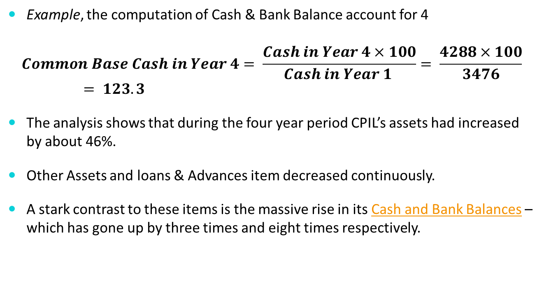
Contd...
Example, the computation of Cash & Bank Balance account for 4
$$Common Base Cash in Year 4= \frac{Cash in Year 4×100}{Cash in Year 1 }= \frac{4288×100}{3476}= 123.3$$
The analysis shows that during the four year period CPIL’s assets had increased by about 46%.
Other Assets and loans & Advances item decreased continuously.
A stark contrast to these items is the massive rise in its Cash and Bank Balances – which has gone up by three times and eight times respectively.

Slide 20
Possible Reasons Include
In Year 2, CPIL’s reducing its advances and parking them as long-term investments (as part of other assets) – possibly indicating higher comfort level to increased capital market exposure.
Change in its credit policy to its large customers in Year 2.
Large profits and no big capital investment needs (in fixed assets) during Year 1 – Year 4 would also be added reasons.

Slide 21
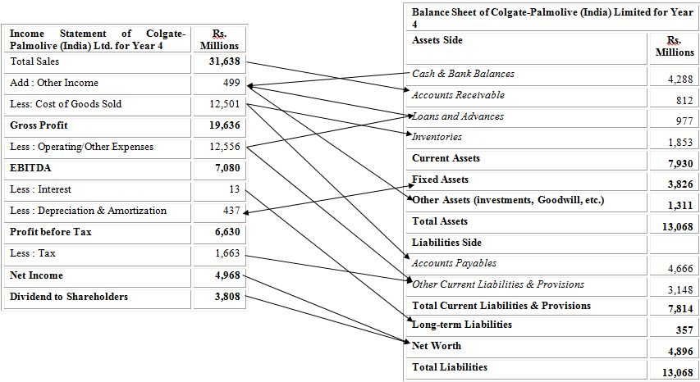
Connections between Income Statement and Balance Sheet

Slide 22
Index Based Profit and Loss Statement
 | Colgate Palmolive (India) Limited
Profit & Loss Statement Items | Year 4 | Year 3 | Year 2 | Year 1
Total Sales | 161.2 | 137.2 | 113.2 | 100.0
Add: Other Income | 50.7 | 51.5 | 108.5 | 100.0
Less: Cost of Goods Sold | 160.9 | 135.2 | 112.2 | 100.0
Gross Profit | 152.9 | 131.9 | 113.3 | 100.0
Less: Operating/Other Expenses | 165.2 | 140 | 113.3 | 100.0
EBITDA | 135.1 | 120.1 | 106.1 | 100.0
Less: Interest | 86.4 | 100.6 | 106.4 | 100.0
Less: Depreciation | 116.3 | 104.6 | 91.2 | 100.0
Profit before Tax | 136.8 | 121.4 | 107.3 | 100.0
Less: Tax | 270.2 | 230.7 | 190.7 | 100.0
Net Income | 117.4 | 105.5 | 95.1 | 100.0
Dividend to Shareholders | 140.0 | 125.0 | 110.0 | 100.0

Slide 23
Index Based Profit and Loss Statement
During the four year period, CPIL’s net income had gone up by 17% compared to an increase in asset base by a meager 46%.
During the period, CPIL’s sales increased by a higher rate (61%) compared to increase in asset base by 46%.
Cost of goods sold and its depreciation expenses, both, increased by 60% and 16% respectively, compared to sales increase of 61%.

Slide 24
Index Based Profit and Loss Statement
Operating expenses and corporate income tax expenses both has increased.
Other income figures nearly halved.

Slide 25
Comparing Index Based Numbers of CPIL’s with ML’s
Balance Sheet Items | Marico Limited
Assets Side | Year 4 | Year 3 | Year 2 | Year 1
Cash & Bank Balances | 239.3 | 118.5 | 191.2 | 100.0
Accounts Receivable | 130.4 | 138.2 | 124.7 | 100.0
Loans and Advances | 138.6 | 189.2 | 114.8 | 100.0
Inventories | 193.9 | 161.9 | 135.1 | 100.0
Current Assets | 177.2 | 158.3 | 136.0 | 100.0
Fixed Assets | 355.9 | 125.6 | 122.5 | 100.0
Other Assets | 303.3 | 303.0 | 225.3 | 100.0
Total Assets | 242.9 | 171.5 | 145.9 | 100.0
Liabilities Side | Year 4 | Year 3 | Year 2 | Year 1
Accounts Payables | 154.6 | 115.8 | 99.0 | 100.0
Other Current Liabilities & Provisions | 732.6 | 631.9 | 202.9 | 100.0
Current Liabilities & Provisions | 300.0 | 245.6 | 125.1 | 100.0
Long-term Liabilities | 108.8 | 102.7 | 173.1 | 100.0
Net Worth | 297.3 | 171.5 | 140.6 | 100.0
Total Liabilities | 242.9 | 171.5 | 145.9 | 100.0

Slide 26
Comparing Index Based Numbers of CPIL’s with ML’s
 | Marico Limited
Profit & Loss Statement Items | Year 4 | Year 3 | Year 2 | Year 1
Total Sales | 172.7 | 149.6 | 117.6 | 100.0
Add: Other Income | 205.5 | 178.4 | 152.8 | 100.0
Less: Cost of Goods Sold | 160.9 | 135.2 | 112.2 | 100.0
Gross Profit | 152.9 | 131.9 | 113.3 | 100.0
Less: Operating/Other Expenses | 165.2 | 140 | 113.3 | 100.0
EBITDA | 135.1 | 120.1 | 106.1 | 100.0
Less: Interest | 225.8 | 165.0 | 153.1 | 100.0
Less: Depreciation | 144.2 | 120.7 | 117.9 | 100.0
Profit before Tax | 182.0 | 132.7 | 126.4 | 100.0
Less: Tax | 220.8 | 118.3 | 135.9 | 100.0
Profit After Tax | 170.9 | 136.9 | 123.6 | 100.0
Dividend to Shareholders | 80.2 | 107.0 | 100.8 | 100.0

Slide 27
Comparing Index Based Numbers
Try to choose a normal year with regard to business cycles and conditions as the base year.
Focus the analysis on only the significant items rather than each and every item of the financial statement.
While making comparative analysis, one should keep note of any change in accounting procedures, policies, and assumptions or a restatement of items by the firm from one category to another.

Slide 28
Using Financial Ratios
Many pieces of information do not have significant meaning in isolation – they become more meaningful when related to an appropriate base.
Ratios reduce large figures to an easily understood relationship.
Ratios do not make conclusions – It is for the analyst to draw conclusion by evaluating and relating the ratios.
There are no “good” ratios and “bad” ratios – It is only possible to make relative inferences.
Company performance is usually analyzed on two parameters:
  Profitability
  Liquidity

Slide 29
Profitability Ratios
 | Margin on sales | Gross Profit Margin
 |  | Operating Profit Margin
 |  | Earnings Before Interest & Tax
 |  | Profit before tax
 |  | Net Profit Margin (i.e., Profit after tax)
 | Return on Investment | Operating Profit to Operating Assets
 |  | Net Income to Total Assets
 |  | Return on Equity
 | Efficiency | Total Asset Turnover
 |  | Operating Asset Turnover
 |  | Working Capital Turnover
 |  | Shareholder Equity Turnover
 | Return per share | Earnings per share
 |  | Earnings to price
 |  | Dividends per share

Slide 30
Solvency Ratios
Short-term | Net Working Capital
 | Current Ratio
 | Quick Ratio
 | Accounts Receivable Turnover
 | Collection Period
 | Inventory Turnover
 | Conversion Period
Long-term | Total Debt to Total Capital
 | Long-term Debt to Total Capital
 | Long-term Debt to Fixed Assets
 | Interest Cover
 | Times Fixed Charges Covered
 | Gearing
 | Equity Multiplier

Slide 31
Profitability
The long-term survival depends on ability to earn sufficient surpluses and to grow.
Only if the operations are profitable, the company will survive in the long run.
Margin on Sales
  Profits are generated by sales.
  First step in analyzing profitability is understanding of costs in relation to revenue and thus profits in relation to revenue.
  Each component of profit and loss account is expressed as percentages of sales.

Slide 32
Illustration – Tools & Tools Ltd.
(Table on Profit Margins)
 | FY 20X7 |  | FY 20X6
 | INR Million | % | INR Million | %
Sales | 300 | 100 | 280 | 100
Cost of goods sold | 148 | 49.33 | 140 | 50.00
Gross Profit (i) | 152 | 50.67 | 140 | 50.00
Total operating expenses | 85 | 28.33 | 80 | 28.57
Operating Profit (ii) | 67 | 22.33 | 60 | 21.43
Interest expense | 14 | 4.67 | 13 | 4.64
Profit Before Tax (iii) | 53 | 17.67 | 47 | 16.79
Income tax | 26 | 8.67 | 23 | 8.21
Profit After Tax (iv) | 27 | 9.00 | 24 | 8.57
Dividends | 2 | 0.67 | 2 | 0.71
Profit Retained (v) | 25 | 8.33 | 22 | 7.86
Depreciation expense | 13 |  | 11
Notes:
The instructor might discuss spotlight 7.3 in pages 418 comparing the importance of various types of margins …

Slide 33

Gross Margins and
Operating Margins
Gross Margins
  The surplus available out of sales revenues after subtracting cost of goods sold.
  It is obtained over the input costs and as such would reflect the efficiency of use of direct inputs given the price:
Gross Profit = Sales – COGS
Operating Margins
  It is the reflection of the operations of the company, and hence considered as a reflection of the management’s performance.

Slide 34
Contd…
  Frequently used as a basis of comparison across companies:
  Operating Profit = PBDIT – Depreciation
Earnings before interest and taxes
  Any non-operating surplus or deficit is adjusted to the operating profit margin to obtain the earnings before interest and taxes.
Profit Before Tax
  It is the surplus amount obtained after meeting interest expense.
  Influenced to a great extent by the financing decisions.

Slide 35

PAT and Retained Earnings
Profit After Tax (a.k.a. Net Income)
  Overall surplus available out of sales to shareholders.
  This is influenced by three major factors namely, operating efficiency, financing efficiency and taxation.
  As a percentage of sales it is known as Net Profit Margin, and is used to compare margins of players in the same industry:
Retained Earnings (a.k.a. Retained Profit)
  Amount of profit remaining after the distribution of dividends.
Notes:
Instructor might like to discuss the Spotlight box 7.3 given in page no. 418 wherein, there is a discussion on, which is more important NPM, GPM or OPM

Slide 36
Tools & Tools Ltd. – Analysis
 | INR Million | % (11) | INR Million | % (10)
Sales | 300 | 100 | 280 | 100
Cost of goods sold | 148 | 49.33 | 140 | 50.00
Gross Profit (i) | 152 | 50.67 | 140 | 50.00
Total operating expenses | 85 | 28.33 | 80 | 28.57
Operating Profit (ii) | 67 | 22.33 | 60 | 21.43
Interest expense | 14 | 4.67 | 13 | 4.64
Profit Before Tax (iii) | 53 | 17.67 | 47 | 16.79
Income tax | 26 | 8.67 | 23 | 8.21
Profit After Tax (iv) | 27 | 9.00 | 24 | 8.57
Dividends | 2 | 0.67 | 2 | 0.71
Profit Retained (v) | 25 | 8.33 | 22 | 7.86
Most margin
Indicators are
improving
Net margins
increased to 9%
Gross margins
increased to 50.6%
Decrease in
company’s direct costs
& operating expenses

Slide 37
Return on Investment
The management has to be evaluated on the basis of how far they had been successful in profitably utilizing the assets.
  The assets used is to be related to the profit earned.
Return on Operating Assets (ROA)
  Operating profit to operating assets is obtained by dividing the operating profit by average value of operating assets used during the year:
  Operating assets refer to total current assets and fixed assets used.
Notes:
Instructors might like to clarify the importance of the term ‘operating assets’ herein using the Spotlight box 7.4 in page 424

Slide 38
Tools & Tools Ltd. - ROA
Return on Operating Assets (ROA) | 20X7 | 20X6
Current assets (Rs Million) | 232 | 190
Fixed assets (Rs Million) | 94 | 79
Total operating assets (Rs Million) | 326 | 269
Operating Profit Before Interest and Taxes (OPBIT) (Rs Million) | 67 | 60
Return on Operating Assets (%) | 20.55 | 22.30
ROA based on average operating assets i.e., (326+269)/2 (%) | 22.52
The company had used on average Rs 297.5 million and it has to be justified in terms of the opportunity cost

Slide 39
ROTA
Return on Total Assets (ROTA)
  The rate of profit the company is able to earn after meeting the cost of financing of a portion of the total assets.
  It is the amount available to the shareholders in relation to the total amount of resources used in the business.
  Here again the average total assets is used (Why?).

Slide 40

ROE
Return on Equity (ROE)
  Net income is the amount available to owners for compensating their investment and the risk being carried by them.
  It measures the net income as a percentage of shareholders investment.

Slide 41
Net Income to Total Assets
Return on Total Assets (ROTA) | 20X7 | 20X6
Total Assets (INR Million) | 330 | 270
Profit After Taxes (PAT) | 27 | 24
Return on Total Assets | 8.18% | 8.89%
ROTA based on average total assets (330+270)/2 | 9.00%
Able to earn
9% return on
Total Assets
The company used
an average INR 300 mn
in total assets to
earn INR 27 mn

Slide 42
ROE Computations…
Return on Equity (ROE) | 20X7 | 20X6
Total Equity (INR Million) | 135 | 110
Profit After Taxes (PAT) | 27 | 24
Return on Equity (%) | 20.00 | 21.82
ROE based on average total assets | 22.04
ROE of 22% is not only the result of management’s ability to employ the assets profitably, but also the result of its ability to use a favorable debt equity structure.
Whenever, management is able to borrow money, and use it to earn more than the cost of such borrowing the ROE increases.

Slide 43
Return Per Share
Interest of a shareholder lies in the amount of dividend that can be earned on the investment in shares and the increase in the price of shares that can be had by holding the same.
Earnings per share (EPS) is computed by dividing ‘net income to ordinary shareholders’ by the ‘number of ordinary shares outstanding’.
Earnings per Share (EPS) | 20X7 | 20X6
Profit After Taxes (PAT) (INR Million) | 27 | 24
Number of ordinary shares (Million) | 3.7 | 3.7
Earnings per Share (EPS) (INR) | 7.30 | 6.49

Slide 44

Earnings-Price Ratio (E/P)
The earnings per share related to the current market price of the share provides a measure of the rate of yield
This yield measure could be used by the shareholder in making decisions about this investment in comparison to other alternate investments
Earnings-Price Ratios (E/P) | 20X7 | 20X6
Earnings per Share (EPS) (Rs) | 7.30 | 6.49
Market price per share (Rs) | 30 | 28
Earnings/Price Ratio (%) | 24.3 | 23.18
Price Earnings Ratio | 4.1 | 4.31

Slide 45
Contd…
It is a common practice to express the E/P ratio by reversing the relationship to measure the price-earnings (P/E) relationship.
Here, this relationship expresses market price as a certain multiple of the earnings per share.
Dividend per Share
  It shows the cash income available to the shareholder of a share.
Dividend per Share (DPS) (INR) | 20X7 | 20X6
Dividend (INR Million) | 2 | 2
Number of ordinary shares (Million) | 3.7 | 3.7
Dividend per Share (INR) | 0.54 | 0.54

Slide 46
Efficiency
The relationship of assets used to sales measures the level of sales generated by given quantum of assets.
This is a measure of the efficiency of use of assets.
This relationship of assets to sales indicates the number of times assets turned over as a result of volume of sales generated.
Thus, the relationship of net income to assets is the turnover of assets times’ margin on sales.
The return on total assets, measured by net income to total assets, comes about by calculating the net income to sales times sales to total assets:

Slide 47
Example – Tools & Tools Ltd.
Particulars | 20X7 | 20X6
Total Assets (INR Million) | 330 | 270
Profit After Taxes (PAT) (INR Million) | 27 | 24
Sales (INR Million) | 300 | 280
Net Income/ Sales (%) | 9.00 | 8.57
Sales / Total Assets (a.k.a. Asset Utilization Ratio) | 0.91 | 1.04
Return on Total Assets (Net Income / Total Assets) (%) | 8.18 | 8.89
Sales / Average Total Assets | 1.00
Various asset (or investment) turnover ratios are measures of efficiency of their use in terms of their ability to convert profit margins to rate of return on assets.

Slide 48
Operating Assets Turnover
Relates sales to the operating assets used.
This ratio assesses the efficiency of the use of operating assets, that is, their ability to generate revenue.
Similar to return on total assets the operating assets turnover times operating profit margin gives us the operating profit to operating asset.

Slide 49
Example – Tools & Tools
Operating Assets Turnover and Return (ROA) | 20X7 | 20X6
Sales (INR Million) | 300 | 280
Operating profit (INR Million) | 67 | 60
Operating Profit Margin (OPM) (%) | 22.33 | 21.43
Fixed assets (INR Million) | 94 | 79
Total operating assets (INR Million) | 326 | 269
Operating Asset Turnover (OAT) | 0.92 | 1.04
Fixed Asset Turnover | 3.19 | 3.54
Return on Operating Assets (OPM × OAT) (%) | 20.55 | 22.30
Avg. Operating Assets Turnover = Sales / AO Assets | 1.01
ROA − on average operating assets (326 + 269) / 2 (%) | 22.52

Slide 50
Working Capital Turnover
It is an efficiency ratio intended at evaluating the efficiency of use of working capital.
It looks at the relationship of revenues earned to working capital investment.
Net Working Capital efficiency | 20X7 | 20X6
Sales (INR Million) | 300 | 280
Net Working Capital | 127 | 110
Working Capital Turnover | 2.36 | 2.55
Avg. Working Capital Turnover (127 + 110) × 0.5 | 2.53

Slide 51
Shareholders’ Equity Turnover
Shows the management ability in terms of efficiently utilizing the shareholders’ funds both with respect to efficient operations and in terms of efficient financial management:
Particulars | 20X7 | 20X6
Sales (INR Million) | 300 | 280
Shareholders Equity | 135 | 110
Shareholders Equity Turnover (ETO) | 2.22 | 2.55
Average Equity Turnover (135 + 110) × 0.5 | 2.45

Slide 52
Solvency
Ability to meet all the short-term commitments and ability to keep sufficient assets to cover all the liabilities in the long run.
Companies can be liquid (solvent) but not profitable.
  For example, imagine a cash rich construction company with no orders.
Companies can be profitable but not liquid.
  For example, a construction company with lot of orders but no cash to execute them.
Hence, we need both profitability and solvency.
Solvency can be of two types – (i)Short Term and (ii) Long Term.

Slide 53
Evaluating Short-Term Solvency
Liquidity is of major concern to short-term creditors and management.
Sale of merchandise (inventory turnover) and collection of receivable generates liquidity (receivable turnover).
Assessing excess of current assets over current liabilities – Working Capital.
Net working capital is financed by long-term sources of funds and as such provides a cushion for liquidity.
This is obvious since it is financed by long-term sources, and it is not required to be repaid in the short-term.

Slide 54
Illustration – Ramsons
RAMSONS’ Balance Sheet
Assets | INR | Liabilities & Capital | INR
Current Assets | 500 | Current liabilities | 250
Net Fixed Assets | 500 | Long-term loans | 500
 |  | Shareholders equity | 250
Total Assets | 1000 | Liabilities & Capital | 1000
Short-term
finance available
is INR 250
➔ Net Working capital is: Current assets – Current liabilities = 250
RAMSONS’ Balance Sheet (Long Term)
Assets | INR | Liabilities & Capital | INR
Net Working Capital | 250 | Long-term loans | 500
Net Fixed Assets | 500 | Shareholders equity | 250
Total Assets | 750 | Liabilities & Capital | 750

Slide 55

Current Ratio
Current Ratio is one of the most widely used balance sheet ratios.
However, making a specific conclusion on the adequacy of any value of current ratio would depend on several factors such as:
  Proportion of various components of the current assets.
  Time taken for conversion of these current assets to cash.
  Speed of maturity of current liabilities, etc.

Slide 56
Discussion…
The rationale for financing part of the current assets with long-term finance is that a part of the current asset remains in stock all through the life of the business.
So, Working Capital is the long-term investment in operating CA.
Current Ratio measures the relationship of CA to CLs.
Margin of
Safety increased
By INR 17mn
Tools & Tools Limited | 20X7 | 20X6
Current assets (INR Million) | 232 | 190
Current liabilities(INR Million) | 105 | 80
Net Working Capital(INR Million) | 127 | 110
Current ratio: CA / CL | 2.21 | 2.38
Current
Ratio has
decreased
Increase in
CA is
not in proportion to
that of CL

Slide 57
Quick Ratio
Quick ratio or Acid test ratio is usually computed by taking assets, which are quick to be converted into cash and divide them by the current liability.
As a practical simplification, it is usual practice to subtract the inventories from the current assets, to arrive at the quick assets.
Quick Ratio − Tools & Tools Ltd | 20X7 | 20X6
Current assets (INR Million) | 232 | 190
Inventory (INR Million) | 121 | 99
Quick Assets(INR Million) | 111 | 91
Current liabilities(INR Million) | 105 | 80
Net Working Capital(INR Million) | 127 | 110
Quick ratio: Quick assets/Current liabilities | 1.06 | 1.14
Notes:
Instructor might like to discuss the spotlight 7.5 box given in page no. 428 wherein, there is a discussion on, which ratio is more important, Current ratio or Quick ratio?

Slide 58


Expenses Cover
We hold the current asset mostly as an insurance against future contingencies.
  Cash is held with the objective of making payments, whenever required.
  Inventory is held to meet the need for inventory either for production or for sale.
Liquidity is essential as cover for the daily operating expenses.

Slide 59
Example…
Particulars | 20X7 | 20X6
Cash | 19 | 11
Current assets (INR Million) | 232 | 190
Quick Assets (INR Million) | 111 | 91
Current liabilities (INR Million) | 105 | 80
Average Daily expenses (INR Million) | 0.6027 | 0.5726
Cash cover (number of days) | 32 | 19
Quick assets cover (number of days) | 184 | 158
Current assets cover (number of days) | 384 | 332
Current liabilities cover (number of days) | 174 | 140
Current assets
amount to more
than a year’s
operating expenses
Cash holding
sufficient for a
month’s
expenses
Current liabilities
amount to almost
6 months’
daily expenses

Slide 60
Account Receivable Turnover
When credit sales figures are not available we could still compute using net sales (assuming that all the sales are on credit basis).
The time period taken for collection of receivable is of great interest in evaluating working capital, known as, Average Collection Period.
Comments will depend on the normal period of credit and credit terms given by the company and the level of deviation.

Slide 61
Accounts Receivable Turnover …
On an average
it takes approximately
32 days for collection of
accounts receivable
Particulars | 20X7 | 20X6
Sales (Rs Million) | 300 | 280
Sales per day (Rs Million) | 0.82 | 0.77
Accounts receivable(INR Million) | 32 | 20
Accounts receivable turnover | 9.37 | 14
Average Collection period (number of days) | 38.9 | 26.1
Average Collection period using Average Accounts Receivable during the period (number of days) | 31.6
Average Accounts receivable turnover | 11.54
Cycle of credit
Sales and its collection
happened more
than 11 times
during the year

Slide 62
Inventory Turnover …
Particulars | 20X7 | 20X6
Cost of goods sold (INR Million) | 148 | 140
Cost of goods sold per day (INR Million) | 0.41 | 0.38
Inventory (INR Million) | 121 | 99
Inventory turnover | 1.22 | 1.41
Inventory Holding Period (number of days) | 299 | 259
Average Inventory Turnover | 1.35
Inventory Holding Period based on average inventory (number of days) | 270
Inventory turnover =
Cost of Goods Sold/Average inventory
Inventory
Holding period is
270 days or
9 months
Inventory
turns over just
about 1.3 times

Slide 63
Inventory Conversion Period
Excess inventory represents wasteful use of the resources.
The need for holding inventory will also be influenced by the availability, time taken for deliveries, seasonal nature of business and a host of other factors.
Inventory turnover tries to assess the velocity with which inventories are converted to revenue.
Conversion period is the time taken for the money invested in raw material to convert into a sale. In Tools & Tools case, this is about 9 months on the average.
Management’s objective should be to turn over the inventory as fast as possible.

Slide 64
Account Payable Turnover
Account Payable Turnover analyze the trade liabilities on the balance sheet to see how long it takes a firm to pay its creditors.
Average Payables Turnover (APT) is computed by dividing Cost of Goods Sold by Average Accounts payable:
A high accounts payable turnover means a relatively short time between purchase of goods and services and payment for them i.e., the company pays its bills quickly.
A low turnover would indicate the opposite.

Slide 65
Operating Cycle and Cash Conversion Period
Operating Cycle is the duration of the period to generate cash through the investment of cash.
To measure operating cycle we need to know:
  Time taken to convert “cash inventory sales accounts receivable” – Inventory Conversion Period (ICP) does capture this period.
  Time taken to collect accounts receivable “accounts receivable cash” – Average Collection Period (ACP) does capture this period.

Slide 66
Example of Colgate Palmolive
CPIL: Operating Cycles Per Year and Cash Conversion Period (in Days)
Cash Conversion Period | Year 4 | Year 3 | Year 2
Average Collection Period (ACP) (in days) | 10 | 11 | 7
Inventory Collection Period (ICP) (in days) | 59 | 65 | 55
Operating Cycle (in days) | 69 | 76 | 62
Average Payables Period (APP) (in days) | 122 | 130 | 157
Operating Cycles Per Year | 5.3 | 4.8 | 5.9
Cash Conversion Period (CCP) (in days) | -53 | -54 | -95
CPIL’s Operating Cycle has come down from 62 days in Year 2 to 69 days in year 4 Due to increase in the Inventory Holding Period and Collection Period
CCP has been negative throughout and has been steady at over 2 month duration
Notes:
Instructors might like to discuss the Spotlight 7.6 box in page 432 here …

Slide 67
Contd….
Cash Conversion Period (CCP) is calculated by subtracting Average Payable Period from Operating Cycle.
Based on CCP figure generated, one can make the following interpretation:
  In case of positive figure, CCP conveys the duration, for which a firm will need to tie up cash. The longer the CCP, the greater is the need for liquidity and working capital funding arrangements especially using long-term sources.
  In case of negative figure CCP conveys the duration, for which a firm will have excess cash to invest. The more negative is the CCP, the greater will be the scope for the firm to use these funds elsewhere.

Slide 68
Long-Term Solvency
Two approaches in evaluating long-term solvency:
  Evaluating the margin of safety available for lenders represented by owners’ equity.
  Ability of the firm to earn sufficient surpluses to meet all the long-term commitments.
Debt-Equity Ratios
The claims against assets are those of creditors and shareholders.
Creditors have a prior claim on the assets of the company and to that extent the owners’ equity forms the extent of margin of safety for lenders’ claims.

Slide 69
Debt-Equity Ratio
Particulars of Tools & Tools Limited | 20X7 | 20X6
Total Debt (INR Million) | 195 | 160
Shareholders Equity (INR Million) | 135 | 110
Total Debt to Shareholders Equity | 1.44 | 1.45
For every Rupee of shareholders funds in the company there is INR 1.4 of lenders claim.
Lower the lender’s claim to shareholders claim; lower are the demands on firm’s earnings for meeting fixed commitment in terms of interest.
There is lesser leverage in the capital structure of the company.

Slide 70
Long-term Debt to Total Capital
Measures the relationship long-term debt bears to owners’ total investment in the company.
Tools & Tools Ltd. | 20X7 | 20X6
Long-term Debt (INR Million) | 90 | 80
Shareholders’ Equity (INR Million) | 135 | 110
Long-term Debt to Shareholders’ Equity (%) | 66.67 | 72.73
For every Rupee of owners’ funds there is a long-term debt commitment of INR 0.67 only.

Slide 71
Long-term Debt to Fixed Asset
Measures the amount of fixed assets available as a backing for long-term debt.
Tools & Tools Ltd. | 20X7 | 20X6
Long-term Debt (INR Million) | 90 | 80
Net Fixed Assets (INR Million) | 94 | 79
Long-term Debt to Net Fixed Assets (%) | 95.8 | 101
The long-term debt is more than covered by net fixed assets of the company during 20X7.

Slide 72
Times Interest Earned
This ratio measures the relationship of earnings before interest and taxes to the fixed interest commitment.
Larger the cover greater is the safety of lender's interest.
Alternately, it also shows the risk in case the firm's earnings decrease.
Particulars | 20X7 | 20X6
Earnings before interest and taxes | 67 | 60
Interest expense (INR Million) | 14 | 13
Long-term Debt to Net Fixed Assets (%) | 4.8 | 4.6

Slide 73
Times Fixed Charges Covered
It is computed usually if the company has other fixed commitments (say lease payments) under non-cancelable lease obligations:
If information is available, one should also be including items like scheduled repayment of the loans (a commitment made by the company) in the fixed charges as above.
Interpretation of this ratio is similar to the interest cover and shows the extent of safety provided by current operating earnings.

Slide 74
Gearing…
It is the extent to which the company is in a position to increase the earnings to shareholders by having fixed interest bearing borrowing in the capital structure.
This could be worked out by disaggregating the earnings on borrowed funds as follows:
Tools & Tools Limited |  | FY20X7
Profit earned by average borrowed funds (using the earlier computed operating profit margin) | 0.5(195 + 160) × 22.33 | 38.52
Less: interest cost |  | 14.0
Gain from borrowed funds |  | 24.52
Less: tax liability on the gain | 24.52 × 49.06% | 12.03
Net gain from borrowed funds |  | 12.49
The net profit realized as a result of gearing | (12.49/177.5)×100 | 7.04%

Slide 75

Equity Multiplier
The equity multiplier will show the extent of enhancement of return to equity holder due to leverage or borrowing:
Tools & Tools Ltd. | 20X7 | 20X6
Total Debt (INR Million) | 195 | 160
Shareholders’ Equity (INR Million) | 135 | 110
Total Assets | 330 | 270
Equity multiplier (Total Assets/Owners’ Equity) | 2.44 | 2.45
Return on Total Assets (%) | 8.18 | 8.89
Return on Equity ( ROTA * Equity Multiplier)(%) | 20 | 21.8

Slide 76

Du Pont Analysis
A combination of margin on sales ratio, efficiency ratio, and long-term solvency ratio is popularly known as the DuPont analysis.
The DuPont break up conveys that one can maximize profitability (ROE) by focusing on playing a margin-based game and/or the asset utilization, and/or the financial leverage game.
The DuPont analysis approach helps in identifying and pinpointing the reasons behind high or low profitability of a firm vis-à-vis its competitors.
Notes:
Instructors might focus on Spotlight 7.7 box given in pages 437-438 with many valuable insights

Slide 77
Using Financial Information
Computation of financial statement ratios does enhance the understanding of the financial statement information.
The rich information could be used for many purposes:
  Evaluating investments
  Deciding on credit terms for customers
  Comparing financial performance of companies, etc.
Important tool for supporting planning for future:
  Financial analysis of other competing firms can be used for tracking the “time-trend” behavior of the industry.
  It is also a usual practice to identify a peer group and keep monitoring for benchmarking.
Notes:
Instructors might like to discuss linking the income statement and balance sheet during analysis … see the discussion and figure in pages 411-412

Slide 78
Hidden Assumptions Mean Caution …quick contexts…
All the firms have similar accounting policies and practices (such as the method of depreciation allocation).
All the firms did not have any significant change in accounting policy (such as a change in the inventory valuation policy).
The processes of generating the accounting numbers are reliable across the firms.
Financial ratios are primarily used for comparison (instead of absolute values) in order to facilitate adjustments for size. However while doing this, we are also assuming that ratios posses the appropriate statistical properties for handling and summarizing data.

Slide 79
Hidden Assumptions Mean Caution …quick contexts…
A large number of such assumptions might be violated even while making comparisons of a single firm over many years.
Hence, care must be taken in terms of making any significant conclusions.
One should carefully read the notes of accounts for any significant comments such as changes on accounting policy or any significant provisions or contingent liabilities that may arise.
Importance ought to be given to qualitative factors, such as differing economic and cultural environments, while doing financial analysis for firms across industries, geographies, and time periods.
Notes:
Instructors might like to discuss a comprehensive illustration of the above such as the one in section 7.8 or any other illustration of their choice.

