Slide 1
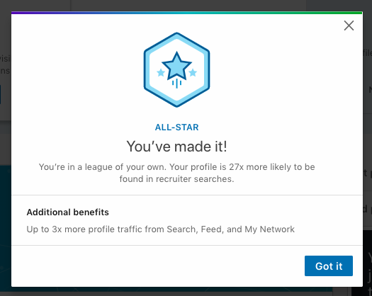
12 Steps to create an
IMPECCABLE LinkedIn Profile

Slide 2
Learning Objective
Participants will be able to:
Create an All- Star LinkedIn profile

Slide 3
Step 1 - Customize your LinkedIn URL
https://www.linkedin.com/in/shivangi-singh-rathore-868157120/
https://www.linkedin.com/in/mehak-thakur-8a2123a4/
https://www.linkedin.com/in/tej-singh-shekhawat-0aa2a1100/
https://www.linkedin.com/in/dilraj-lotey/
https://www.linkedin.com/in/sadaftahir/
https://www.linkedin.com/in/sarahdjohnston/

Slide 4
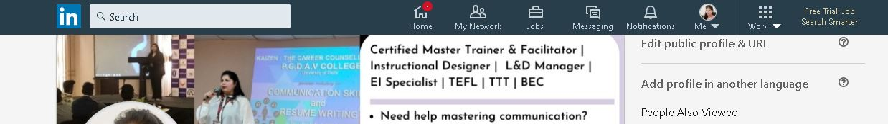
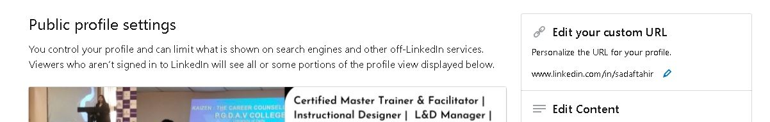

Slide 5
If you want to be treated humanely, make yourself HUMAN!
Why?
Because YOU’RE worth it!
NOT some 5 or 6 digit number!
To customize your LinkedIn URL:
1. Profile>
2. Settings>
3. Privacy>
4. Edit public profile>
5. Customize URL>
6. Save

Slide 6
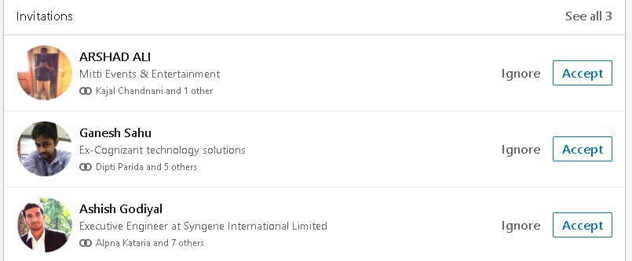
Group 1

Slide 7
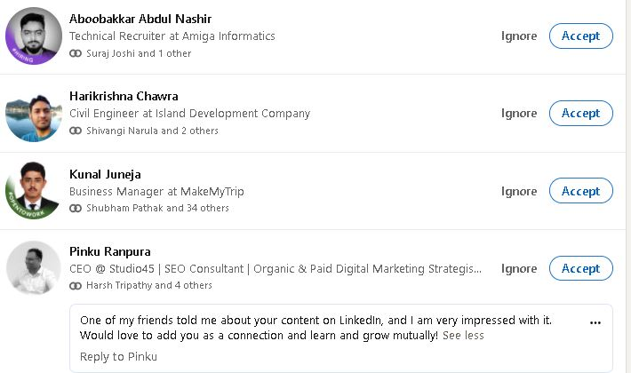
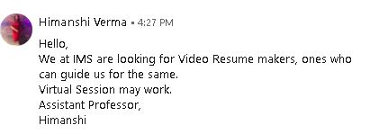
Group 2

Slide 8
Group 1
Name in All-Caps
Inappropriate profile picture
Non- SEO Centric Title
Invite WITHOUT any Note!

Slide 9
Which group’s invitation were you impressed with?
Step 2
Be Clickable!
Whose invite would you accept first?

Slide 10
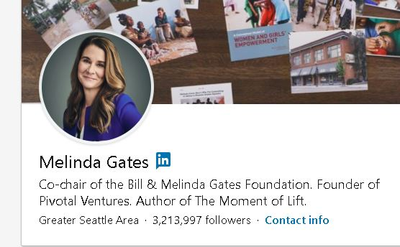
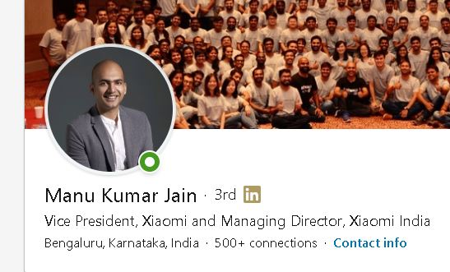
Step 2- Be Clickable!

Slide 11
3 Ps- Proper Profile Picture
A smiling picture
Professional headshot
Formal attire
Clear background
Don one piece of bright clothing
RELEVANT title/headline!

Slide 12
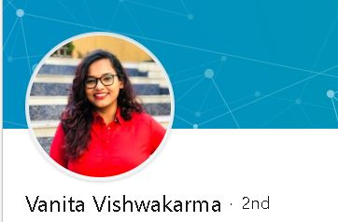
Good Job!

Slide 13
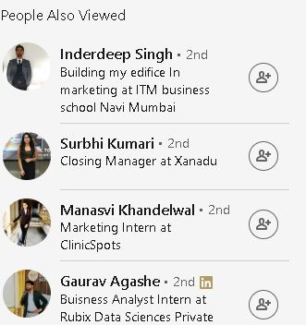
Step 3- Be Searchable
Headline
Profile Picture

Slide 14
Headline / Title
Your headline is the 1 - 3 lines underneath your name.
You have 120 characters including spaces for your headline.
Don’t just describe who you are and what you do.
Write a headline that contains a benefit to the viewer.
Use keywords others might use when needing your services.
Use vertical bars |, ◊, ➤ to separate phrases.
Notes:
A LinkedIn headline is the section at the top of a LinkedIn user's profile where they can describe what they do in 120 characters or less. This brief description appears next to the user's name in search results. It should entice readers to click the profile to learn more about the user's experience and background.

Slide 15
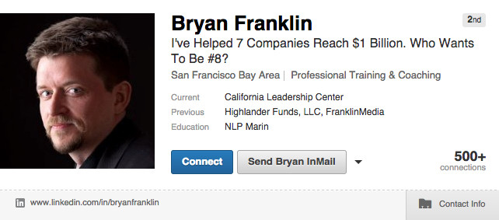

Slide 16
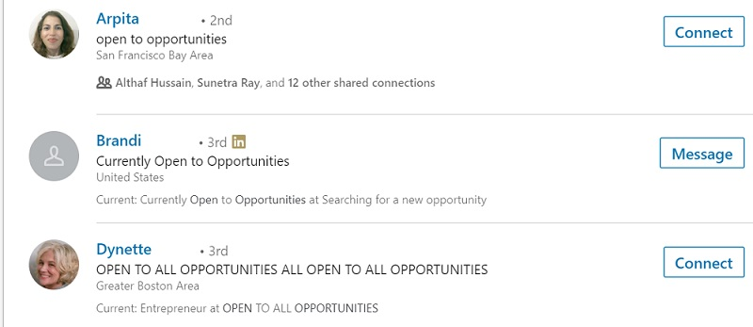

Slide 17
Don’t Copy- Create your own!
MBA Finance graduate with a focus in financial analysis, reporting, and auditing
MBA | Marketing enthusiast | MS Office Expert
Aspiring Content Writer ➤ MBA-Marketing ➤ SEO Certified
Marketing Intern @ Uber | If you're still reading this, then I marketed right.

Slide 18
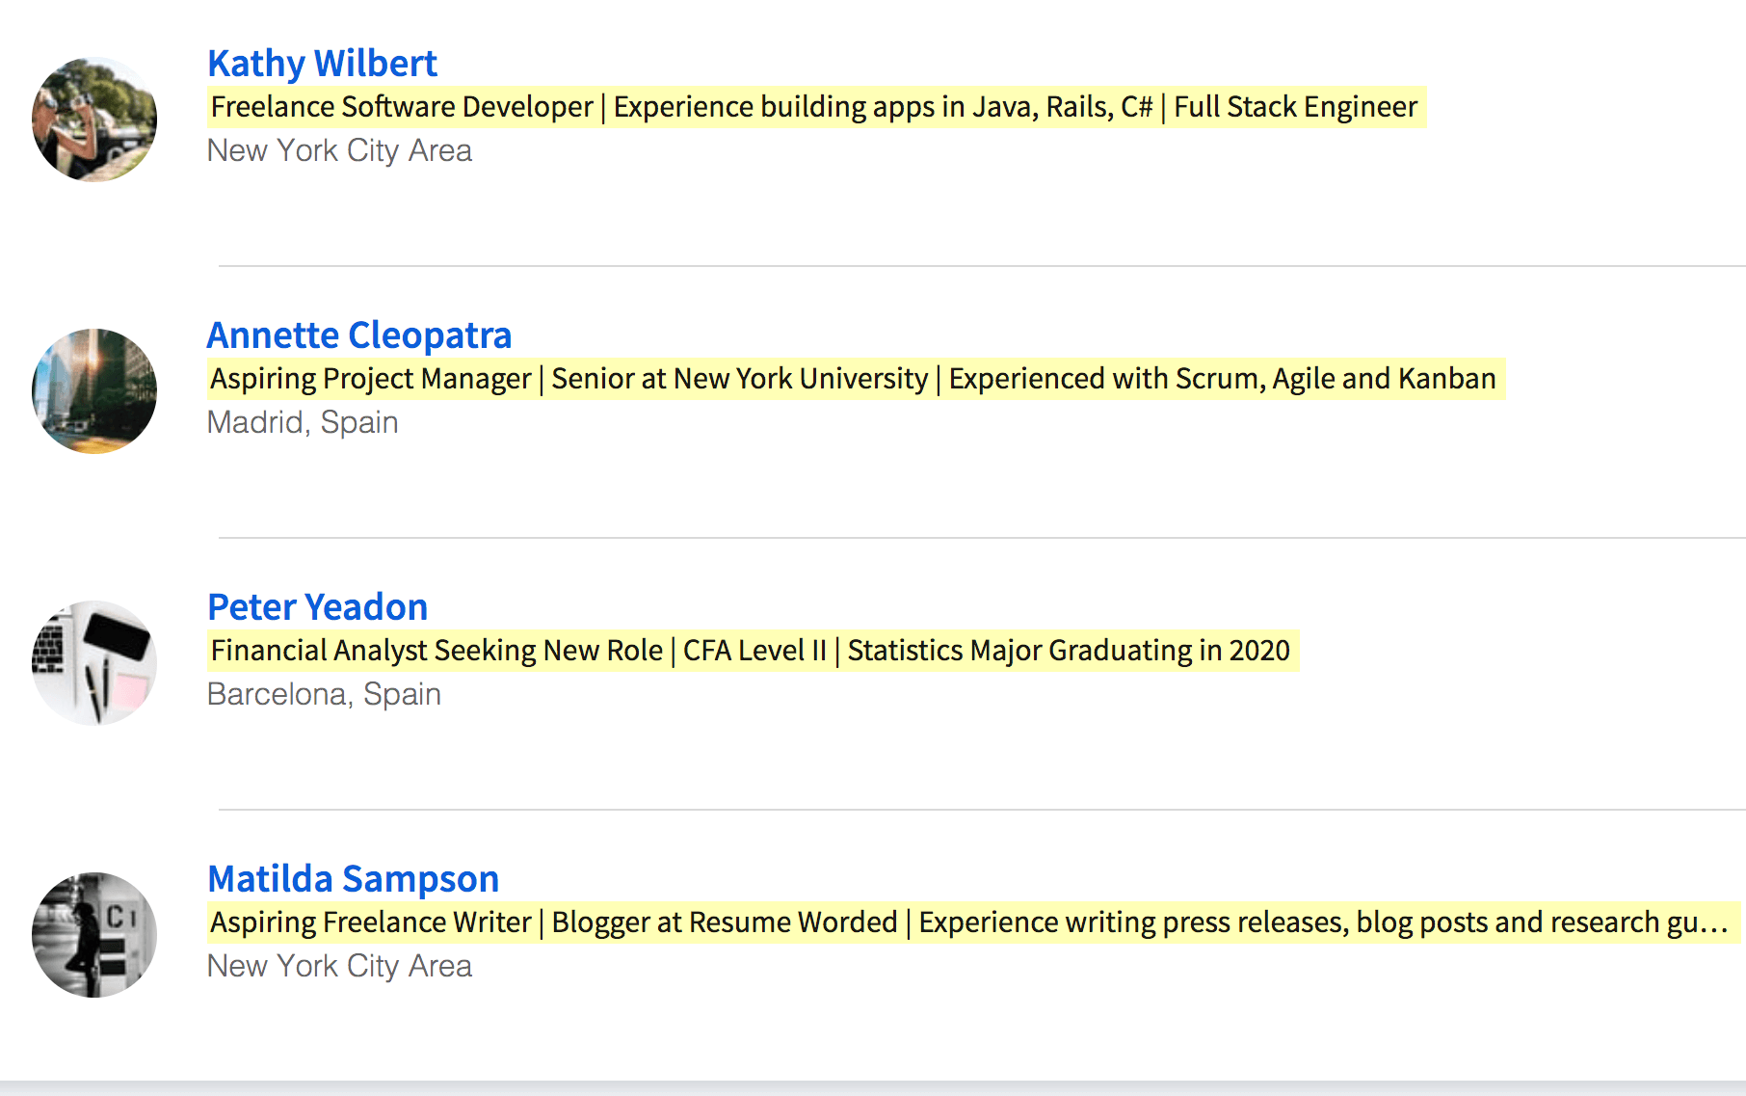

Slide 19
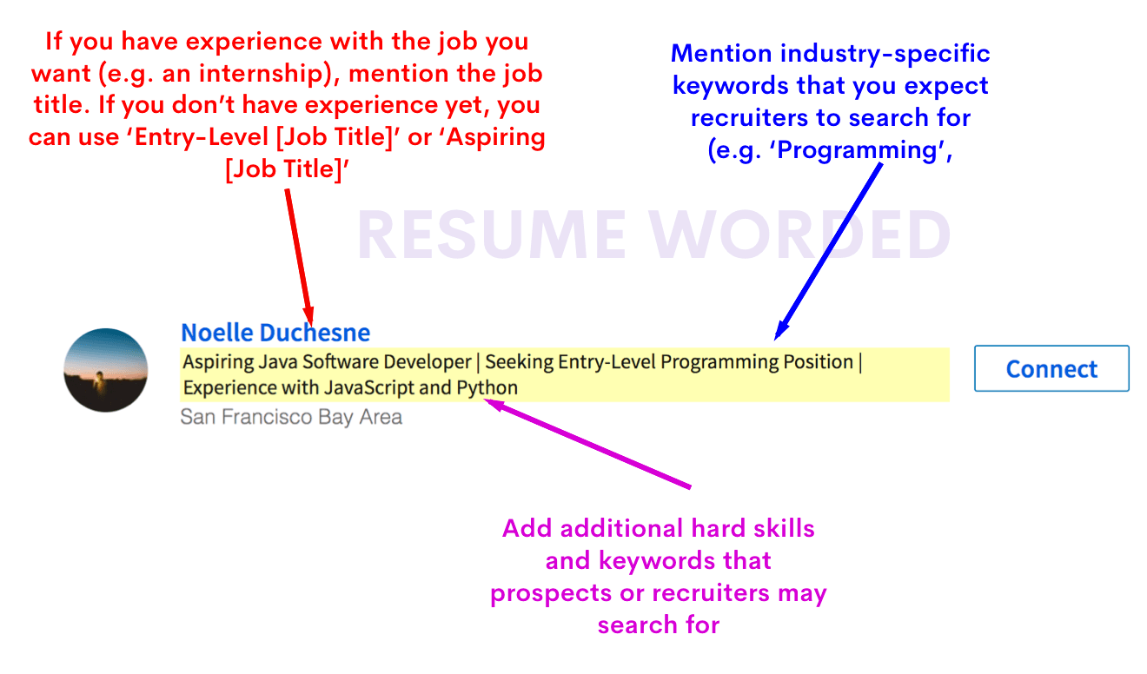

Slide 20
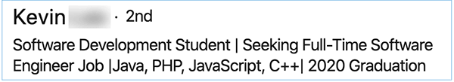
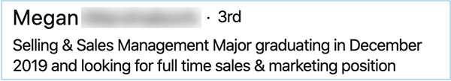

Slide 21
Step 4 – Don’t cover your
Cover Picture
Have a combination of Text and Image
Highlight your achievements
Communicate your value, skills & professional identity
Still confused ? Add quotes!

Slide 22
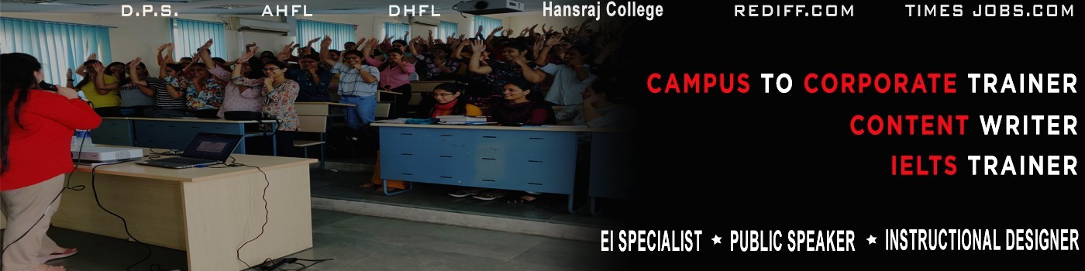

Slide 23
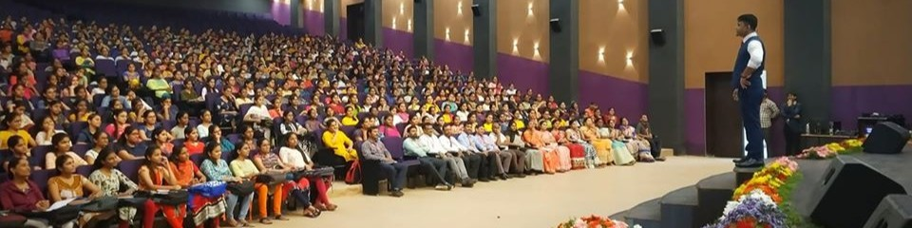

Slide 24
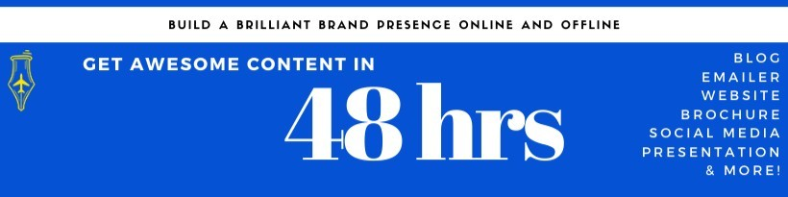

Slide 25


Slide 26
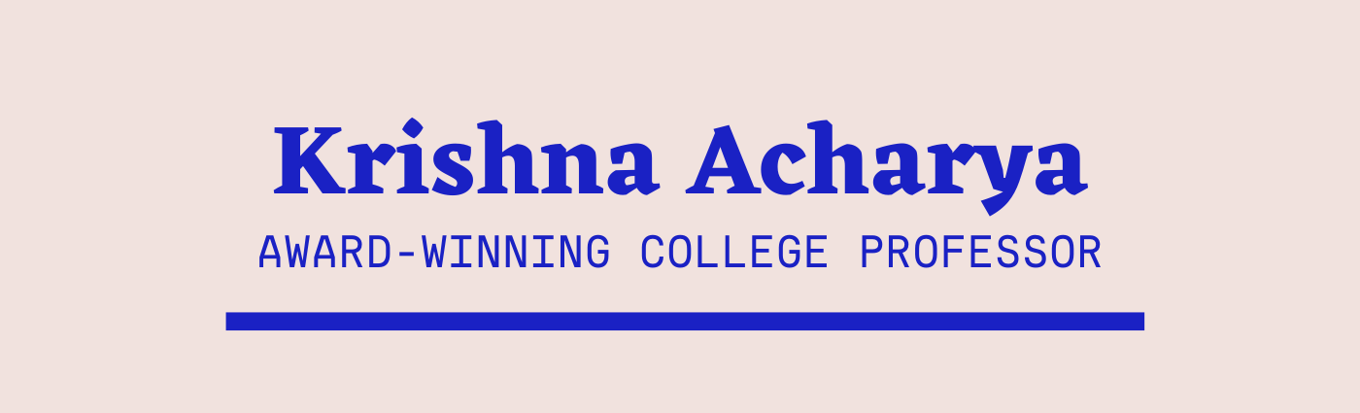

Slide 27
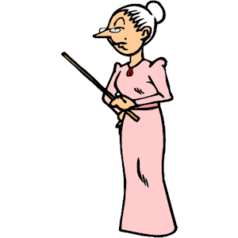
Create your cover picture NOW!
https://www.canva.com/templates/search/linkedin-banners/
Notes:
https://www.canva.com/templates/search/linkedin-banners/

Slide 28
Step 5 – Be Approachable
Add email id in Contact info and About section

Slide 29
Step 6 – Profile Summary
Now, comes the most dreary but the MOST IMPORTANT PART!
Why you may ask?
It helps recruiters find your profile!
Notes:
2000 character limit

Slide 30
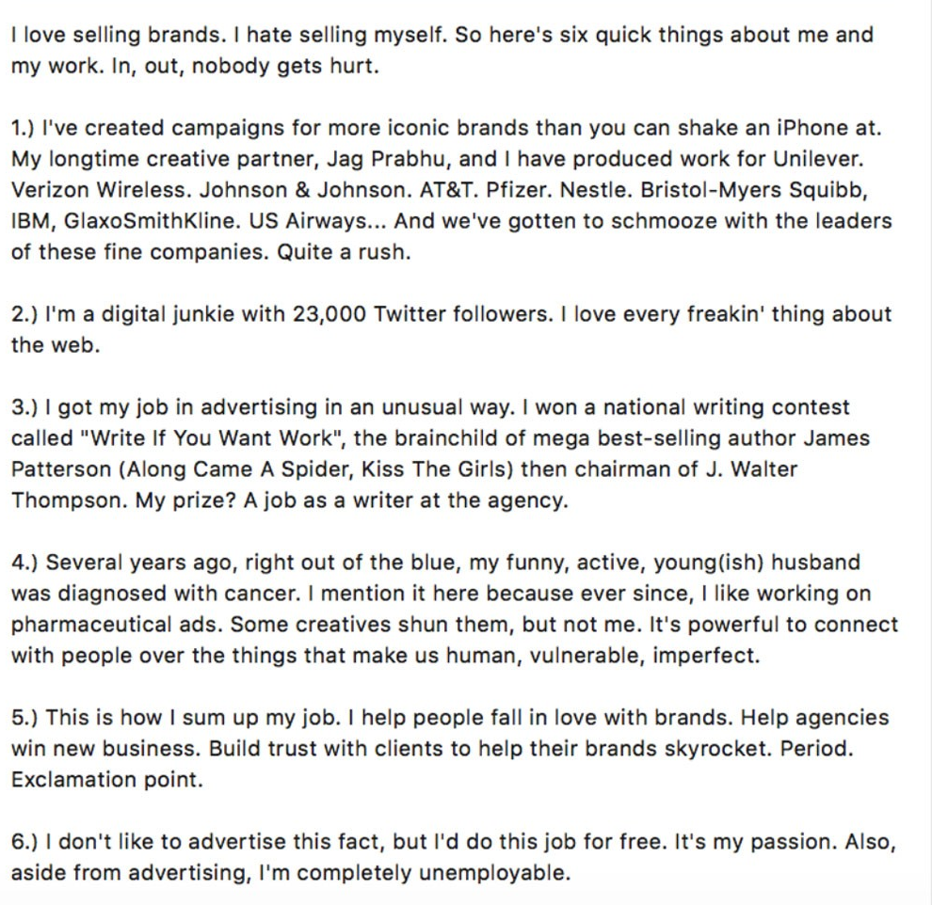
Start strong with a catchy opening statement

Slide 31
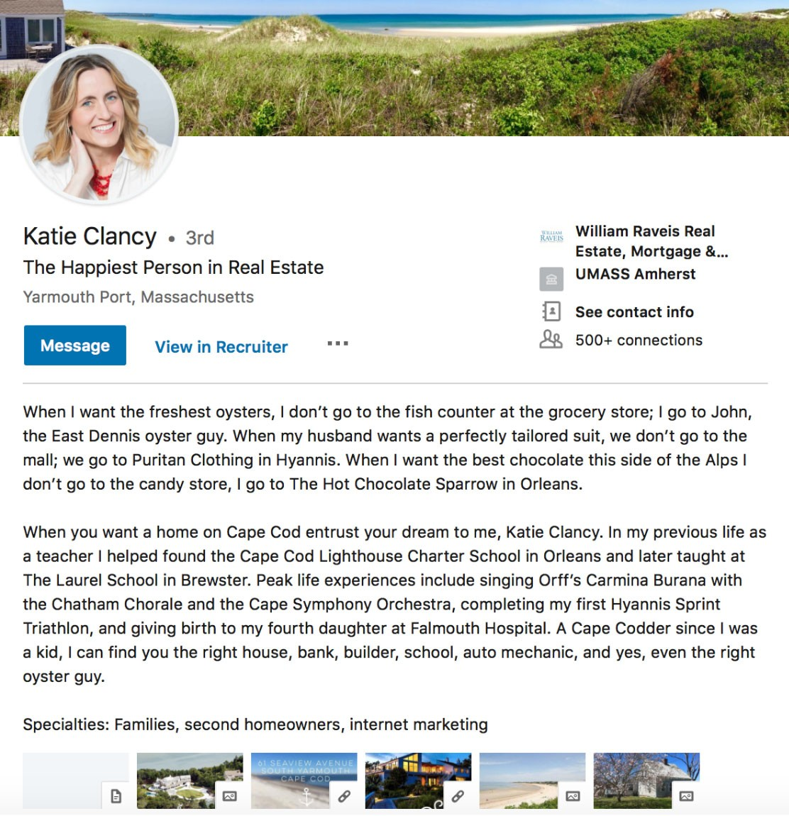
Add context to your career story
Utilize as much of the character limit (2000) as you can

Slide 32
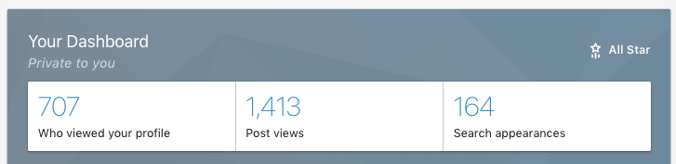
Make your LinkedIn summary keyword rich

Slide 33
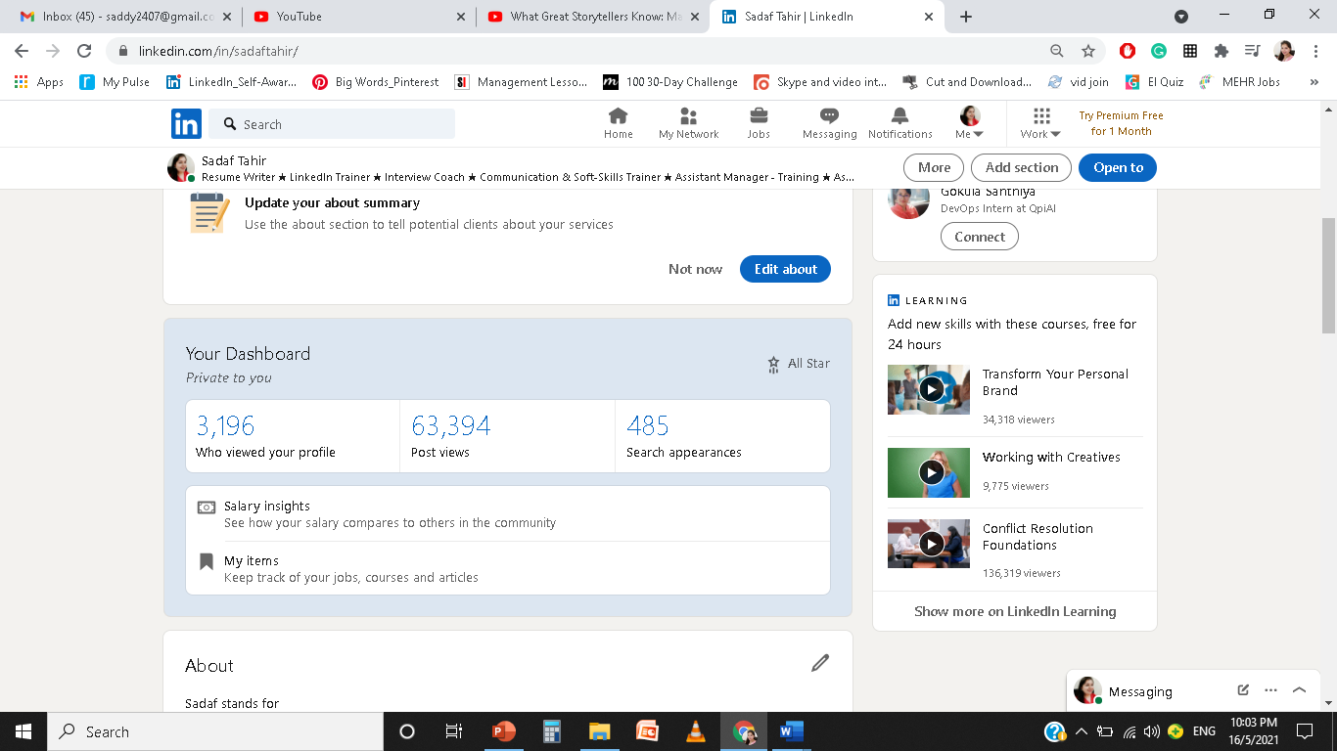
More Profile Views Enhanced Search Results
Better Keywords Enhanced Search Results

Slide 34
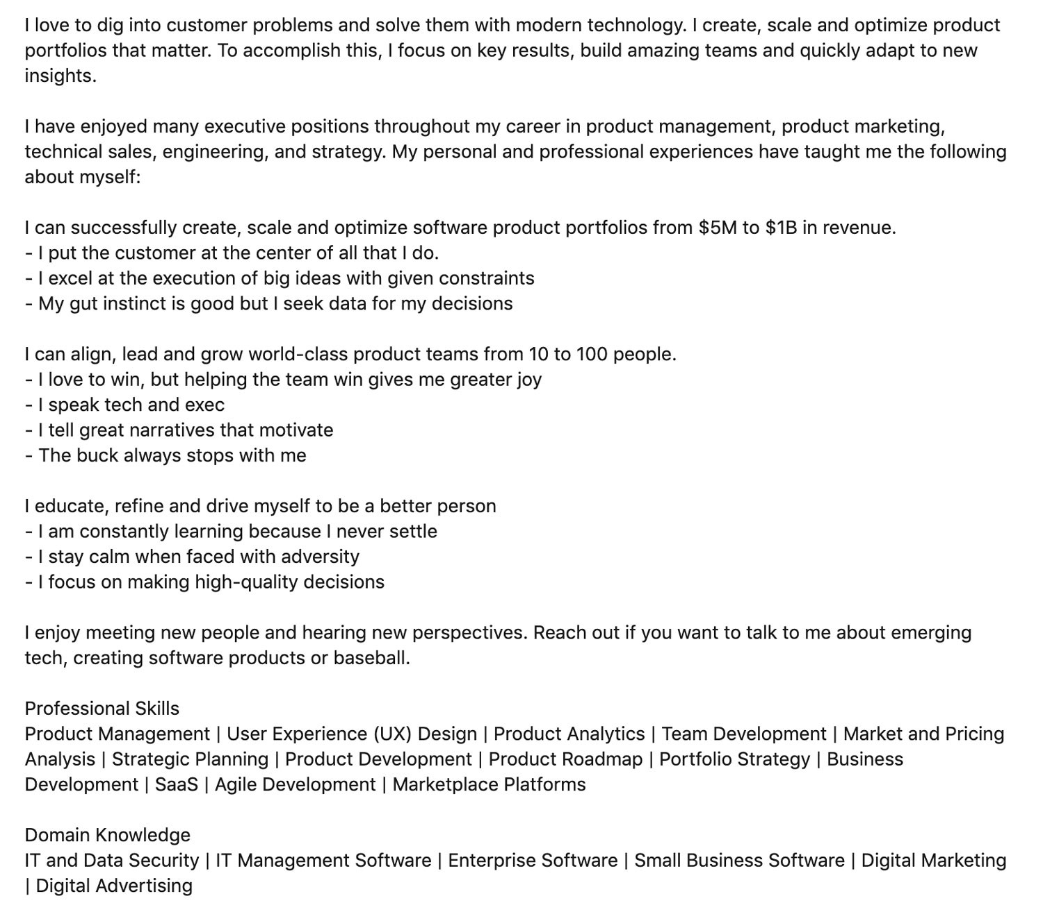
Brag about your accomplishments
Keep it readable with short paragraphs or bullet points

Slide 35
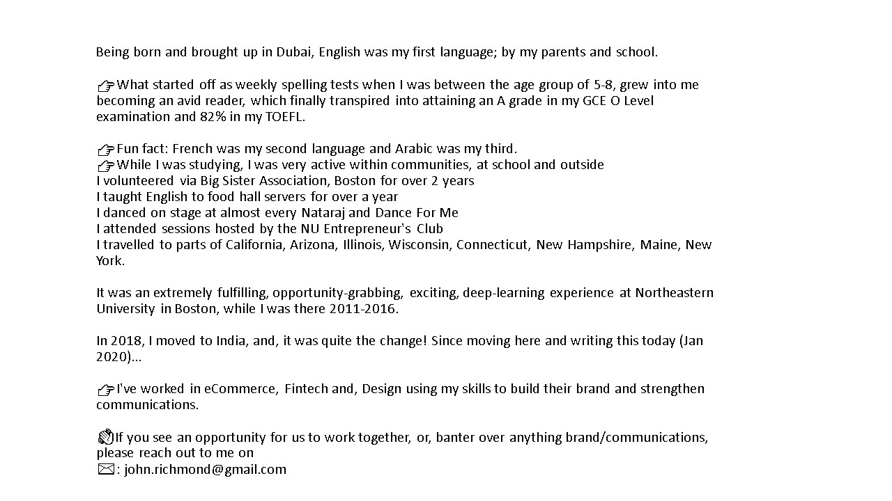
Don’t be afraid to inject some personality
Don’t go overboard with special characters
Use a “Call To Action” @the end
Notes:
LinkedIn shows only the first two lines of your profile summary before readers have to click to see more. Start your summary with a catchy hook that invites readers to click “See More.” Otherwise, top load your LinkedIn summary with the number-one thing you want recruiters or hiring managers to know about you.

Slide 36
Step 7 – Use the Featured Snippet
Showcase work samples that you’re most proud of
Authored articles / Images / Documents
Blog links / Video Resume / Certifications
Appreciation Letters

Slide 37
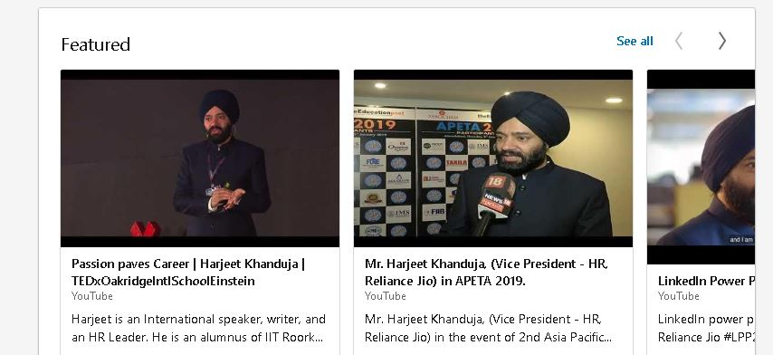

Slide 38
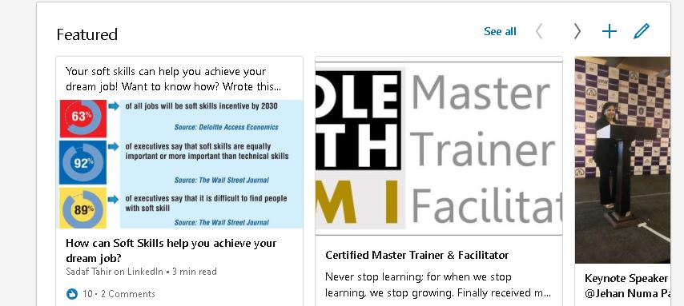

Slide 39
Step 8 – 3Es Approach
Education – Name of institute + Degree + Year + 1-2 liners about accomplishments or learnings
Experience – Name of organization + Designation + 3-4 pointers on role & responsibilities / accomplishments / learnings
Endorsements – Add most important skills as Top 3
(Add media)
(Make it SEO centric & add media)
(Add Skills to get endorsed. They boost search)

Slide 40
Step 9 – BYA
Boast Your Accomplishments
Publication
Patent
Course
Project
Test Score
Language
Organization
Honour and Award

Slide 41
Step 10 - 10 Second Pitch
Voice Note – 10 seconds only
Why just your name?
When you can PITCH?
Be Creative like DAVE OFFICERRRRRRRRRRRRRRRRRRR
Notes:
Search DAVE OFFICER AND SALMAN SHAH – Hear their VOICE NOTE – Highly CREATIVE

Slide 42
Step 11 – Boost Credibility!
Get Recommendations
Quality > Quantity
College Professors / Colleagues / Clients / HOD / Current & Ex Managers
Relevant to your field
Focus on Hard skills / Soft-skills / Qualities / Work Ethic / Human Persona / Character

Slide 43
Step 12 – 30 Second Video Cover Story
Sell your USP
Promote your Product
Be Creative
Great way to pitch
30 seconds only
Boost your BRAND

Slide 44
CONGRATULATIONS!

Slide 45
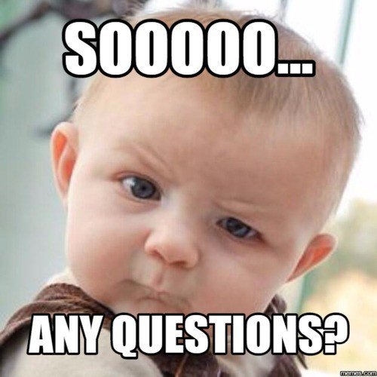

Slide 46

9 Steps for
LinkedIn Networking

Slide 47
Learning Objective
How to reach out to recruiters
DO's and Don'ts of networking on LinkedIn
Etiquette to follow when posting content on LinkedIn
Creating engaging posts to reach a wider audience
Creating your personal brand through LinkedIn

Slide 48
Step 1- Connection Game
Define your purpose
Identify your target audience
Connect with a NOTE!
1st connections limit – 30,000 (Unlimited followers)
Have relevant first 5k connections

Slide 49
Identifying target audience
What do you do? – MBA student specialising in Marketing/Digital Marketing
What are your dream companies ? – Ogilvy, Amazon, TCS
Who could get you a job / interview offer ?
Hiring Managers of the companies
People in similar roles in your dream companies
People in senior roles in your dream companies

Slide 50
Would you enter an interview room without knocking the door?

Slide 51
Then how can you send connection invites WITHOUT a NOTE!

Slide 52
Step 2- Note the Note
Hi, I would like to connect with you. 🗶
Hi, I’m looking for a job. My resume is attached. Looking forward to hear from you. 🗶
Hi, could you connect me with the HR of your company? 🗶
Hi, are there any vacancies available in your company? 🗶
Notes:
Notes has a word limit of 300 characters including spaces

Slide 53
Include the How and Why?
Dear Mr. Joseph,
I found your post on ‘revised marketing strategies post Covid’ really insightful. I’m a marketing student & would definitely want to stay updated & learn a lot from you.
Take Care
Rahul

Slide 54
Hi Tina,
I’m also a member of the KLM Marketing LinkedIn group and I always find your posts to be incredibly helpful and thought-provoking. I’d love to be able to keep in touch and hear more about your work.
All the Best,
Priya

Slide 55
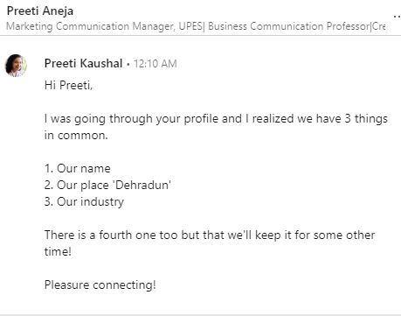


Slide 56
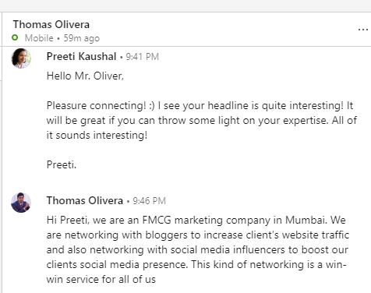

Slide 57
It was great meeting you at . . .
Congratulations on your recent promotion I read in [reference newspaper / blog / press release site]. . .
I read your article [title] ...
You and I are involved in similar community interests related to . . .
I noticed you and I are both interested in . . .
[If connecting with CEOs / senior executives] I read a press release about your company's new initiative. . .
Since we are members of [Group name] on LinkedIn. .
I listened to your talk on . . .

Slide 58
Step 3 – Don’t be THANKLESS
Immediately thank the person who accepted your invite
Don’t use LinkedIn automated messages
Have open-ended questions

Slide 59
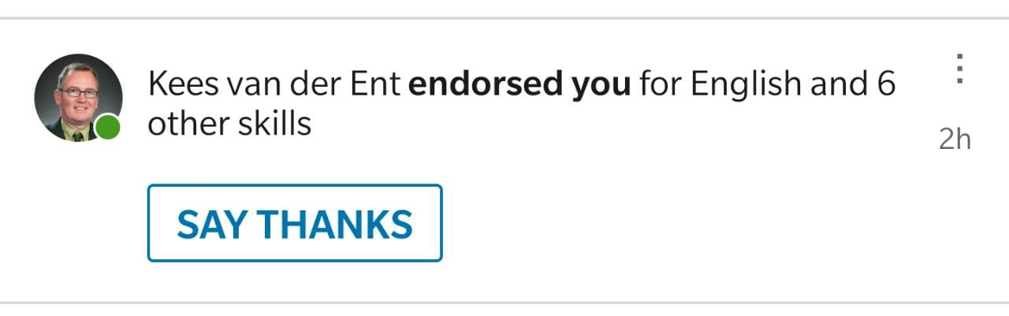
A simple Thank You landed me 6 endorsements
in 1.5 hours

Slide 60
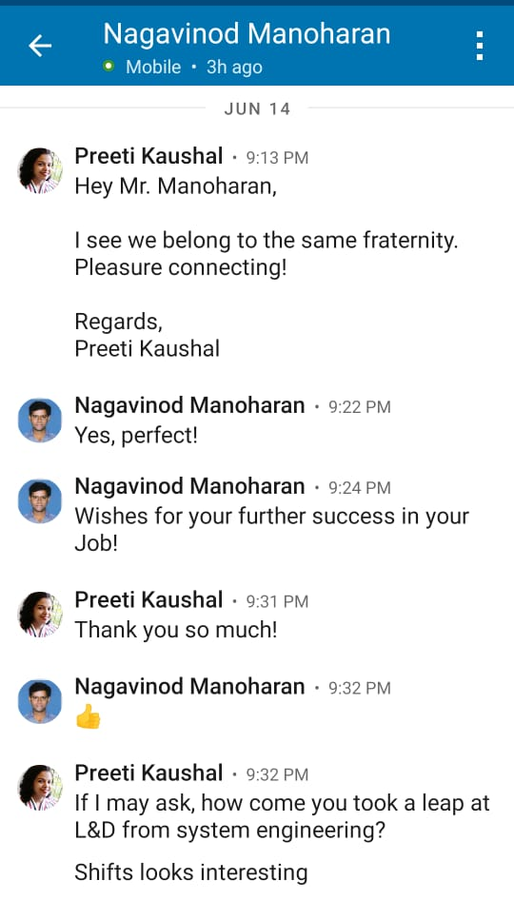
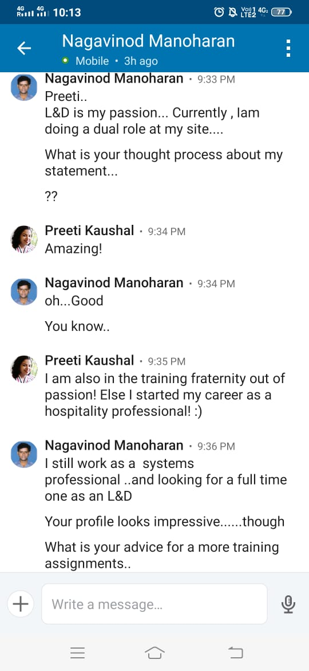
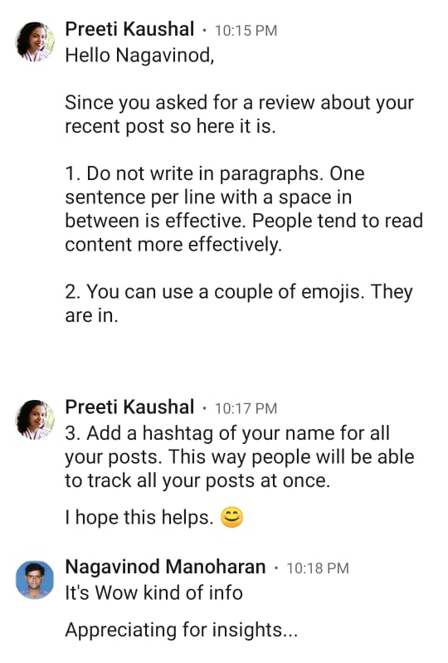
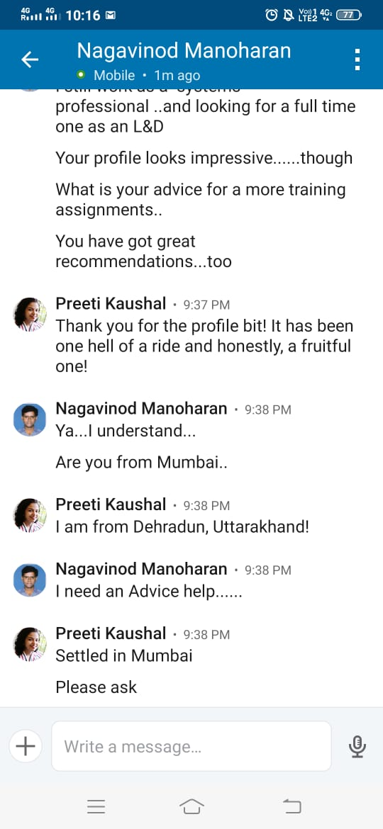

Slide 61

Step 4 – Indirect Reach

Slide 62
Hi Pooja, I noticed that Rajeev Gupta is one of your connections on LinkedIn.
Would you mind introducing us? I would love to connect with him about a
potential position available in his organization. I appreciate your time.
Thank you
Priyanka

Slide 63
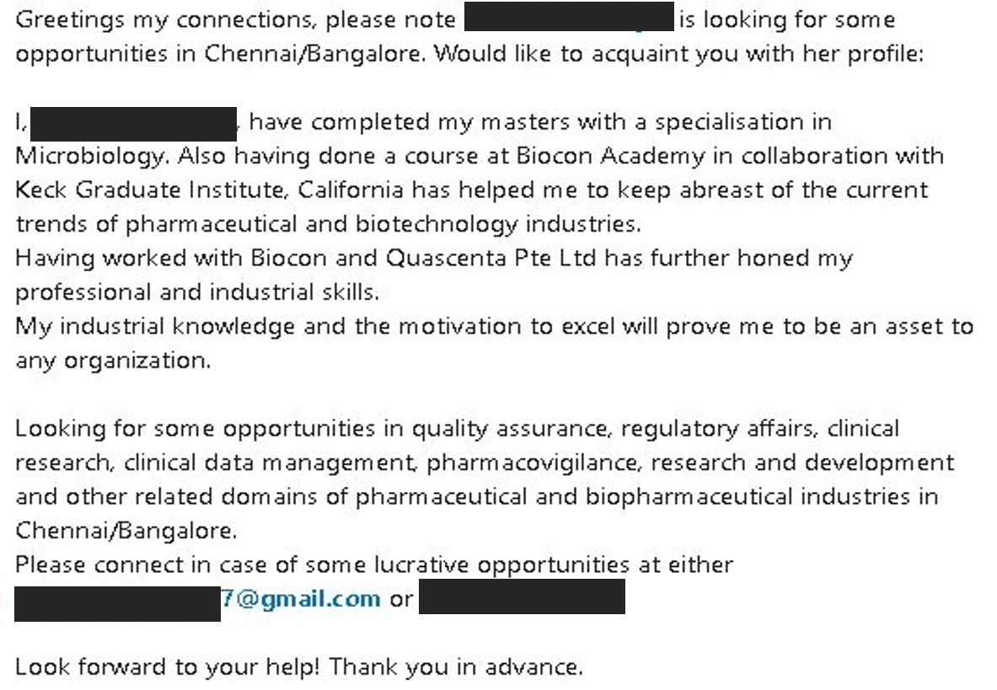
Use Shout-Outs

Slide 64

Step 5 – Get Engaged
In the News Feed
Like
Comment
Share
🗶

Slide 65

Step 6 – Content is
Consistency is the key
Use stories / case study / video
Hashtags
Identify active user time-slot
See more= Higher engagement

Slide 66
Step 7 – Join Groups
Ask questions
Answer questions
Like and comment on answers/questions.
Invite active group members to join your LinkedIn network

Slide 67
Want to DM recruiters & don’t have Premium?
Notes:
10 dollars for InMail= 758.25 Indian Rupee

Slide 68
Step 8 – Tagging = Spamming
Avoid direct tagging. Ask first
Tag ONLY when relevant
If you want your posts to have higher engagement, create interesting content
Direct Message if you want influencers’ reach

Slide 69
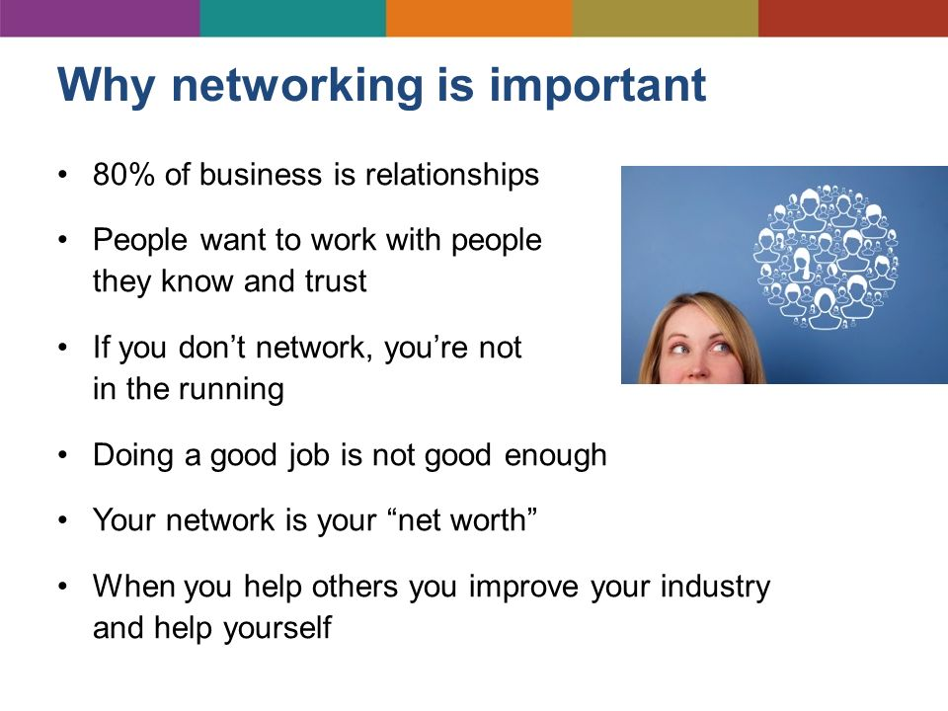

Slide 70
How to Get Recruiters to
Notice You on LinkedIn?

Slide 71
No single ranking
Searcher’s behaviour
Profile views
Keywords

Slide 72
