Slide 1

Management - I

Slide 2

Notes:
The trainer can ask the students what is something that they consider a hurdle in the path of their career and what’s that they want to overcome
Compiling the responses

Slide 3


Slide 4
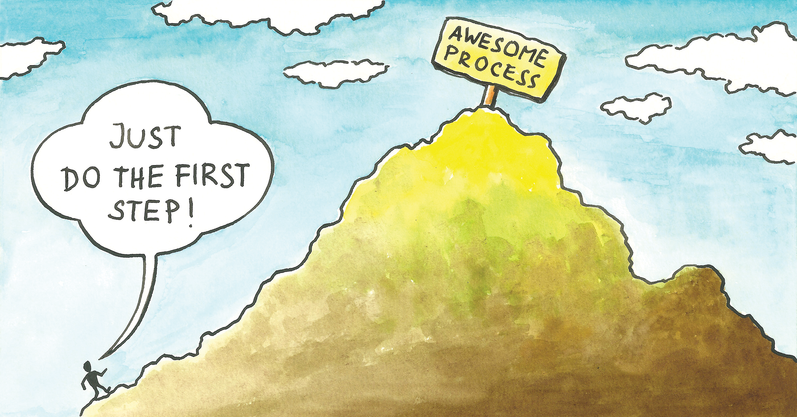

Slide 5



Slide 6

Resume Building- ITM Format
1

Slide 7


Slide 8


Slide 9
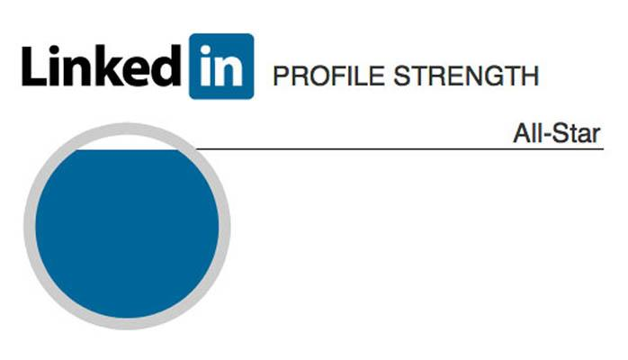
2

Slide 10


Slide 11
LinkedIn for Networking
3

Slide 12


Slide 13
Live Project Communication
4

Slide 14

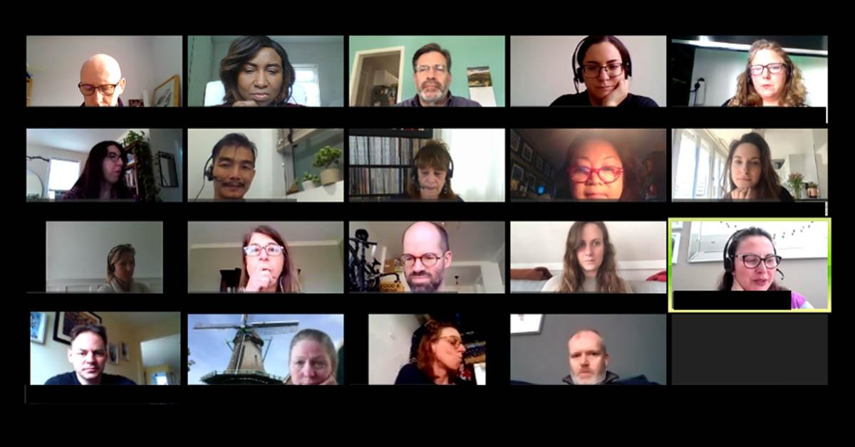


Slide 15
Virtual Meeting Etiquette
5
Telephone Etiquette
6

Slide 16
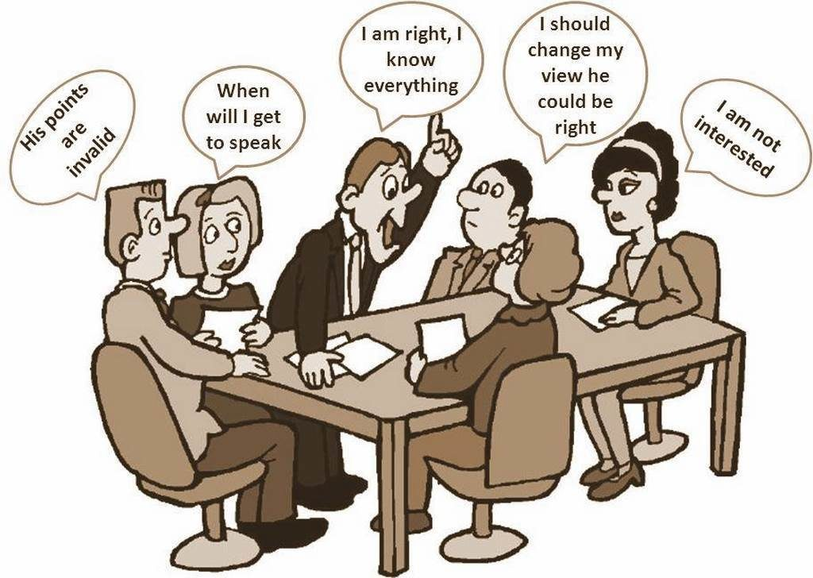

Slide 17
Overview of Group Discussion
7

Slide 18


Slide 19
Mock GD
8
GD Assessment
9

Slide 20
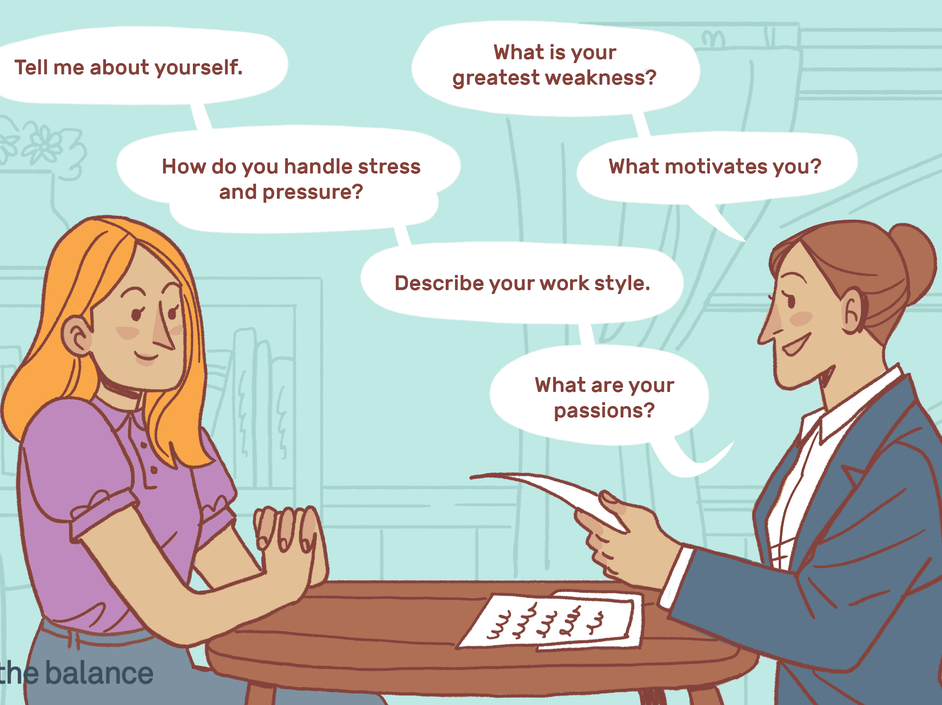

Slide 21
Overview of Personal Interview
10

Slide 22
External Marks
10
40
Internal Marks

Slide 23
Internals
Group Discussion

Slide 24


