Slide 1
Revision through kahoot/quiz
Notes:
A recap of previous sessions- resume building, linkedIn, live project overview and online meeting etiquette.
Now that u know how to prepare your resume, how to expand and utilize your network, and how to behave online, let me ask you one question

Slide 2


What would you do???
Notes:
1st animation- what would you do , if you get one?
2nd animation – what would you do now- when you have multiple offers?
How would you accept one or reject others?

Slide 3

Notes:
You will eliminate all but one. Exactly this is what happens with the recruiters. There are so many candidates for a vacancy, and they have to select 1 (or few) out of so many applicants. So they eliminate the rest to choose the best.

Slide 4
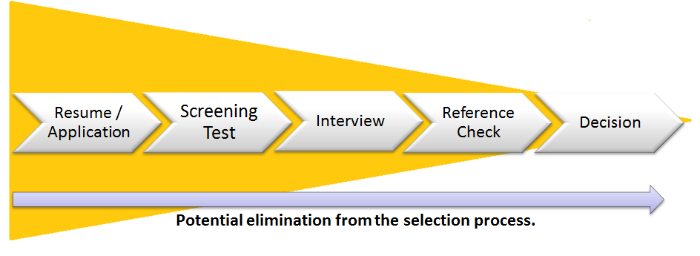
Notes:
You can see how the process goes. Now that you are done with the resume part, next in line comes screening.
Can you guess which step are we talking about??
Group discussion is usually a step/process between application and interviews.

Slide 5

Notes:
Group Discussion – A very crucial step in the hiring process and as the name suggests, we have to perform in a group.

Slide 6
Learning Outcomes
Notes:
Self explanatory

Slide 7
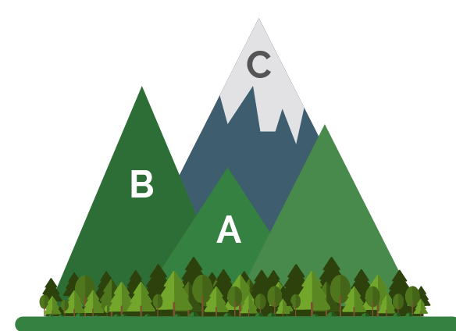


Why GD?
Individuals’ behaviour in a group
Time Saving
Comparative Evaluation
Notes:
GD round is an elimination round.
This round is introduced because
It is time saving. Can evaluate multiple candidates at once
It provides a scope for comparative evaluation
It helps understand the tendency of candidates to work in a group
Self explanatory

Slide 8
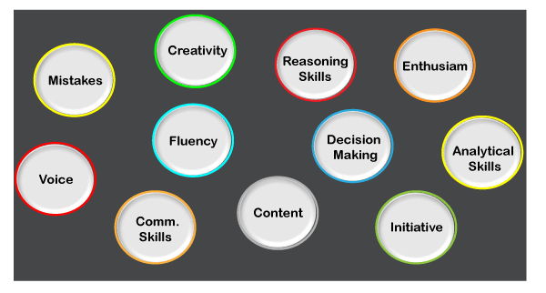
Evaluation of GD
Notes:
GD round is an elimination round.
It evaluates candidates on the parameters mentioned in the pic on the slide
Self explanatory

Slide 9
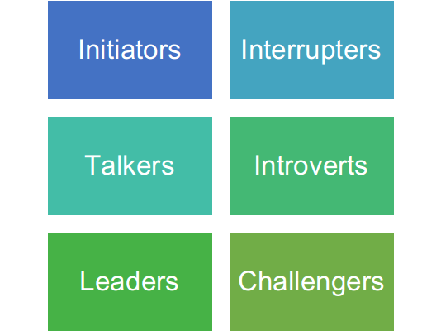
Types of participants in a GD
Notes:
Self explanatory

Slide 10
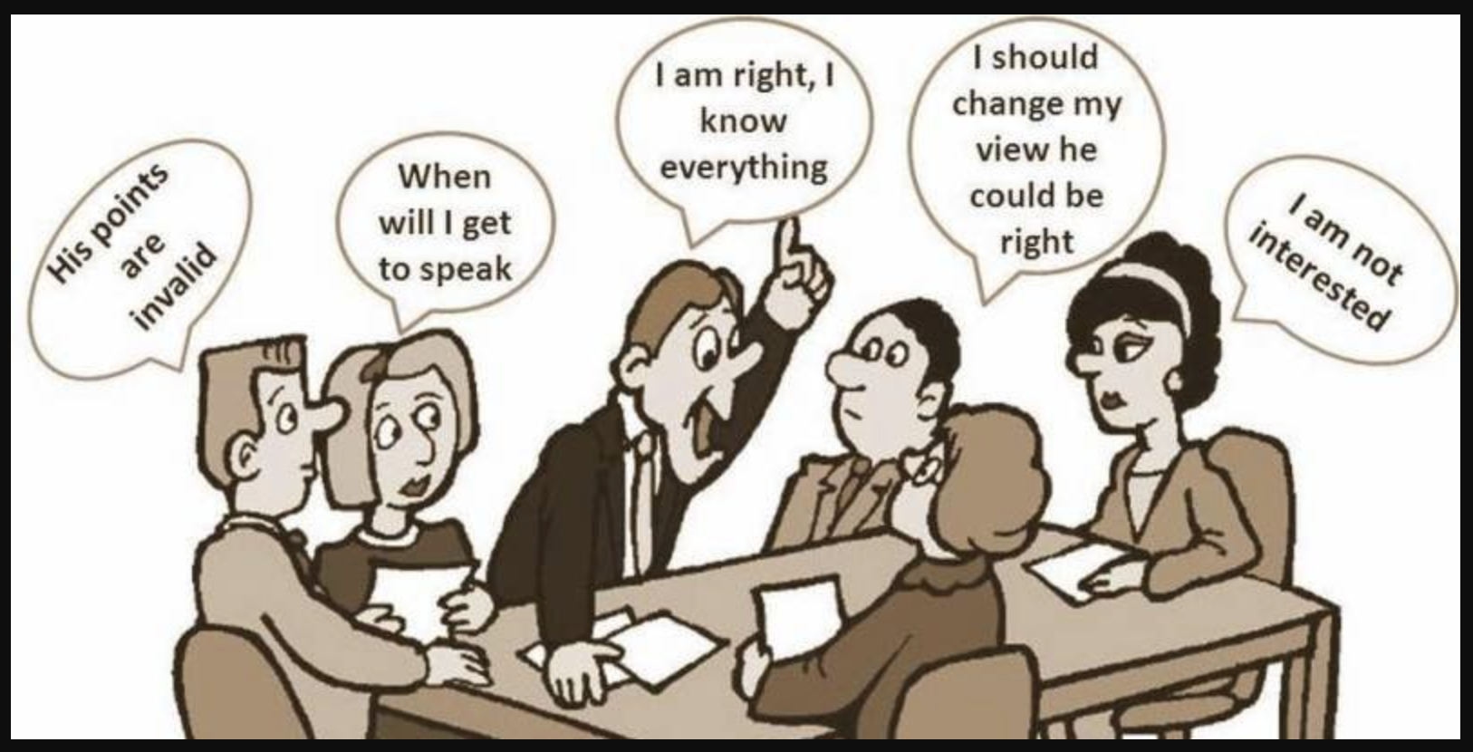
Notes:
Mindset/ Thought process of participants of GD

Slide 11

Notes:
Just being a part of a group doesn’t help. You need to be impactful.

Slide 12
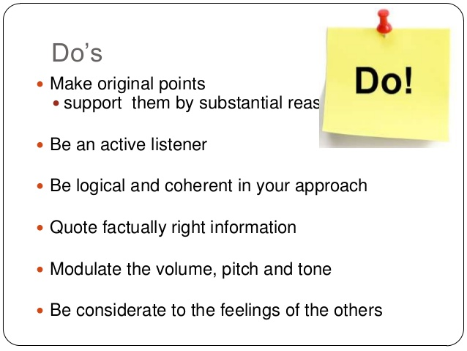
Notes:
Self Explanatory

Slide 13
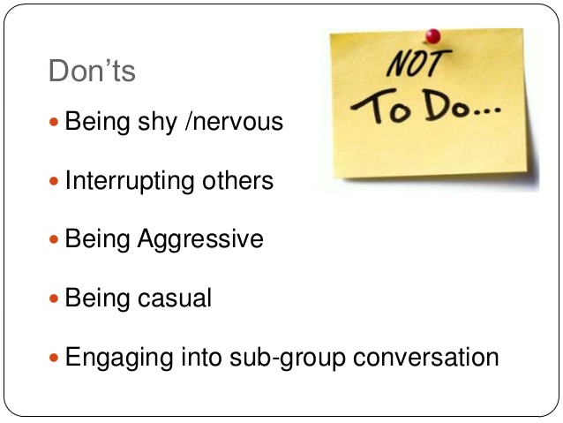
Notes:
Self Explanatory

Slide 14
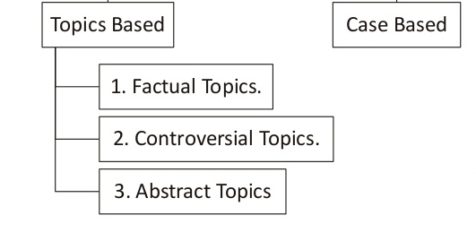
Types of GD
Notes:
Self Explanatory

Slide 15
Examples of Factual Topics
Coronavirus- An invisible terrorist
The immigration policy of the United States
Economic reforms in India since independence
Notes:
Self Explanatory

Slide 16
Examples of Controversial Topics
Reservation in Education
Narendra Modi – the best Indian leader
Loudspeakers should be allowed at religious places
Notes:
Self Explanatory

Slide 17
Examples of Abstract Topics
Black Vs grey
Negative is the new positive
Zero
Notes:
Self Explanatory

Slide 18
Examples of Case Based Topics
“A software engineer is hired as a trainee by a company that specializes in hardware. As the end of his mandatory training period approaches, his job performance is found below par, and he is informed that he must leave the company at the end of his training period. His immediate superior, out of kindness, writes him a recommendation letter, which may help him in getting the next job. However, this engineer uses the letter to take the company to court and challenges his dismissal.”
How should the company resolve this situation?
Notes:
Self Explanatory

Slide 19
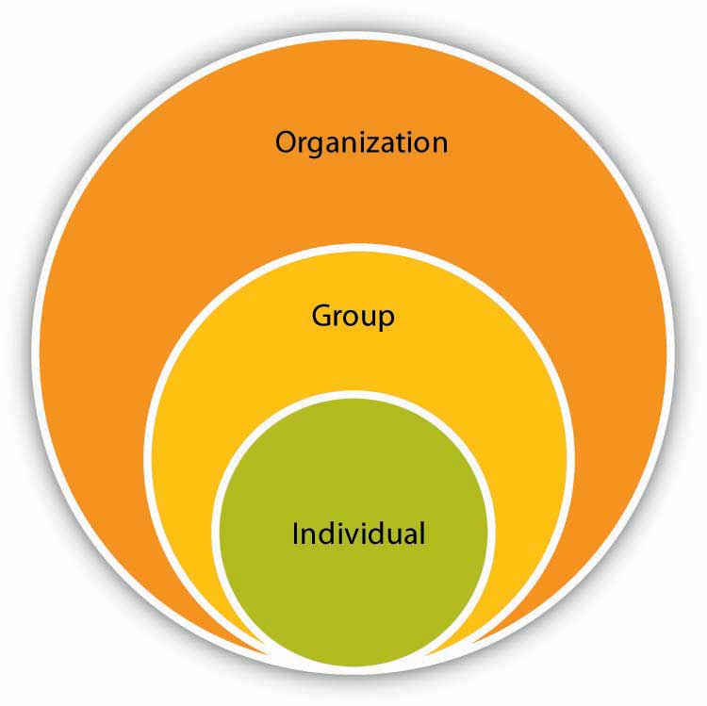
Notes:
Induvial behaviour tends to change while in a group.
The idea of judgement in a group discussion is organizational success and healthy organizational environment/culture.
Plan your content and attitude keeping the above statement in mind.

